Slide 1
WIFI Control and Intelligent Speakers
How to use Echo and Google Home to Control

Slide 2
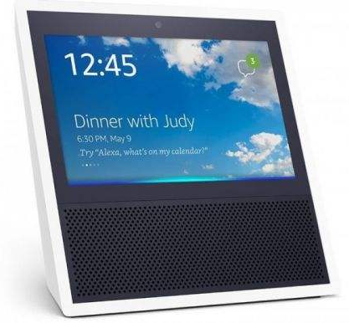
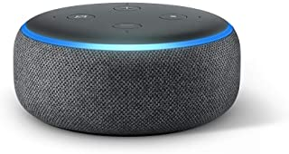
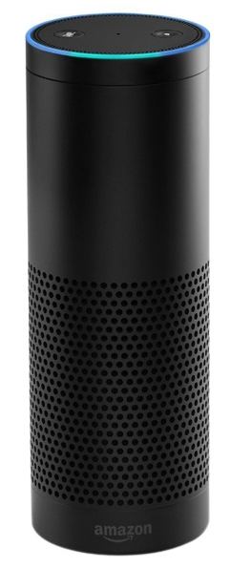
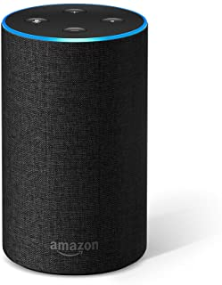
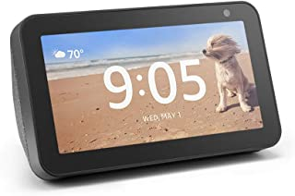
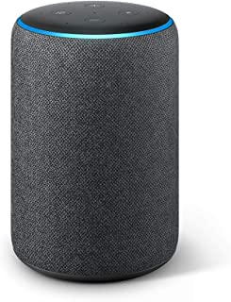
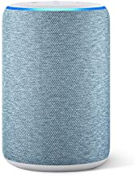
WIFI Control and Intelligent Speakers
In November, 2014, Amazon presented a whole new intelligent speaker Echo which integrated voice interaction
There are 2 types of Amazon speakers till now, Echo and Echo Show. Call Echo/Amazon/Alexa to wake them up.
Smart Home Skill: User can control air-conditioners directly without wake up special skill. But only On/Off, mode, temperature and fan speed. A certificate will be issued by Amazon, and all features are limited.
Custom skill：Extended Features are supported without Amazon certification. Users have to wake up the custom skill (Midea Air/Nethome Plus) to control air-conditioners.

Slide 3
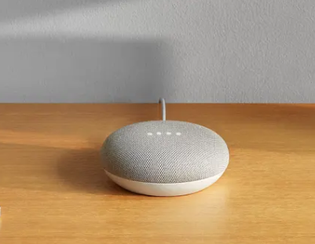
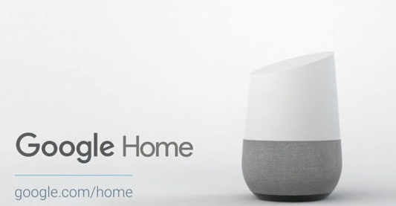
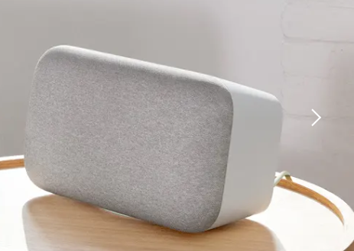
WIFI Control and Intelligent Speakers
Google published its own intelligent speaker Google Home integrated voice interaction on Oct 5th, 2016.
The control of air-conditioner is almost same as Echo, but the wake up directive is “Ok, google”.

Slide 4
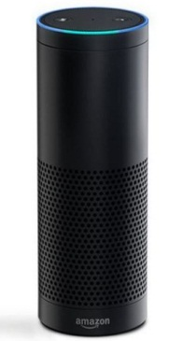
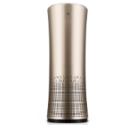
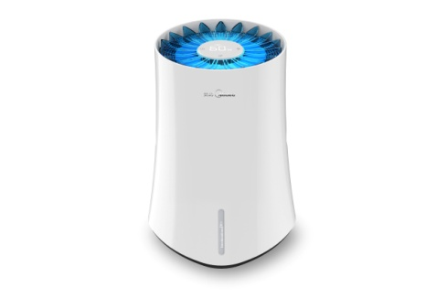
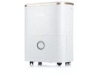
WIFI Control and Intelligent Speakers
“Echo, turn on AC”
3
1
2
Alexa Service
Smart Home Skill API
Directive Language:
TurnOnRequest
4
Amazon Echo
1
Voice input
AWS Lambda
-- Developer
2
ECHO Alexa
AWS Lambda Skill Adapter
3
Alexa Service
AC
Skill registration on developer portal
4
AWS Lambda
Purifier
Humidifier
Cloud
Dehumidifier
6
5

Slide 5
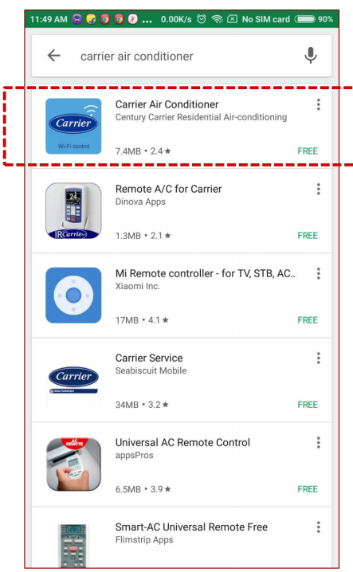
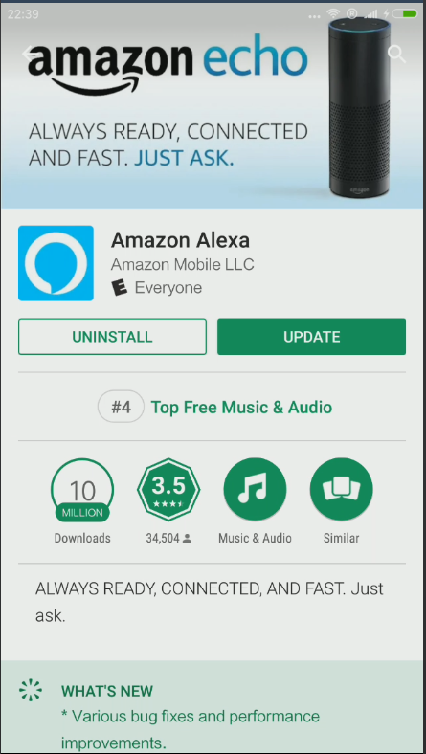
WIFI Control and Intelligent Speakers
1. Download Carrier Air conditioner and Amazon Alexa app from App Store or Google Play.
2. Connect the air-conditioner to internet via Carrier Air app according to the prompts.

Slide 6
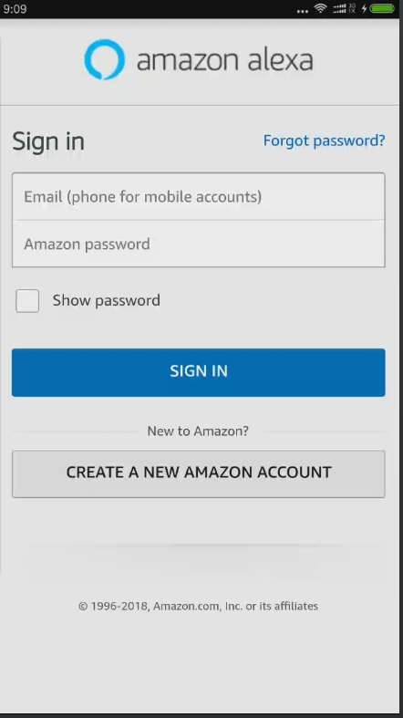
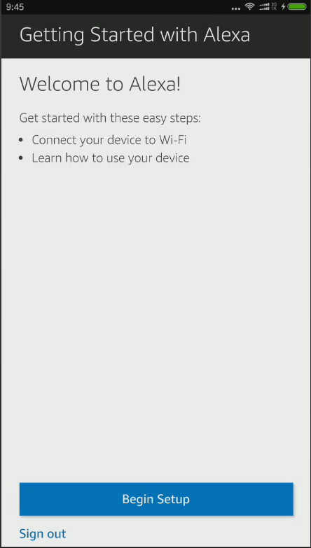
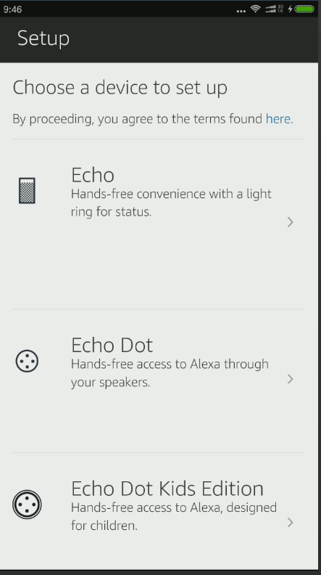
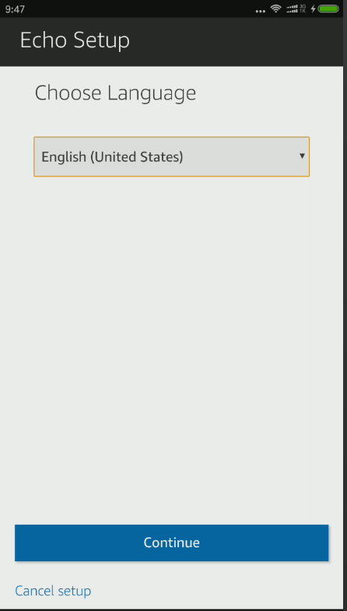
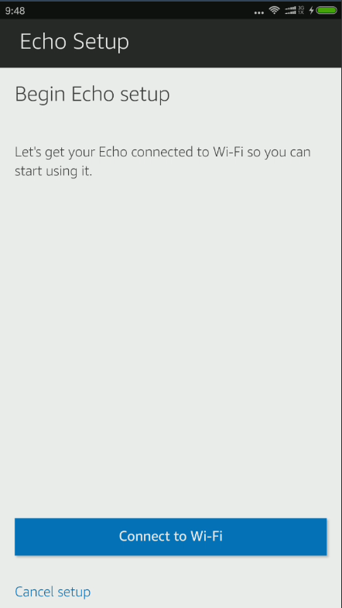
WIFI Control and Intelligent Speakers
3. Configure your Echo speaker via Alexa app according to the prompts.

Slide 7
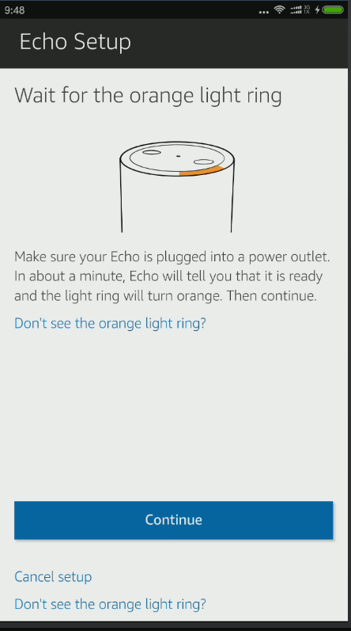
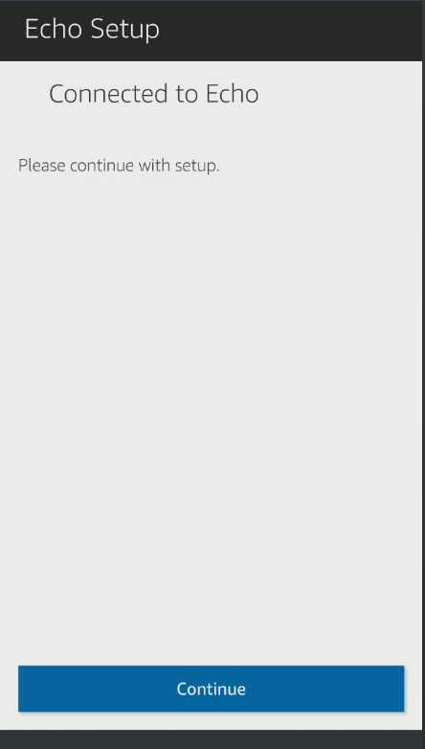
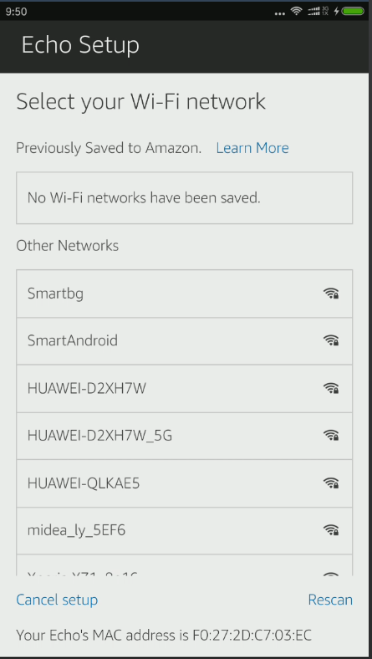
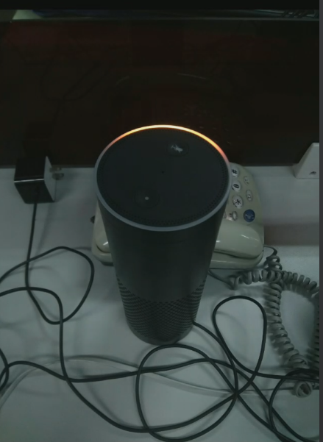
WIFI Control and Intelligent Speakers
3. Configure your Echo speaker via Alexa app according to the prompts.
Listen to the voice prompts
Press and hold POWER button to AP mode

Slide 8
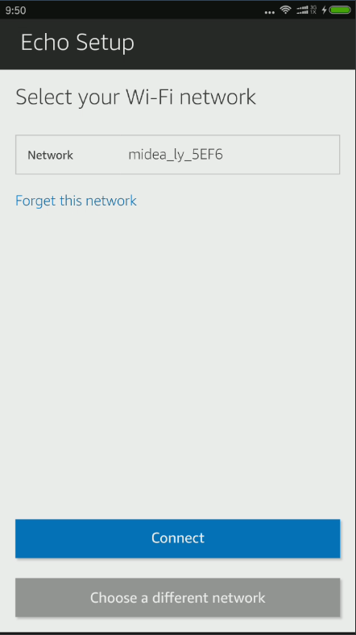
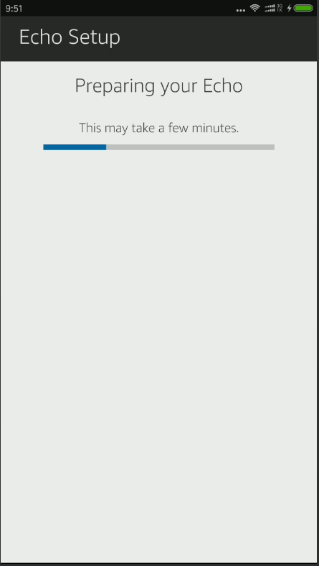
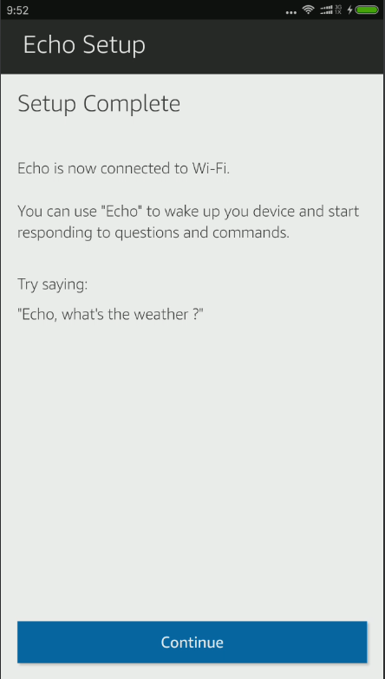
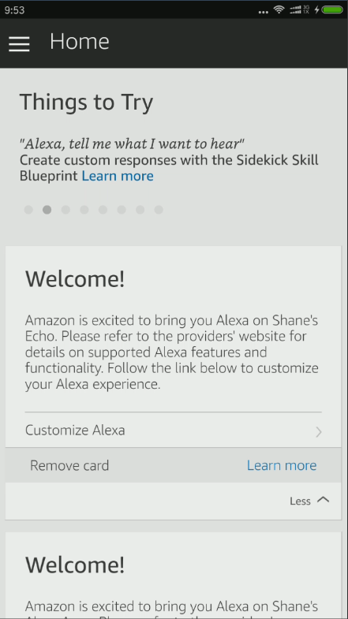
WIFI Control and Intelligent Speakers
3. Configure your Echo speaker via Alexa app according to the prompts.

Slide 9
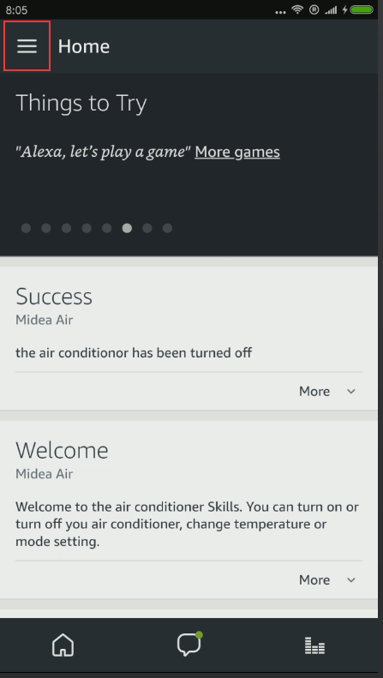
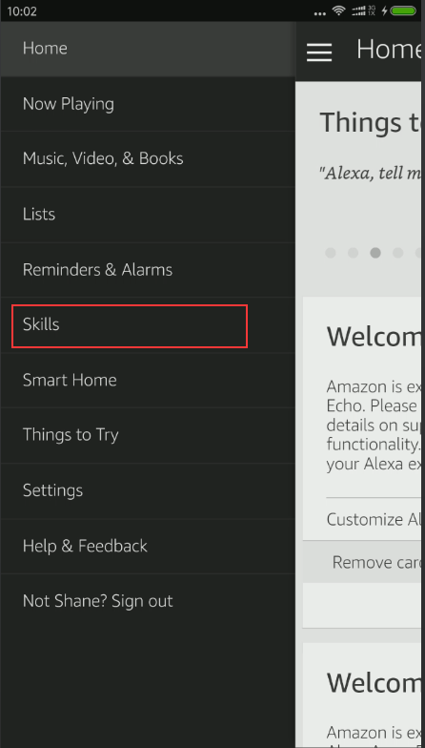
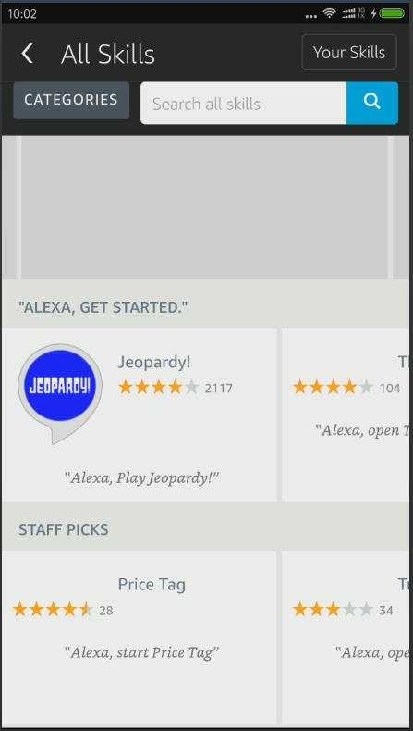
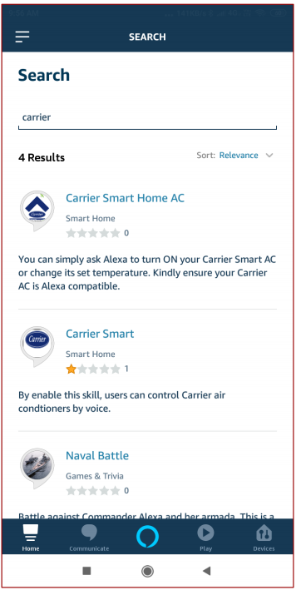
WIFI Control and Intelligent Speakers
4. Configure Carrier Air Skill.

Slide 10
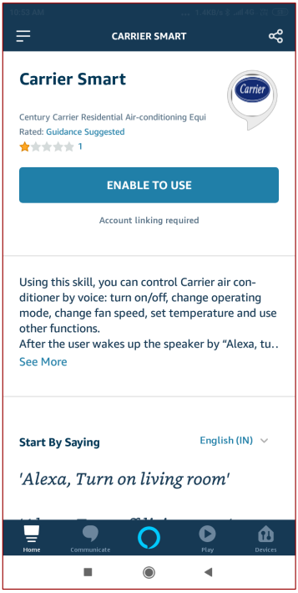
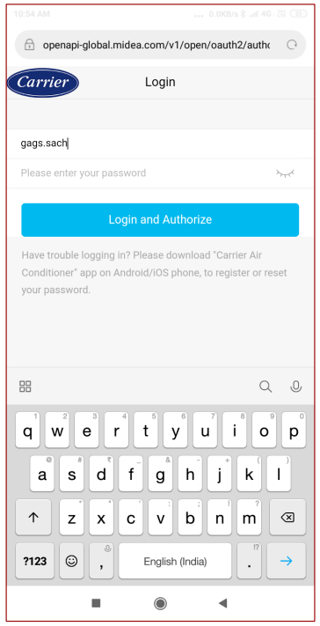
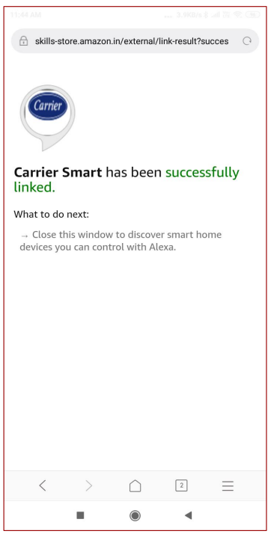
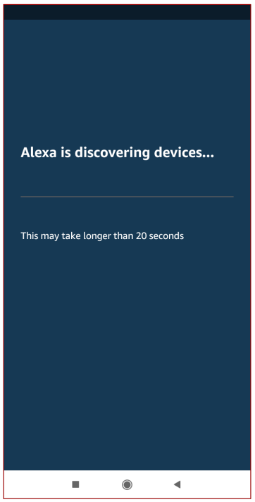
WIFI Control and Intelligent Speakers
4. Configure Carrier Air Skill.

Slide 11
WIFI Control and Intelligent Speakers
5. Voice command
Function | Parameter | Command
On/off | Turn on | Echo, turn on the air conditioner
 | Turn off | Echo, turn off the air conditioner
Temperature setting | 62°F | Echo, set air conditioner to 62 degrees
 | 63°F | Echo, set air conditioner to 63 degrees
 | 86°F | Echo, set air conditioner to 86 degrees
 | 17°C | Echo, set air conditioner to 17 degrees
 | 29°C | Echo, set air conditioner to 29 degrees
 | 30°C | Echo, set air conditioner to 30 degrees
Mode setting | Cool | Echo, set air conditioner to cool mode
 | Heat | Echo, set air conditioner to heat mode
 | ECO | Echo, set air conditioner to ECO mode

Slide 12
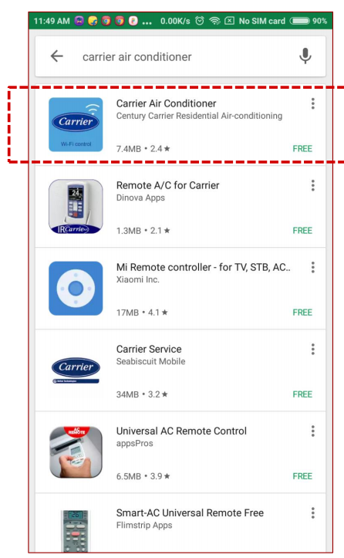
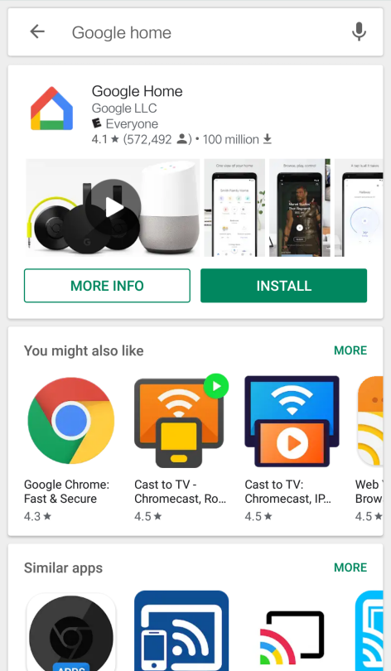
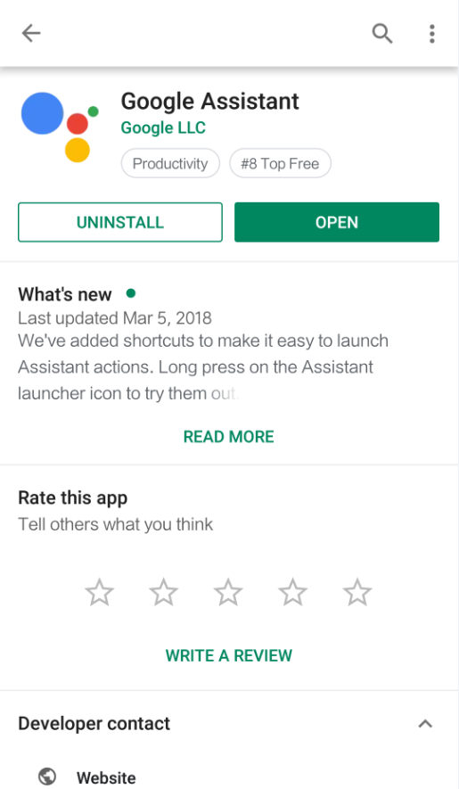
WIFI Control and Intelligent Speakers
1. Download Carrier air conditioner, Google Home and Google Assistant app from Google Play.
2. Connect the air-conditioner to internet via Carrier Air conditioner app according to the prompts.

Slide 13
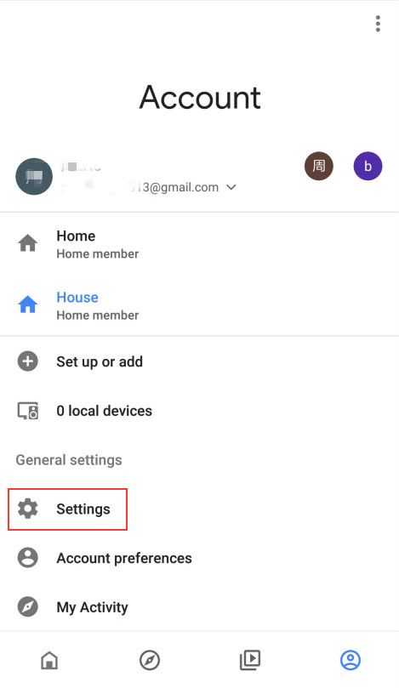
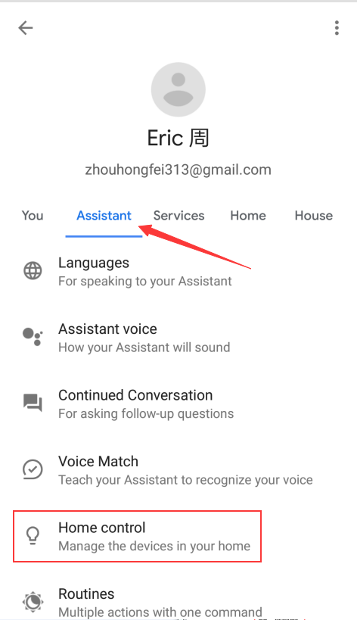
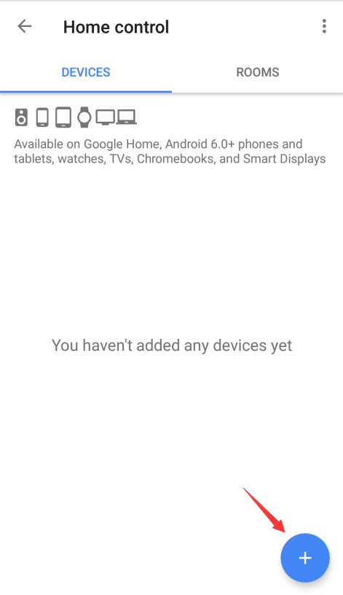
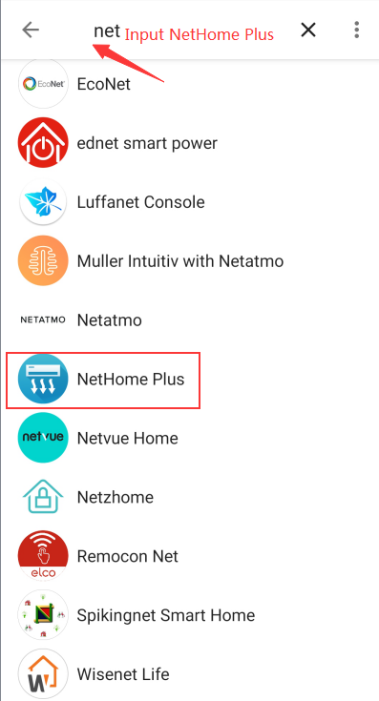
WIFI Control and Intelligent Speakers
3. Configure your Google Home speaker via app according to the prompts.
4. Link Nethome Plus to Google Home

Slide 14
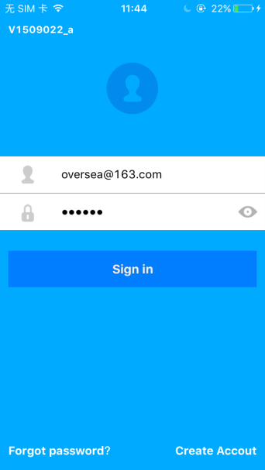
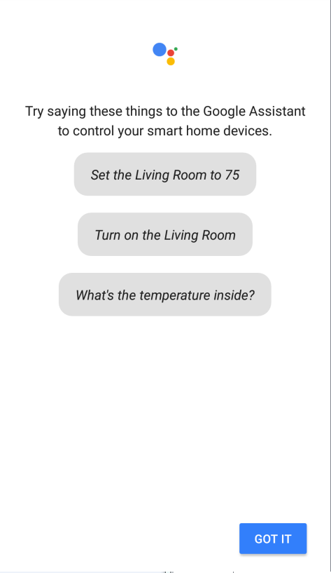
WIFI Control and Intelligent Speakers
4. Link Carrier air conditioner to Google Home

Slide 15
WIFI Control and Intelligent Speakers
5. Voice command
Function | Parameter | Command
On/off | Turn on | OK, Google, turn on the air conditioner
 | Turn off | OK, Google, turn off the air conditioner
Temperature setting | 62°F | OK, Google, set air conditioner to 62 degrees
 | 63°F | OK, Google, set air conditioner to 63 degrees
 | 86°F | OK, Google, set air conditioner to 86 degrees
 | 17°C | OK, Google, set air conditioner to 17 degrees
 | 29°C | OK, Google, set air conditioner to 29 degrees
 | 30°C | OK, Google, set air conditioner to 30 degrees
Mode setting | Cool | OK, Google, set air conditioner to cool mode
 | Heat | OK, Google, set air conditioner to heat mode
 | ECO | OK, Google, set air conditioner to ECO mode

Slide 16
Thanks Make Yourself Home
Dennis Huang
Foshan Midea Carrier Air-conditioning Equipment Co., Ltd.

