Slide 1
Optional Control for
QHP QHG QHE QHB QHC
Hi-wall Inverter
FMCC Engineering
2022

Slide 2
Optional Control for Hi-wall
1. WLAN / Wired control / Central control / Dry contact can be selected only one on the same unit.
2. Remote controller can be used together with other controls.
Central Control/BMS Control
Professional for commercial users
WLAN Control
Operates your AC wherever you are
Remote Control
Remote On/Off
Easy for commercial users
Wired Control
Avoid mislaying

Slide 3
Part 1
Optional Control for QHE Hi-wall

Slide 4
Hi-wall Control Combination QHE
No. | Option 1 | Option 2 |  | Option 4 |  | Option 5
Functions | Standard (Remote control) | WLAN function |  | Dual-way communication (485) wired controller（4 core） Central control |  | Non-Polarity wired controller（2 core）
Parts | Display PCB 1 For 9/12/18K 17222000A59075 74 For 24K 17222000A60016 74 | Display PCB 2 assembly For 9/12/18K 17222000A59075 74 For 24 K 17222000A60016 74 |  | Transfer adapter below already has integrated display PCB, no need to order separately
 |  |  |  | Multifunction board 1 For 9/12/18K 17222000A60657 7403090 For 24 K 17222000A60656 7403091 | Multifunction board 2 For 9/12/18K 17222000A63780 7403093 For 24 K 17222000A63779 7403094
 |  | / |  | 12V wire has already included PCB main board assembly. Dry Contact(On/Off)/Alarm function are already included Transfer Adapter.
 | Remote controller: RG10L 17317000A63323 | WLAN USB 16122000A67265 (OSK105) 7403092 |  | 485 Wired controller KJR-120G2: 17317100A27842 / 7403019 KJR-120X2: 17317100A28268 / 7403081 Central controller CCM30: 17311500A03641/7403018 CCM09: 17311500A03642/7403017 |  | Non-Polarity Wired controller KJR-120X: 17317100A28269/7403079

Slide 5
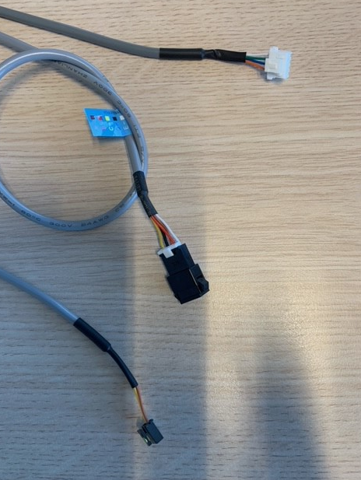
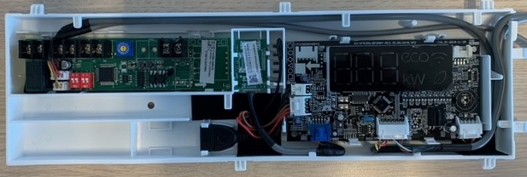
Hi-wall Control Combination QHE (option 4)
multifunction board 1
9/12/18K = 17222000A60657 = 7403090
24K = 17222000A60656 = 7403091
multifunction board 1 will have 3 outgoing cables/connectors

Slide 6
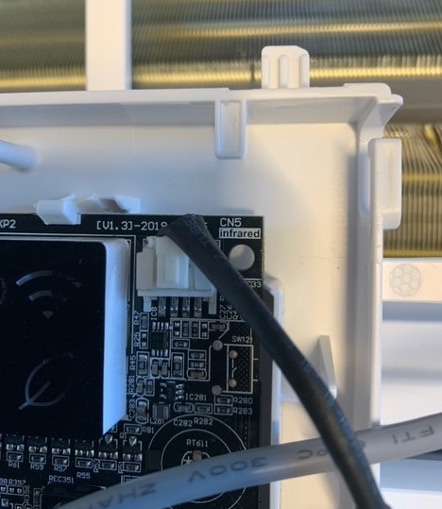
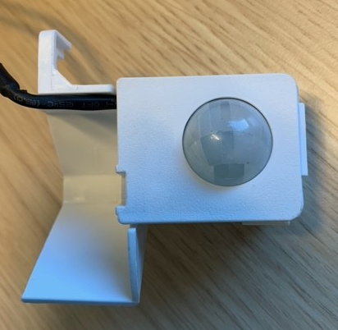
Hi-wall Control Combination QHE (option 4)
Connector for Infrared sensor must be transferred from old to new display PCB

Slide 7
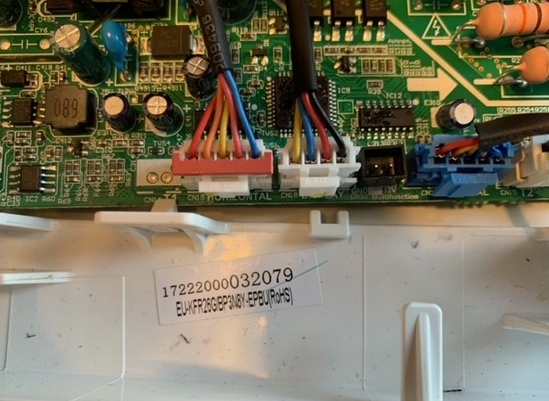
Hi-wall Control Combination QHE (option 4)
Cable 1 (4 core)
Coming from display PCB CN1
Disconnect cable current PCB
Connect cable 1 to main PCB, display CN18

Slide 8
Hi-wall Control Combination QHE (option 4)
Cable 2 (5 core)
Coming from display PCB CN2
Connect to wired controller
KJR-12B

Slide 9
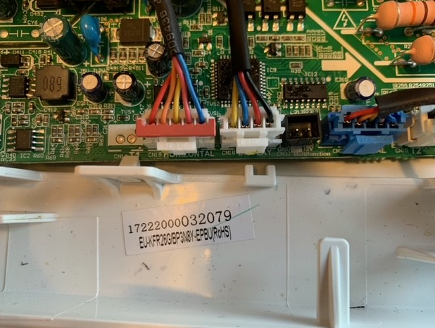
Hi-wall Control Combination QHE (option 4)
Cable 3 (2 core)
Coming from multi function PCB CN43
Connect to CN32 of main PCB

Slide 10
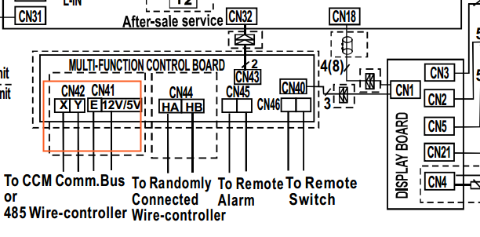
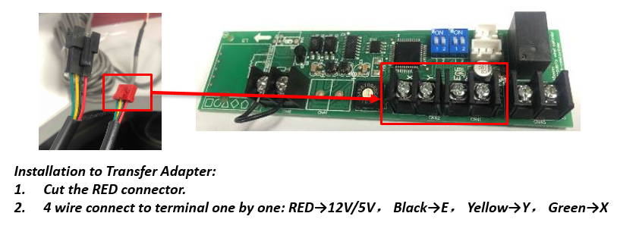
Hi-wall Control Combination QHE (option 4)
How to connect wired controller KJR-120G2/X2, to CN41-42

Slide 11
Hi-wall Control Combination QHE (option 4)
Central controller CCM09/CCM30 connect to XYE
Dry contact (remote on-off) connect to CN46
Alarm output connect to CN45

Slide 12
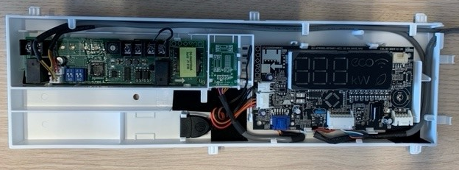
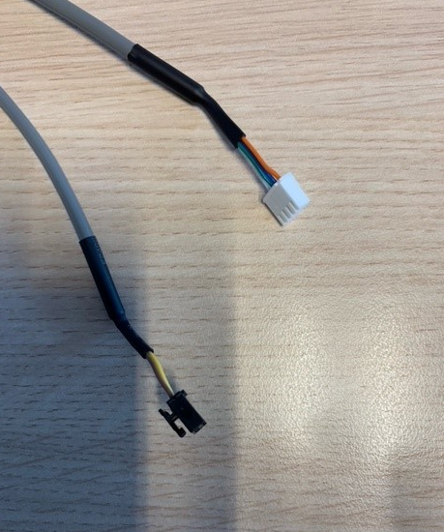
Hi-wall Control Combination QHE (option 5)
multifunction board 2
9/12/18K = 17222000A63780 = 7403093
24K = 17222000A63779 = 7403094
multifunction board 2 will have 2 outgoing cables/connectors

Slide 13
Hi-wall Control Combination QHE (option 5)
Connector for Infrared sensor must be transferred from old to new display PCB

Slide 14
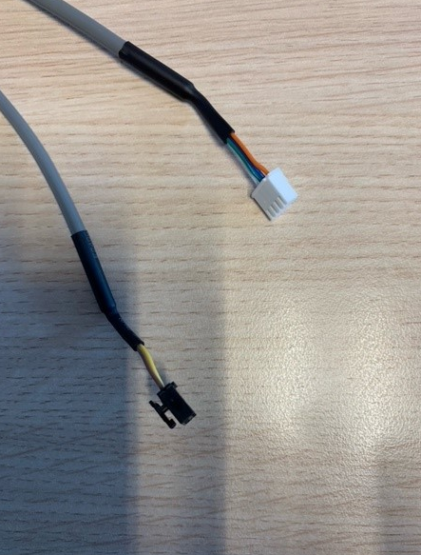
Hi-wall Control Combination QHE (option 5)
Cable 1 (4 core)
Coming from display PCB CN1
Disconnect cable current PCB
Connect cable 1 to main PCB, display CN18

Slide 15
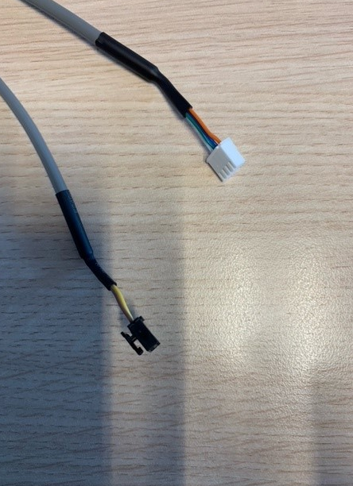
Hi-wall Control Combination QHE (option 5)
Cable 3 (2 core)
Coming from multi function PCB CN43
Connect to CN32 of main PCB

Slide 16
Hi-wall Control Combination QHE (option 5)
Wired controller KJR-120X connect to CN44
Dry contact (remote on-off) connect to CN46
Alarm output connect to CN45

Slide 17
Part 1
Optional Control for QHG Hi-wall

Slide 18
Hi-wall Control Combination QHG
No. | Option 1 | Option 2 | Option 3 | Option 4 |  | Option 5
Functions | Standard (Remote control) | WLAN function | 5 core Wired controller | Dual-way communication (485) wired controller（4 core） Central control |  | Non-Polarity wired controller（2 core）
Parts | Display PCB 1 For 9/12K 17222000030895 For 18K 17222000031322 For 22/24K 17222000031565 | Display PCB 2 assembly For 9/12/18K 17222000A58269 For 22/24 K 17222000A58395 | Display PCB 3 For 9/12/18K 17222000A58426 For 22/24K 17222000A58427 | Display PCB 2 assembly For 9/12/18K 17222000A58269 For 22/24 K 17222000A58395
 |  | WLAN USB adapter (Multi-function box) (already included in the display PCB assembly) |  | Transfer Adapter 1 For 9/12/18K 17222000A58719 For 22/24 K 17222000A58718 | Transfer Adapter 2 For 9/12/18K 17222000A58716 For 22/24 K 17222000A58717
 |  | / |  | 12V wire has already included PCB main board assembly. Dry Contact(On/Off)/Alarm function are already included Transfer Adapter.
 | Remote controller: RG67G 17317000007154 | WLAN USB 17310900A03781 | KJR-12B: 17317100A22492 | 485 Wired controller KJR-120G2: 17317100A27842 KJR-120X2: 17317100A28268 Central controller CCM30: 17311500A03641 CCM09: 17311500A03642 |  | Non-Polarity Wired controller KJR-120G: 17317100A25375 KJR-120X: 17317100A28269

Slide 19
Hi-wall Control Combination QHG
No. | Option 1 | Option 2 |  | Option 4 |  | Option 5
Functions | Standard (Remote control) | WLAN function |  | Dual-way communication (485) wired controller（4 core） Central control |  | Non-Polarity wired controller（2 core）
Parts | Display PCB 1 For 9/12K 17222000030895 7409751 For 18K 17222000031322 7409752 For 22/24K 17222000031565 7409753 | Display PCB 2 assembly For 9/12/18K 17222000A58269 7409754 For 22/24 K 17222000A58395 7409755 |  | Display PCB 2 assembly For 9/12/18K 17222000A58269 7409754 For 22/24 K 17222000A58395 7409755
 |  |  |  | Transfer Adapter 1 For 9/12/18K 17222000A58719 7403082 For 22/24 K 17222000A58718 7403083 | Transfer Adapter 2 For 9/12/18K 17222000A58716 7403084 For 22/24 K 17222000A58717 7403085
 |  | / |  | 12V wire has already included PCB main board assembly. Dry Contact(On/Off)/Alarm function are already included Transfer Adapter.
 | Remote controller: RG67G 17317000007154 7409750 | WLAN USB 17310900A03781 7403078 |  | 485 Wired controller KJR-120G2: 17317100A27842 / 7403019 KJR-120X2: 17317100A28268 / 7403081 Central controller CCM30: 17311500A03641/7403018 CCM09: 17311500A03642/7403017 |  | Non-Polarity Wired controller KJR-120X: 17317100A28269/7403079

Slide 20
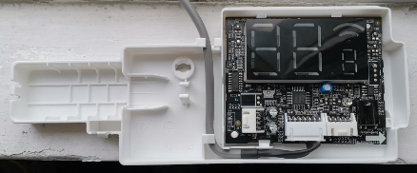
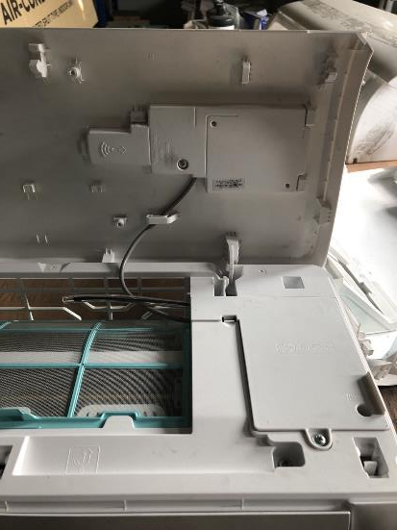
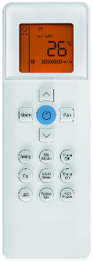
Option 1 – Standard (Remote control) QHG
No wifi, No wired control function
Remote controller
Display PCB 1

Slide 21
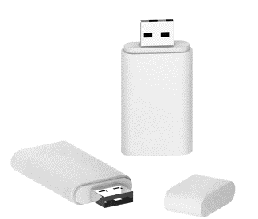
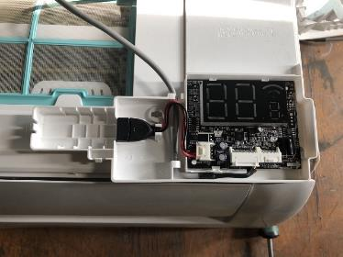
Option 2 - WLAN Control QHG
Working with smart phone APP
USB
PN: 17310900A03781
Display PCB 2
 | Display PCB 1 (Standard) | Display PCB 2 (WLAN function) | USB | Note
Option 1: Standard | √ |  |  | Remote control
Option 2.1: WLAN function without USB kit. |  | √ |  | If the user want to control the unit by WLAN, they have to buy the WLAN kit from Carrier
Option 2.2: WLAN Ready |  | √ | √ | WLAN available

Slide 22
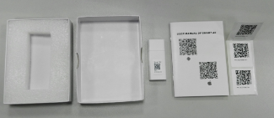
Option 2 - WLAN Control QHG
Option 2.2: WLAN Ready
Note:
Display PCB 2 is assembled in the unit by factory.
The WLAN kit must be sold separately
Display PCB 2
WLAN kit (optional accessory)

Slide 23
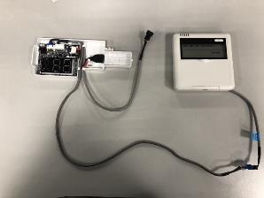
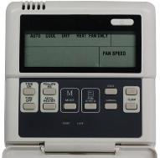
Option 3 – 5 core Wired Controller QHG
KJR-12B without weekly timer.
KJR-120B
(PN: 17317100A22492)
Display PCB 3
 | Display PCB 1 (standard) | Display PCB 3 (5 core wired control function) | 5 core Wired controller | Note
Option 1 | √ |  |  | Remote control
Option 3.1 |  | √ |  | Need to buy wired controller separately
Option 3.2 |  | √ | √ | Wired controller available

Slide 24
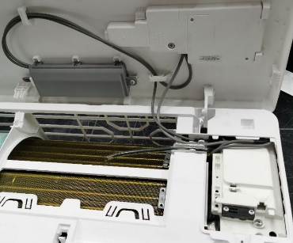
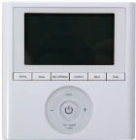
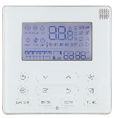
Option 4 – 485 Wired Controller & Central Control QHG
KJR-120G2/TFBG-E
(PN: 17317100A27842)
KJR-120X2/TFBG-E
(PN: 17317100A26817)
Transfer adapter
(To wired controller/
Central Control)
Display PCB 2
 | Display PCB 1 (standard) | Display PCB 2 (485 wired control function) | Transfer adapter 1 | 485 Wired controller | Note
Option 1 | √ |  |  |  | Remote control
Option 4.1 |  | √ | √ |  | Need to buy wired controller separately
Option 4.2 |  | √ | √ | √ | Wired controller available

Slide 25
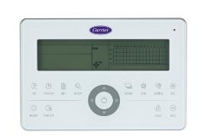
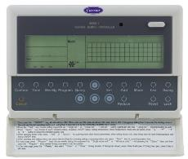
Option 4 – 485 Wired Controller & Central Control QHG
CCM30:
17311500A03641
Transfer adapter
(To wired controller/
Central Control)
CCM09: 17311500A03642
Display PCB 2
 | Display PCB 1 (standard) | Display PCB 2 (Central Control) | Transfer adapter 1 | Central Control | Note
Option 1 | √ |  |  |  | Remote control
Option 4.3 |  | √ | √ |  | Need to buy Central Control separately
Option 4.4 |  | √ | √ | √ | Central control available

Slide 26
Option 5 – Non-Polarity Wired Controller QHG
KJR-120G/TFBG-E
(PN: 17317100A25375)
KJR-120X/TFBG-E
(PN: 17317100A26816)
Transfer adapter
(To wired controller)
Display PCB 2
 | Display PCB 1 (standard) | Display PCB 2 (Non-Polarity wired control function) | Transfer adapter 2 | Non-Polarity Wired controller | Note
Option 1 | √ |  |  |  | Remote control
Option 5.1 |  | √ | √ |  | Need to buy wired controller separately
Option 5.2 |  | √ | √ | √ | Wired controller available

Slide 27
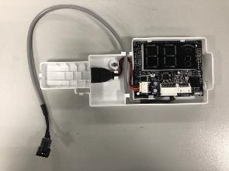
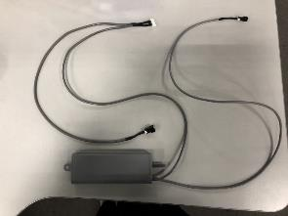
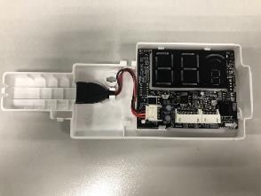
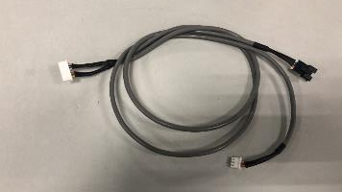
Installation of Transfer Adapter QHG
Installation
Delete the 4 core cable from Display board.
The 7 core cable from Transfer adapter connect to CN1 on Display board.
4-wired part
7 core cable
3-wired part
Note：
7-wired cable, the 4-wired part should connect to the main control PCB board; the 3-wired part should connect to the multi function board

Slide 28
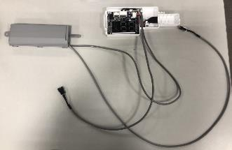
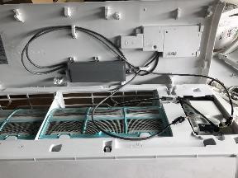
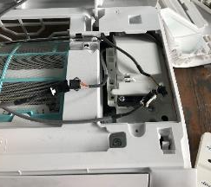
Installation of Transfer Adapter QHG
Installation
4-wired cable
3-wired cable
Install
2
1
2-wired cable
Transfer Adapter
Display Board
3-wired cable
2-wired cable connect to main PCB board 12V wire.
4-wired cable connect to communication wire on main PCB board.
2-wired cable
4-wired cable
Main PCB board

Slide 29
Introduction of Transfer Adapter QHG
Transfer Adapter 1
Dip-switch F1 Dip-switch F2
To PCB
To display board
On-off port
Rotary switch ENC3
485 wired controller/
Central controller
Alarm port
Note:
1. Rotary switch ENC3 and Dip-switch F1 is for Net address setting;
2. Dip switch F2 is for On-off setting
3. If connected to 485 wired controller, you should cut the connector and connect 4 wire to terminal one by one.

Slide 30
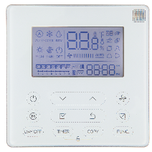
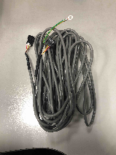
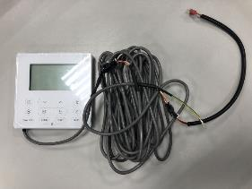
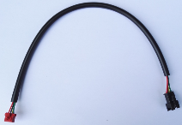
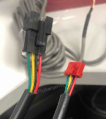
Introduction of Transfer Adapter QHG
Transfer Adapter 1-Connect with 485 wired controller
Accessory for 120X2:
KJR-120X2
4-core cable(6m)
Installation to Transfer Adapter:
Cut the RED connector.
4 wire connect to terminal one by one: RED→12V/5V， Black→E， Yellow→Y， Green→X

Slide 31
Introduction of Transfer Adapter QHG
Wiring diagram for Transfer Adapter 1

Slide 32
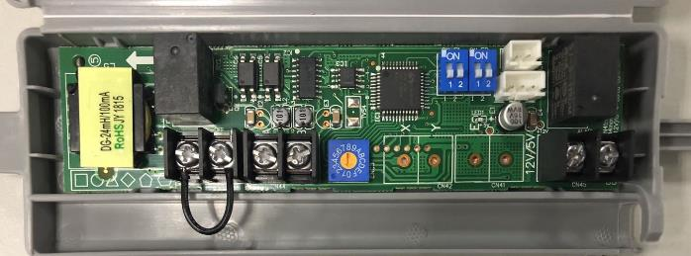
Introduction of Transfer Adapter QHG
Transfer Adapter 2
Dip-switch F1 Dip-switch F2
To PCB
To display board
On-off port
Rotary switch ENC3
Alarm port
non-polarity wired controller
Note:
1. Rotary switch ENC3 and Dip-switch F1 is for Net address setting;
2. Dip switch F2 is for On-off setting

Slide 33
Introduction of Transfer Adapter QHG
Wiring diagram for Transfer Adapter 2

Slide 34
Settings dipswitch F2 QHG

Slide 35
Part 2
Optional Control for QHP Hi-wall

Slide 36
Hi-wall Control Combination QHP
Option 4-5-6 are combined in 1 Multifunction board 2209983200000A (7403034)
Note: WLAN / Wired control / Central control / Dry contact can be selected only one on the same unit.

Slide 37
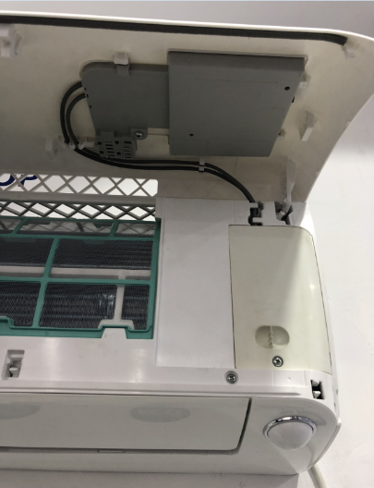
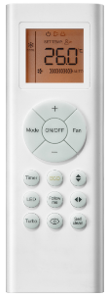
Option 1&2– Standard/WLAN Control QHP
Standard & WLAN function, No wired control function
Display PCB 1
Remote controller

Slide 38
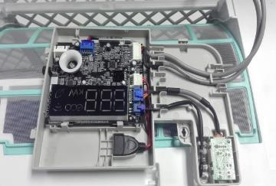
Option 2 - WLAN Control QHP
Working with smart phone APP
USB
PN: 17310900A00681
Display PCB 1
 | Display PCB 1 (Standard/WLAN function) | USB | Note
Option 1: Standard | √ |  | Remote control
Option 2.1: WLAN function without USB kit. | √ |  | If the user want to control the unit by WLAN, they have to buy the WLAN kit from Carrier
Option 2.2: WLAN Ready | √ | √ | WLAN available

Slide 39
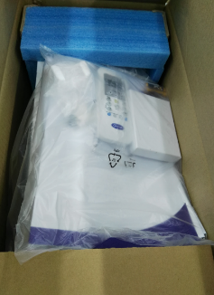
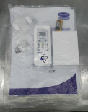
Option 2 - WLAN Control QHP
Option 2.2: WLAN Ready
Note:
Display PCB 1 is assembled in the unit by factory.
The WLAN kit will be put in the IDU package.
Display PCB 1
WLAN kit (In the accessary bag, and put in the package)

Slide 40
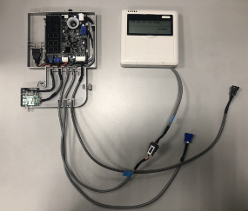
Option 3 - Wired Controller 1 QHP
KJR-12B without weekly timer.
KJR-120B
(PN: 17317100000004)
Display PCB 2
 | Display PCB 1 (standard) | Display PCB 2 (wired control function) | Wired controller | Note
Option 1 | √ |  |  | Remote control
Option 3.1 |  | √ |  | Need to buy wired controller separately
Option 3.2 |  | √ | √ | Wired controller available

Slide 41
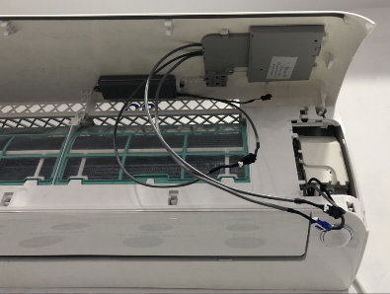
Option 4 - Wired Controller 2 QHP
KJR-120G1 with weekly timer and Error code display.
KJR-120G1/TFBG-E
(PN: 17317100A26536)
Transfer adapter
(To wired controller)
Display PCB 3
 | Display PCB 1 (standard) | Display PCB 3 (wired control function) | Transfer adapter | Wired controller | Note
Option 1 | √ |  |  |  | Remote control
Option 4.1 |  | √ | √ |  | Need to buy wired controller separately
Option 4.2 |  | √ | √ | √ | Wired controller available

Slide 42
Option 4 - Wired Controller 2 QHP
KJR-120G1 with weekly timer and Error code display.

Slide 43
Option 5 – Central Control QHP
CCM30 (No Weekly Timer) CCM09 (Weekly Timer)
CCM30:
17311500A00252
Transfer adapter
(To Central controller)
CCM09: 17311500A00145
Display PCB 3
 | Display PCB 1 (standard) | Display PCB 3 (central control function) | Transfer adapter | Central Controller | Note
Option 1 | √ |  |  |  | Remote control
Option 5.1 |  | √ | √ |  | Need to buy central controller separately
Option 5.2 |  | √ | √ | √ | Central controller available

Slide 44
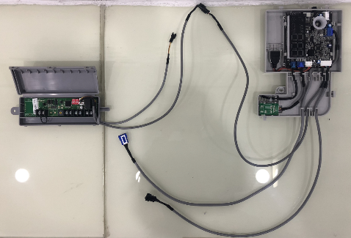
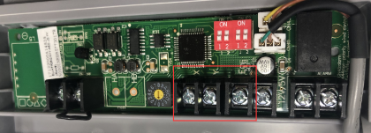
Option 5 – Central Control QHP
Display board
Adaptor board
Terminals board
For central control, connect to XYE (Red Mark terminals).

Slide 45
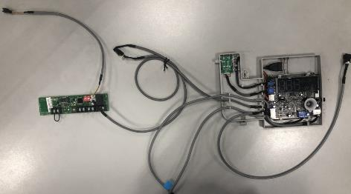
Option 6 – Dry Contactor Control (On/Off) QHP
PCB
connection wire (2-core)
Transfer adapter
(To On/Off switch)
Transfer Adapter connection wire (3-core)
PCB connection wire (4-core)
Display PCB 3
 | Display PCB 1 (standard) | Display PCB 3 (Dry contact function) | Transfer adapter | Note
Option 1 | √ |  |  | Remote control
Option 6 |  | √ | √ | On/Off switch is provided in field.

Slide 46
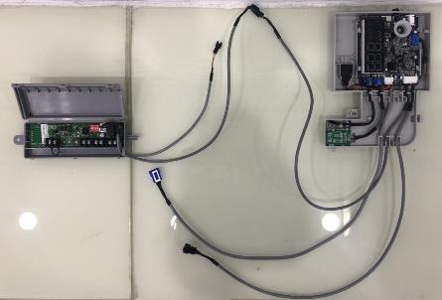
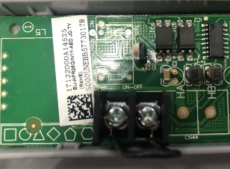
Option 6 – Dry Contactor Control (On/Off) QHP
Display board
Adaptor board
Terminals board
Short connecting wire (Standard)
If the short wire is missing, there will be “CP” error code.
Remote ON/OFF switch
There are reserved ports for connecting a remote switch to control the unit to run or stop.
NOTE: If there is no remote switch connected, these 2 ports should be short connected.

Slide 47
Part 2
Optional Control for new QHP Hi-wall

Slide 48
Hi-wall Control Combination new QHP-01
Display PCB, transfer adapter and 12 V cable will come as 1 multi function kit PCB (22099832000008)
7403035
Note: WLAN / Wired control / Central control / Dry contact can be selected only one on the same unit.

Slide 49
Part 2
Optional Control for QHC&QHB Hi-wall

Slide 50
Hi-wall Control Combination QHC/QHB
No. | Option 1 | Option 2 | Option 3 | Option 4 | Option 5 | Option 6
Functions | Standard (Remote control) | Wifi function | Wired control 1 | Wired control 2 | Central control | Dry contactor control
Parts | Display PCB 1 for 9/12/18 K 17222000009789 Coolmark ; 7409232 for 24 K 17222000010648 Coolmark ; 7409286 | Display PCB 2 assembly for 9/12/18 K 17222000A48490 Coolmark ; 7409389 for 24 K 17222000A48491 Coolmark ; 7409392 | Display PCB 3 17222000A07665 Coolmark ; 7403014 | Display PCB 4 assembly 17222000A49832 Coolmark ; 7403015 | Display PCB 5 assembly 17222000A49836 Coolmark ; 7403028 | Display PCB 6 assembly 17222000A49855 Coolmark ; 7403031
 |  | Wifi USB adapter (Multi-function box) (already included in the display PCB assembly) |  | Transfer Adapter 1 (Multi-function box) (already included in the display PCB assembly)
 |  | / |  | Direct connector and Cable (already included in the display PCB assembly) | Terminal block box and Cable (already included in the display PCB assembly) | Terminal block box and Cable (already included in the display PCB assembly)
 | Remote controller: | Wifi USB 17310900A00521 Coolmark ; 7403013 | Wired controller 1 KJR-12B: 17317100000004 | Wired controller 2 KJR-120G1: 17317100A19005 Coolmark ; 7403016 | Central controller: CCM30: 17311500A03641 Coolmark ; 7403018 CCM09: 17311500A03642 Coolmark ; 7403017 | /
Note: Wifi / Wired control / Central control / Dry contact can be selected only one on the same unit.

Slide 51
Option 1 – Standard (Remote control QHC/QHB)
No wifi, No wired control function
Display PCB 1
Remote controller

Slide 52
Option 2 - Wifi Control QHC/QHB
Working with smart phone APP
USB
PN: 17310900A00521
USB adapter
Display PCB 2
 | Display PCB 1 (Standard) | Display PCB 2 (wifi function) | USB adapter | USB | Note
Option 1 | √ |  |  |  | Remote control
Option 2.1 |  | √ | √ |  | Need to buy USB separately
Option 2.2 |  | √ | √ | √ | Wifi available

Slide 53
Wifi Control QHC/QHB
Option 2.1
Display PCB B
(with Wi-Fi function)
Note:
1. Display PCB B and USB adapter was assembly in the unit by factory.
2. If the user want to control the unit by Wi-Fi, they have to buy the Wi-Fi kit from Carrier.
USB adapter

Slide 54
Wifi Control QHC/QHB
Option 2.2
Note:
Display PCB B and USB adapter are assemblied in the unit by factory.
The Wi-Fi kit will be put in the IDU package.
Wi-Fi kit (In the accessary bag, and put in the package)

Slide 55
Option 3 - Wired Controller 1 QHC/QHB
KJR-12B without weekly timer.
KJR-120B
(PN: 17317100000004)
Display PCB 3
Wired controller
 | Display PCB 1 (standard) | Display PCB 3 (wired control function) | Wired controller | Note
Option 1 | √ |  |  | Remote control
Option 3.1 |  | √ |  | Need to buy wired controller separately
Option 3.2 |  | √ | √ | Wired controller available

Slide 56
Option 4 - Wired Controller 2 QHC/QHB
KJR-120G1 with weekly timer and Error code display.
KJR-120G1/TFBG-E
(PN: 17317100A06345)
Transfer adapter
(To wired controller)
Display PCB 4
 | Display PCB 1 (standard) | Display PCB 4 (wired control function) | Transfer adapter | Wired controller | Note
Option 1 | √ |  |  |  | Remote control,
Option 4.1 |  | √ | √ |  | Need to buy wired controller separately
Option 4.2 |  | √ | √ | √ | Wired controller available

Slide 57
Option 5 – Central Control QHC/QHB
CCM30 (No Weekly Timer) CCM09 (Weekly Timer)
CCM30: 17311500A00238
CCM09: 17311500A00145
Transfer adapter
(To Central controller)
Display PCB 5
 | Display PCB 1 (standard) | Display PCB 5 (central control function) | Transfer adapter | Central Controller | Note
Option 1 | √ |  |  |  | Remote control
Option 5.1 |  | √ | √ |  | Need to buy central controller separately
Option 5.2 |  | √ | √ | √ | Central controller available

Slide 58
Option 6 – Dry Contactor Control (On/Off) QHC/QHB
Transfer adapter
(To On/Off switch)
Display PCB 6
 | Display PCB 1 (standard) | Display PCB 6 (Dry contact function) | Transfer adapter | Note
Option 1 | √ |  |  | Remote control
Option 6 |  | √ | √ | On/Off switch is provided in field.

Slide 59
Thank you!

