Slide 1
Optional Control for
console QZY
FMCC Engineering
2022

Slide 2
Optional Control for console QZY
1. WLAN / Wired control / Central control / Dry contact can be selected only one on the same unit.
2. Remote controller can be used together with other controls.
Central Control/BMS Control
Professional for commercial users
WLAN Control
Operates your AC wherever you are
Remote Control
Remote On/Off
Easy for commercial users
Wired Control
Avoid mislaying

Slide 3
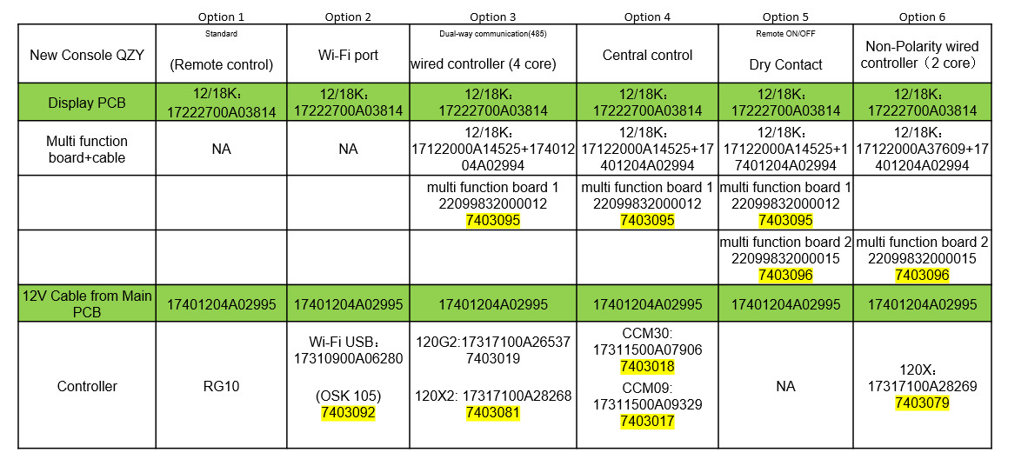
Optional Control for console QZY

Slide 4
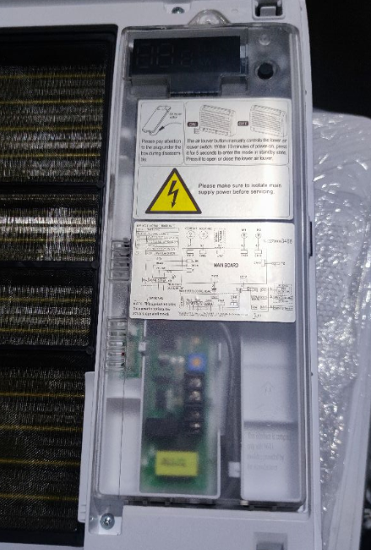
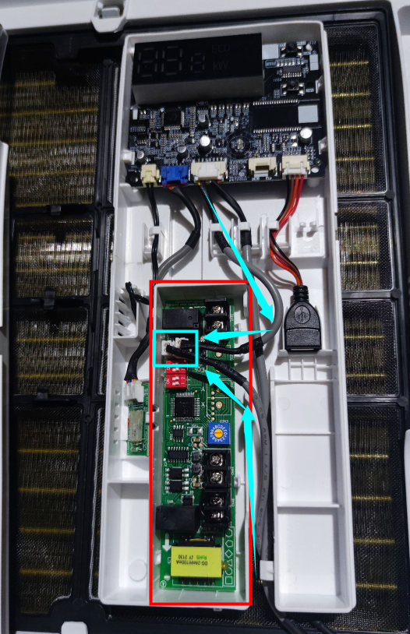
Open the panel and find the display box

Slide 5
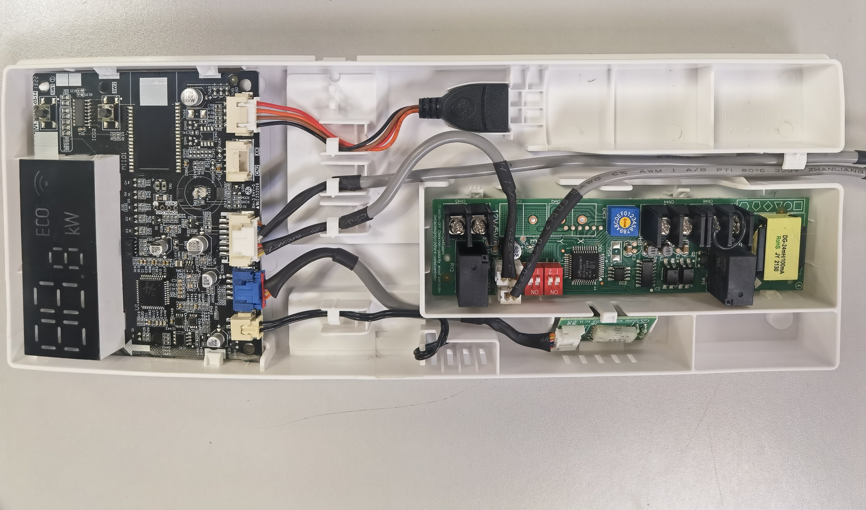
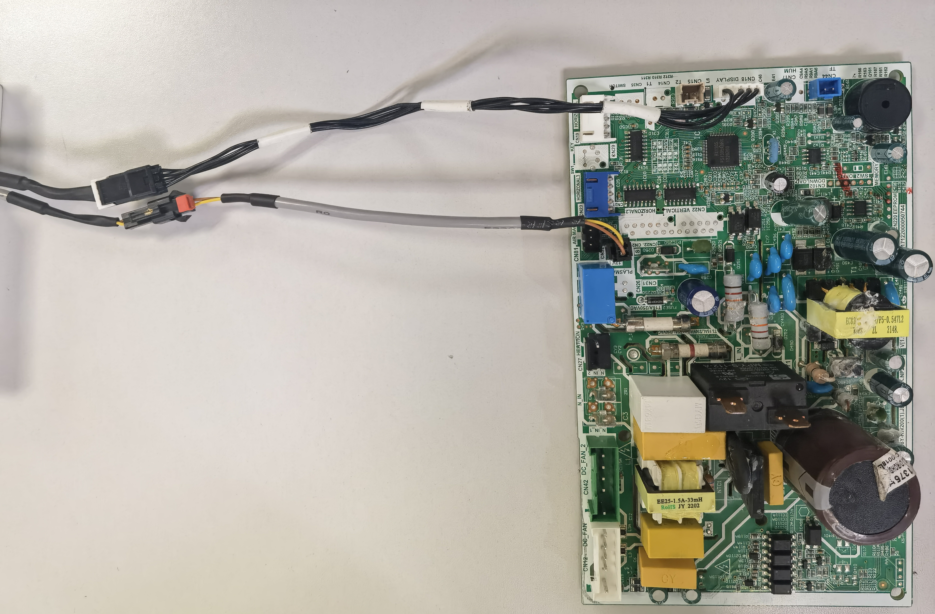
if you want to achieve Multi function, you must make a change , and you need the following parts:
2-wired cable, 17401204A02994, connect 12V port in multi function board and the 2-wired cable in main control PCB board
Multi function board
1.on-off/ alarm/central controller/4-wired controller 120X2/120G2;
17122000A14525
2.on-off/ alarm/2-wired non-polarity controller 120G/120X 17122000A37609
4-wired cable
CN18
To wifi kit
3-wired cable
CN32
2-wired cable
The multifunction board
The main board

Slide 6
Multi function board
1.on-off/ alarm/central controller/4-wired controller 120X2/120G2;
17122000A14525
2.on-off/ alarm/2-wired non-polarity controller 120G/120X 17122000A37609
XYE
HAHB

Slide 7
The explanation of ports on multi function board
17122000A14525
Dip-switch F1 Dip-switch F2
To PCB
To display board
On-off port
Rotary switch ENC3
Central controller
Alarm port
Note:
1. Rotary switch ENC3 and Dip-switch F1 is for Net address setting;
2. Dip switch F2 is for On-off setting

Slide 8
The explanation of ports on multi function board
17122000A37609
Dip-switch F1 Dip-switch F2
To PCB
To display board
On-off port
Rotary switch ENC3
Alarm port
non-polarity wired controller
KJR-120G
Note:
1. Rotary switch ENC3 and Dip-switch F1 is for Net address setting;
2. Dip switch F2 is for On-off setting

Slide 9
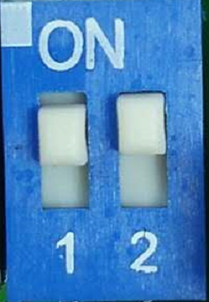
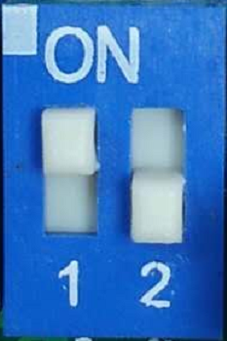
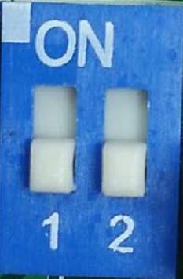
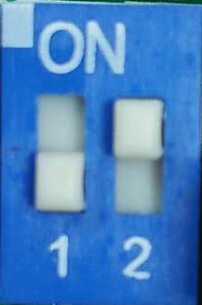
The explanation of F2 port on multi function board
Picture | Dip-switch 1 | Dip- switch 2 | ON-OFF port | Unit’s Operation
 | ON | ON | ON-OFF port works as an ON/OFF button. By connecting the port,'OFF' signal is sent to switch off the unit. You can switch on the unit with remote controller. By disconnecting the port, 'ON' signal is send to switch on the unit. You can switch off the unit with remote controller. | Restart with auto mode,24°C
 | ON | OFF | ON-OFF port works as an ON/OFF button. By disconnecting the port, 'OFF' signal is sent to switch off the unit. You can switch on the unit with remote controller. By connecting the port, 'ON' signal is send to switch on the unit.. You can switch off the unit with remote controller. | Restart with auto mode,24°C
 | OFF | OFF | When ON-OFF port is connected, unit shows CP and can't work. And you can not control the unit with remote controller. When ON-OFF port is disconnected, unit works normally. And you can control the unit with remote controller. | Restart with previous setting
 | OFF | ON | When ON-OFF port is connected, unit works normally. And you can control the unit with remote controller. When ON-OFF port is disconnected, unit shows CP and can't work. And you can not control the unit with remote controller. | Restart with previous setting

Slide 10
Note:
Multi function board is compatible with wifi function and basic 5-wired controller KJR-12B/4-wired controller/ 2-wired controller at the same time, because wifi port and wired controller ports are connected to different sockets on the display board. But kind remind you that there are two type of multi function boards and each type multi function board cannot support 2-wired and 4-wired controller at the same time, you can only choose one.

