Slide 1
Cool Easy
R32 Cooling & Heating
3 DC inverter

Slide 2
Content
Product overview
SPEC
Features
Special features for Cool Easy

Slide 3
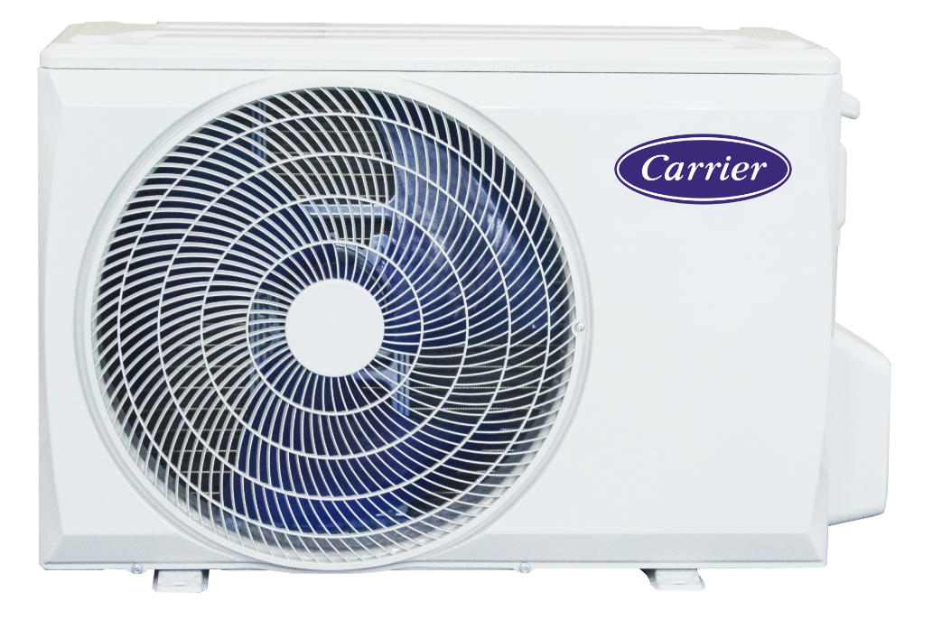
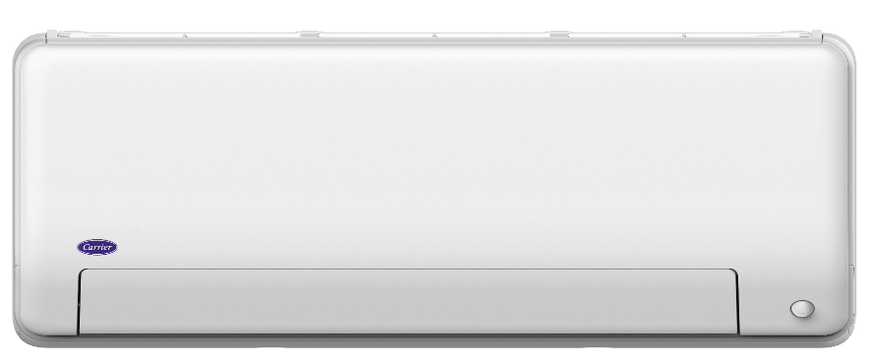
Product overview
EP24 Panel
RG10L Remote
X outdoor unit
No | Inverter (R32) | SEER | SCOP | Operation temperature | Power supply | Remark
1 | ERP Top 9K/12K | ≥8.5 A+++ | 4.6 A++ | 16~30 ℃ | 220-240V/50/60 Hz/1Ph | European standard (EU)
2 | ERP Top 18K/24K | ≥8.5 A+++ | 4.4/4.2 A+

Slide 4
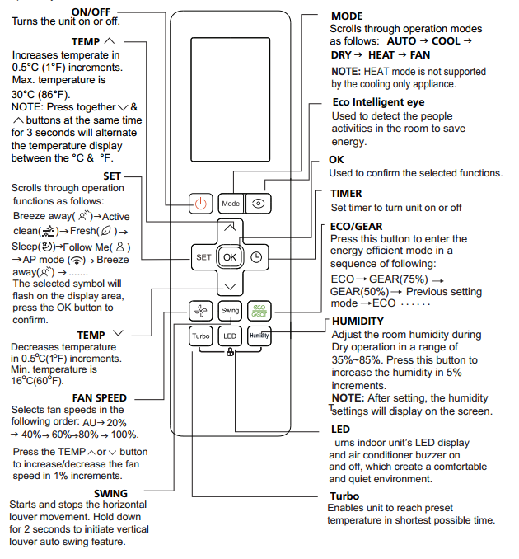
RG10 Remote Controller
 | For fix speed type |  | For inverter type
 | RG67N | RG67B | RG67V | RG67G | RG10L
Temperature Range | 17-30 | 16-30 | 17-30 | 16-30 | 16-30
Stepless fan speed | N | N | N | Y | Y
Swing | Y | Y | Y | Y | Y
Sleep | Y | Y | Y | Y | Y
LED | Y | Y | Y | Y | Y
Turbo | Y | Y | Y | Y | Y
Follow Me | Y | Y | Y | Y | Y
Clean | Y | Y | Y | Y | Y
8° heating | Y | Y | Y | Y | Y
silence | Y | Y | Y | Y | Y
Fresh | Y | Y | Y | Y | Y
ECO | N | N | Y | Y | Y
GEAR | N | N | N | Y | Y
Wind avoid Me | N | N | N | Y | Y
Intelligent eye | N | N | N | N | Y
HUMIDITY | N | N | N | N | Y
Increased temperature in 0.5℃ | N | N | N | N | Y
RG10L

Slide 5
SPEC

Slide 6
Features
General
 | Comfort
1 | Turbo
2 | Silence Mode
3 | Follow Me
4 | Do Not Disturb
5 | 1%~100% Grades Indoor Fan Speed
6 | Fast cooling and heating
7 | 9 Grades Outdoor Fan Speed
8 | 3D Air Flow
10 | Anti-Cold Air Function
9 | Wind Avoid Me
10 | Intelligent eye
 | Energy Saving
1 | GA compressor frequency control
2 | X-ECO Mode
3 | 8℃ Heating
4 | Sleep Mode
5 | 1W Standby
6 | Gear operation
7 | Timer
 | Convenience
1 | Multi Controllers
2 | 2-way Draining
3 | Louver Position Memory
4 | Manual On & Off Button
5 | Open terminal block
 | Reliability
1 | Refrigerant Leakage Detect
2 | Emergency Using
3 | Low Ambient Cooling & Heating
4 | Auto Defrosting
5 | Intelligent dusting switch
 | Health
1 | HD Dust Filter
2 | Cold-catalyst filter
3 | Active clean
4 | *Ionizer
Notes:* means optional.

Slide 7
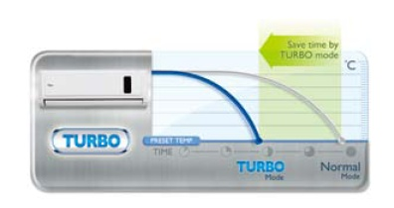
Features
Comfort Energy saving Convenience Reliability Health
Turbo
Indoor fan turns to turbo speed.
In cooling mode, the unit will keep running with turbo function..
In heating mode, the unit will keep running with turbo function.

Slide 8
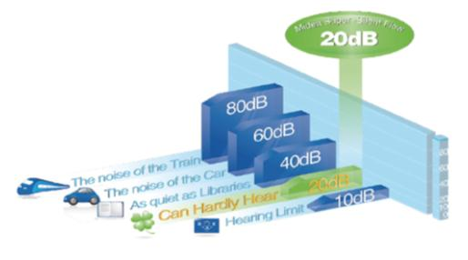
Features
Comfort Energy saving Convenience Reliability Health
Silence mode
Select SILENCE on remote controller to enter silent operation .
Press ON/OFF, Mode, Sleep button, turn on F.P. or Self clean function while operating will cancel silence function.(Model dependent)
Indoor fan will run at super breeze which keeps indoor noise as low as 20dB(A)*.
The frequency will be fixed at certain value when in silence mode.

Slide 9
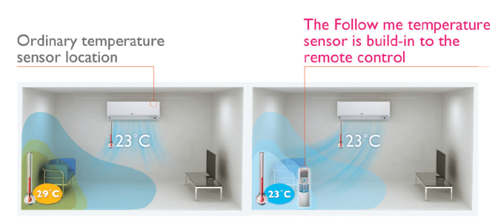
Features
Comfort Energy saving Convenience Reliability Health
Follow me
With this function, the room temperature sensor built in remote controller is activated and replaces the one in indoor unit. Then the air conditioner will regulate the room temperature based on the temperature around the remote controller, just like the air conditioner is following the user.
Pressing the “Follow me” button on remote controller to active this function. Then the remote controller will send PCB the signal every three minutes. If the PCB doesn’t receive the signal for 7 minutes or pressing “Follow me” button again, the follow me function will terminate.

Slide 10
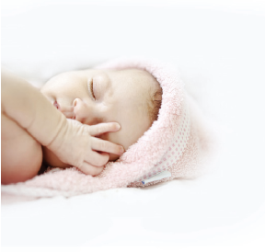
Features
Comfort Energy saving Convenience Reliability Health
Do Not Disturb
OFF OFF
Turn off the ring and display, which gives you a quiet and comfortable sleep.

Slide 11
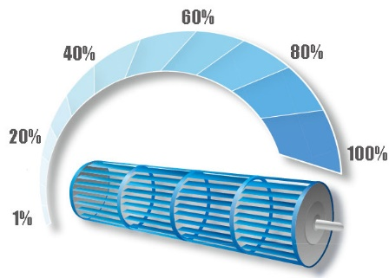
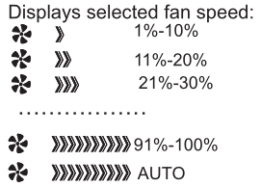
Features
Comfort Energy saving Convenience Reliability Health
1%~100%Grades Indoor Fan Speed
Au
20%
40%
60%
100%
80%
Via remote control, you can adjust fan speed from 1%-100%, enjoying a more comfortable cooling experience by precise wind speed control.

Slide 12
Features
Comfort Energy saving Convenience Reliability Health
Fast Cooling and Heating
Like a runner sprinting to the line, this tech enables the compressor to achieve maximum frequency in split of the moment(65Hz within 6s) upon start up, providing you powerful cooling/heating once the air conditioner is on.

Slide 13
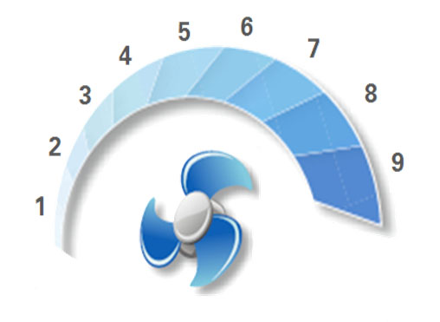
Features
Comfort Energy saving Convenience Reliability Health
9 Grades of Outdoor fan speed
Due to the DC fan motor, outdoor fan speeds are increased from 2 grades to 9 grades, more comfortable and energy saving.

Slide 14
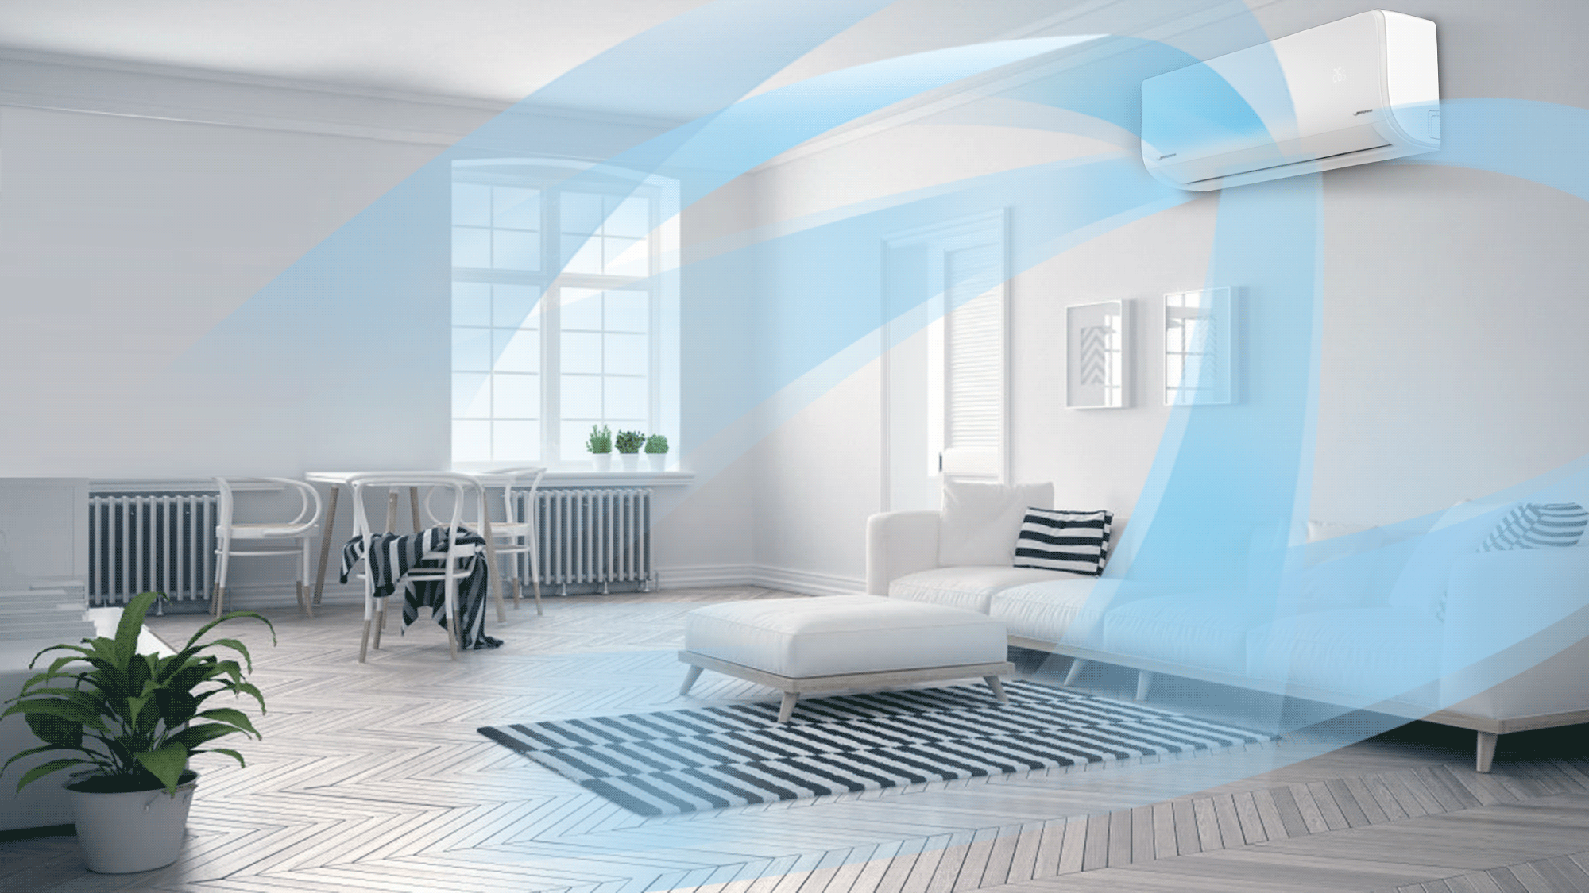
Features
Comfort Energy saving Convenience Reliability Health
3D Air Flow
3D Airflow
The directional air outlet moves automatically to direct air flow to every corner of the room and keep it thoroughly cool.

Slide 15
Features
Comfort Energy saving Convenience Reliability Health
Anti-Cold Air Function

Slide 16
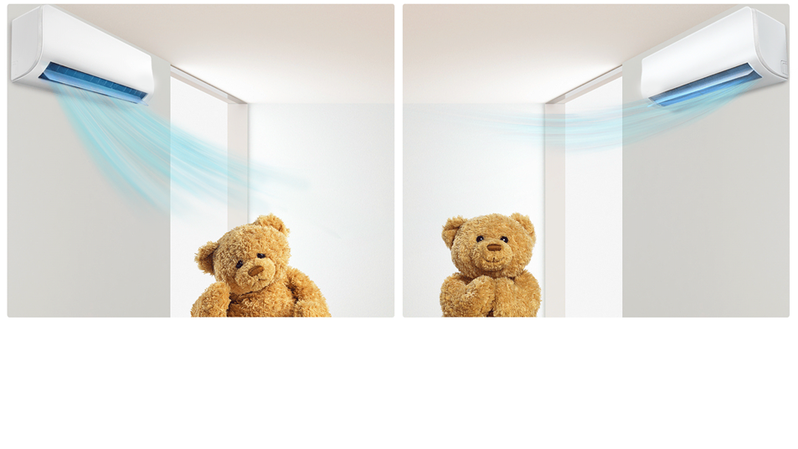
Features
Comfort Energy saving Convenience Reliability Health
Wind Avoid Me(Breeze Away)
Wind Avoid Me
Avoid wind blowing directly on you by using the remote
to instantly adjust the wind direction.

Slide 17
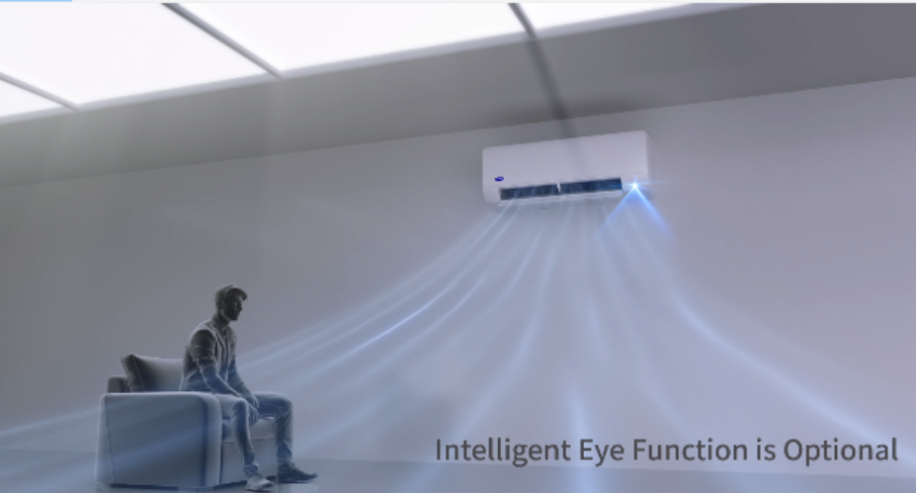
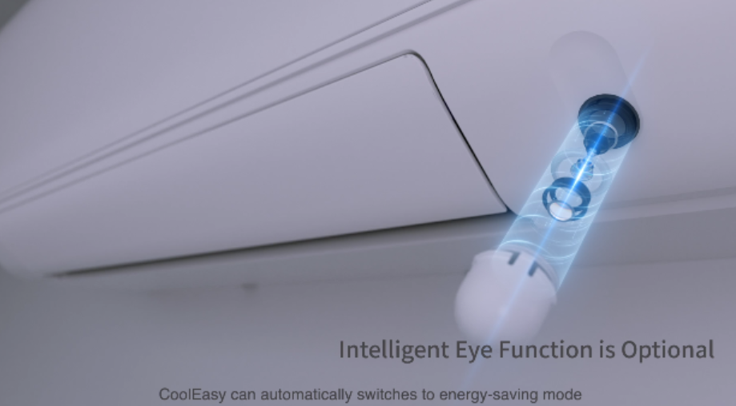
Features
Comfort Energy saving Convenience Reliability Health
Intelligent eye
Intelligent eye
It could automatically switches into energy saving mode, or turns off when it detects an empty room.

Slide 18
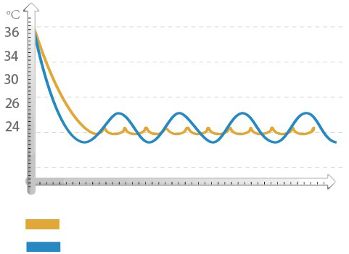
Features
Comfort Energy saving Convenience Reliability Health
● GA compressor frequency control
The frequency of traditional air conditioner has dramatic fluctuation during operation, leading to the instability of room temperature. However, Carrier air conditioners break away from this pattern with our unique GA Stepless Comfort Technology（0.6Hz for every step）. Its inverter frequency variation is so smooth that you wouldn’t notice the room temperature fluctuation at all.
Fmax
Temperature Graph
Ordinary Inverter Mode
Fmin
Fmax
GA Stepless Inverter Mode
GA Stepless Inverter Mode
Fmin
Ordinary Inverter Mode

Slide 19
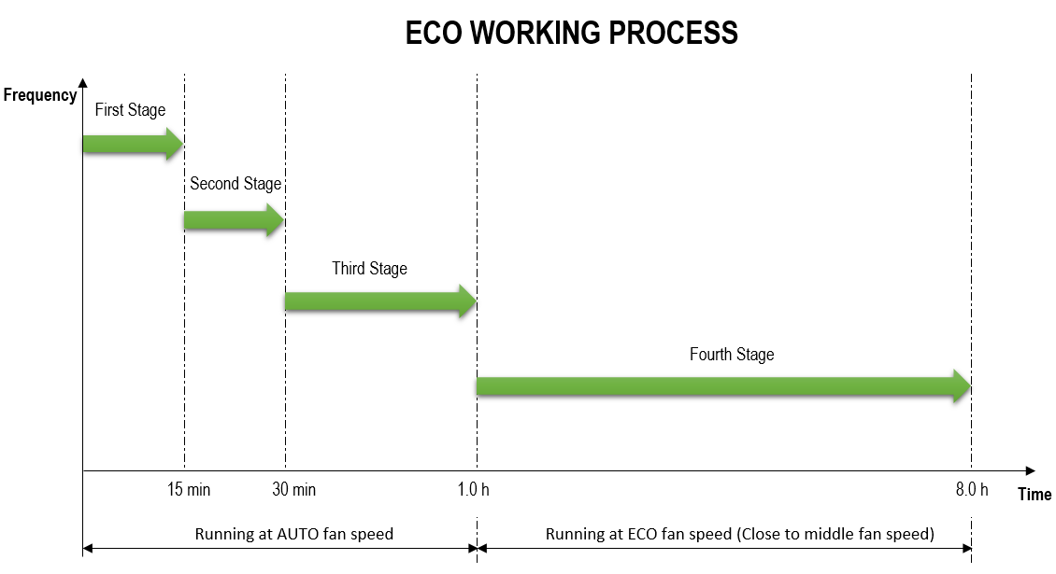
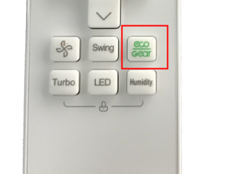
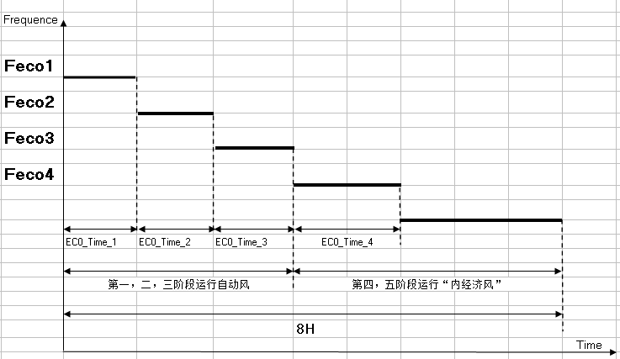
Features
Comfort Energy saving Convenience Reliability Health
X-ECO
X-ECO mode applies to inverter model, smart control on compressor frequency as low as 12HZ. As a smart running mode, it limits the highest compressor frequency and fan speed of each stage by intelligent control system.
First stage
Second stage
Third stage
Forth stage
Fifth stage
15 min
15 min
30 min
60 min
Running at Auto fan speed
Running at ECO fan speed

Slide 20
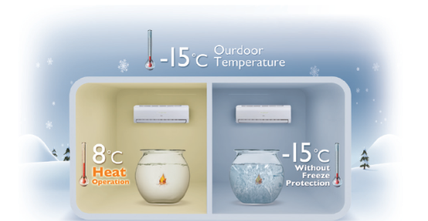
Features
Comfort Energy saving Convenience Reliability Health
8 ℃ heating
Electrical control logical
Press the Temperature Down button 2 times on remote controller to active this function.
Off condition:
Press On/off, Sleep, Mode, Fan and Temp. button while operating will cancel this function.
8 ℃ heating function can be memorized if the power fails.
Anti-cold wind function is inactive.
Advantage for end-user: In heating operation, the preset temperature of the air conditioner can be as lower as 8℃ (why 8℃ heating？energy saving concerned), which keeps the room temperature steady at 8℃ and prevents household things freezing when the house is unoccupied for a long time in winter.

Slide 21
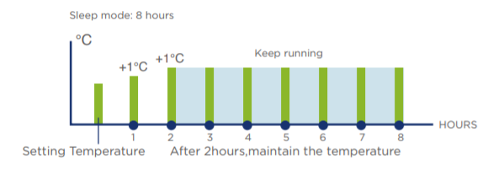
Features
Comfort Energy saving Convenience Reliability Health
Sleep Mode
In cooling mode, the setting temperature rises 1℃(no more than 30℃) everyone hour, 2 hour later the rising stops and indoor fan is fixed at low speed.
In heating mode, the setting temperature descends 1℃(no less than 16℃) every one hour, 2 hour later the descending stops and indoor fan is fixed at low speed, and anti-cold-air function is available.
The unit will quit this mode and turn off after running 8 hours in sleep mode.

Slide 22
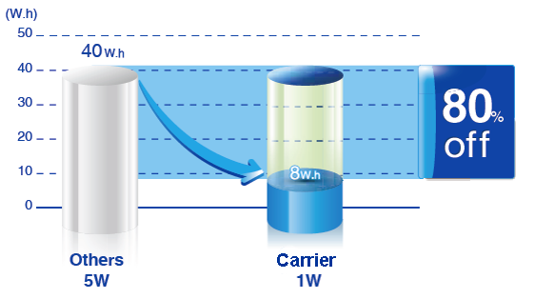
Features
Comfort Energy saving Convenience Reliability Health
1W Standby
Intelligent on-off technology enables products automatically enter energy-saving mode when on standby mode, cut energy consumption from normal 4~5W to 0.5~1W which counts 80% of saving.

Slide 23
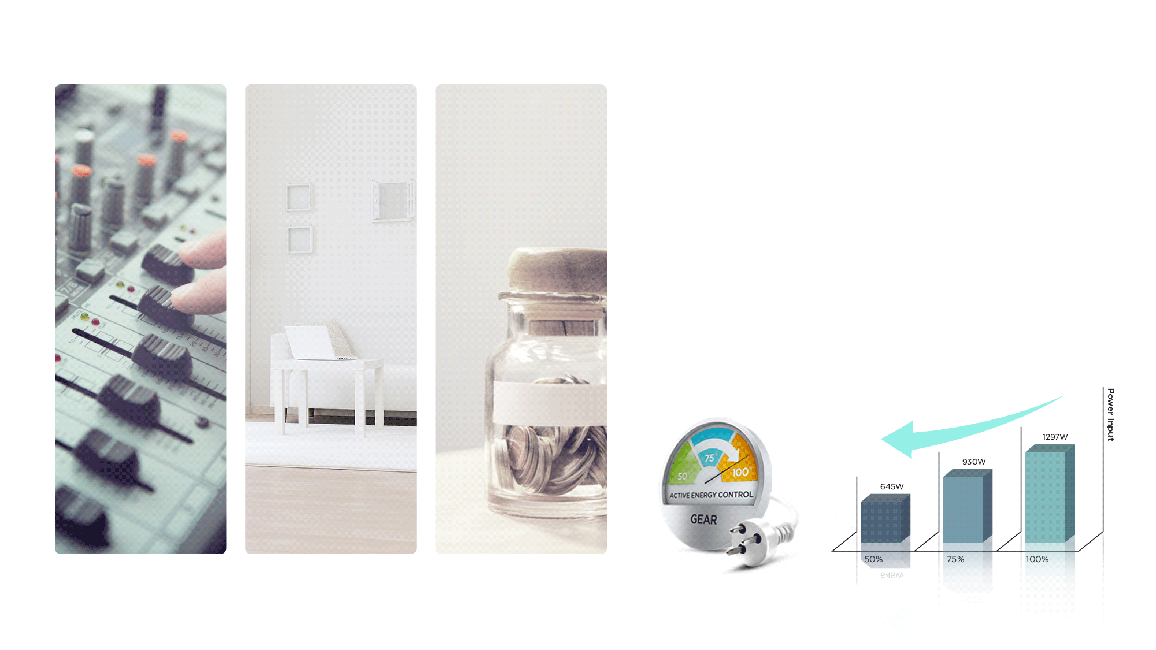
Features
Comfort Energy saving Convenience Reliability Health
Gear
Carrier inverter air conditioners offer three operating
power options: 50%, 75%, and 100%.
You can choose a lower power level to conserve energy.

Slide 24
Features
Comfort Energy saving Convenience Reliability Health
Multi Controllers
Central Control
Professional for commercial users
Wi-Fi Control
Operates your AC wherever you are
Remote Control
Remote On/Off
Easy for commercial users
Wired Control
Avoid mislaying
Note: For some units, wired controller and WI-FI control are optional, central control and remote on-off are not available.

Slide 25
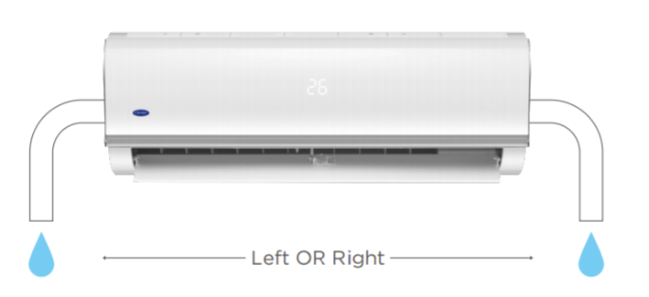
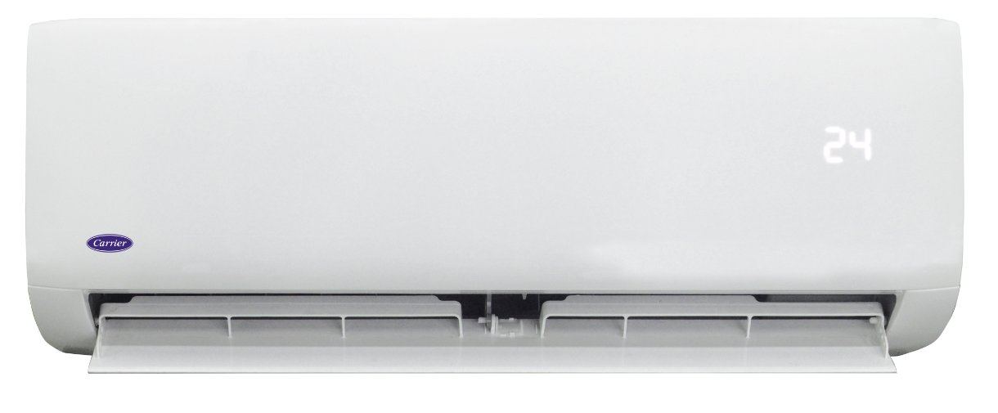
Features
Comfort Energy saving Convenience Reliability Health
2-way Draining
The refrigerant piping and drainage hose can reach either the left or right side of the indoor unit for maximum installation flexibility

Slide 26
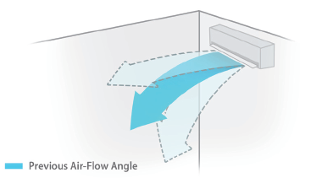
Features
Comfort Energy saving Convenience Reliability Health
Louver position memory
When you start the unit next time, the angle of horizontal louver will automatically move to the same position as you set last time.

Slide 27
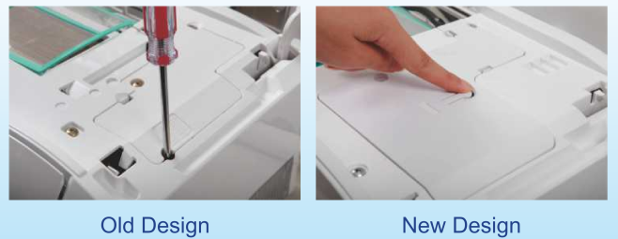
Features
Comfort Energy saving Convenience Reliability Health
Manual ON/OFF Button
In case the remote controller is lost, the manual mutton can be used to turn ON/OFF the unit temporary, and the structure design is more easy to access.

Slide 28
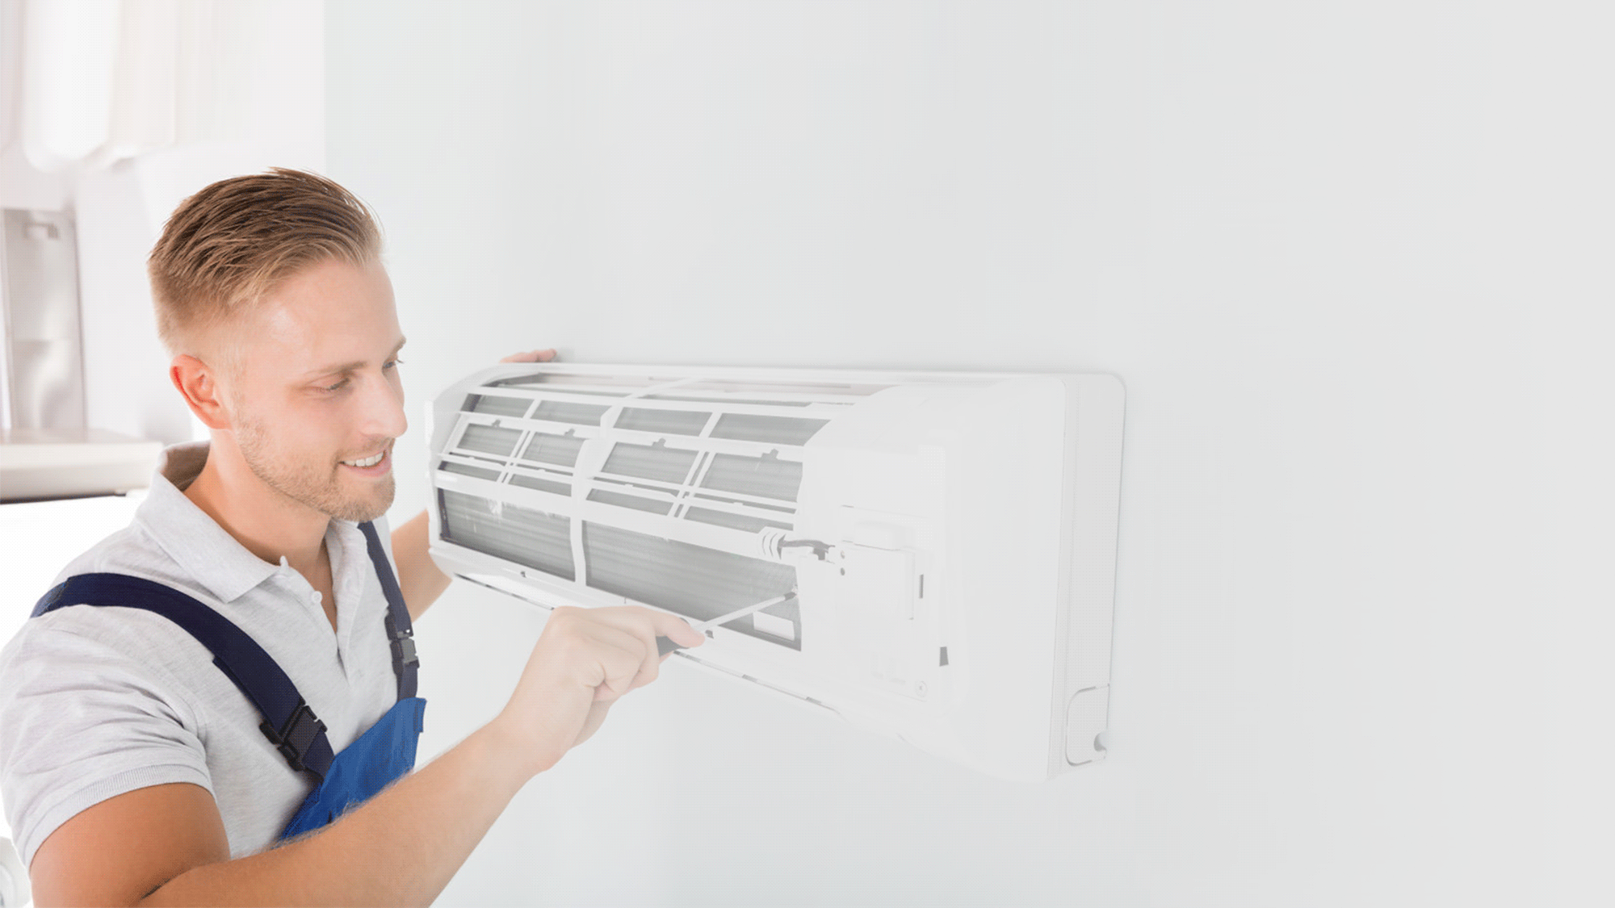
Features
Comfort Energy saving Convenience Reliability Health
Open Terminal Block
Easy installation
Bigger wiring terminal &
Easier wiring connection
Time Saving
Open Space
Broad Wiring Terminal
Narrow Space
Compact Wiring Terminal

Slide 29
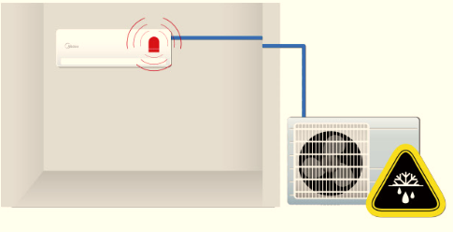
Features
Comfort Energy saving Convenience Reliability Health
Refrigerant Leakage Detect
Indoor unit shows error code “EL0C” and stops automatically when refrigerant leakage is detected. This protects the compressor from high temperature damage due to refrigerant leakage.
This function updated base on old units, the refrigerant leakage will protect according
to T2, current , frequency, exhaust gas temperature and T1 together or more relative parameters.

Slide 30
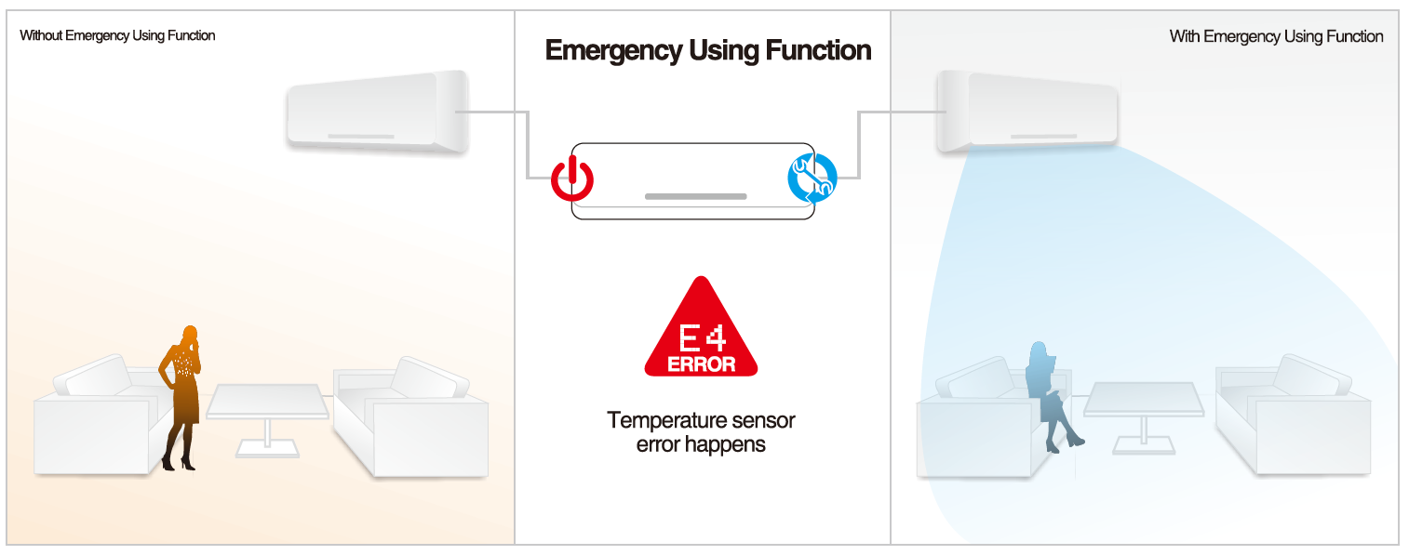
Features
Comfort Energy saving Convenience Reliability Health
Emergency Using
Normally, when temperature error happens, the air-conditioner will display error code and stop immediately. With this function, when temperature error happens, the air-conditioner will display error code and continue running in a proper status instead of stopping immediately, which keeps the unit in emergency working.
Note: when two or more sensors are abnormal, the unit will stop.

Slide 31
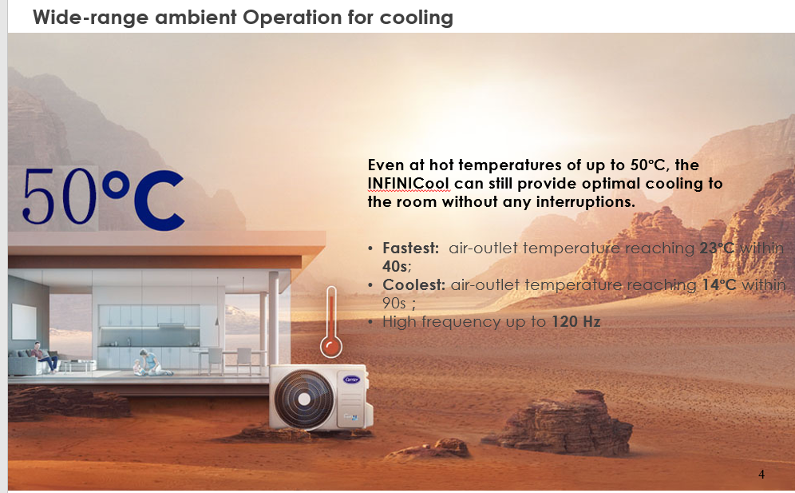
Features
Comfort Energy saving Convenience Reliability Health
Low Ambient Cooling & Heating

Slide 32
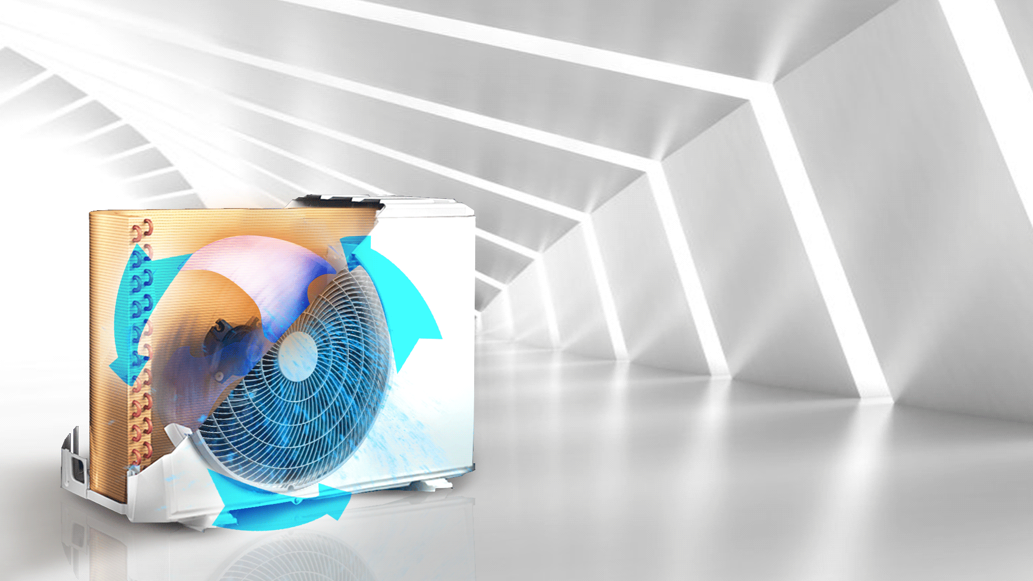
Features
Comfort Energy saving Convenience Reliability Health
Low Intelligent dusting switch
Rotation:
Intelligent dusting switch
Apart from the bionic fan blades, the DC motor itself can constantly rotate in reverse to get rid of the sand and dust from outside, ensuring that the compressor is clean and function swell.

Slide 33
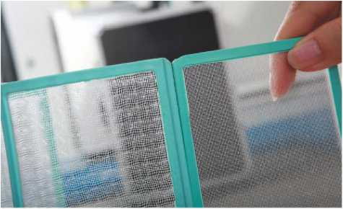
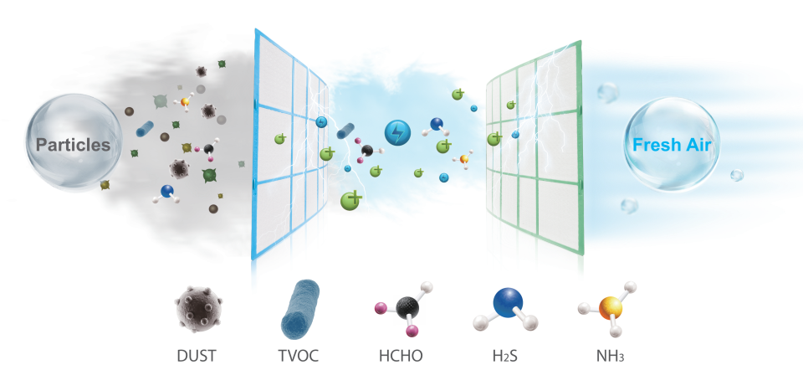
Features
Comfort Energy saving Convenience Reliability Health
HD Dust Filter
1 First Guard
The Dust Filter filters out dust and harmful particles from the indoor air.
Filter Type | “Ordinary “ | “HD”
Quantity of Holes per cm² | 156 | 255
Hole Size (mm) | 1.2*1.2 | 0.54*0.54
2 Second Guard(optional)
The fresh filter options provide different functions to fresh the air.
“Ordinary Filter” VS “HD Filter”

Slide 34
Features
Comfort Energy saving Convenience Reliability Health
Cold-catalyst Filter
Eliminate formaldehyde and other volatile
organic compounds (VOCs) as well as harmful
gases and odors.

Slide 35
Features
Comfort Energy saving Convenience Reliability Health
Active clean
Active Clean Technology washes away dust, mold, and grease that may cause odors when it adheres to the heat exchanger by automatically freezing and then rapidly thawing the frost.
A “pi-pi” sound will be heard. The Active clean operation is used to product more condensed water to improve the cleaning effect, and the cold air will blow out.
The internal wind wheel then keeps operating to blow-dry the evaporator, thus preventing the growth of mold and keeping the inside clean.
When this function is turned on, the indoor unit display window appears “CL”, after 20 to 45 minutes, the unit will turn off automatically and cancel Active Clean function.

Slide 36
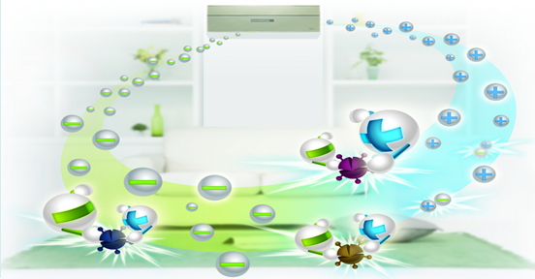
Features
Comfort Energy saving Convenience Reliability Health
Ionizer(Optional)
Ionizer Generator can generate positive and negative ions. When positive ions meet negative ones, they will release enormous energy instantly and result in bacilli death. The redundant negative ions not only eliminates odor, dust, smoke and pollen particles in the air, but also brings more fresh.

Slide 37
Features
Cool Easy VS 18C
Features | AE II | 18C | Features | AE II | 18C
High density filter | ● | ● | ECO | ● | ●
Cold-catalyst filter | ● | ● | Gear operation | ● | ●
Compound filter (vitamin C+Cold-catalyst+Anti-mite) | ◎ | ◎ | Sleep | ● | ●
Compound filter (Cold-catalyst+Active Carbon+silver ion) | ◎ | ◎ | 1W standby | ● | ●
UV lamp | X | ◎ | Timer | ● | ●
Self clean | X | X | GA Inverter | ● | ●
Active Clean | ● | ● | 8°C heating (Freeze Protection) | ● | ●
Optimation outdoor fan blades | ● | ● | Intelligent dusting switch | ● | ●
9 Grades of outdoor fan speed | ● | ● | Refrigerant Leakage Detect | ● | ●
1%-100% stepless Comfort | ● | ● | Louver Position Memory Function | ● | ●
Wide range voltage operation | ● | ● | Emergency Using(when temp sensor is abnormal) | ● | ●
Fast cooling/heating | ● | ● | Low Ambient Cooling | ● | ●
Crankcase Heater | ◎ | ◎ | Low Ambient Heating | ● | ●
Base Pan Heater | ◎ | ◎ | Golden Fin | ● | ●
Silence | ● | ● | Mono & Multi compatible | ● | ●
Turbo | ● | ● | I Remote (Engineering Mode) | ● | ●
Follow Me | ● | ● | On-off Control | ◎ | ◎
3D Airflow | ● | ◎ | Error Alarm port | ◎ | ◎
360℃ air supply | X | X | Centrol control | ◎ | ◎
Do not disturb | ● | ● | Wired control | ◎ | ◎
Auto-Restart | ● | ● | Wifi control | ◎ | ◎
Wind avoid me(Breeze Away) | ● | ● | AE pro installation plate | ● | X
intelligent eye | ● | X
● standard ◎ Optional X without

Slide 38
Special features for Cool Easy

Slide 39
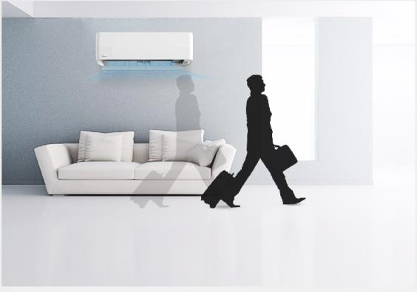
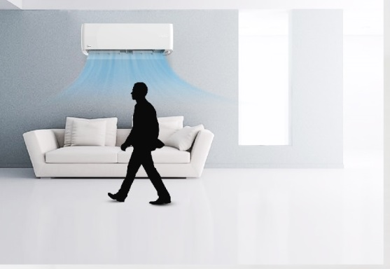
Intelligent Eye
When you are away for 30 minutes, automatically lowers the frequency to save energy
The unit will automatically start and resume operation if sensing human activity again.
● standard ◎ Optional X without

Slide 40
All Easy

Slide 41
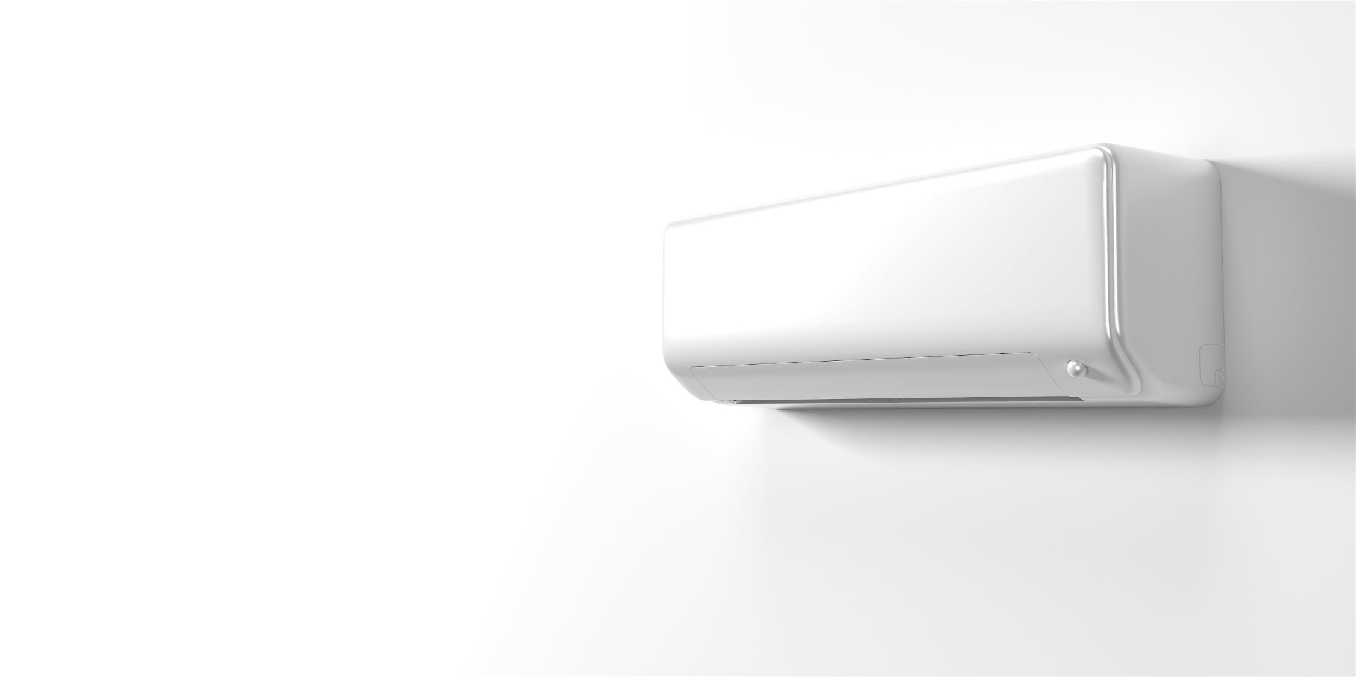
All Easy
A Short Guide:
Fast Disassembly
Of
THE CORE

Slide 42
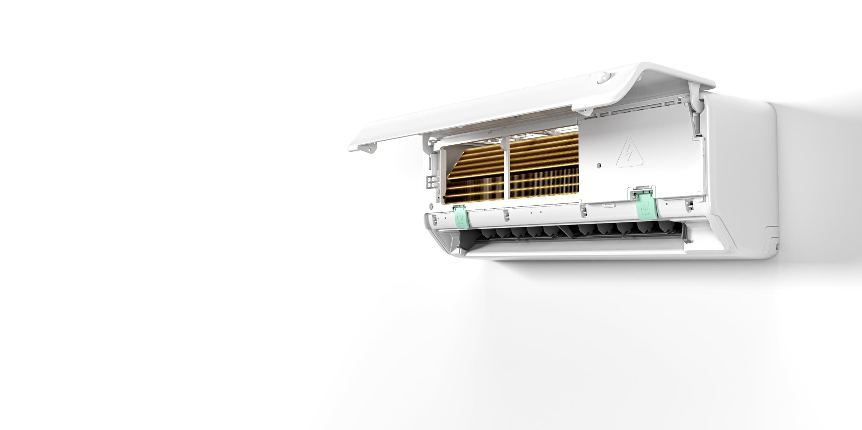
All Easy
A Short Guide:
Fast Disassembly
Of
THE CORE

Slide 43
All Easy
Fast Disassembly
Of THE CORE
STEP 1
Snap Open the Front Hasps.
Detach the Bottom Panel.
Remove the Screw

Slide 44
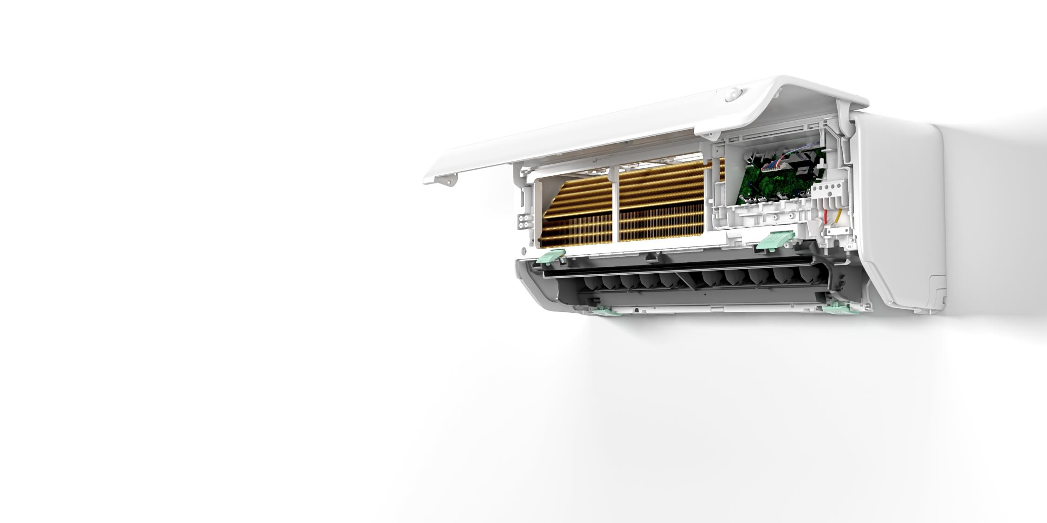
All Easy
Fast Disassembly
Of THE CORE
STEP 2
Open the Electricity Box Lid
And
Unplug the Fan and
Vertical Louvre Motor Terminals

Slide 45
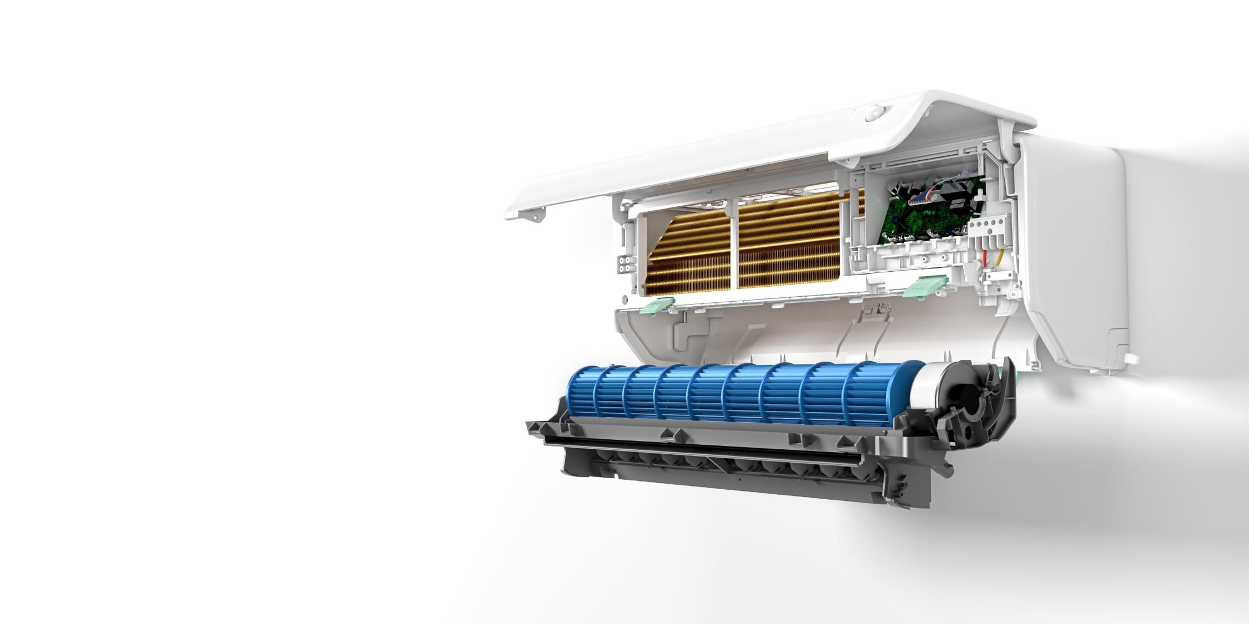
All Easy
Fast Disassembly
Of THE CORE
STEP 3
Snap Open the Back Hasps
Unload the Fan and Indoor
Motor Assembly
Replace as You Want.

Slide 46
TKS!

