Slide 1
Carrier Infinity series
Powerful Heating Even in -25℃ Extreme Weather

Slide 2
Gerenal Information
Primary Specification

Slide 3
Ultra-high Energy Efficiency
Φ7 and Φ5 hybrid pipe design heat exchanger offers better performance rate, which is 10% more than the conventional heat exchanger
The leading energy efficiency compressor as core element of the technology.
Optimized air outlet design assists the energy efficiency.

Slide 4
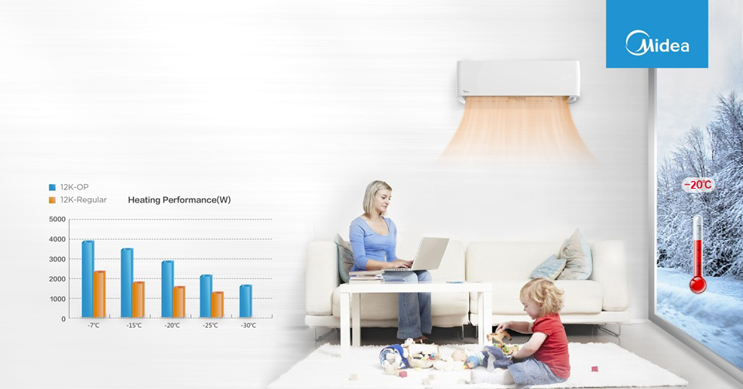
Low Ambient Heating
The advanced inverter technology to withstand the most extreme weather conditions. You can enjoy comfortable and heating air even when the outdoor temperature is as low as -25℃.

Slide 5
Low Ambient Cooling
With low ambient cooling function, the outdoor fan speed can be changed according to the condenser temperature and AC can run smoothly under the temperature as low as -25 ℃

Slide 6
Comfort Airflow
Offers the most comfort airflow with warm air down to your toes, feeling spring in every corner of your room. Cool air up to the ceiling, enjoy a more homogeneous coolness around.

Slide 7
Strong Long Windblast
110
70-80
25%
108mm
94mm
Conventional AC
OP Series
OP Series
Conventional AC
Strong Airflow
Long Windblast
Air outlet design is 110mm wide, 25% bigger than conventional AC.
Take 12000 BTU/h OP series as an example, indoor fan is φ 108mm wide, much bigger than conventional AC as φ82~94mm.

Slide 8
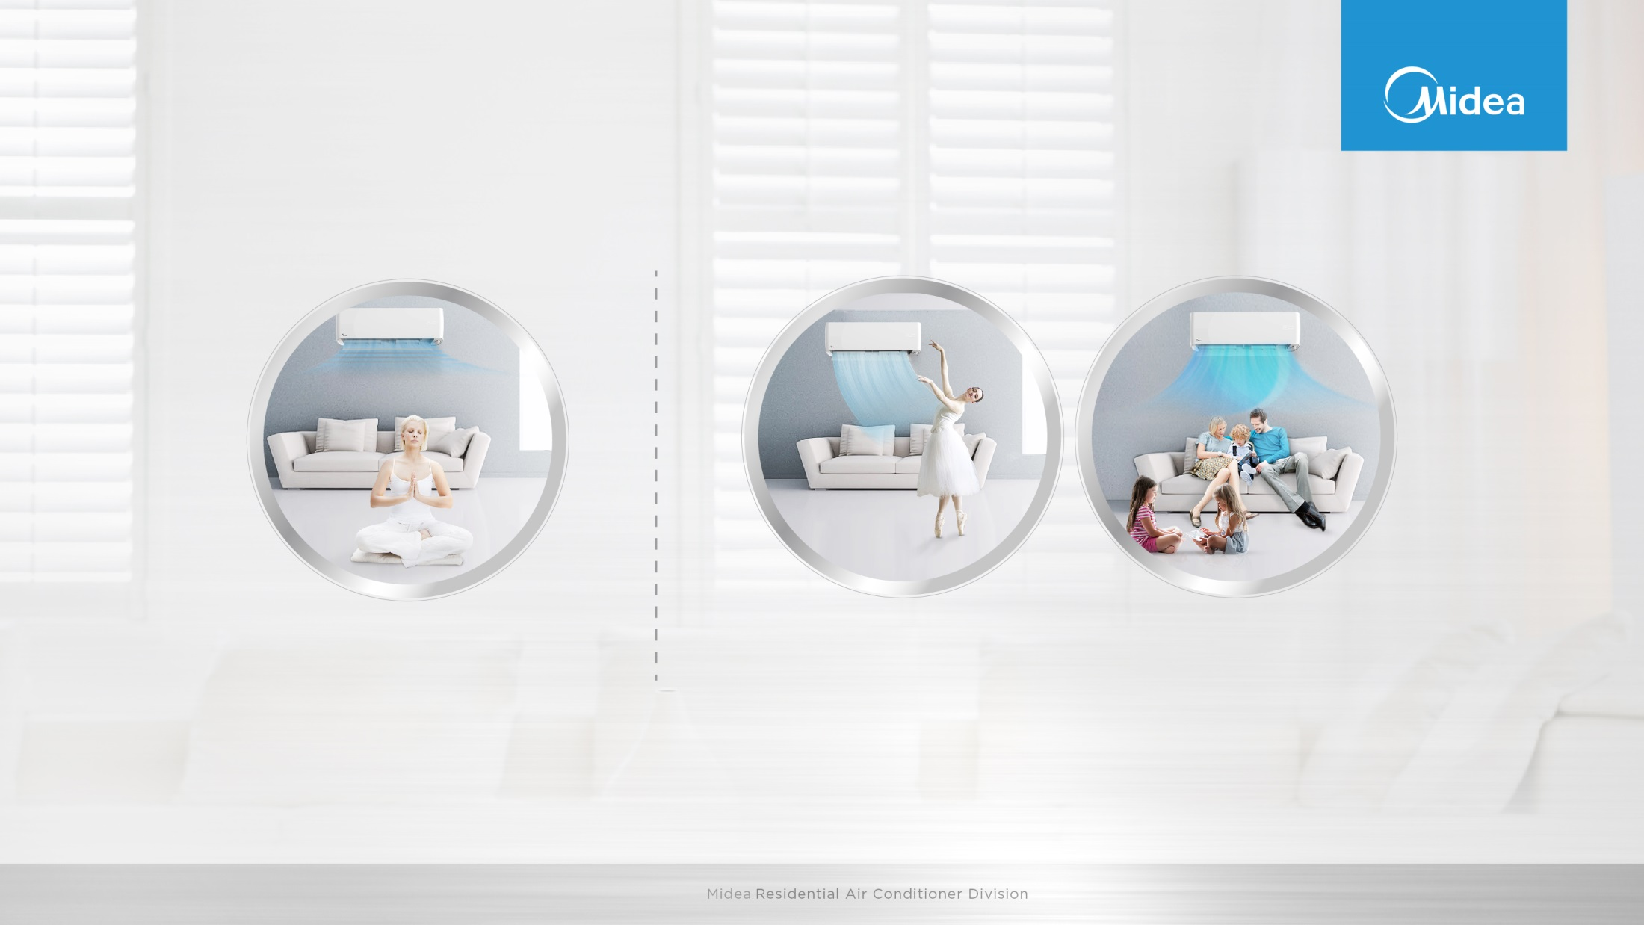
Intelligent Eye
Wind flow away from people
Wind flow follow people
The intelligent eye includes two functions. These two function is selected through the IR remote button.
1. wind flow away from people
2. wind flow follows the people.

Slide 9
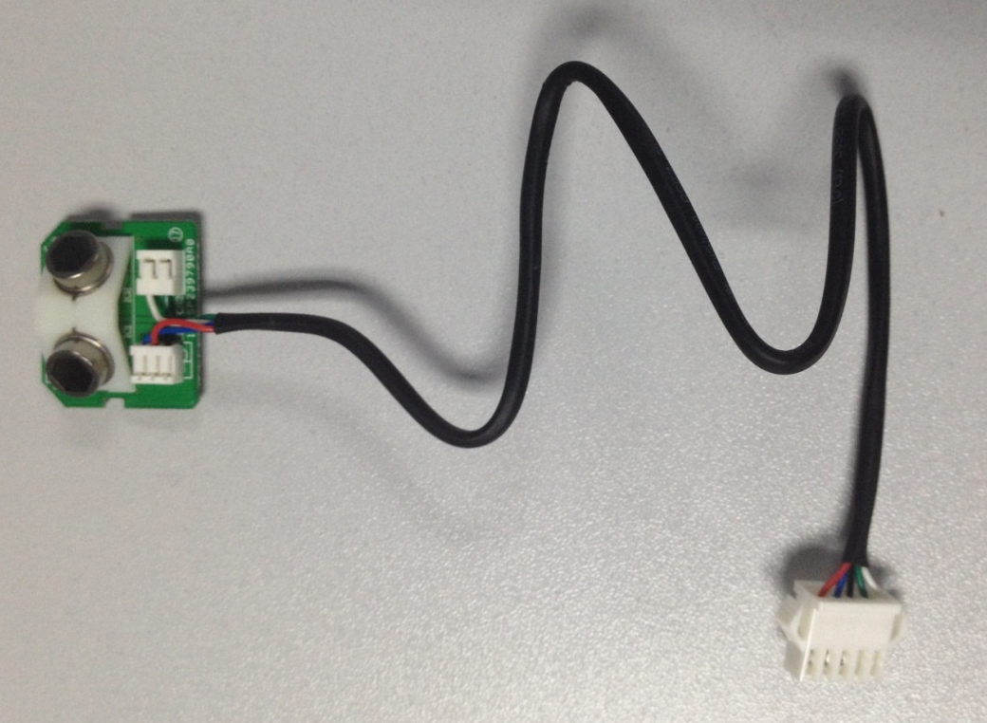
Intelligent Eye

Slide 10
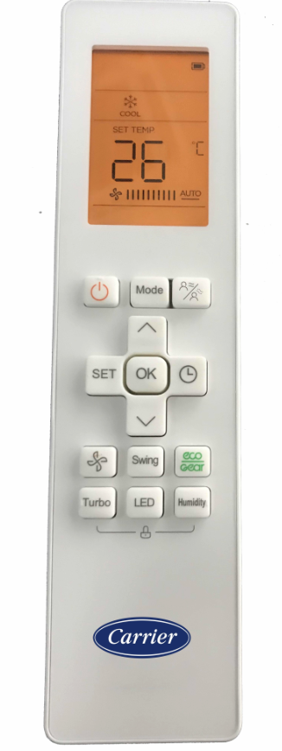
Intelligent Eye
Press the Intelligent Eye button to activate 'wind flow follow people' feature, the fan speed is Auto, and the auto swing feature is activated.
Press it again to stop and activate the 'wind flow away people' feature. The fan speed is Auto, and the auto swing feature is turned off.
Press it the third time to stop the 'wind flow away people feature'.

Slide 11
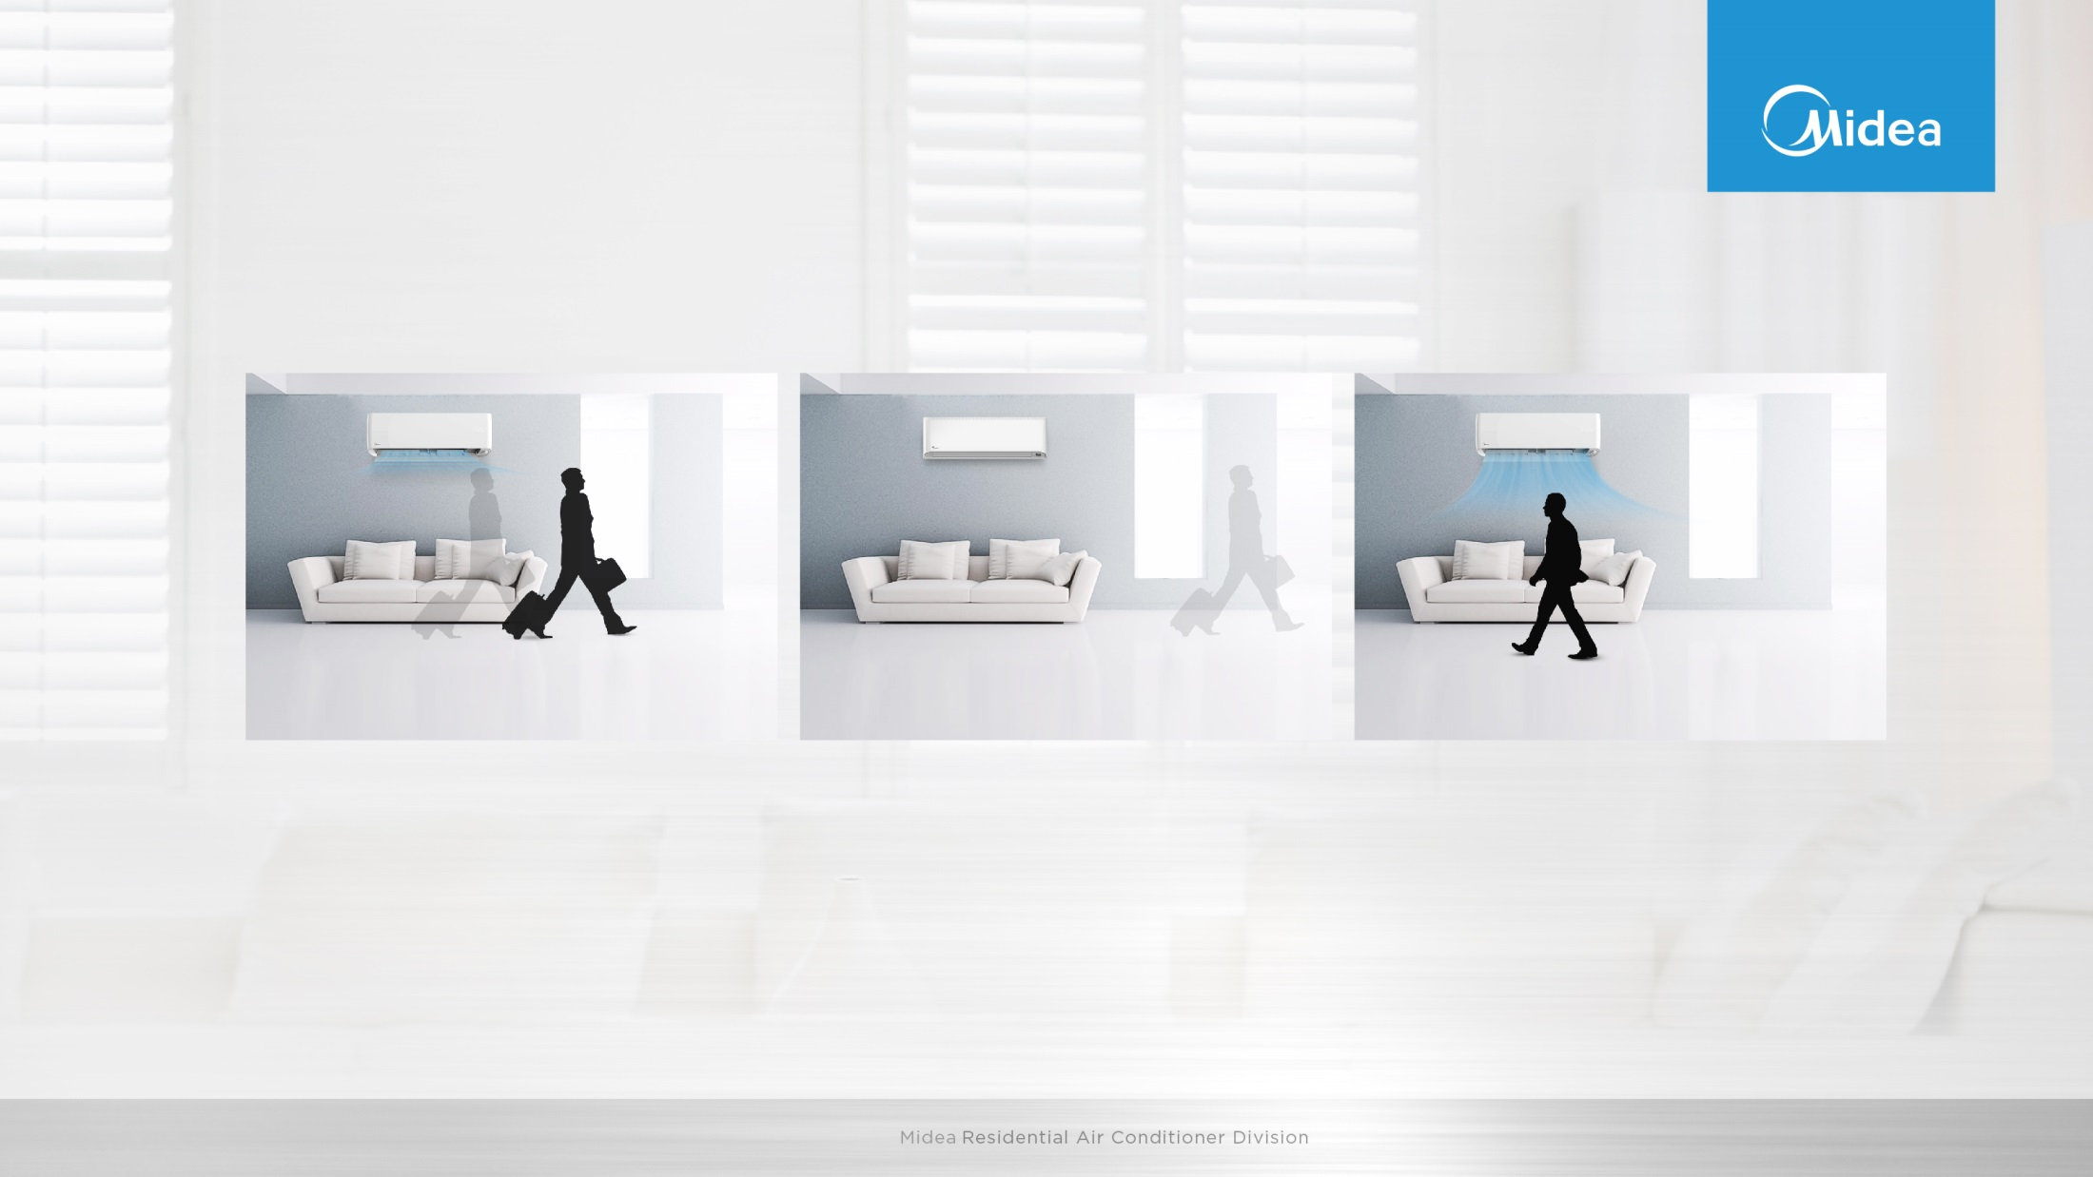
Intelligent Eye
Besides, with intelligent eye, the unit can achieve energy saving mode when people are away.
When you are away for 30 minutes, automatically lowers the frequency to save energy (for inverter modes only)
When you are away for 2 hours, automatically shuts down
When you returns to the room, automatically turns on

Slide 12
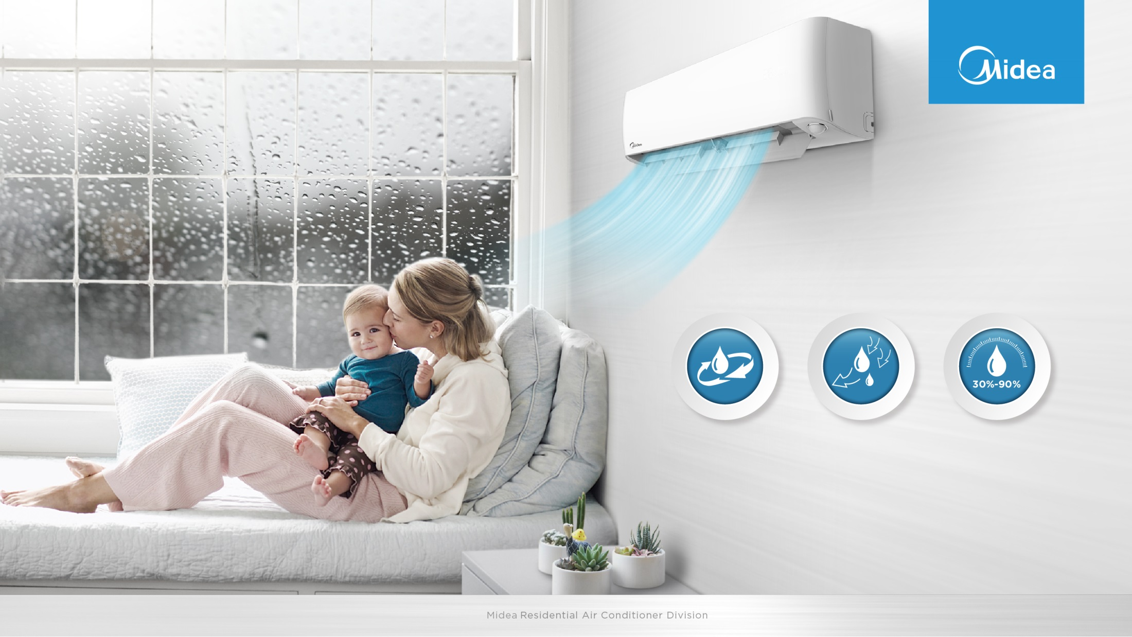
Comfort Humidity
With smart sensor technology, not only detect the temperature but also detect humidity level of the room. Through smart APP, you can customize your most comfortable humidity level, applicable from 30%-90%.
Power Mode
2805ml/h
Normal Mode
1757ml/h
DIY Mode

Slide 13
Comfort – Auto Photosensitive Display
新增光敏传感器控制宣传页，当机器检测房间内灯灭，则自动关闭屏显，同MT
The unit has a build-in light sensor to detect the ambient brightness. When the light is turned off, the display
will dim down gradually, saving energy and offering you a comfortable sleep.

Slide 14
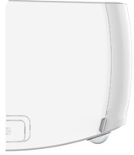
Carrier Exclusive Panel

