Slide 1
Optional Control for
QHC & QHB Hi-wall Inverter
FMCC Engineering
2022

Slide 2
Optional Control for Hi-wall
1. WLAN / Wired control / Central control / Dry contact can be selected only one on the same unit.
2. Remote controller can be used together with other controls.
Central Control/BMS Control
Professional for commercial users
WLAN Control
Operates your AC wherever you are
Remote Control
Remote On/Off
Easy for commercial users
Wired Control
Avoid mislaying

Slide 3
Hi-wall Control Combination QHC/QHB
No. | Option 1 | Option 2 | Option 3 | Option 4 | Option 5 | Option 6
Functions | Standard (Remote control) | Wifi function | Wired control 1 | Wired control 2 | Central control | Dry contactor control
Parts | Display PCB 1 for 9/12/18 K 17222000009789 Coolmark ; 7409232 for 24 K 17222000010648 Coolmark ; 7409286 | Display PCB 2 assembly for 9/12/18 K 17222000A48490 Coolmark ; 7409389 for 24 K 17222000A48491 Coolmark ; 7409392 | Display PCB 3 17222000A07665 Coolmark ; 7403014 | Display PCB 4 assembly 17222000A49832 Coolmark ; 7403015 | Display PCB 5 assembly 17222000A49836 Coolmark ; 7403028 | Display PCB 6 assembly 17222000A49855 Coolmark ; 7403031
 |  | Wifi USB adapter (Multi-function box) (already included in the display PCB assembly) |  | Transfer Adapter 1 (Multi-function box) (already included in the display PCB assembly)
 |  | / |  | Direct connector and Cable (already included in the display PCB assembly) | Terminal block box and Cable (already included in the display PCB assembly) | Terminal block box and Cable (already included in the display PCB assembly)
 | Remote controller: | Wifi USB 17310900A00521 Coolmark ; 7403013 | Wired controller 1 KJR-12B: 17317100000004 | Wired controller 2 KJR-120G1: 17317100A19005 Coolmark ; 7403016 | Central controller: CCM30: 17311500A03641 Coolmark ; 7403018 CCM09: 17311500A03642 Coolmark ; 7403017 | /
Note: Wifi / Wired control / Central control / Dry contact can be selected only one on the same unit.

Slide 4
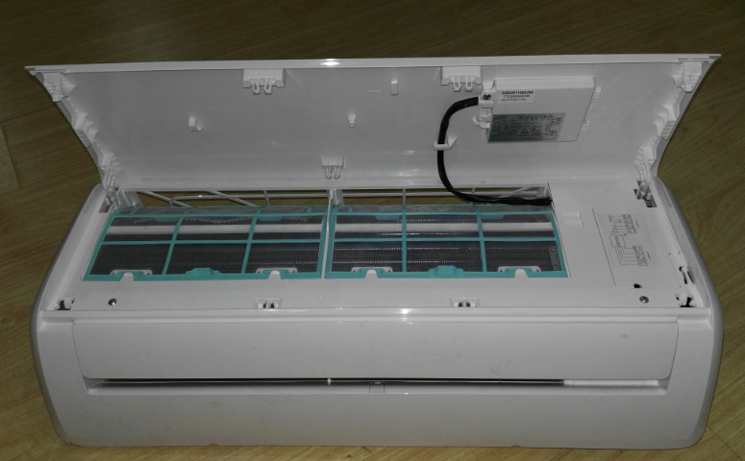
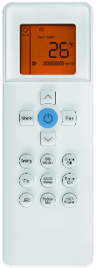
Option 1 – Standard (Remote control QHC/QHB)
No wifi, No wired control function
Display PCB 1
Remote controller

Slide 5
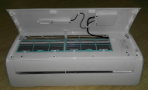
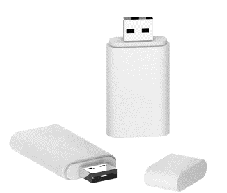
Option 2 - Wifi Control QHC/QHB
Working with smart phone APP
USB
PN: 17310900A00521
USB adapter
Display PCB 2
 | Display PCB 1 (Standard) | Display PCB 2 (wifi function) | USB adapter | USB | Note
Option 1 | √ |  |  |  | Remote control
Option 2.1 |  | √ | √ |  | Need to buy USB separately
Option 2.2 |  | √ | √ | √ | Wifi available

Slide 6
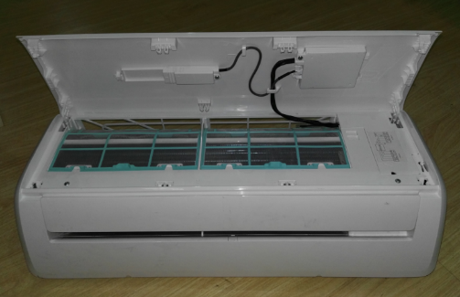
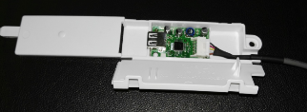
Wifi Control QHC/QHB
Option 2.1
Display PCB B
(with Wi-Fi function)
Note:
1. Display PCB B and USB adapter was assembly in the unit by factory.
2. If the user want to control the unit by Wi-Fi, they have to buy the Wi-Fi kit from Carrier.
USB adapter

Slide 7
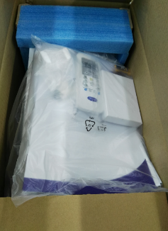
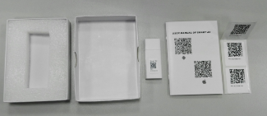
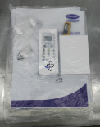
Wifi Control QHC/QHB
Option 2.2
Note:
Display PCB B and USB adapter are assemblied in the unit by factory.
The Wi-Fi kit will be put in the IDU package.
Wi-Fi kit (In the accessary bag, and put in the package)

Slide 8
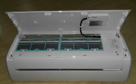
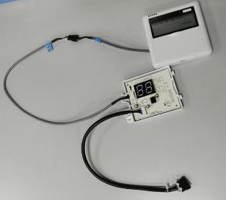
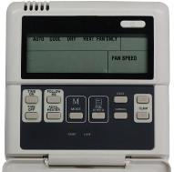
Option 3 - Wired Controller 1 QHC/QHB
KJR-12B without weekly timer.
KJR-120B
(PN: 17317100000004)
Display PCB 3
Wired controller
 | Display PCB 1 (standard) | Display PCB 3 (wired control function) | Wired controller | Note
Option 1 | √ |  |  | Remote control
Option 3.1 |  | √ |  | Need to buy wired controller separately
Option 3.2 |  | √ | √ | Wired controller available

Slide 9
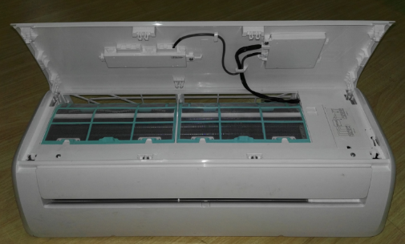
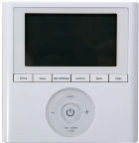
Option 4 - Wired Controller 2 QHC/QHB
KJR-120G1 with weekly timer and Error code display.
KJR-120G1/TFBG-E
(PN: 17317100A06345)
Transfer adapter
(To wired controller)
Display PCB 4
 | Display PCB 1 (standard) | Display PCB 4 (wired control function) | Transfer adapter | Wired controller | Note
Option 1 | √ |  |  |  | Remote control,
Option 4.1 |  | √ | √ |  | Need to buy wired controller separately
Option 4.2 |  | √ | √ | √ | Wired controller available

Slide 10
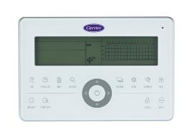
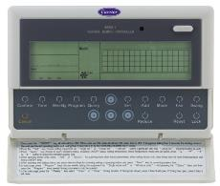
Option 5 – Central Control QHC/QHB
CCM30 (No Weekly Timer) CCM09 (Weekly Timer)
CCM30: 17311500A00238
CCM09: 17311500A00145
Transfer adapter
(To Central controller)
Display PCB 5
 | Display PCB 1 (standard) | Display PCB 5 (central control function) | Transfer adapter | Central Controller | Note
Option 1 | √ |  |  |  | Remote control
Option 5.1 |  | √ | √ |  | Need to buy central controller separately
Option 5.2 |  | √ | √ | √ | Central controller available

Slide 11
Option 6 – Dry Contactor Control (On/Off) QHC/QHB
Transfer adapter
(To On/Off switch)
Display PCB 6
 | Display PCB 1 (standard) | Display PCB 6 (Dry contact function) | Transfer adapter | Note
Option 1 | √ |  |  | Remote control
Option 6 |  | √ | √ | On/Off switch is provided in field.

Slide 12
Thank you!

