Slide 1
Optional Control for
QHP Hi-wall Inverter
FMCC Engineering
2022

Slide 2
Optional Control for Hi-wall
1. WLAN / Wired control / Central control / Dry contact can be selected only one on the same unit.
2. Remote controller can be used together with other controls.
Central Control/BMS Control
Professional for commercial users
WLAN Control
Operates your AC wherever you are
Remote Control
Remote On/Off
Easy for commercial users
Wired Control
Avoid mislaying

Slide 3
Hi-wall Control Combination QHP
Option 4-5-6 are combined in 1 Multifunction board 2209983200000A (7403034)
Note: WLAN / Wired control / Central control / Dry contact can be selected only one on the same unit.

Slide 4
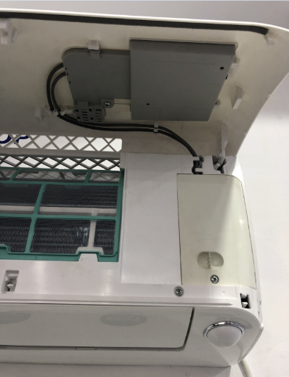
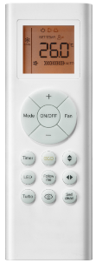
Option 1&2– Standard/WLAN Control QHP
Standard & WLAN function, No wired control function
Display PCB 1
Remote controller

Slide 5
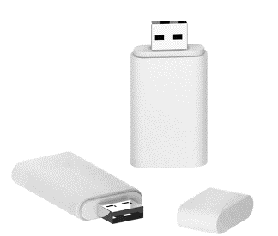
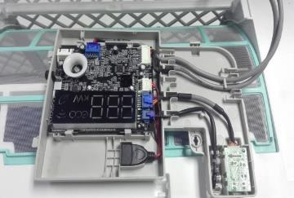
Option 2 - WLAN Control QHP
Working with smart phone APP
USB
PN: 17310900A00681
Display PCB 1
 | Display PCB 1 (Standard/WLAN function) | USB | Note
Option 1: Standard | √ |  | Remote control
Option 2.1: WLAN function without USB kit. | √ |  | If the user want to control the unit by WLAN, they have to buy the WLAN kit from Carrier
Option 2.2: WLAN Ready | √ | √ | WLAN available

Slide 6
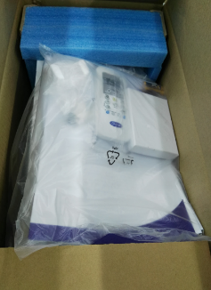
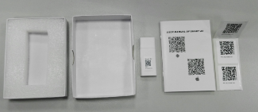
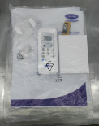
Option 2 - WLAN Control QHP
Option 2.2: WLAN Ready
Note:
Display PCB 1 is assembled in the unit by factory.
The WLAN kit will be put in the IDU package.
Display PCB 1
WLAN kit (In the accessary bag, and put in the package)

Slide 7
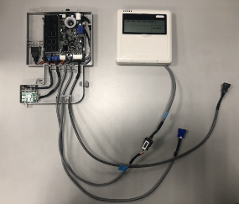
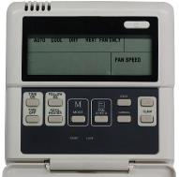
Option 3 - Wired Controller 1 QHP
KJR-12B without weekly timer.
KJR-120B
(PN: 17317100000004)
Display PCB 2
 | Display PCB 1 (standard) | Display PCB 2 (wired control function) | Wired controller | Note
Option 1 | √ |  |  | Remote control
Option 3.1 |  | √ |  | Need to buy wired controller separately
Option 3.2 |  | √ | √ | Wired controller available

Slide 8
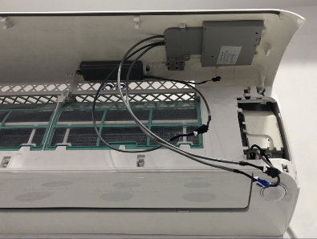
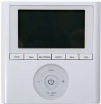
Option 4 - Wired Controller 2 QHP
KJR-120G1 with weekly timer and Error code display.
KJR-120G1/TFBG-E
(PN: 17317100A26536)
Transfer adapter
(To wired controller)
Display PCB 3
 | Display PCB 1 (standard) | Display PCB 3 (wired control function) | Transfer adapter | Wired controller | Note
Option 1 | √ |  |  |  | Remote control
Option 4.1 |  | √ | √ |  | Need to buy wired controller separately
Option 4.2 |  | √ | √ | √ | Wired controller available

Slide 9
Option 4 - Wired Controller 2 QHP
KJR-120G1 with weekly timer and Error code display.

Slide 10
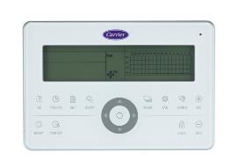
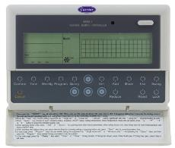
Option 5 – Central Control QHP
CCM30 (No Weekly Timer) CCM09 (Weekly Timer)
CCM30:
17311500A00252
Transfer adapter
(To Central controller)
CCM09: 17311500A00145
Display PCB 3
 | Display PCB 1 (standard) | Display PCB 3 (central control function) | Transfer adapter | Central Controller | Note
Option 1 | √ |  |  |  | Remote control
Option 5.1 |  | √ | √ |  | Need to buy central controller separately
Option 5.2 |  | √ | √ | √ | Central controller available

Slide 11
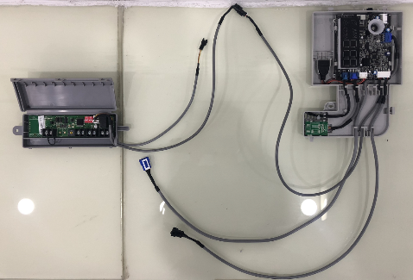
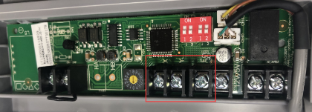
Option 5 – Central Control QHP
Display board
Adaptor board
Terminals board
For central control, connect to XYE (Red Mark terminals).

Slide 12
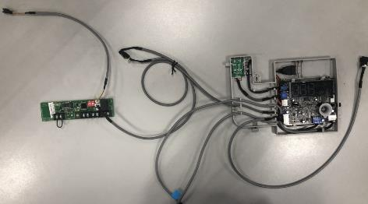
Option 6 – Dry Contactor Control (On/Off) QHP
PCB
connection wire (2-core)
Transfer adapter
(To On/Off switch)
Transfer Adapter connection wire (3-core)
PCB connection wire (4-core)
Display PCB 3
 | Display PCB 1 (standard) | Display PCB 3 (Dry contact function) | Transfer adapter | Note
Option 1 | √ |  |  | Remote control
Option 6 |  | √ | √ | On/Off switch is provided in field.

Slide 13
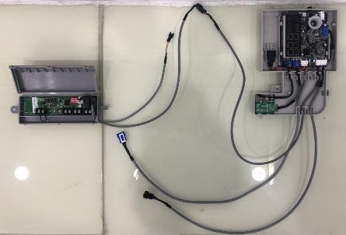
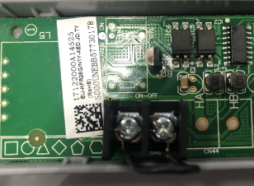
Option 6 – Dry Contactor Control (On/Off) QHP
Display board
Adaptor board
Terminals board
Short connecting wire (Standard)
If the short wire is missing, there will be “CP” error code.
Remote ON/OFF switch
There are reserved ports for connecting a remote switch to control the unit to run or stop.
NOTE: If there is no remote switch connected, these 2 ports should be short connected.

Slide 14
Part 2
Optional Control for new QHP Hi-wall

Slide 15
Hi-wall Control Combination new QHP-01
Display PCB, transfer adapter and 12 V cable will come as 1 multi function kit PCB (22099832000008)
7403035
Note: WLAN / Wired control / Central control / Dry contact can be selected only one on the same unit.

Slide 16
Thank you!

