Slide 1
Introduction for Multi Units

Slide 2
>>
Basic Information
01
^{Contents}
>>
Technical features
02

Slide 3
Part I Basic Information

Slide 4
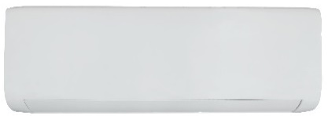
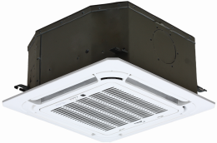
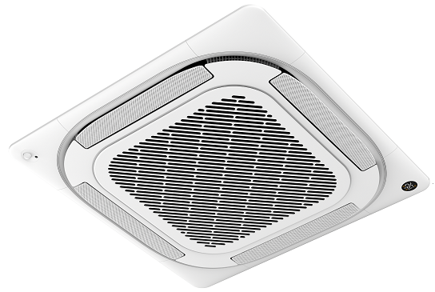
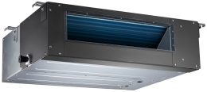
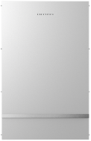
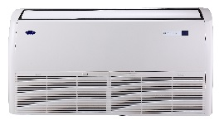
Basic Information Features
Product line Basic Information
Indoor units
Series
Panel
7K
9K
12K
18K
24K
Split
Compact Cassette
Super-slim Cassette
Duct
Under Ceiling
Note: 7K-24K hi-wall units and 12-24K light commercial units are universal for multi and mono connection,36K ODU specially could connect 27K Hydraulic Box, could provide life heat water.

Slide 5
Basic Information Features
Product line Basic Information
Remote controller
18K
IDU | Remote
QHG Model | RG67G(16~30℃）
QHE Model | RG10L(16~30℃）with intelligent eye
Compact cassette(7K/9K) Duct(7K/9K) | RG67N (17~30℃）
Compact cassette(12K/18K) Duct(12K/18K/24K) Under Ceiling (18K/24K) | RG67G(16~30℃）
Slim Cassette(24K) | RG67G1(16~30℃） with independent vane

Slide 6
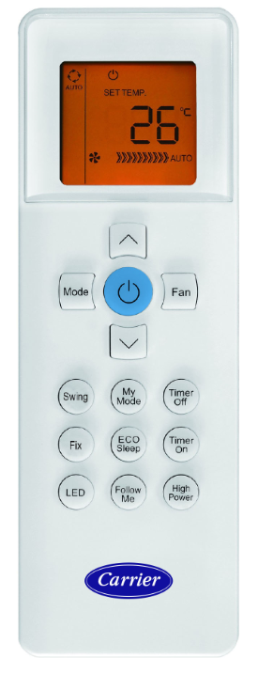
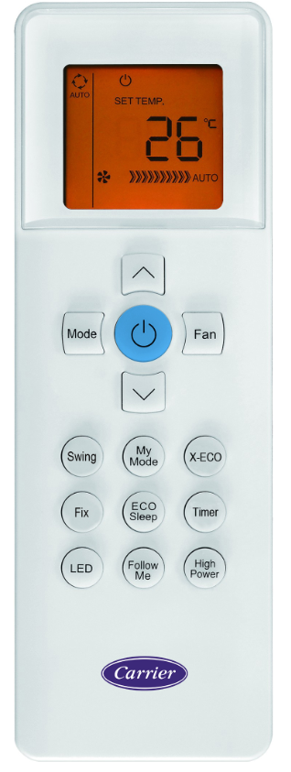
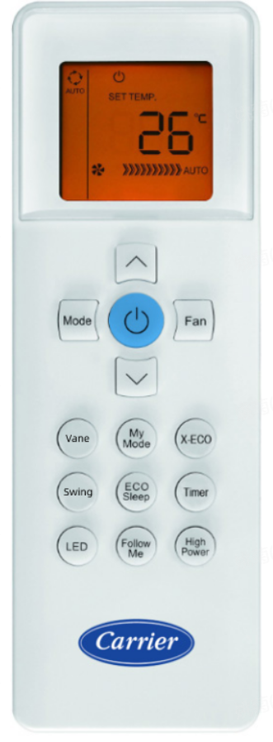
Basic Information Features
Product line Basic Information
Remote controller
RG67G
(16~30℃）
RG67G1
(16~30℃）
with independent vane
RG10L
(16~30℃）with intelligent eye
RG67N
(17~30℃）

Slide 7
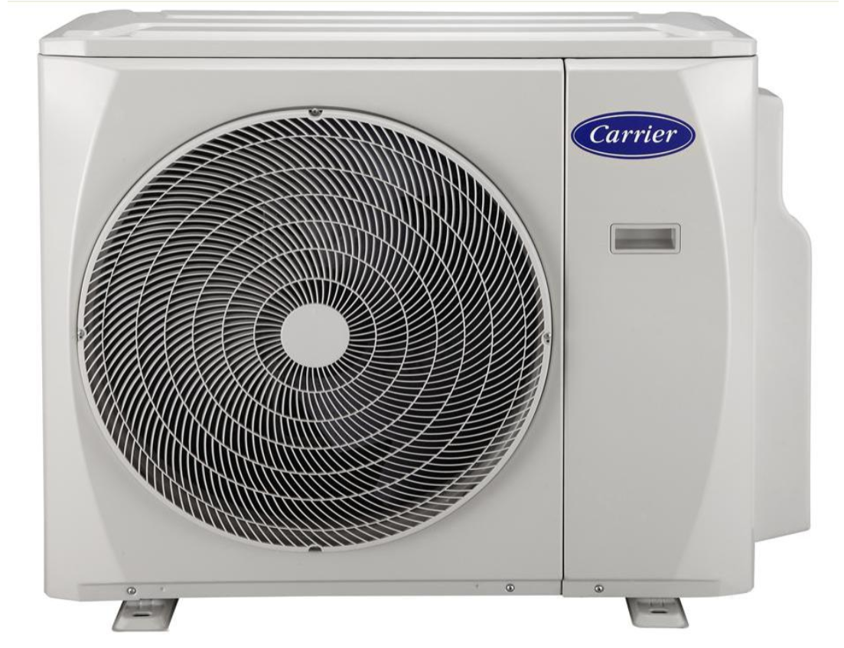
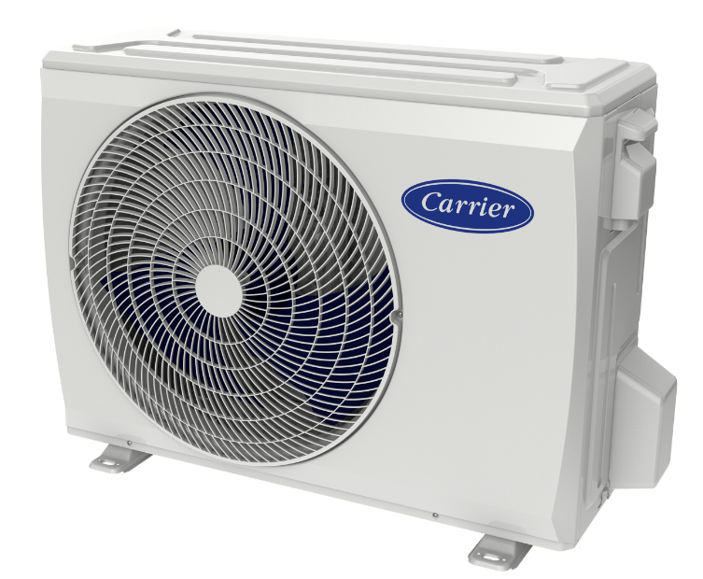
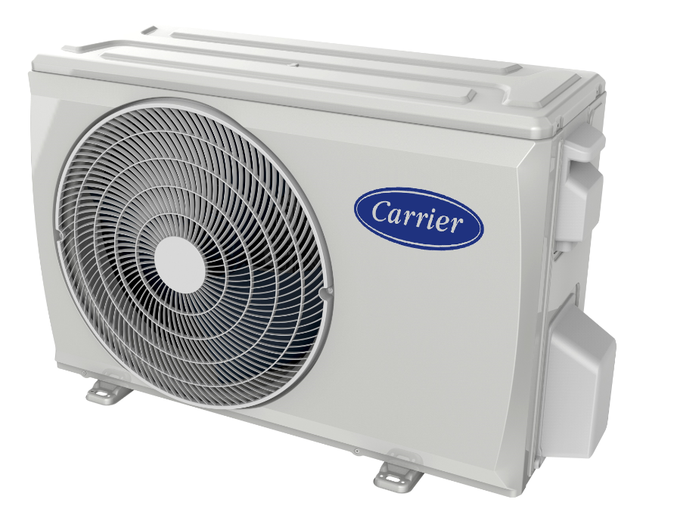
Basic Information Features
Product line Basic Information
Outdoor units(For EU R32 Product)
(1 drive 2) 14K, 18K X3(805x330x554mm)
(1 drive 3) 21K, 27K
X4(890x342x673mm)
(1 drive 4) 28K, 36K
(1 drive 5) 42K
D(946×410×810mm)
Note: Pdesignc/Pdesignh/SEER/SCOP are tested by combination at capacity ratio 1. Capacity ratio means indoor total capacity is equal to outdoor capacity, for example 7Kx2=14K, 9Kx3=27K.

Slide 8
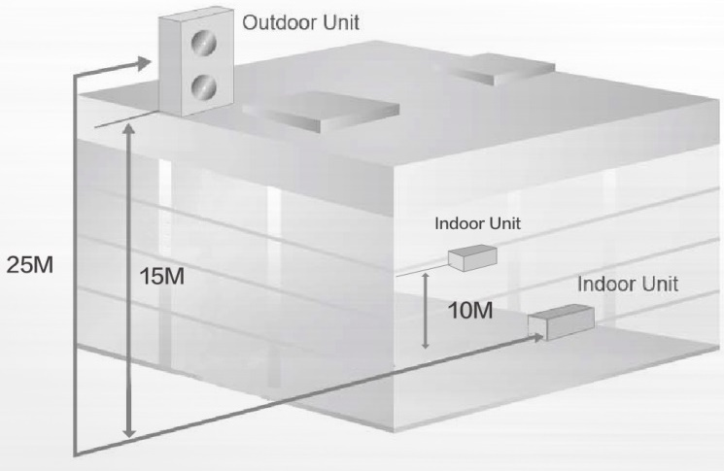
Basic Information Features
Product line Basic Information
Installation requirement
Outdoor units | Max. Length |  | Max. Elevation
 | Total length | One indoor | Between indoor and outdoor | Between indoor and indoor
1 drive 2 | 40 | 25 | 15 | 10
1 drive 3 | 60 | 30 | 15 | 10
1 drive 4 | 80 | 35 | 15 | 10
1 drive 5 | 80 | 35 | 15 | 10

Slide 9
Basic Information Features
Product line Basic Information
Installation requirement
 | Model | Liquid (mm) | Gas (mm) | Max. length /elevation (m) | Additional gas charge (g/m)
Indoor unit | 7K9K12K | Ф6.35 | Ф9.52 | 25-35/ IDU AND ODU: 15 Between IDUs: 10 | 12
 | 18K | Ф6.35 | Ф12.7 | 25-35/ IDU AND ODU: 15 Between IDUs: 10 | 12
 | 24K | Ф9.52 | Ф15.9 | 35/ IDU AND ODU: 15 Between IDUs: 10 | 24
Outdoor unit | 14K18K (Dual) | Ф6.35 x 2 | Ф9.52 x 2 | Single: 25 Total: 40
 | 21K27K (Triple) | Ф6.35 x 3 | Ф9.52 x 3 | Single: 30 Total: 60
 | 28K36K (quadruple) | Ф6.35 x 4 | Ф9.52 x 3 Ф12.7 x 1 | Single: 35 Total: 80
 | 42K (quintuple) | Ф6.35 x 5 | Ф9.52 x 4 Ф12.7 x 1 | Single: 35 Total: 80
The refrigerant pre-charged inside the outdoor unit is applied to 7,5 m standard pipes each.
If the actual pipes are longer than 7,5 m, extra refrigerant charging for every liquid pipe is necessary.

Slide 10
Basic Information Features
Product line Basic Information
Installation requirement
Capacity | Joint | Pipe | Dimension |  | Adaptor I (for 18K IDU), Standard
14K | A | Liquid | 1/4 | 6.35
 |  | Gas | 3/8 | 9.52
 | B | Liquid | 1/4 | 6.35
 |  | Gas | 3/8 | 9.52 | 3/8→1/2
18K | A | Liquid | 1/4 | 6.35
 |  | Gas | 3/8 | 9.52
 | B | Liquid | 1/4 | 6.35
 |  | Gas | 3/8 | 9.52 | 3/8→1/2
21K | A | Liquid | 1/4 | 6.35
 |  | Gas | 3/8 | 9.52
 | B | Liquid | 1/4 | 6.35
 |  | Gas | 3/8 | 9.52
 | C | Liquid | 1/4 | 6.35
 |  | Gas | 3/8 | 9.52 | 3/8→1/2
27K | A | Liquid | 1/4 | 6.35
 |  | Gas | 3/8 | 9.52
 | B | Liquid | 1/4 | 6.35
 |  | Gas | 3/8 | 9.52
 | C | Liquid | 1/4 | 6.35
 |  | Gas | 3/8 | 9.52 | 3/8→1/2
For 14K-27K, all connectors are 6.35/9.52,
When connect 18K IDU, pipe adaptor (Ф9.52 → Ф 12.7) needs to be fixed on the gas valve of outdoor unit.

Slide 11
Basic Information Features
Product line Basic Information
Installation requirement
Capacity | Joint | Pipe | Dimension |  | Adaptor I (for 18K IDU), Standard | Adaptor II (for 7-12K IDU), Standard
28K | A | Liquid | 1/4 | 6.35
 |  | Gas | 3/8 | 9.52
 | B | Liquid | 1/4 | 6.35
 |  | Gas | 3/8 | 9.52
 | C | Liquid | 1/4 | 6.35
 |  | Gas | 3/8 | 9.52
 | E | Liquid | 1/4 | 6.35
 |  | Gas | 1/2 | 12.7 |  | 1/2→3/8
36K | A | Liquid | 1/4 | 6.35
 |  | Gas | 3/8 | 9.52
 | B | Liquid | 1/4 | 6.35
 |  | Gas | 3/8 | 9.52
 | C | Liquid | 1/4 | 6.35
 |  | Gas | 3/8 | 9.52
 | E | Liquid | 1/4 | 6.35
 |  | Gas | 1/2 | 12.7 |  | 1/2→3/8
42K | A | Liquid | 1/4 | 6.35
 |  | Gas | 3/8 | 9.52
 | B | Liquid | 1/4 | 6.35
 |  | Gas | 3/8 | 9.52
 | C | Liquid | 1/4 | 6.35
 |  | Gas | 3/8 | 9.52
 | D | Liquid | 1/4 | 6.35
 |  | Gas | 3/8 | 9.52 | 3/8→1/2
 | E | Liquid | 1/4 | 6.35
 |  | Gas | 1/2 | 12.7 |  | 1/2→3/8
For 28K-42K, one connector is 6.35/12.7,
When connect to 7K-12K, pipe adaptor (Ф12.7 → Ф 9.52) needs to be fixed on the gas valve of outdoor unit.
The other connectors are 6.35/9.52, when connect 18K IDU, pipe adaptor (Ф9.52 → Ф 12.7) needs to be fixed on the gas valve of outdoor unit.

Slide 12
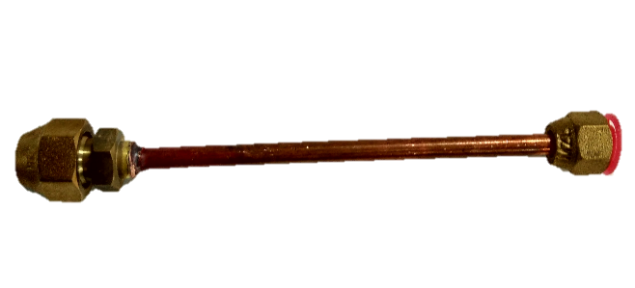
Basic Information Features
Product line Basic Information
Installation requirement
For 28K-42K, the connector 6.35/12.7 cannot connect with 24K indoor unit.
When connect to 24K, two pipe adaptors (Liquid: Ф6.35 → Ф 9.52, Gas: Ф12.7 → Ф 15.9, ) need to be fixed on the valve of outdoor unit.

Slide 13
Basic Information Features
Product line Basic Information
Installation combination
Maximum combination is 130%
14K
18K
One Unit | Two Unit
7 | 7+7 | 9+12
9 | 7+9
12 | 7+12
18 | 9+9
One Unit | Two Unit
7 | 7+7 | 9+12
9 | 7+9 | 12+12
12 | 7+12
18 | 9+9
21K
One Unit | Two Unit |  | Three Unit
7 | 7+7 | 9+9 | 7+7+7 | 9+9+9
9 | 7+9 | 9+12 | 7+7+9
12 | 7+12 | 9+18 | 7+7+12
18 | 7+18 | 12+12 | 7+9+9
PS : maximum combination is based on not all indoor units will turn on at the same time.

Slide 14
Basic Information Features
Product line Basic Information
Installation combination
Maximum combination is 130%
Combination table for 27K
One Unit | Two Unit |  |  | Three Unit
7 | 7+7 | 9+9 | 12+18 | 7+7+7 | 7+9+12 | 9+12+12
9 | 7+9 | 9+12 |  | 7+7+9 | 7+12+12
12 | 7+12 | 9+18 |  | 7+7+12 | 9+9+9
18 | 7+18 | 12+12 |  | 7+9+9 | 9+9+12
Combination table for 28K
One Unit | Two Unit |  |  | Three Unit |  |  | Four Unit
7 | 7+7 | 9+9 | 12+18 | 7+7+7 | 7+9+12 | 9+9+18 | 7+7+7+7 | 7+9+9+9
9 | 7+9 | 9+12 | 12+24 | 7+7+9 | 7+9+18 | 9+12+12 | 7+7+7+9 | 9+9+9+9
12 | 7+12 | 9+18 | 18+18 | 7+7+12 | 7+12+12 | 12+12+12 | 7+7+7+12 | 9+9+9+12
18 | 7+18 | 9+24 |  | 7+7+18 | 9+9+9 |  | 7+7+9+9
24 | 7+24 | 12+12 |  | 7+9+9 | 9+9+12 |  | 7+7+9+12
PS : maximum combination is based on not all indoor units will turn on at the same time.

Slide 15
Basic Information Features
Product line Basic Information
Installation combination
Maximum combination is 130%
Combination table for 36K
One unit | Two unit |  | Three unit |  |  |  | Four unit
7 | 7+7 | 9+18 | 7+7+7 | 7+9+18 | 9+9+12 | 12+12+12 | 7+7+7+7 | 7+7+9+18 | 7+9+12+12 | 9+12+12+12
9 | 7+9 | 9+24 | 7+7+9 | 7+9+24 | 9+9+18 | 12+12+18 | 7+7+7+9 | 7+7+9+24 | 7+9+12+18
12 | 7+12 | 12+12 | 7+7+12 | 7+12+12 | 9+9+24 |  | 7+7+7+12 | 7+7+12+12 | 7+12+12+12
18 | 7+18 | 12+18 | 7+7+18 | 7+12+18 | 9+12+12 |  | 7+7+7+18 | 7+7+12+18 | 9+9+9+9
24 | 7+24 | 12+24 | 7+7+24 | 7+12+24 | 9+12+18 |  | 7+7+7+24 | 7+9+9+9 | 9+9+9+12
 | 9+9 | 18+18 | 7+9+9 | 7+18+18 | 9+12+24 |  | 7+7+9+9 | 7+9+9+12 | 9+9+9+18
 | 9+12 |  | 7+9+12 | 9+9+9 | 9+18+18 |  | 7+7+9+12 | 7+9+9+18 | 9+9+12+12
PS : maximum combination is based on not all indoor units will turn on at the same time.

Slide 16
Basic Information Features
Product line Basic Information
Installation combination
Maximum combination is 130%
Combination table for 42K
One Unit | Two Unit | Three Unit |  | Four Unit |  |  | Five Unit
7 | 7+7 | 7+7+7 | 9+9+9 | 7+7+7+7 | 7+9+9+9 | 9+9+9+24 | 7+7+7+7+7 | 7+7+9+9+18 | 9+9+9+12+12
9 | 7+9 | 7+7+9 | 9+9+12 | 7+7+7+9 | 7+9+9+12 | 9+9+12+12 | 7+7+7+7+9 | 7+7+9+12+12 | 9+9+12+12+12
12 | 7+12 | 7+7+12 | 9+9+18 | 7+7+7+12 | 7+9+9+18 | 9+9+12+18 | 7+7+7+7+12 | 7+7+9+12+18
18 | 7+18 | 7+7+18 | 9+9+24 | 7+7+7+18 | 7+9+9+24 | 9+9+12+24 | 7+7+7+7+18 | 7+7+12+12+12
24 | 7+24 | 7+7+24 | 9+12+12 | 7+7+7+24 | 7+9+12+12 | 9+12+12+12 | 7+7+7+7+24 | 7+7+12+12+18
 | 9+9 | 7+9+9 | 9+12+18 | 7+7+9+9 | 7+9+12+18 | 9+12+12+18 | 7+7+7+9+9 | 7+9+9+9+9
 | 9+12 | 7+9+12 | 9+12+24 | 7+7+9+12 | 7+9+12+24 | 12+12+12+12 | 7+7+7+9+12 | 7+9+9+9+12
 | 9+18 | 7+9+18 | 9+18+18 | 7+7+9+18 | 7+9+18+18 | 12+12+12+18 | 7+7+7+9+18 | 7+9+9+9+18
 | 9+24 | 7+9+24 | 12+12+12 | 7+7+9+24 | 7+12+12+12 |  | 7+7+7+9+24 | 7+9+9+12+12
 | 12+12 | 7+12+12 | 12+12+18 | 7+7+12+12 | 7+12+12+18 |  | 7+7+7+12+12 | 7+9+12+12+12
 | 12+18 | 7+12+18 | 12+12+24 | 7+7+12+18 | 9+9+9+9 |  | 7+7+7+12+18 | 9+9+9+9+9
 | 12+24 | 7+12+24 | 12+18+18 | 7+7+12+24 | 9+9+9+12 |  | 7+7+9+9+9 | 9+9+9+9+12
 | 18+18 | 7+18+18 |  | 7+7+18+18 | 9+9+9+18 |  | 7+7+9+9+12 | 9+9+9+9+18
PS : maximum combination is based on not all indoor units will turn on at the same time.

Slide 17
Basic Information Features
Product line Basic Information
Working temperature range
Mode | Cooling | Heating
Room temp. | 17~32 | 0~30
Outside ambient temp. | -15~ 50 | -15~ 24

Slide 18
Basic Information Features
Product line Basic Information
Basic information for key components
Compressor: DC Inverter Rotary type
Indoor fan motor: Max. 220-240V,
Outdoor fan motor: 220-240V, 50Hz
Swing motor: DC12V
Four-way valve: 220-240V, 50Hz, energized in heating mode
Transformer: Input 220-240V, 50Hz, output 12-14V
Electronic expansive valve: DC 12V

Slide 19
Part II Features

Slide 20
Basic Information Features
Auto-correction Easy Maintenance Compatible Reliable
● | Standard
◎ | Could optional
X | No this function
Notes: This features list base on
EU product
and specific remote controller,
it is only for reference.
Notes: Compare to mono system, some functions of multi system are un available, such as Clean, Refrigerant detection, Silent,
1W standby,ECO, Emergency Using, Breeze away,Gear.

Slide 21
Basic Information Features
Auto-correction Easy Maintenance Compatible Reliable
● | Standard
◎ | Could optional
X | No this function
Notes: This features list base on EU product
and specific remote controller, it is only for reference.
Notes: Compare to mono system, some functions of multi system are un available, such as Clean, Refrigerant detection, Silent,
1W standby,ECO, Emergency Using, Breeze away, Gear.

Slide 22
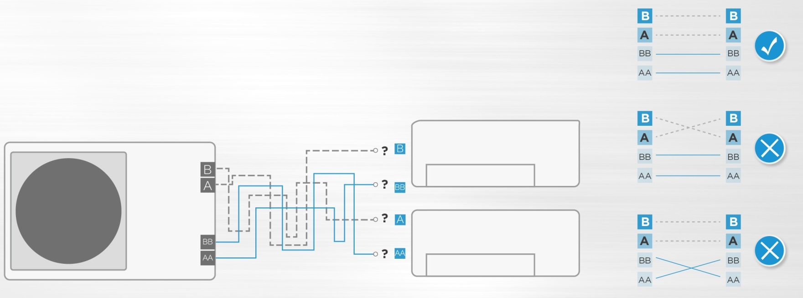
Basic Information Features
Auto-correction Easy Maintenance Compatible Reliable
Automatic wiring/piping correction function (new feature)
New product is capable of automatic correction of wiring/piping error.
Press the "check switch" on the outdoor unit PCB board 5 seconds until LED display "CE", which mean this function is working, Approximately 5-10 minutes after the switch is pressed, the "CE" disappear the wiring/piping error will be corrected, and wiring/piping is properly connected.
Before
Incorrect wiring
Indoor unit B
Terminal block
Indoor unit A
Liquid/gas pipe
Outdoor unit

Slide 23
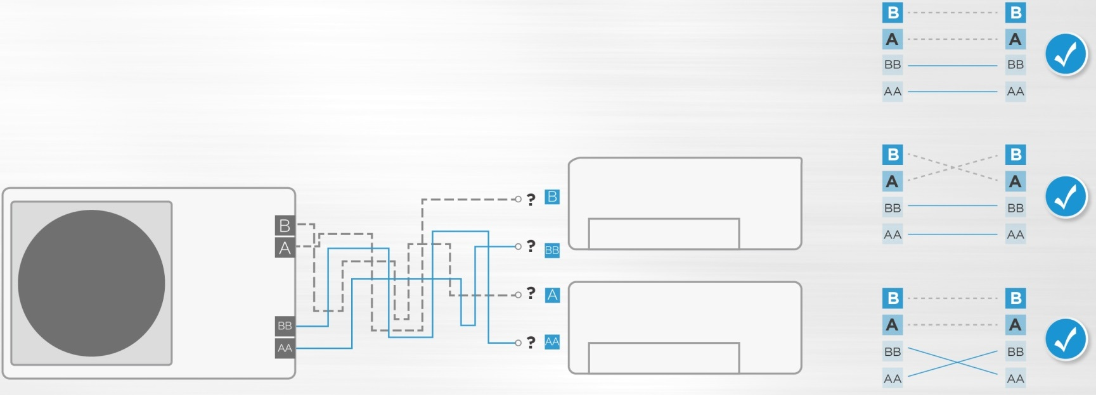
Basic Information Features
Auto-correction Easy Maintenance Compatible Reliable
Automatic wiring/piping correction function (new feature)
Conditions:
1. Check at outside temperature is above 5℃. (This function does not work when outside temperature is not above 5℃) 2. Check that the stop valves of the liquid pipe and gas pipe are open. 3. Turn on the breaker and wait at least 2 minute. 4. Press the check switch on the outdoor PCB board unit LED display "CE".
Now
Incorrect wiring
Indoor unit B
Terminal block
Indoor unit A
Liquid/gas pipe
Outdoor unit

Slide 24
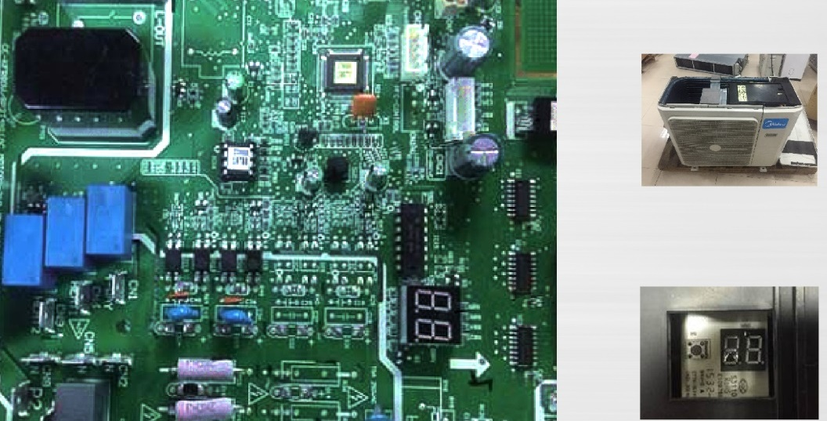
Basic Information Features
Auto-correction Easy Maintenance Compatible Reliable
Automatic wiring/piping correction function (new feature)
New product is capable of automatic correction of wiring/piping error.
Press the "check switch" on the outdoor unit PCB board 5 seconds until LED display "CE", which mean this function is working, Approximately 5-10 minutes after the switch is pressed, the "CE" disappear the wiring/piping error will be corrected, and wiring/piping is properly connected.
Check switch
LED display

Slide 25
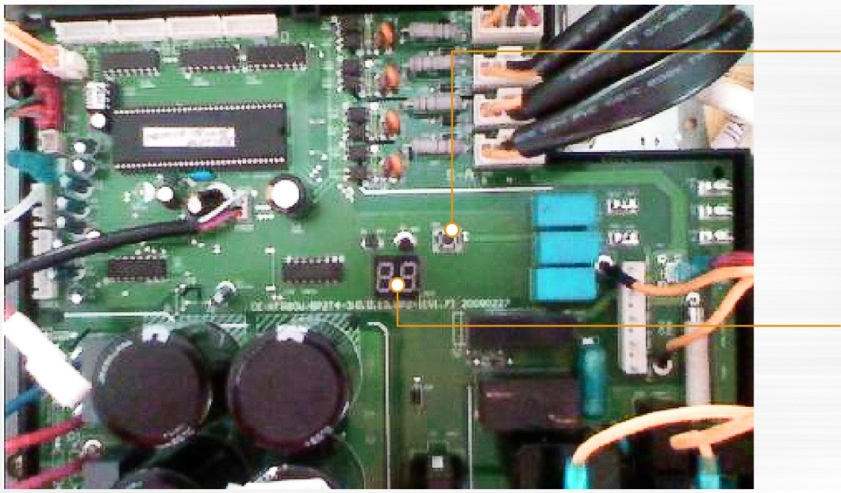
Basic Information Features
Auto-correction Easy Maintenance Compatible Reliable
Outdoor check function
Check point button
Press this button to check operation
parameters when the unit is running.
Status and Error Display
Display operation status and error codes.

Slide 26
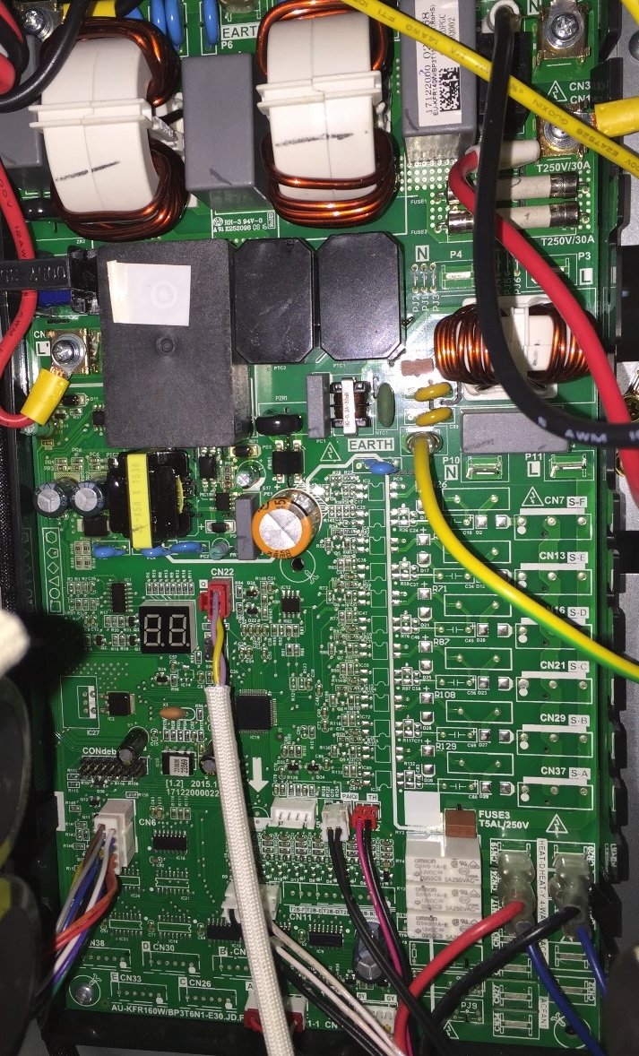
Basic Information Features
Auto-correction Easy Maintenance Compatible Reliable
Outdoor check function
With the check button and digital display, many useful information will be showed.
Every time the button is pressed, the item code will be showed for 1.5 second, then the information will be showed.
Digital Display
Check Button
In standby, the LED displays “- -”.
In compressor operation, the LED displays the running frequency.
In defrosting mode, The LED displays “dF” or alternative displays between running frequency and “dF”(each displays 2s).
In protection or malfunction, the LED displays error code or protection code.

Slide 27
Basic Information Features
Auto-correction Easy Maintenance Compatible Reliable
Outdoor check function
Push the button, you can check some parameters on display tube when the unit is running.
No. | Display | Remark
00 | Normal display | Display running frequency, running state or malfunction code
01 | Number of indoor units in good connection | Actual data
02 | Outdoor unit running mode | 0-Standby, 1-Fan only, 2-Cooling, 3-Heating, 4-Forced cooling
03 | A indoor unit capacity HP | 7K: HP=0.8, 9K: HP=1.0, 12K: HP=1.2, 18K: HP=1.5 If the indoor unit is not connected, the digital display tube will show: “――”
04 | B indoor unit capacity HP
05 | C indoor unit capacity HP
06 | D indoor unit capacity HP
07 | E indoor unit capacity HP
08 | A Indoor unit capacity demand code | Norm value*HP
09 | B Indoor unit capacity demand code
10 | C Indoor unit capacity demand code
11 | D Indoor unit capacity demand code
12 | E Indoor unit capacity demand code
13 | Total indoor units amendatory capacity demand code | 7 for Forced cooling mode
14 | Target frequency corresponding to the total indoor units amendatory capacity demand

Slide 28
Basic Information Features
Auto-correction Easy Maintenance Compatible Reliable
Outdoor check function
No. | Display | Remark
15 | Target frequency after the frequency limit
16 | Target frequency sending to compressor control chip
17 | A indoor unit evaporator outlet temp.(T_{2B}A) | If the temp. is lower than -9 degree, the digital display tube will show “-9”.If the temp. is higher than 70 degree, the digital display tube will show “70”. If the indoor unit is not connected, the digital display tube will show: “――”
18 | B indoor unit evaporator outlet temp.(T_{2B}B)
19 | C indoor unit evaporator outlet temp.(T_{2B}C)
20 | D indoor unit evaporator outlet temp.(T_{2B}D)
21 | E indoor unit evaporator outlet temp.(T_{2B}E)
22 | A indoor unit room temp.(T₁A) | If the temp. is lower than 0 degree, the digital display tube will show “0”.If the temp. is higher than 50 degree, the digital display tube will show “50”. If the indoor unit is not connected, the digital display tube will show: “――”
23 | B indoor unit room temp.(T₁B)
24 | C indoor unit room temp.(T₁C)
25 | D indoor unit room temp.(T₁D)
26 | E indoor unit room temp.(T₁E)
27 | A indoor unit evaporator temp.(T₂A) | If the temp. is lower than -9 degree, the digital display tube will show “-9”.If the temp. is higher than 70 degree, the digital display tube will show “70”. If the indoor unit is not connected, the digital display tube will show: “――”
28 | B indoor unit evaporator temp.(T₂B)
29 | C indoor unit evaporator temp.(T₂C)
30 | D indoor unit evaporator temp.(T₂D)
31 | E indoor unit evaporator temp.(T₂E)

Slide 29
Basic Information Features
Auto-correction Easy Maintenance Compatible Reliable
Outdoor check function
No. | Display | Remark
32 | Condenser pipe temp.(T3) | If the temp. is lower than -9 degree, the digital display tube will show “-9”.If the temp. is higher than 70 degree, the digital display tube will show “70”.
33 | Outdoor ambient temp.(T4)
34 | Compressor discharge temp.(Tp) | The display value is between 30~129 degree. If the temp. is lower than 30 degree, the digital display tube will show “30”.If the temp. is higher than 99 degree, the digital display tube will show single digit and tens digit. For example, the digital display tube show “0.5”,it means the compressor discharge temp. is 105 degree.)
35 | AD value of current | The display value is hex number. For example ,the digital display tube show “Cd”, it means AD value is 205.
36 | AD value of voltage
37 | EEV open angle for A indoor unit | Actual data/4. If the value is higher than 99, the digital display tube will show single digit and tens digit. For example ,the digital display tube show “2.0”,it means the EEV open angle is 120×4=480p.)
38 | EEV open angle for B indoor unit
39 | EEV open angle for C indoor unit
40 | EEV open angle for D indoor unit
41 | EEV open angle for E indoor unit

Slide 30
Basic Information Features
Auto-correction Easy Maintenance Compatible Reliable
Outdoor check function
No. | Display | Remark
42 | Frequency limit symbol | Bit7 | Frequency limit caused by IGBT radiator | The display value is hex number. For example, the digital display tube show 2A,then Bit5=1, Bit3=1, Bit1=1. It means frequency limit caused by T4,T3 and current.
 |  | Bit6 | Frequency limit caused by PFC
 |  | Bit5 | Frequency limit caused by T4.
 |  | Bit4 | Frequency limit caused by T2.
 |  | Bit3 | Frequency limit caused by T3.
 |  | Bit2 | Frequency limit caused by Tp.
 |  | Bit1 | Frequency limit caused by current
 |  | Bit0 | Frequency limit caused by voltage
43 | Average value of T2 | (Sum T2 value of all indoor units)/(indoor units number)
44 | Outdoor fan speed | 0- Off, 1- High speed, 2- Med speed, 3- Low speed, 4- breeze speed, 5- Super breeze speed
45 | The last error or protection code | 00 means no error or protection

Slide 31
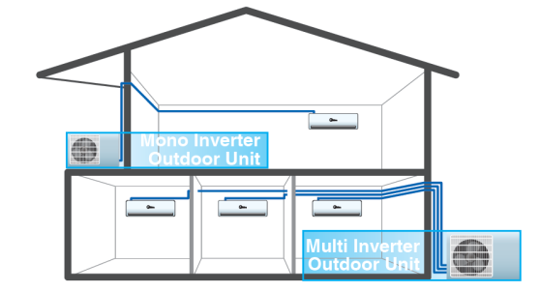
Basic Information Features
Auto-correction Easy Maintenance Compatible Reliable
Mono & Multi Compatible (standard)
Compatible indoor unit for both mono and multi inverter system.
The advantage for us: It comes in handy for warehouse and stock administration.
Models | Split | Cassette | Duct | Console
7K | Y | N | N | N
9K | Y | N | N | N
12K | Y | Y | Y | Y
18K | Y | Y | Y | Y
24K | Y | Y | Y | Y

Slide 32
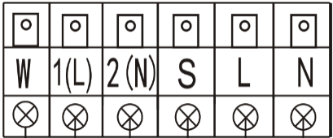
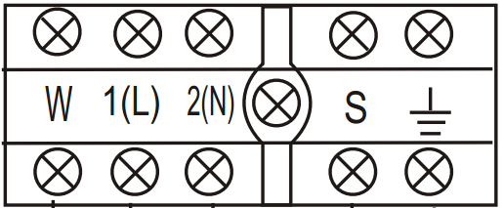
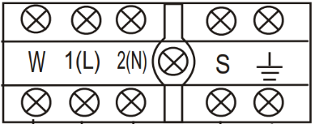
Basic Information Features
Auto-correction Easy Maintenance Compatible Reliable
Mono & Multi Compatible (standard)
Wiring of mono system
Wiring of multi system
A relay(RY) is placed between the W and 1(L) of the indoor PCB. It can cut off the power of outdoor unit when the unit is in standby mode, helping realize 1W standby function.
Outdoor Unit
Outdoor Unit
Power Supply
Indoor Unit
Power Supply
Indoor Unit
W,1(L) : Live line
2(N) : Zero line
S : Signal line
Ralay
Not connected

Slide 33
Basic Information Features
Auto-correction Easy Maintenance Compatible Reliable
Mode conflict
When there are different mode settings among active indoor units, system will define as following:
Heating mode will have a priority.
Cooling mode and Fan mode will conflict to heating mode.
Setting mode | Cooling | Heating | Fan | Off
Cooling | No | Yes | No | No
Heating | Yes | No | Yes | No
Fan | No | Yes | No | No
Off | No | No | No | No
Note: ”Yes” means mode conflict, “No” means no mode conflict.

Slide 34
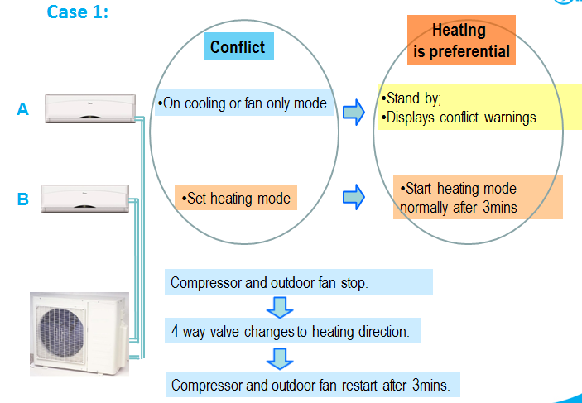
Basic Information Features
Auto-correction Easy Maintenance Compatible Reliable
Mode conflict

Slide 35
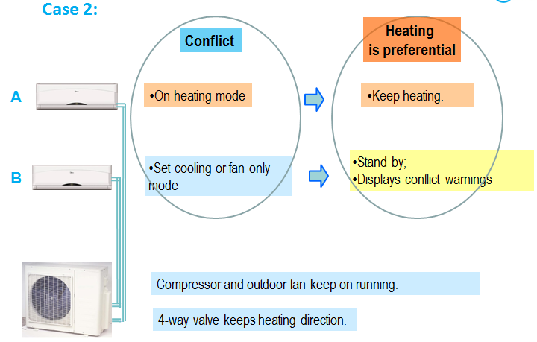
Basic Information Features
Auto-correction Easy Maintenance Compatible Reliable
Mode conflict

