Slide 1
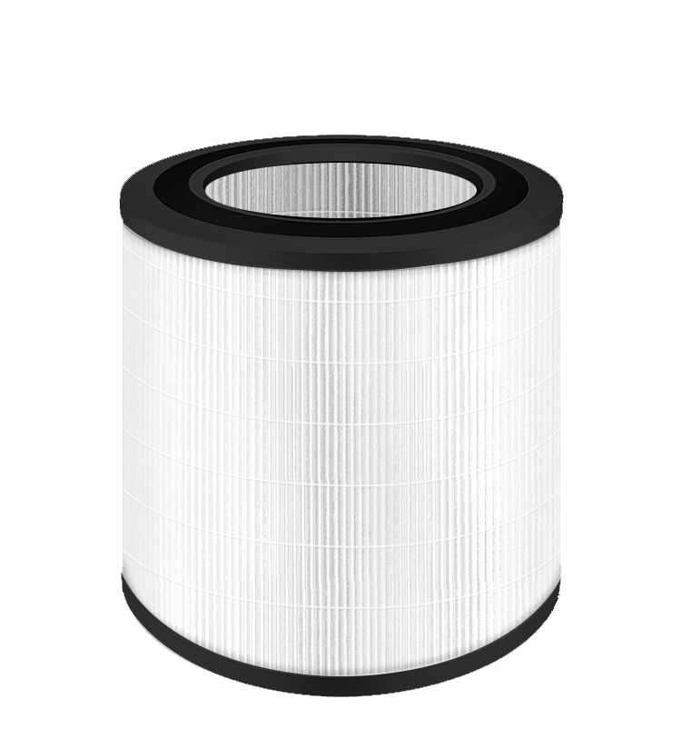
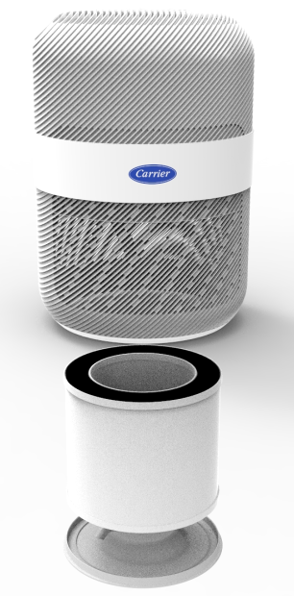
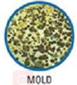
CAFN012LA1 HEPA Filter
size：φ176*150mm
HEPA Filter will remove the fine particles which is as small as 0.3 micron,such as allergens, pollen, dust, smog and viruses, so it can reduce the spread of allergens and bacteria in air.
The difference between H11 and H13 is the fiter efficiency , H11 is 99.5%, H13 is 99.95%

Slide 2
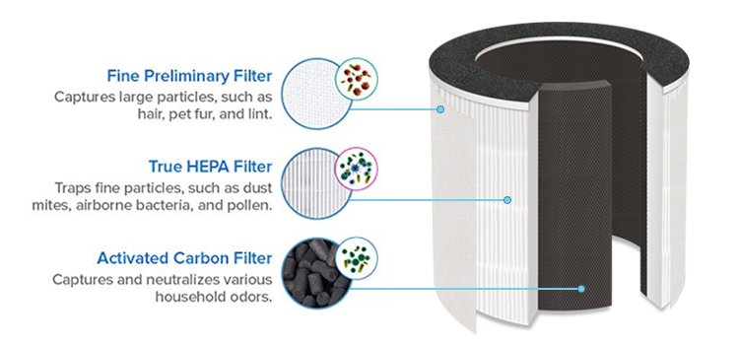
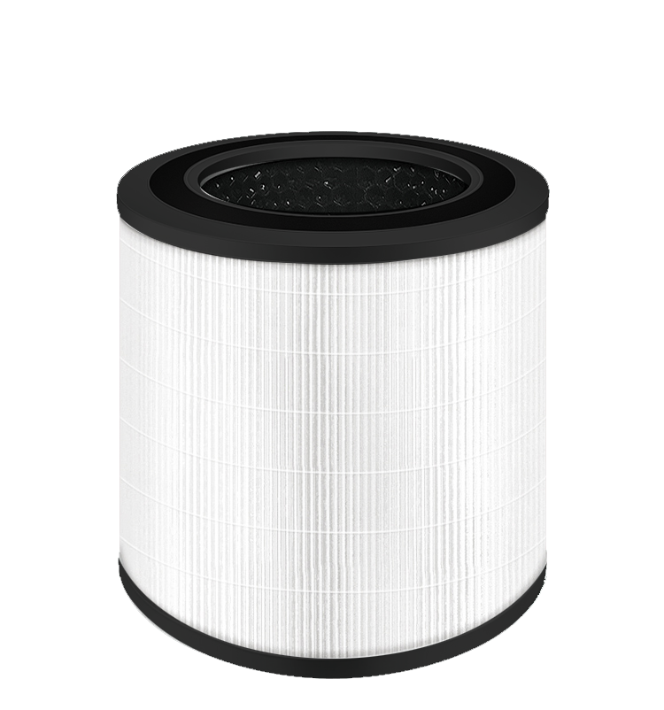
CAFN012LA1 HEPA+Activated Carbon Fiter
We put activated carbon inside the HEPA filter, then it can help to remove volatile organic compounds, such as secondhand smoke ,formaldehyde, benzene and and kinds of polluting gases.

Slide 3
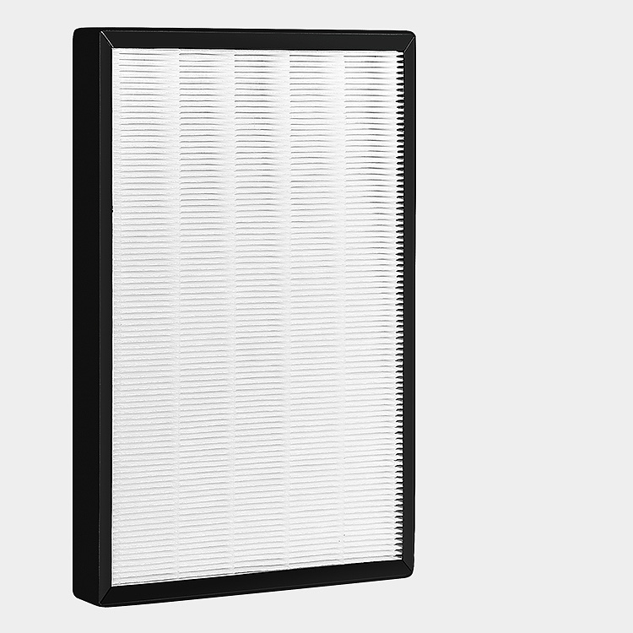
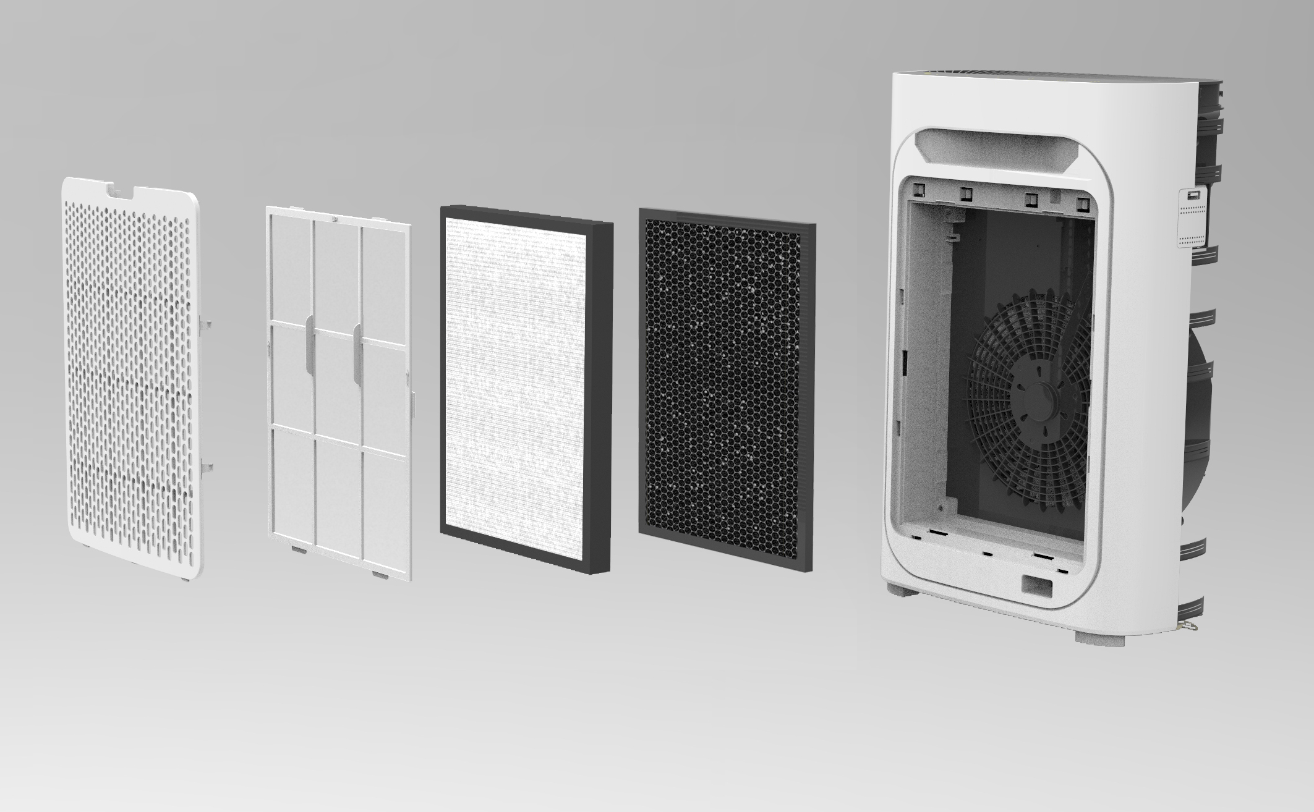
CAFN026/36/51LC2 HEPA Fiter
AP2006 HEPA filter size: 317x228x23（mm）
AP3006 HEPA fiter size: 390x280x30（mm）
AP6006 HEPA fiter size: 415x294x42（mm）
HEPA Filter will remove the fine particles which is as small as 0.3 micron,such as allergens, pollen, dust, smog and viruses, so it can reduce the spread of allergens and bacteria in air.
The difference between H11 and H13 is the fiter efficiency , H11 is 99.5%, H13 is 99.95%

Slide 4
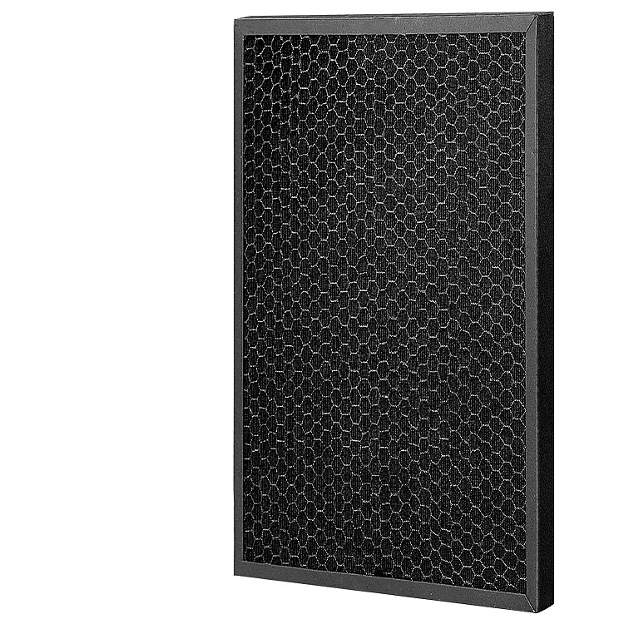
CAFN026/36/51LC2 Activated Carbon Fiter
AP2006 Activated Carbon Filter size: 317x228x10（mm）
AP3006 Activated Carbon Filter size: 390x280x15（mm）
AP6006 Activated Carbon Filter size: 415x294x15（mm）
We put activated carbon after the HEPA filter, then it can help to remove volatile organic compounds, such as secondhand smoke ,formaldehyde, benzene and and kinds of polluting gases.

