Slide 1
Optional Control for
QHG Hi-wall Inverter
FMCC Engineering
2022

Slide 2
Optional Control for Hi-wall
1. WLAN / Wired control / Central control / Dry contact can be selected only one on the same unit.
2. Remote controller can be used together with other controls.
Central Control/BMS Control
Professional for commercial users
WLAN Control
Operates your AC wherever you are
Remote Control
Remote On/Off
Easy for commercial users
Wired Control
Avoid mislaying

Slide 3
Hi-wall Control Combination QHG
No. | Option 1 | Option 2 | Option 3 | Option 4 |  | Option 5
Functions | Standard (Remote control) | WLAN function | 5 core Wired controller | Dual-way communication (485) wired controller（4 core） Central control |  | Non-Polarity wired controller（2 core）
Parts | Display PCB 1 For 9/12K 17222000030895 For 18K 17222000031322 For 22/24K 17222000031565 | Display PCB 2 assembly For 9/12/18K 17222000A58269 For 22/24 K 17222000A58395 | Display PCB 3 For 9/12/18K 17222000A58426 For 22/24K 17222000A58427 | Display PCB 2 assembly For 9/12/18K 17222000A58269 For 22/24 K 17222000A58395
 |  | WLAN USB adapter (Multi-function box) (already included in the display PCB assembly) |  | Transfer Adapter 1 For 9/12/18K 17222000A58719 For 22/24 K 17222000A58718 | Transfer Adapter 2 For 9/12/18K 17222000A58716 For 22/24 K 17222000A58717
 |  | / |  | 12V wire has already included PCB main board assembly. Dry Contact(On/Off)/Alarm function are already included Transfer Adapter.
 | Remote controller: RG67G 17317000007154 | WLAN USB 17310900A03781 | KJR-12B: 17317100A22492 | 485 Wired controller KJR-120G2: 17317100A27842 KJR-120X2: 17317100A28268 Central controller CCM30: 17311500A03641 CCM09: 17311500A03642 |  | Non-Polarity Wired controller KJR-120G: 17317100A25375 KJR-120X: 17317100A28269

Slide 4
Hi-wall Control Combination QHG
No. | Option 1 | Option 2 |  | Option 4 |  | Option 5
Functions | Standard (Remote control) | WLAN function |  | Dual-way communication (485) wired controller（4 core） Central control |  | Non-Polarity wired controller（2 core）
Parts | Display PCB 1 For 9/12K 17222000030895 7409751 For 18K 17222000031322 7409752 For 22/24K 17222000031565 7409753 | Display PCB 2 assembly For 9/12/18K 17222000A58269 7409754 For 22/24 K 17222000A58395 7409755 |  | Display PCB 2 assembly For 9/12/18K 17222000A58269 7409754 For 22/24 K 17222000A58395 7409755
 |  |  |  | Transfer Adapter 1 For 9/12/18K 17222000A58719 7403082 For 22/24 K 17222000A58718 7403083 | Transfer Adapter 2 For 9/12/18K 17222000A58716 7403084 For 22/24 K 17222000A58717 7403085
 |  | / |  | 12V wire has already included PCB main board assembly. Dry Contact(On/Off)/Alarm function are already included Transfer Adapter.
 | Remote controller: RG67G 17317000007154 7409750 | WLAN USB 17310900A03781 7403078 |  | 485 Wired controller KJR-120G2: 17317100A27842 / 7403019 KJR-120X2: 17317100A28268 / 7403081 Central controller CCM30: 17311500A03641/7403018 CCM09: 17311500A03642/7403017 |  | Non-Polarity Wired controller KJR-120X: 17317100A28269/7403079

Slide 5
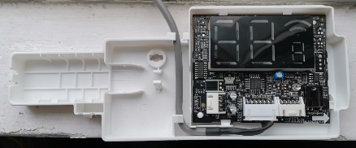
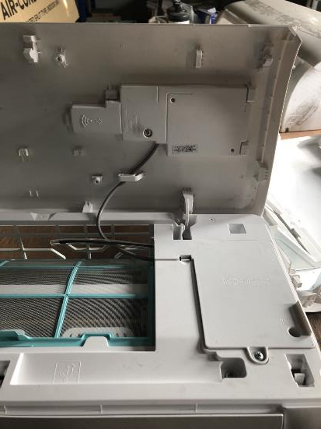
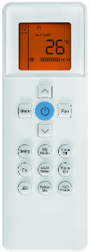
Option 1 – Standard (Remote control) QHG
No wifi, No wired control function
Remote controller
Display PCB 1

Slide 6
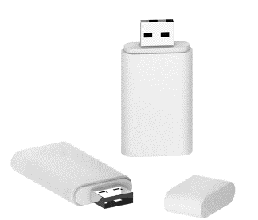
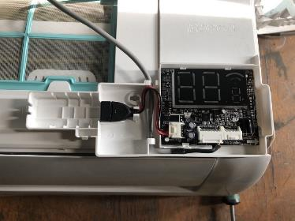
Option 2 - WLAN Control QHG
Working with smart phone APP
USB
PN: 17310900A03781
Display PCB 2
 | Display PCB 1 (Standard) | Display PCB 2 (WLAN function) | USB | Note
Option 1: Standard | √ |  |  | Remote control
Option 2.1: WLAN function without USB kit. |  | √ |  | If the user want to control the unit by WLAN, they have to buy the WLAN kit from Carrier
Option 2.2: WLAN Ready |  | √ | √ | WLAN available

Slide 7
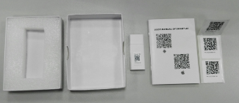
Option 2 - WLAN Control QHG
Option 2.2: WLAN Ready
Note:
Display PCB 2 is assembled in the unit by factory.
The WLAN kit must be sold separately
Display PCB 2
WLAN kit (optional accessory)

Slide 8
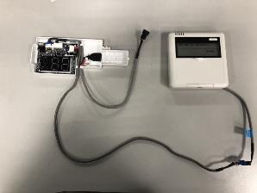
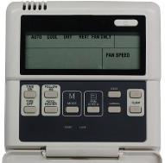
Option 3 – 5 core Wired Controller QHG
KJR-12B without weekly timer.
KJR-120B
(PN: 17317100A22492)
Display PCB 3
 | Display PCB 1 (standard) | Display PCB 3 (5 core wired control function) | 5 core Wired controller | Note
Option 1 | √ |  |  | Remote control
Option 3.1 |  | √ |  | Need to buy wired controller separately
Option 3.2 |  | √ | √ | Wired controller available

Slide 9
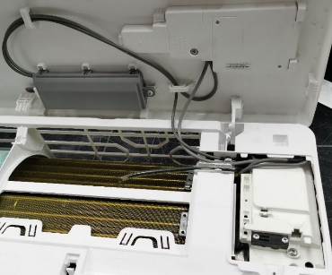
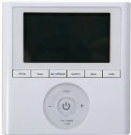
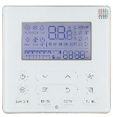
Option 4 – 485 Wired Controller & Central Control QHG
KJR-120G2/TFBG-E
(PN: 17317100A27842)
KJR-120X2/TFBG-E
(PN: 17317100A26817)
Transfer adapter
(To wired controller/
Central Control)
Display PCB 2
 | Display PCB 1 (standard) | Display PCB 2 (485 wired control function) | Transfer adapter 1 | 485 Wired controller | Note
Option 1 | √ |  |  |  | Remote control
Option 4.1 |  | √ | √ |  | Need to buy wired controller separately
Option 4.2 |  | √ | √ | √ | Wired controller available

Slide 10
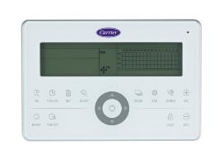
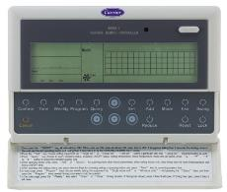
Option 4 – 485 Wired Controller & Central Control QHG
CCM30:
17311500A03641
Transfer adapter
(To wired controller/
Central Control)
CCM09: 17311500A03642
Display PCB 2
 | Display PCB 1 (standard) | Display PCB 2 (Central Control) | Transfer adapter 1 | Central Control | Note
Option 1 | √ |  |  |  | Remote control
Option 4.3 |  | √ | √ |  | Need to buy Central Control separately
Option 4.4 |  | √ | √ | √ | Central control available

Slide 11
Option 5 – Non-Polarity Wired Controller QHG
KJR-120G/TFBG-E
(PN: 17317100A25375)
KJR-120X/TFBG-E
(PN: 17317100A26816)
Transfer adapter
(To wired controller)
Display PCB 2
 | Display PCB 1 (standard) | Display PCB 2 (Non-Polarity wired control function) | Transfer adapter 2 | Non-Polarity Wired controller | Note
Option 1 | √ |  |  |  | Remote control
Option 5.1 |  | √ | √ |  | Need to buy wired controller separately
Option 5.2 |  | √ | √ | √ | Wired controller available

Slide 12
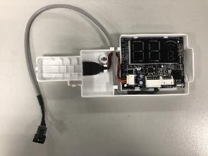
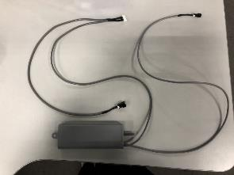
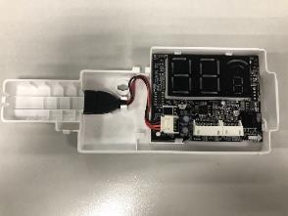
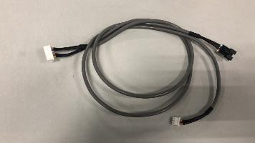
Installation of Transfer Adapter QHG
Installation
Delete the 4 core cable from Display board.
The 7 core cable from Transfer adapter connect to CN1 on Display board.
4-wired part
7 core cable
3-wired part
Note：
7-wired cable, the 4-wired part should connect to the main control PCB board; the 3-wired part should connect to the multi function board

Slide 13
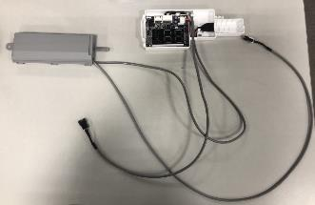
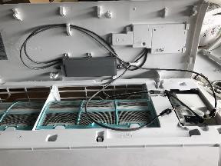
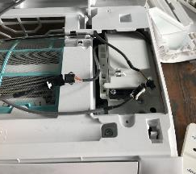
Installation of Transfer Adapter QHG
Installation
4-wired cable
3-wired cable
Install
2
1
2-wired cable
Transfer Adapter
Display Board
3-wired cable
2-wired cable connect to main PCB board 12V wire.
4-wired cable connect to communication wire on main PCB board.
2-wired cable
4-wired cable
Main PCB board

Slide 14
Introduction of Transfer Adapter QHG
Transfer Adapter 1
Dip-switch F1 Dip-switch F2
To PCB
To display board
On-off port
Rotary switch ENC3
485 wired controller/
Central controller
Alarm port
Note:
1. Rotary switch ENC3 and Dip-switch F1 is for Net address setting;
2. Dip switch F2 is for On-off setting
3. If connected to 485 wired controller, you should cut the connector and connect 4 wire to terminal one by one.

Slide 15
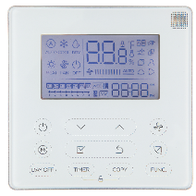
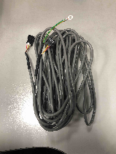
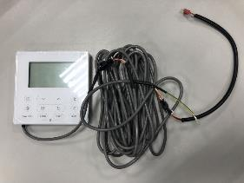
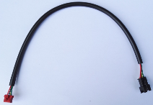
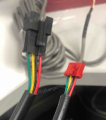
Introduction of Transfer Adapter QHG
Transfer Adapter 1-Connect with 485 wired controller
Accessory for 120X2:
KJR-120X2
4-core cable(6m)
Installation to Transfer Adapter:
Cut the RED connector.
4 wire connect to terminal one by one: RED→12V/5V， Black→E， Yellow→Y， Green→X

Slide 16
Introduction of Transfer Adapter QHG
Wiring diagram for Transfer Adapter 1

Slide 17
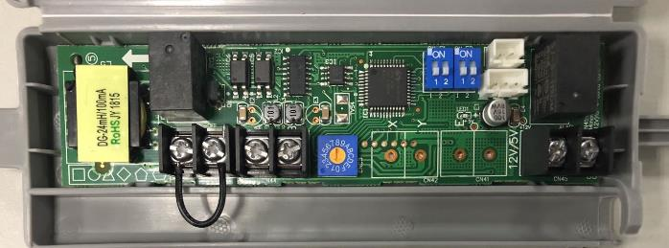
Introduction of Transfer Adapter QHG
Transfer Adapter 2
Dip-switch F1 Dip-switch F2
To PCB
To display board
On-off port
Rotary switch ENC3
Alarm port
non-polarity wired controller
Note:
1. Rotary switch ENC3 and Dip-switch F1 is for Net address setting;
2. Dip switch F2 is for On-off setting

Slide 18
Introduction of Transfer Adapter QHG
Wiring diagram for Transfer Adapter 2

Slide 19
Settings dipswitch F2 QHG

Slide 20
Thank you!

