Slide 1

New Engineering Mode

Slide 2
>>
General Information
01
^{Contents}
>>
Running Data Checking
02
>>
Parameter Setting
03

Slide 3
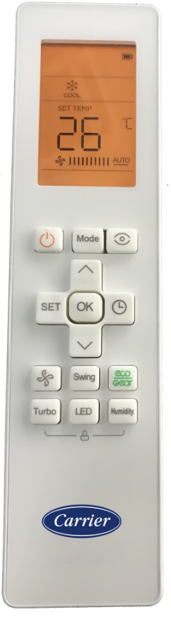
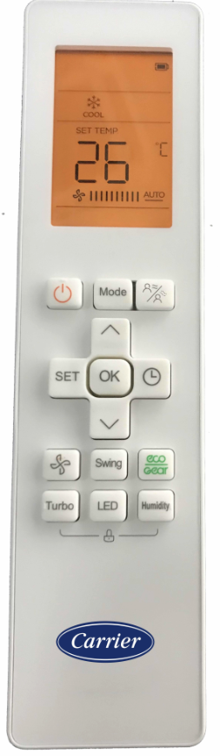
General Information Running Data Checking Parameter Setting
Introduction Operation Instructions
RG10 G series
Brief Features
Easier Operation
Combined “Data Checking” and “Presetting” functions
Easier data reading in “Data Checking” mode
More parameters for choosing in “Presetting” mode
RG10L(G)
QHE models
RG10P(G)
QHP models

Slide 4
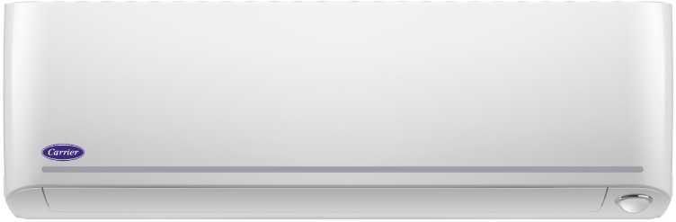
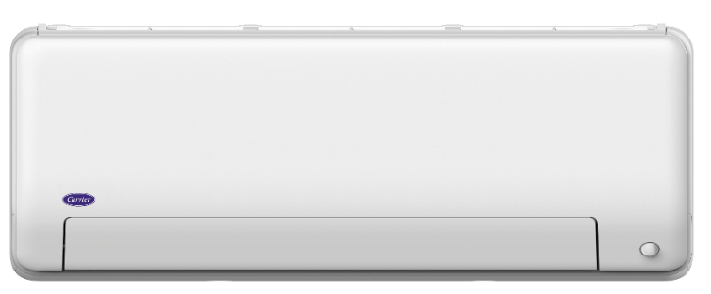

General Information Running Data Checking Parameter Setting
Introduction Operation Instructions
Available Products Lines
Oasis Plus

Slide 5


General Information Running Data Checking Parameter Setting
Introduction Operation Instructions
General Operation
Nothing in 60s
+ 7s
2s
+ 2s
2s
Or nothing in 60s
Normal
Data Checking
Presetting

Slide 6
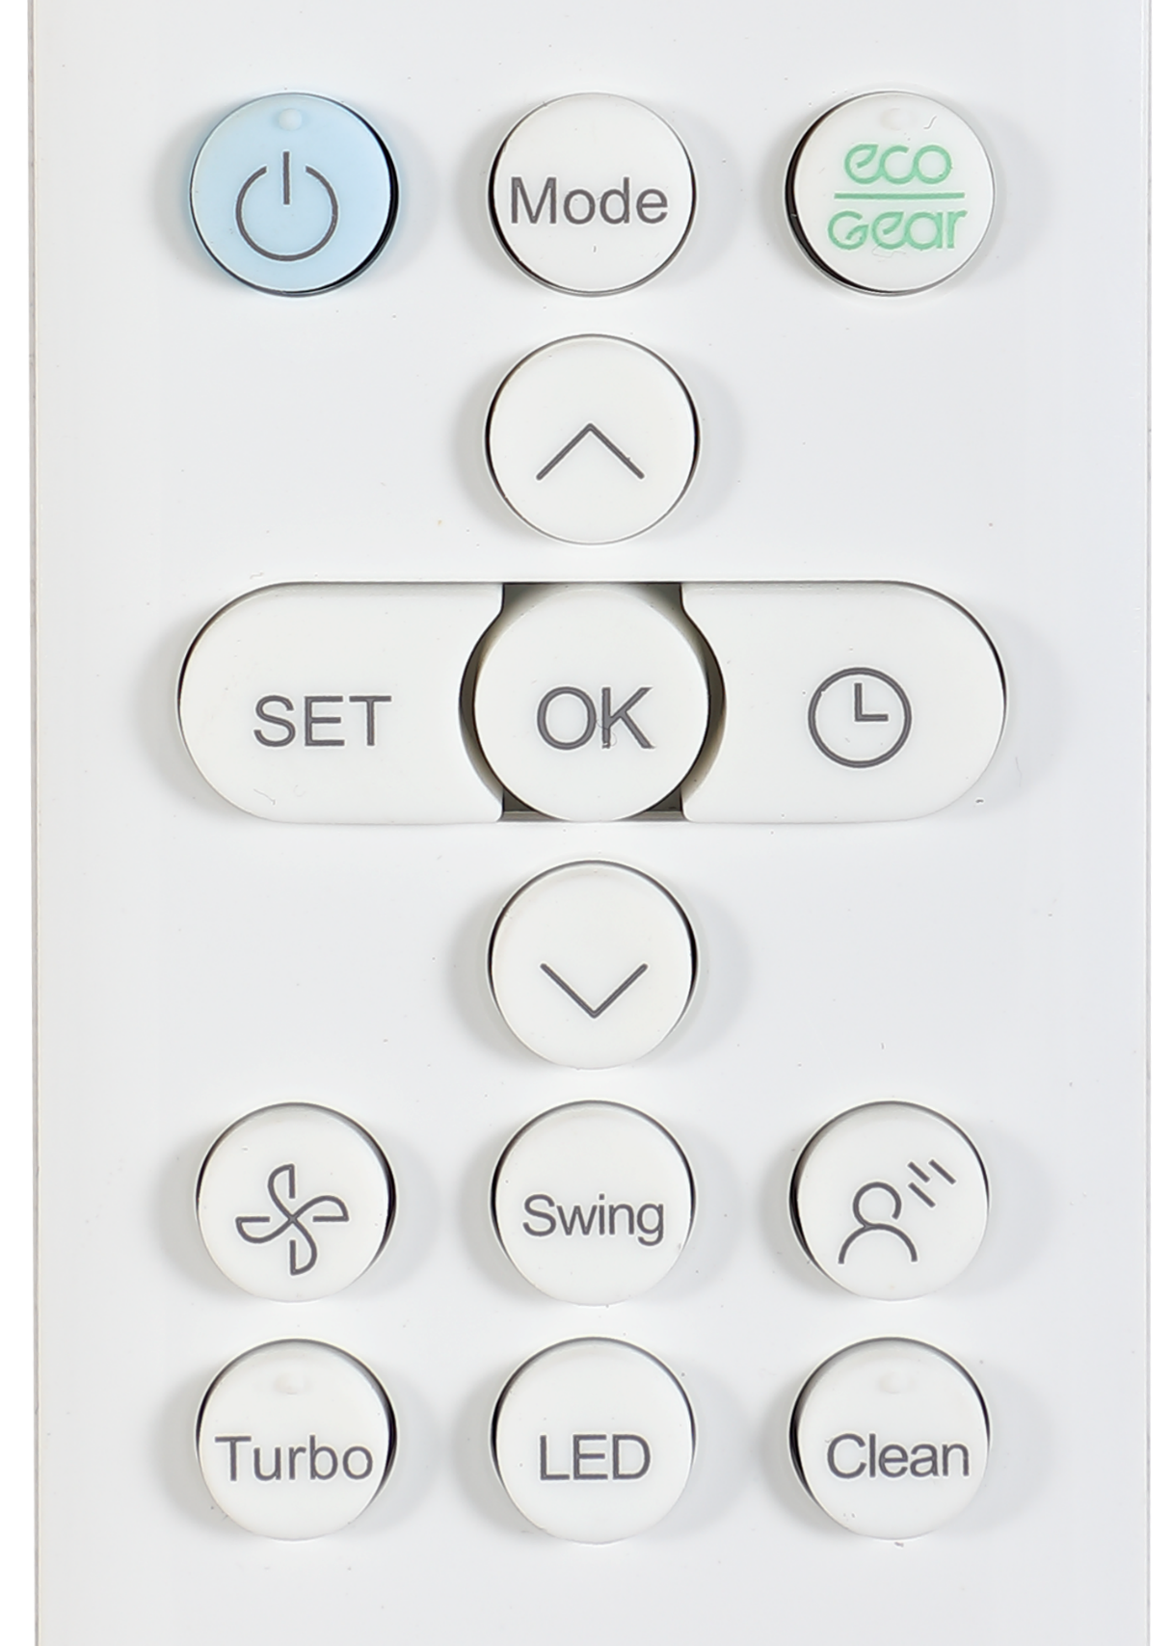
General Information Running Data Checking Parameter Setting
Operation Instructions Data Explanation
Into Data Checking mode
1
Press and hold “Power” and “Fan” buttons for 7 seconds
1
2
Press “Up” or “Down” to check different data
2
1
2

Slide 7
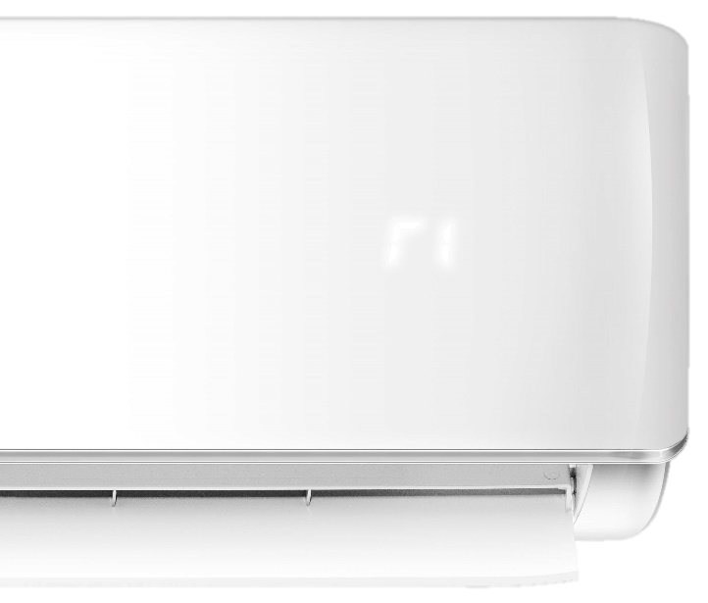
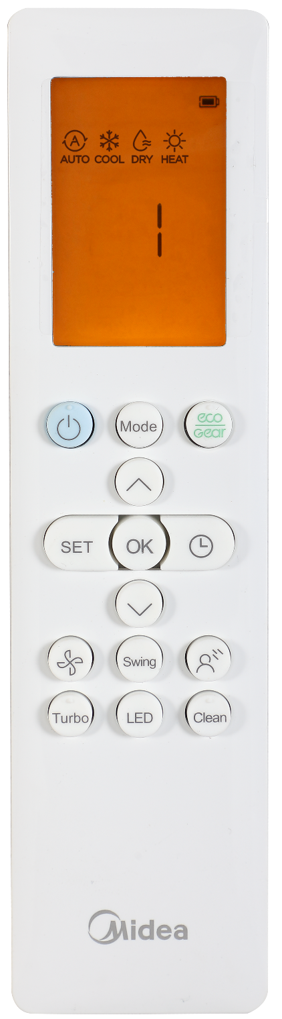
General Information Running Data Checking Parameter Setting
Operation Instructions Data Explanation
Running Data Checking
Channel
Data
Press “Up” or “Down” to choose different channel (CH, from 0-30) on the remote controller, then the indoor unit will show different data.

Slide 8
General Information Running Data Checking Parameter Setting
Operation Instructions Data Explanation
Data Checking List
CH | Code | Meaning | Remark | CH | Code | Meaning | Remark
0 |  | Detailed error code (nA if no error) |  | 16 | TT | Set temperature including compensation | Actual data, ℃
1 | T1 | Room temperature | Actual data, ℃ | 17 | nA | Reserved
2 | T2 | Indoor coil temperature | Actual data, ℃ | 18 | nA | Reserved
3 | T3 | Outdoor coil temperature | Actual data, ℃ | 19 | nA | Reserved
4 | T4 | Ambient temperature | Actual data, ℃ | 20 | oT | Target Frequency calculated by indoor | Without limitation
5 | TP | Discharge temperature | Actual data, ℃ | 21 | nA | Reserved
6 | FT | Targeted frequency | Actual data | 22 | nA | Reserved
7 | Fr | Actual frequency | Actual data | 23 | nA | Reserved
8 | dL | Running current | 3.2A=3 | 24 | nA | Reserved
9 | Uo | Input voltage | 220V=22* | 25 | nA | Reserved
10 | Sn | Reserved |  | 26 | nA | Reserved
11 | -- | Reserved |  | 27 | nA | Reserved
12 | Pr | Outdoor fan speed | Actual data/8 | 28 | nA | Reserved
13 | Lr | EXV opening steps | Actual data/8 | 29 | nA | Reserved
14 | Ir | Indoor fan speed | Actual data/8 | 30 | nA | Reserved
15 | Hu | Humidity (if a sensor there) | Actual data, %
The indoor unit will show code for 2 seconds, and then the value.
* Some other units will show 22-20, some will show 20.

Slide 9
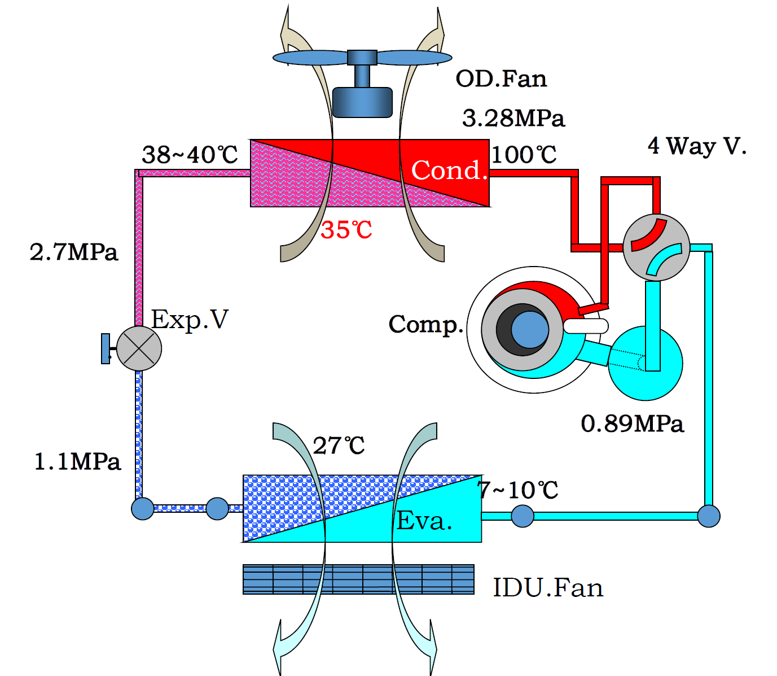
General Information Running Data Checking Parameter Setting
Operation Instructions Data Explanation
Items Shown
TP
FT, Fr, oT
ir
T2
T1
T3
TP
T4
Indoor Unit
T1
T2
Design Parameters for reference
Outdoor Unit
T4
Pr
T3
Lr

Slide 10
General Information Running Data Checking Parameter Setting
Operation Instructions Data Explanation
Detailed Error Code (2 digits)
Detailed Code | Meaning | Possible Faulty Part | Normal Error Code
P10 | Low DC voltage protection | Outdoor PCB or IPM board | P1
P11 | High DC voltage protection | Outdoor PCB or IPM board | P1
P40 | Communication error between main control trip and drive chip | Outdoor PCB or IPM board | P4
P41 | Error of current sampling circuit of compressor | Outdoor PCB or IPM board | P4
P42 | Error of compressor start up | Compressor | P4
P43 | Phase lose protection | Connection cable of compressor | P4
P44 | Zero speed protection | Compressor | P4
P45 | Synchronization error between 341 chip and PWM | Outdoor PCB or IPM board | P4
P46 | Compressor speed out of control | Outdoor PCB or IPM board, or compressor | P4
P49 | Over current of compressor | Outdoor PCB or IPM board, compressor or refrigeration system | P4

Slide 11
General Information Running Data Checking Parameter Setting
Operation Instructions Data Explanation
Detailed Error Code (4 digits)
Detailed Code | Meaning | Possible Faulty Part | Normal Error Code
EH 31 | DC voltage is too low of indoor DC fan motor (with DC fan driver board) | Indoor PCB or DC fan driver board | EH 03
EH 32 | DC voltage is too high of indoor DC fan motor (with DC fan driver board) | Indoor PCB or DC fan driver board | EH 03
EH 33 | Over-current protection of indoor DC fan motor (with DC fan driver board) | Indoor PCB, DC fan driver board or indoor DC motor | EH 03
EH 34 | IPM protection of indoor DC fan motor (with DC fan driver board) | DC fan driver board or indoor DC motor | EH 03
EH 35 | Phase lack protection of indoor DC fan motor (with DC fan driver board) | Connection cable of indoor DC motor | EH 03
EH 36 | Current checking circuit faulty of indoor DC fan motor (with DC fan driver board) | DC fan driver board | EH 03
EH 37 | Zero speed protection of indoor DC fan motor (with DC fan driver board) | Indoor DC motor | EH 03
EC 55 | IPM temperature sensor open circuit or short circuit | IPM temperature sensor | EC 02
EC 71 | Over-current protection of outdoor DC fan motor | Outdoor PCB or DC motor | EC 07
EC 72 | Phase lack protection of outdoor DC fan motor | Connection cable of outdoor DC motor | EC 07
EC 73 | Zero speed protection of outdoor DC fan motor | Outdoor DC motor | EC 07
EC 74 | Current checking circuit faulty of outdoor DC fan motor | Outdoor PCB | EC 07
EC 75 | IPM protection of outdoor DC fan motor | Outdoor PCB or DC motor | EC 07

Slide 12
General Information Running Data Checking Parameter Setting
Operation Instructions Data Explanation
Detailed Error Code (4 digits)
Detailed Code | Meaning | Possible Faulty Part | Normal Error Code
EH b5 | Communication error between indoor PCB and smart eye | Indoor PCB or smart eye | EH 03
EH 0F | Smart eye fault | Smart eye | EH 03
EH 0L | Display EEPROM fault | Display board | EH 0b
PC 10 | Outdoor AC voltage is too low | Power supply or outdoor PCB | PC 01
PC 11 | Outdoor DC voltage is too high | Power supply or outdoor PCB | PC 01
PC 12 | Outdoor DC voltage is too low (MCE faulty of IR341 chip) | Power supply or outdoor PCB (Outdoor PCB) | PC 01
PC 40 | Communication error between main control trip and drive chip | Outdoor PCB or IPM board | PC 04
PC 41 | Error of current sampling circuit of compressor | Outdoor PCB or IPM board | PC 04
PC 42 | Error of compressor start up | Compressor | PC 04
PC 43 | Phase lose protection | Connection cable of compressor | PC 04
PC 44 | Zero speed protection | Compressor | PC 04
PC 45 | Suddenly power lost | Power wire looses connection | PC 04
PC 46 | Compressor speed out of control | Outdoor PCB or IPM board, or compressor | PC 04
PC 49 | Over current of compressor | Outdoor PCB or IPM board, compressor or refrigeration system | PC 04
PC 06 | High discharge temperature protection of compressor | Lack of refrigerant, blocked condenser (cooling) or blocked evaporator (heating)

Slide 13
General Information Running Data Checking Parameter Setting
Operation Instructions Data Explanation
Detailed Error Code (4 digits)
Detailed Code | Meaning | Possible Faulty Part | Normal Error Code
PC 08 | Over current of outdoor unit | Power supply, outdoor PCB or blocked refrigeration system
PH 09 | Indoor fan stop because of anti-cold wind function | Lack of refrigerant or blocked refrigeration system
PC 0F | IGBT fault of PFC circuit | Outdoor PCB
PH 90 | Hi evaporator temperature protection in heating mode | Blocked evaporator or capillary, EXV, or faulty sensor
PH 91 | Lo evaporator temperature protection in cooling mode | Lack of refrigerant or partial blocked capillary, EXV, or faulty sensor
PC 0A | Hi condenser temperature protection in cooling mode | Blocked condenser or capillary, EXV, or faulty sensor
LH 00 | Frequency limitation caused by high or low evaporator temperature
LC 01 | Frequency limitation caused by high condenser temperature
LC 02 | Frequency limitation caused by high discharge temperature
LC 03 | Frequency limitation caused by high current
LC 05 | Frequency limitation caused by high or low voltage
LC 06 | Frequency limitation caused by high IPM temperature or faulty PFC
LC 30 | Frequency limitation caused by high pressure
LC 31 | Frequency limitation caused by low pressure
LH 07 | Frequency limitation caused remote controller

Slide 14

General Information Running Data Checking Parameter Setting
Operation Instructions Parameter Explanation
Pre-setting when installation
With this mode, you can change some pre-settings such as auto-restart, temperature compensation and so on when installing an air conditioner to make it run more properly for real applications.
Note:
Presetting mode is only valid in 1 minutes when AC unit is first-time electrified.
The AC unit should be off.

Slide 15



General Information Running Data Checking Parameter Setting
Operation Instructions Parameter Explanation
Into Parameter Setting
Note:
The remote controller should be in data checking mode first.
Press and hold “Power” button for 2 seconds to active presetting function in the channel.
2s
2s
Data Checking
Presetting

Slide 16
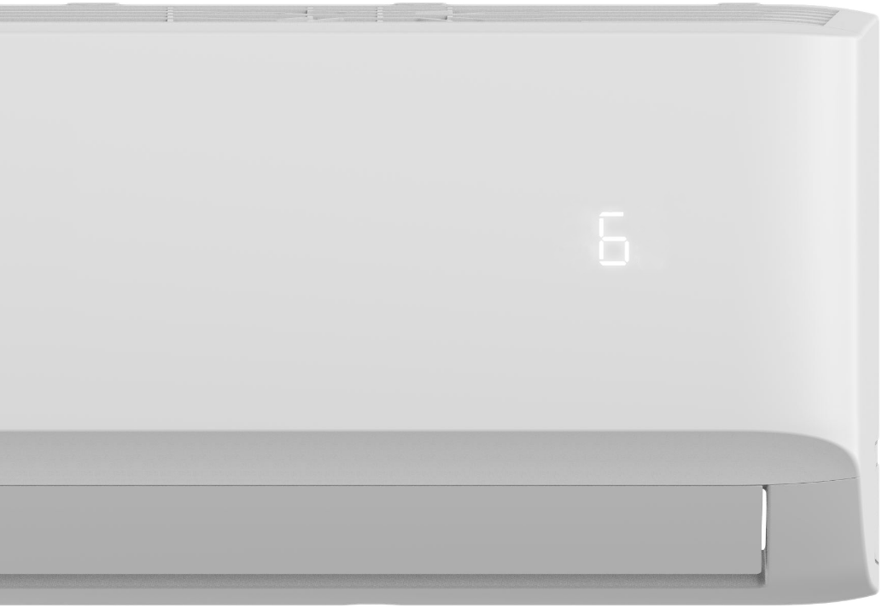
General Information Running Data Checking Parameter Setting
Operation Instructions Parameter Explanation
Parameter query
1
Press “Up” or “Down” button to choose a channel that you want to query
2
2
Press and hold “Power” button for 2 seconds
1
Press “OK” to query current parameter while the remote controller shows “CH”. The parameter will be shown on the indoor unit.
3
3
1

Slide 17
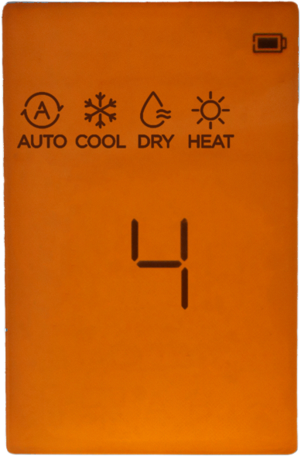
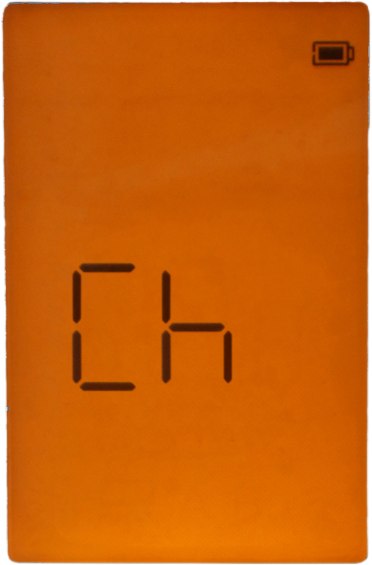
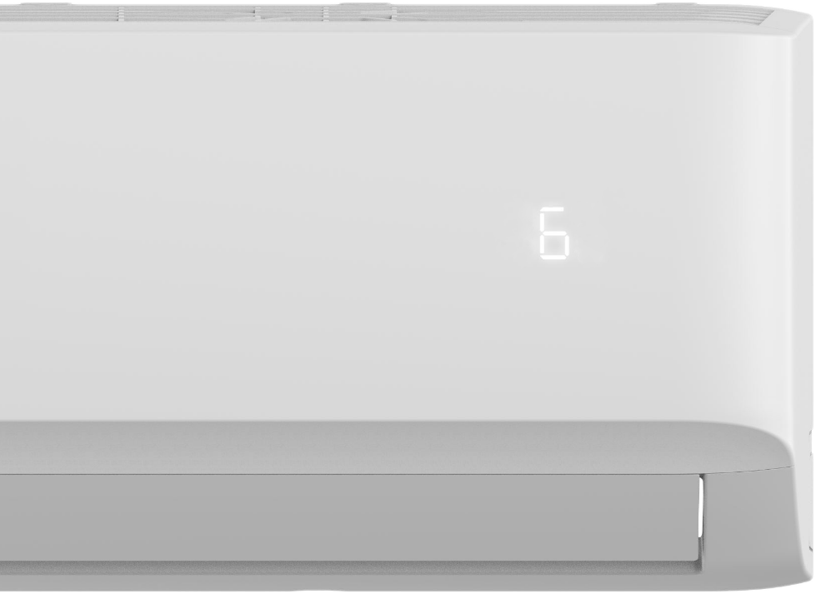
General Information Running Data Checking Parameter Setting
Operation Instructions Parameter Explanation
Query Example
1
Press “Up” or “Down” button to choose channel 4 (Fan control when Ts reached)
2
Press and hold “Power” button for 2 seconds
Press “OK” to query current parameter while the remote controller shows “CH”. The parameter will be shown on the indoor unit.
(“6” means the fan will be off for 15 mins and run for 1 min.)
3

Slide 18
General Information Running Data Checking Parameter Setting
Operation Instructions Parameter Explanation
Parameter setting
1
Press “Up” or “Down” button to choose a channel that you want to set
2
2
Press and hold “Power” button for 2 seconds
1
3
Press “Up” or “Down” to choose the suitable parameter.
3
4
4
Press “OK” to send the parameter to indoor unit.
1
3
The indoor unit will show the parameter sent by the controller to confirm acceptance, and then it will show “88”, which means the program is resetting.

Slide 19
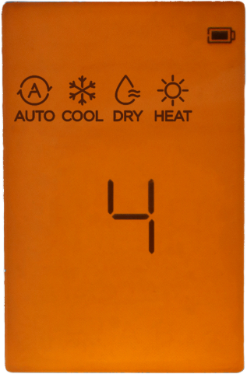
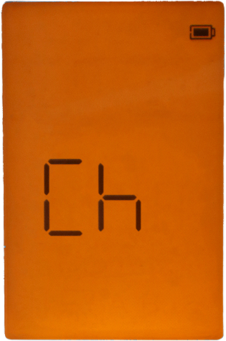
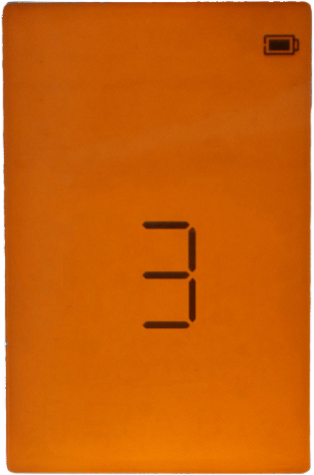
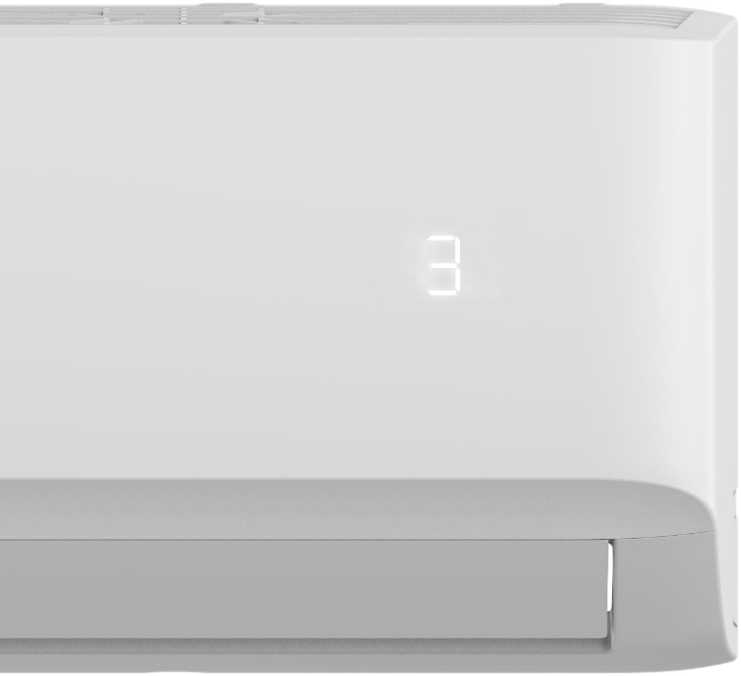
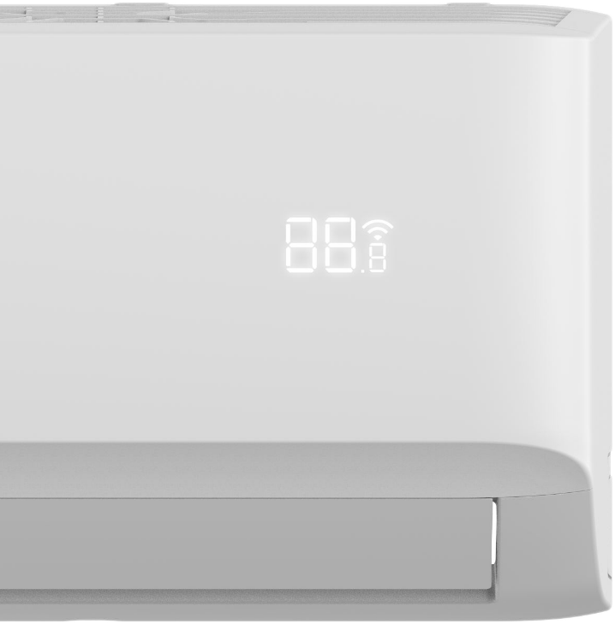
General Information Running Data Checking Parameter Setting
Operation Instructions Parameter Explanation
For Example
Press “Up” or “Down” button to choose channel 4 (Fan control when Ts reached)
1
2
Press and hold “Power” button for 2 seconds
3
Press “Up” or “Down” to choose 3 (keep in setting fan speed).
4
Press “OK” to send the parameter to indoor unit.
The indoor unit will show “3” to confirm acceptance. And then it will show “88”, which means the program is resetting.

Slide 20
General Information Running Data Checking Parameter Setting
Operation Instructions Parameter Explanation
Settable Parameter List
CH | Item | Parameter Meaning | Remark
0 | / | Nothing to set
1 | Auto-restart function | 0 – Inactive 1 – Active
2 | Heating temperature compensation | -6.5, -6.0, -5.5, …, 0.5, 1.0, 1.5, …, 7.0, 7.5, -- (Cancel)
3 | / | Nothing to set
4 | Fan control when Ts reached | 1 – Fan stop 2 – Fan runs at lowest RPM 3 – Fan runs at setting RPM 4 – Fan stops for 5 mins and runs for 1 mins 5 – Fan stops for 10 mins and runs for 1 mins 6 – Fan stops for 15 mins and runs for 1 mins 7 – Fan stops for 20 mins and runs for 1 mins 8 – Fan stops for 30 mins and runs for 1 mins 9 – Fan stops for 40 mins and runs for 1 mins 10 – Fan stops for 50 mins and runs for 1 mins 11 – Fan stops for 60 mins and runs for 1 mins

Slide 21
General Information Running Data Checking Parameter Setting
Operation Instructions Parameter Explanation
Settable Parameter List
CH | Item | Parameter Meaning | Remark
5 | / | Nothing to set
6 | Mode lock | CH – Cooling and heating (all modes) HH – Heating only (Heating + Fan only) CC – Cooling only (Cooling + Drying + Fan only) nU – Cooling and heating without Auto | Remote controller will change as well.
7 | Cooling temperature compensation | -3.0, -2.5, -2.0, …, 3.0, 3.5, -- (Cancel)
8 | / | Nothing to set
9 | / | Nothing to set
10 | / | Nothing to set
11 | Lowest setting temperature | 16-24 | Remote controller will change as well.
12 | Highest setting temperature | 25-30 | Remote controller will change as well.
13 | / | Nothing to set
14 | / | Nothing to set
15 | Mode priority selection for multi units | H – Heating first C – Cooling first

Slide 22
General Information Running Data Checking Parameter Setting
Operation Instructions Parameter Explanation
Settable Parameter List
CH | Item | Parameter Meaning | Remark
16 | / | Nothing to set
17 | / | Nothing to set
18 | Min. frequency limitation in cooling mode | 10, 11, 12, …, 49, 50, -- (Cancel)
19 | Min. frequency limitation in heating mode | 10, 11, 12, …, 49, 50, -- (Cancel)
20 | Max frequency selection in T4 limitation of Zone6 | 20, 21, 22, …, 149, 150, -- (Cancel)
21 | Frequency selection of outdoor forced-operation | 10, 11, 12, …, 249, 250, -- (Cancel)
22 | One button reset | rS – Reset
23 | Max. frequency selection in cooling mode | 40, 41, 42, …, 83, 84, -- (Cancel)
24 | Max. frequency selection in heating mode | 40, 41, 42, …, 83, 84, -- (Cancel)
25 | Cooling temperature compensation | -3.0, -2.5, -2.0, …, 3.0, 3.5, -- (Cancel)
26 | Heating temperature compensation | -6.5, -6.0, -5.5, …, 0.5, 1.0, 1.5, …, 7.0, 7.5, -- (Cancel)

Slide 23
General Information Running Data Checking Parameter Setting
Operation Instructions Parameter Explanation
Settable Parameter List
CH | Item | Parameter Meaning | Remark
26 | Heating temperature compensation | -6.5, -6.0, -5.5, …, 0.5, 1.0, 1.5, …, 7.0, 7.5, -- (Cancel)
27 | Max. fan speed selection in cooling | -41, -40, -39, …, 19, 20, -- (Cancel) | Fan speed will add set data*8. It is risk. Do not set it if not necessary
28 | Min. fan speed selection in cooling | -41, -40, -39, …, 19, 20, -- (Cancel)
29 | Max. fan speed selection in heating | -41, -40, -39, …, 19, 20, -- (Cancel)
30 | Min. fan speed selection in heating | -41, -40, -39, …, 19, 20, -- (Cancel)
NOTE | Data in red is not valid for setting.

