Slide 1


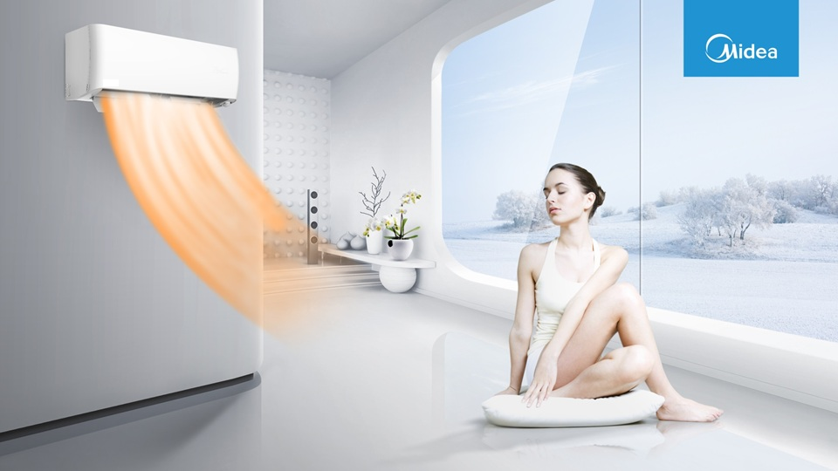

Carrier Infinity series
Powerful Heating Even in -25℃ Extreme Weather
FMCC 2022,April

Slide 2
Contents
Part I Some Features
Part II Difference QHP models between old and new

Slide 3

Gerenal Information
Primary Specification
High energy efficiency
SEER A+++
SCOP A+++
Temp range cooling -15～50°C
Temp range heating -25~30°C

Slide 4

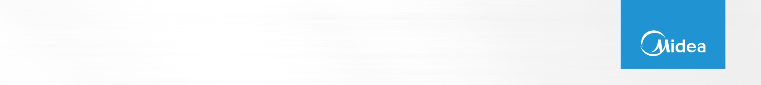
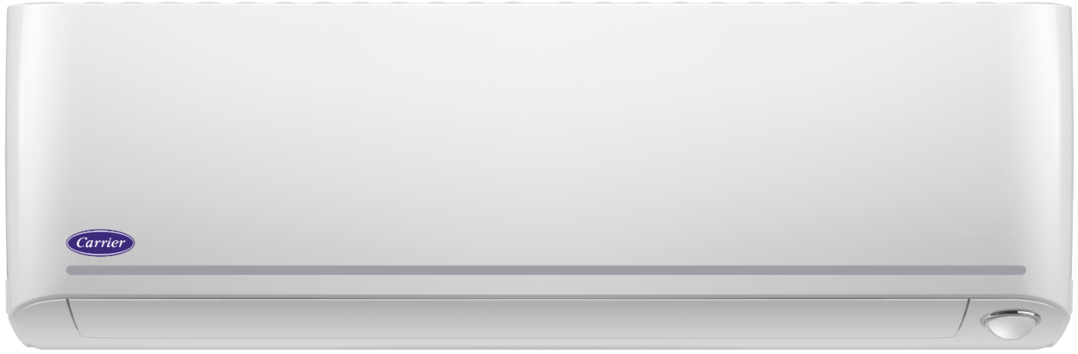
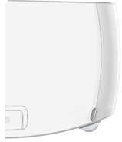
Carrier Exclusive Panel

Slide 5

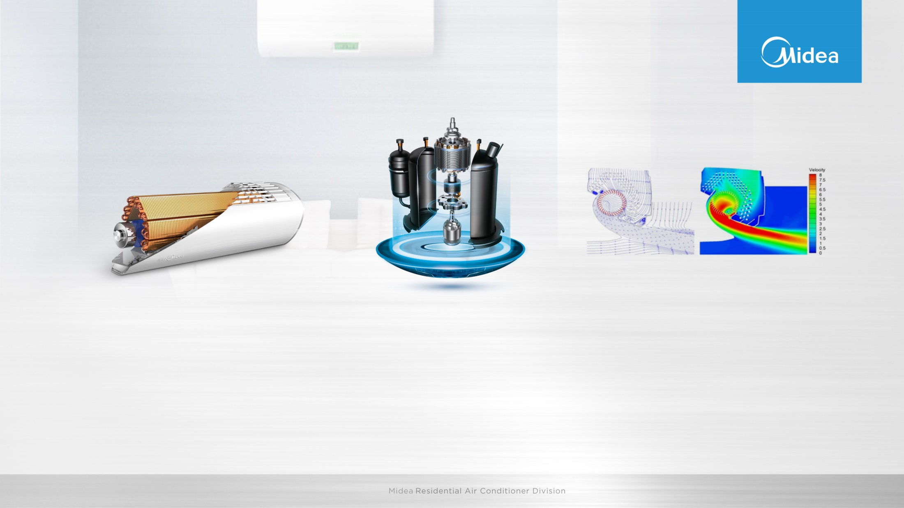
Ultra-high Energy Efficiency
Φ7 and Φ5 hybrid pipe design heat exchanger offers better performance rate, which is 10% more than the conventional heat exchanger
The leading energy efficiency compressor as core element of the technology.
Optimized air outlet design assists the energy efficiency.

Slide 6
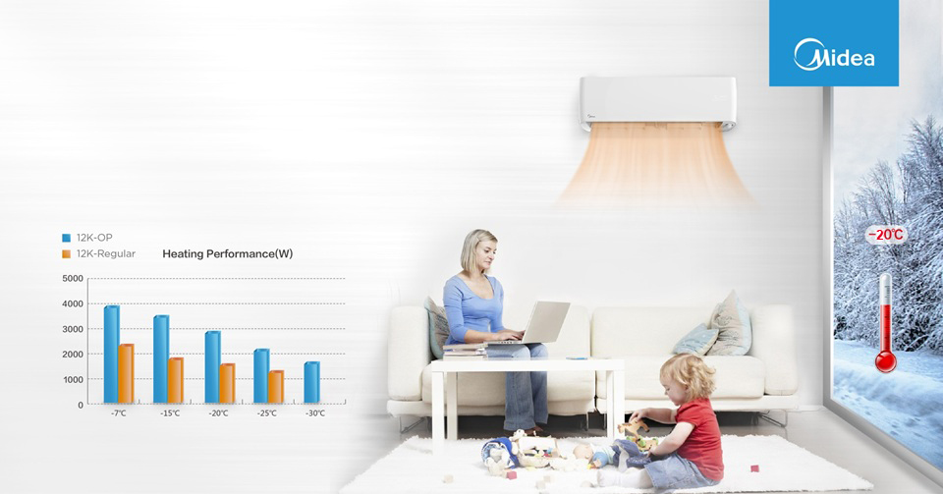

Low Ambient Heating
The advanced inverter technology to withstand the most extreme weather conditions. You can enjoy comfortable and heating air even when the outdoor temperature is as low as -25℃.

Slide 7
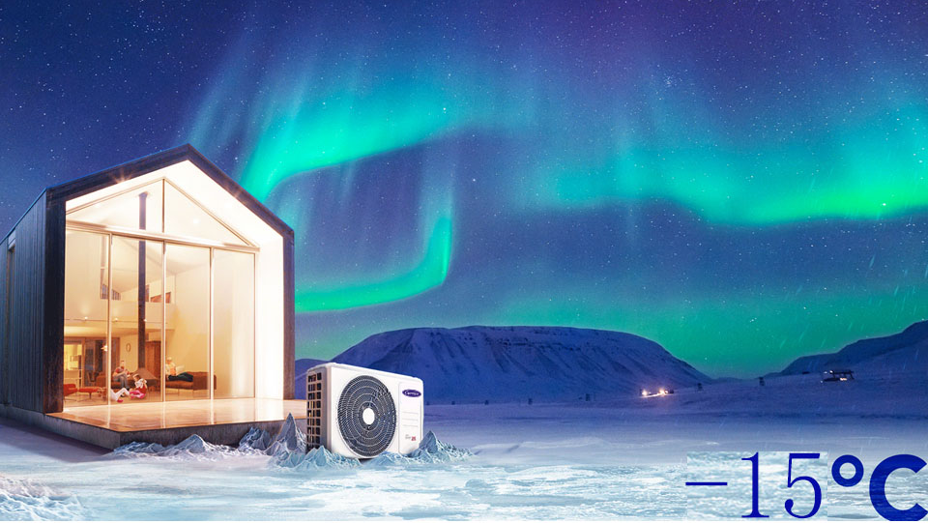
Low Ambient Cooling
With low ambient cooling function, the outdoor fan speed can be changed according to the condenser temperature and AC can run smoothly under the temperature as low as -15 ℃

Slide 8

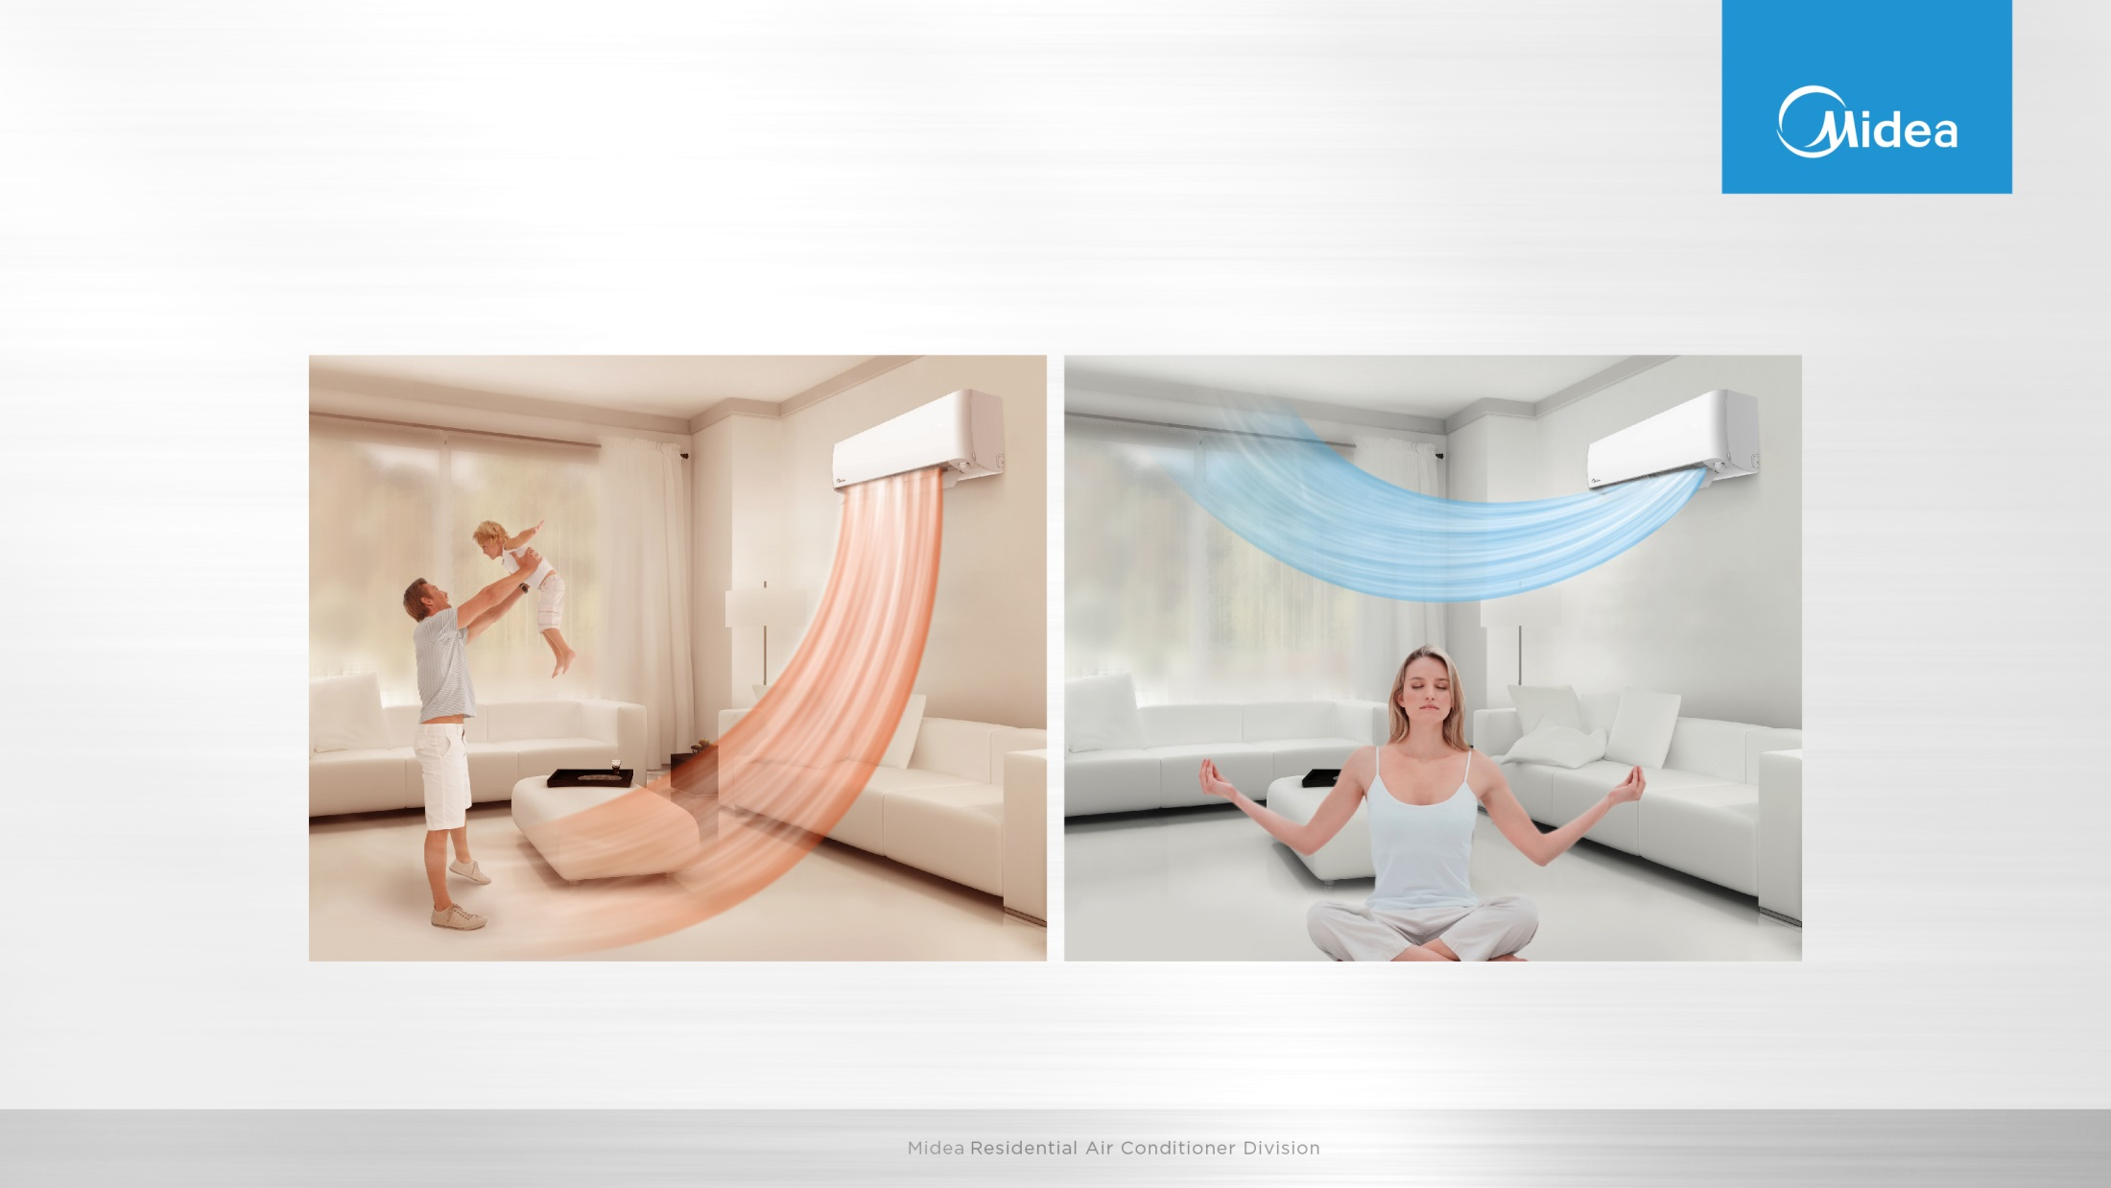
Comfort Airflow
Offers the most comfort airflow with warm air down to your toes, feeling spring in every corner of your room. Cool air up to the ceiling, enjoy a more homogeneous coolness around.

Slide 9
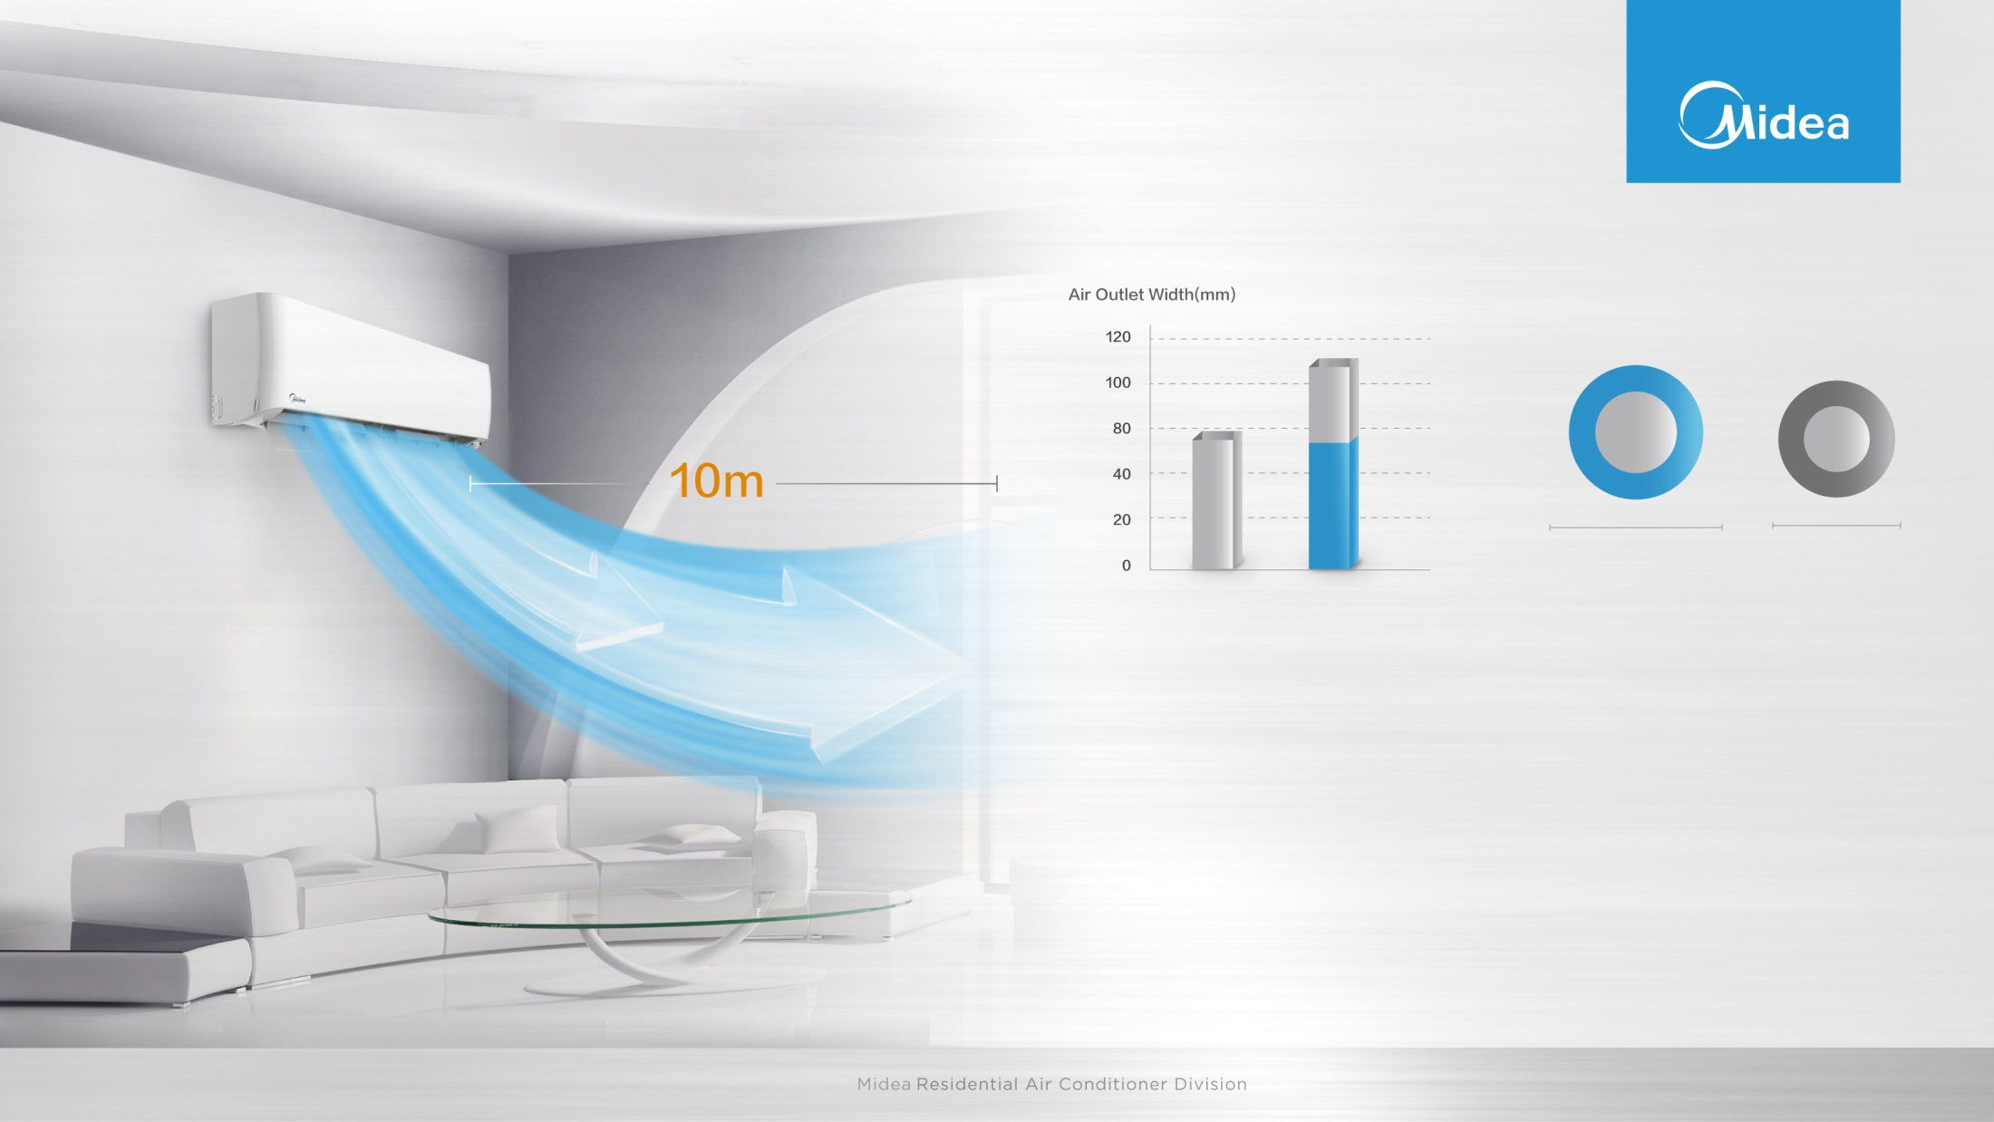
Strong Long Windblast
110
70-80
25%
108mm
94mm
Conventional AC
OP Series
OP Series
Conventional AC
Strong Airflow
Long Windblast
Air outlet design is 110mm wide, 25% bigger than conventional AC.
Take OP series as an example, indoor fan is φ 108mm wide, much bigger than conventional AC as φ82~94mm.

Slide 10
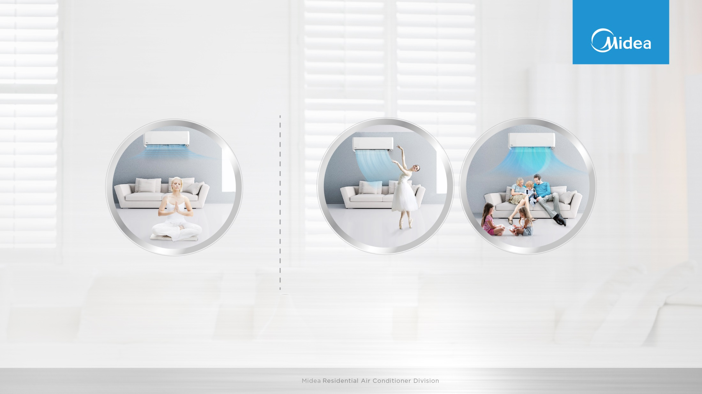
Intelligent Eye
Wind flow away from people
Wind flow follow people
The intelligent eye includes two functions. These two function is selected through the IR remote button.
1. wind flow away from people
2. wind flow follows the people.

Slide 11
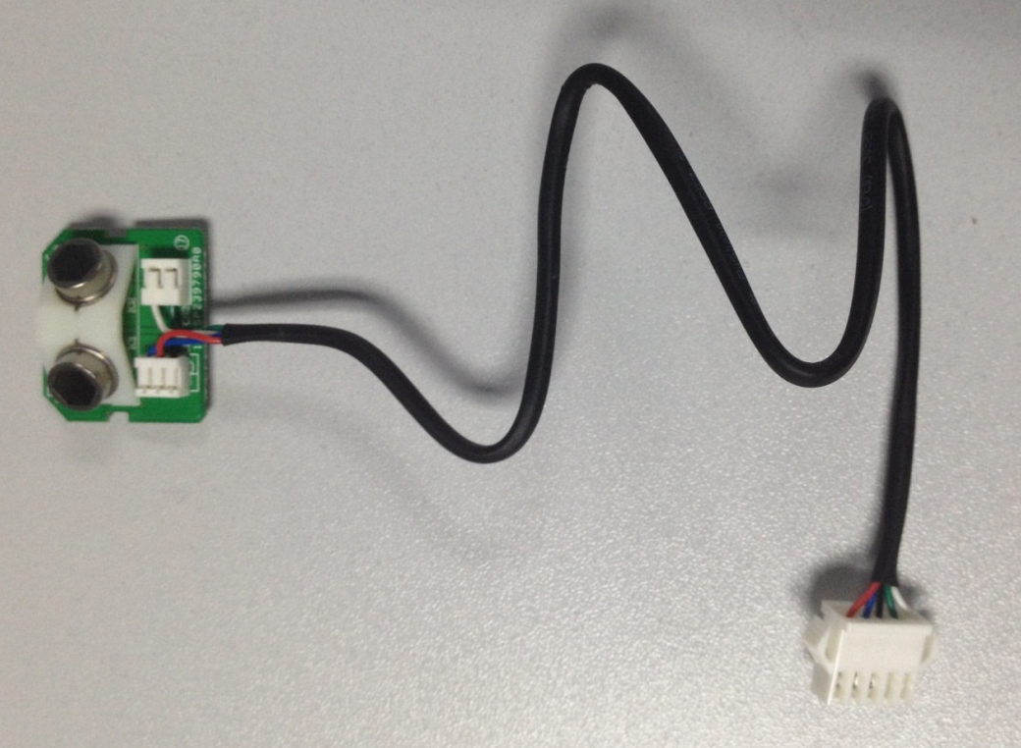
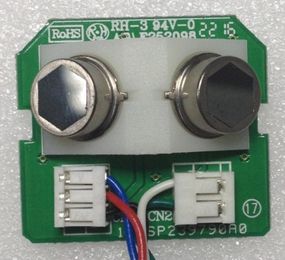
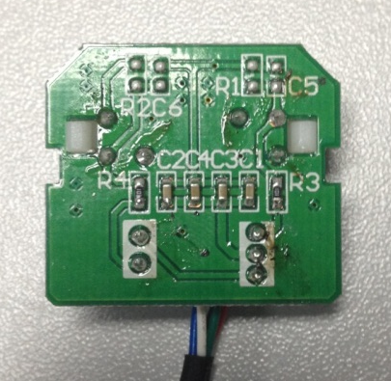
Intelligent Eye

Slide 12
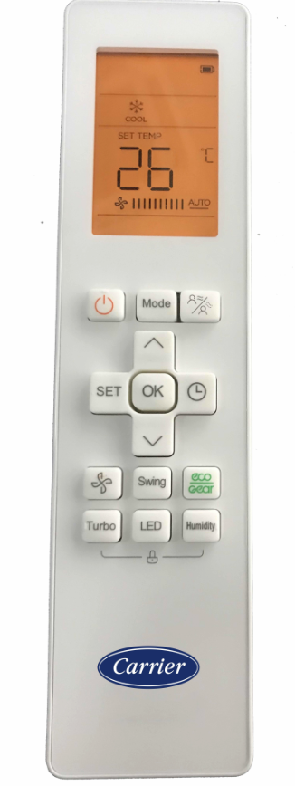
Intelligent Eye
Press the Intelligent Eye button to activate 'wind flow follow people' feature, the fan speed is Auto, and the auto swing feature is activated.
Press it again to stop and activate the 'wind flow away people' feature. The fan speed is Auto, and the auto swing feature is turned off.
Press it the third time to stop the ‘wind flow away people feature’,and exit this function.
wind flow follow people
wind flow away people
exit this function
RG10

Slide 13
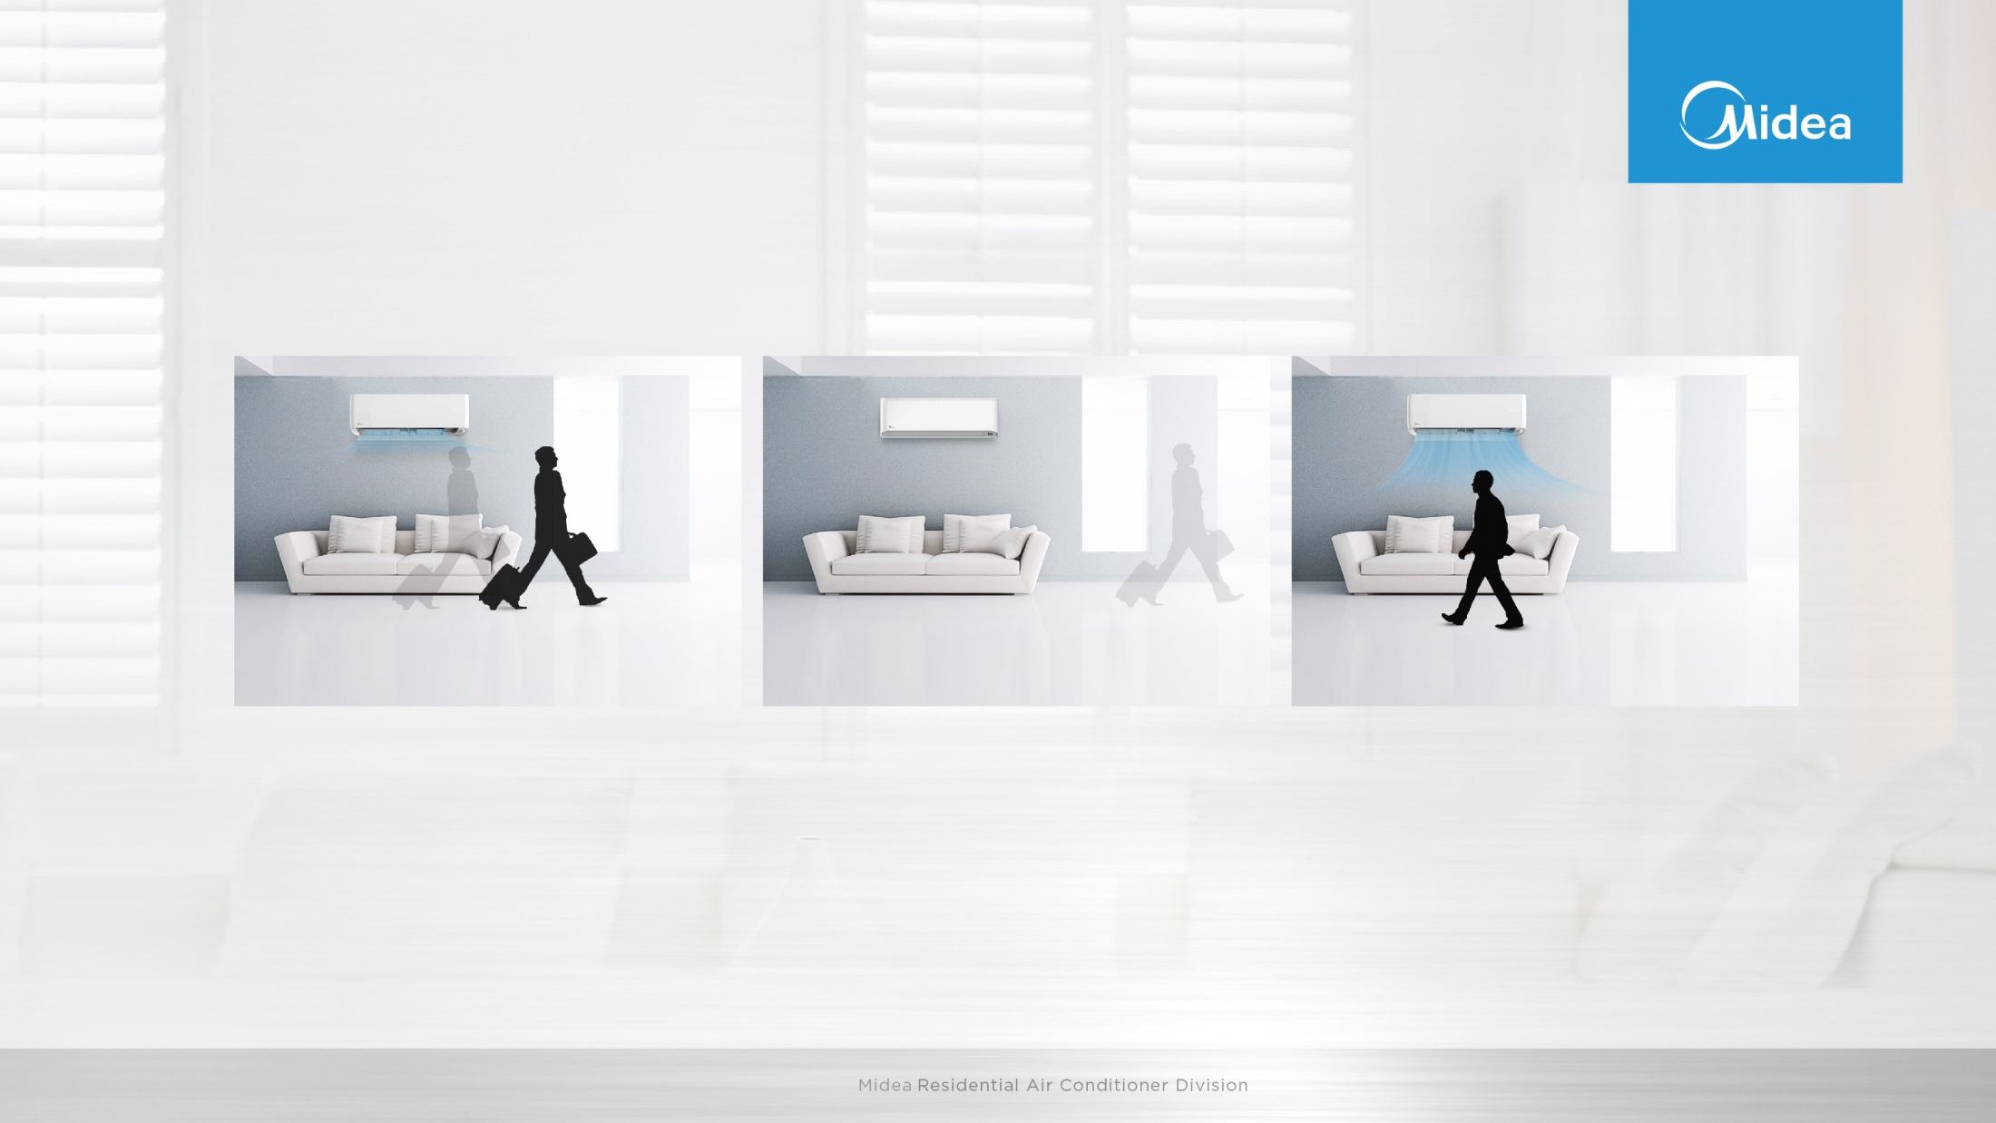
Intelligent Eye
Besides, with intelligent eye, the unit can achieve energy saving mode when people are away.
When you are away for 30 minutes, automatically lowers the frequency to save energy (for inverter modes only)
When you are away for 2 hours, automatically shuts down
When you returns to the room, automatically turns on

Slide 14

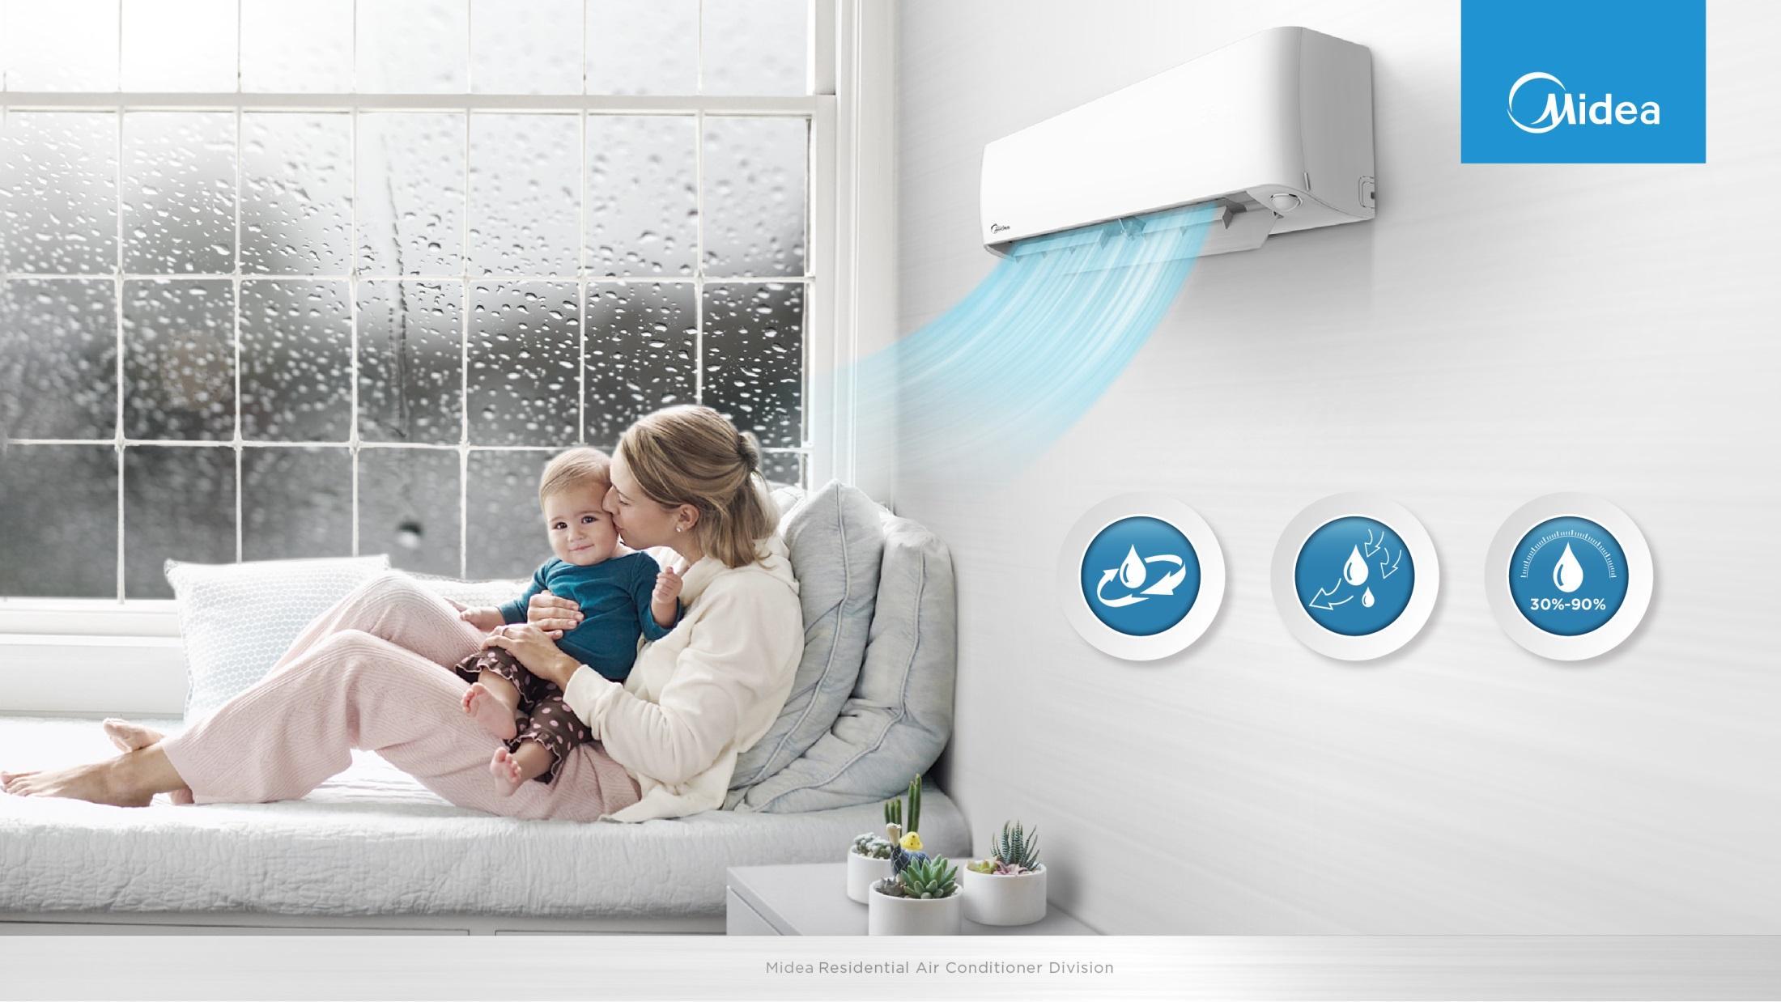
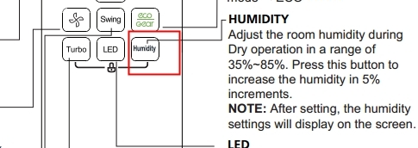
Comfort Humidity
With smart sensor technology, not only detect the temperature but also detect humidity level of the room. Through smart APP, you can customize your most comfortable humidity level, applicable from 35%-85%.
35%~85%
Power Mode
2805ml/h
Normal Mode
1757ml/h
DIY Mode

Slide 15
Compressor belt heater
This heating belt is to preheat the inverter upon start-up to get rid of the external coldness and get the compressor ready in a split second for the heating.
Notes:
Compressor belt heater: preheating for unit operate, ensure unit quickly work when the coldness.

Slide 16

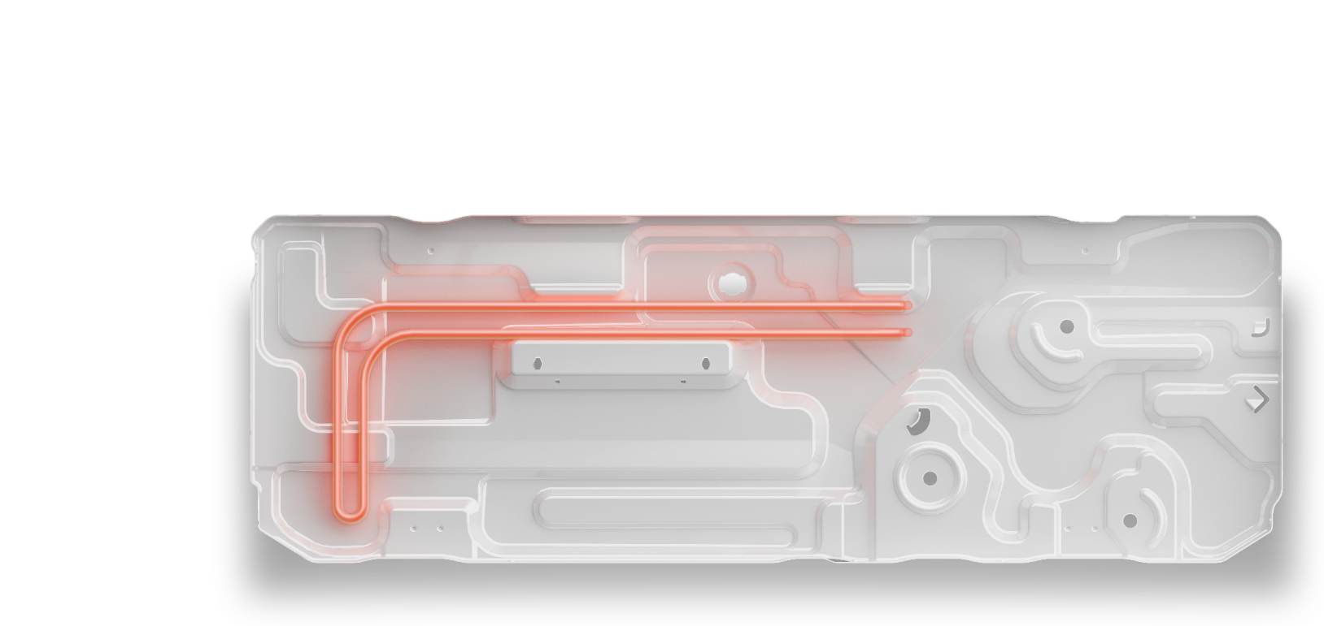
Base Pan heater
With 1.9 times of former output power and brand-new stainless steel material, the base pan heater can quickly melt and remove snow & ice in the outdoor unit, ensuring stable heating capacity.
stainless steel
Unfrozen rate: 100% defrostation for 72-hour low-frequency operation (Inside: 10°C; Outside: -10°C)
Notes:
Base Pan heater: quickly melt and remove snow & ice in the outdoor unit, ensuring stable heating capacity.

Slide 17
Feature list

Slide 18
Part II Difference to old unit
Difference QHP models
between old and new

Slide 19

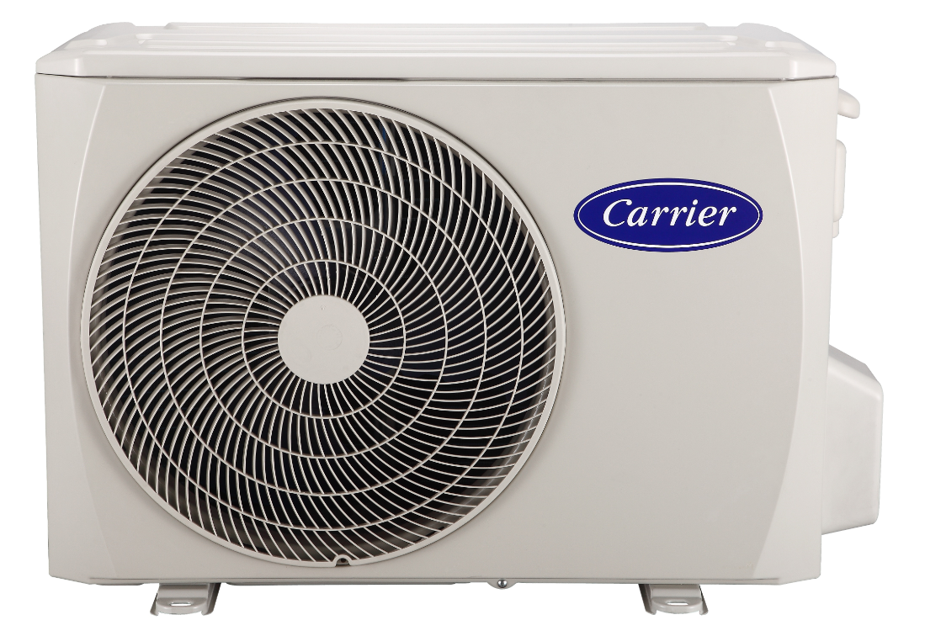
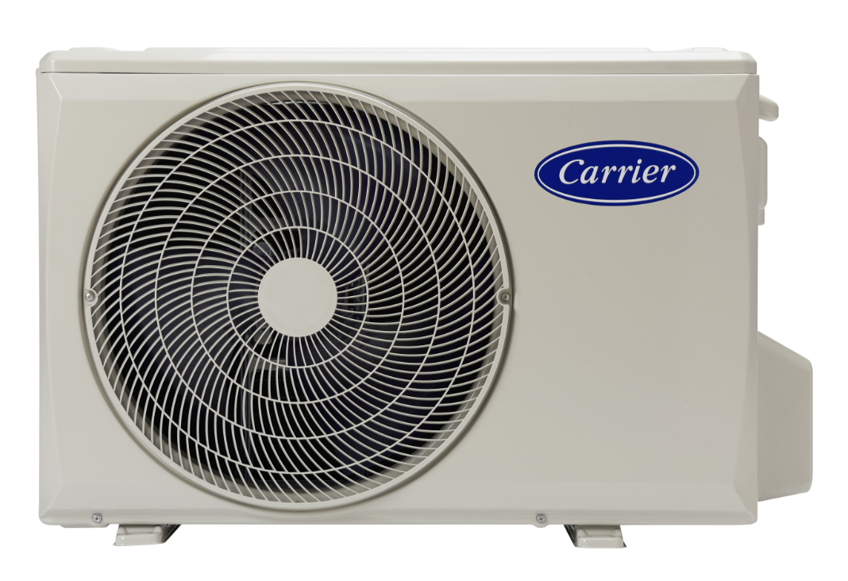
Difference1CDU chassis updates
New
Old
B chassis
Dimensions (W×D×H)
800×333×554
X3 chassis
Dimensions (W×D×H)
805x330x554
Notes: Product ODU chassis standardization required, AB/B/BA/CA chassis will update into X chassis in sep,2021.

Slide 20
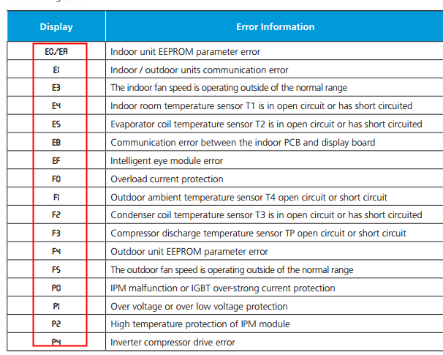
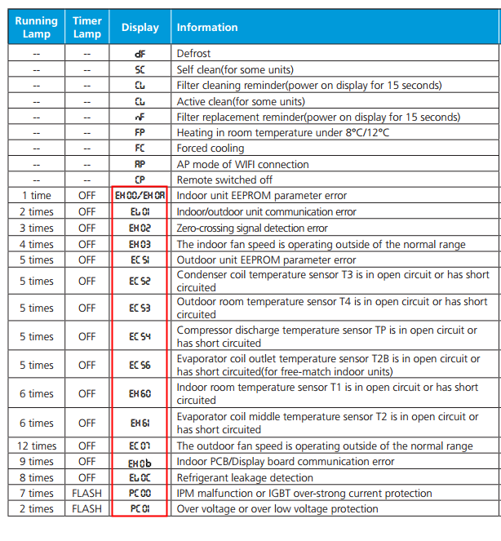
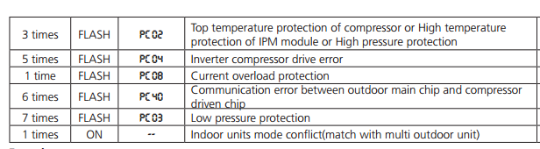
Difference2
Error code updated
New
Old
Notes: error code display updated into four digits from two digits,
so the display PCB and E-box code updated.

Slide 21
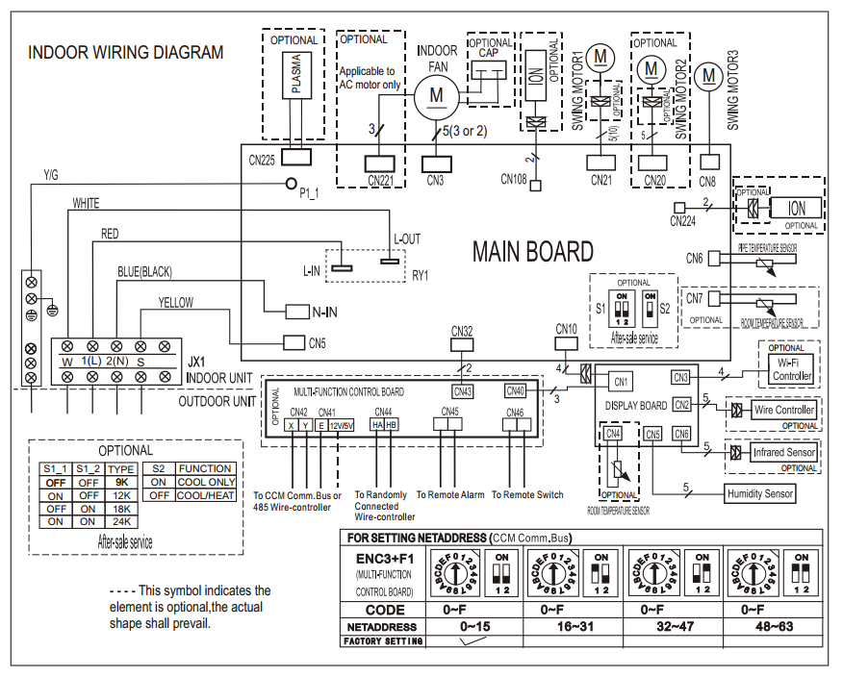
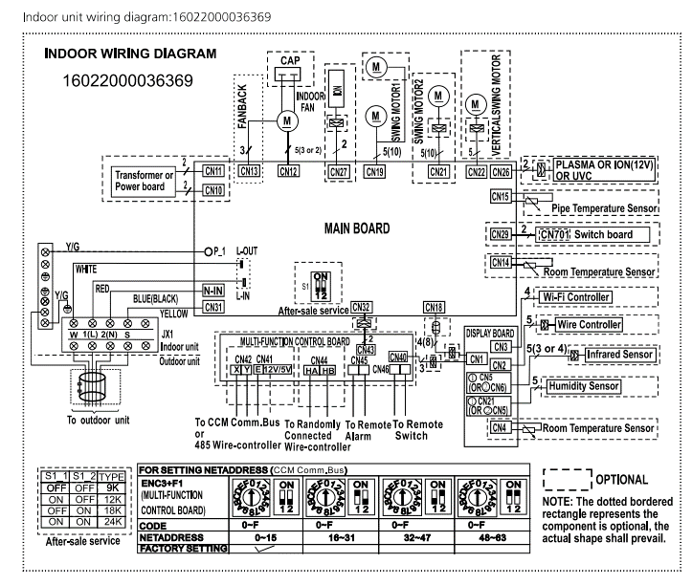
Difference3
Wiring diagram/IDU
New
Old
Notes: as the control program are difference, the new QHP and old QHP are not compatible.

Slide 22
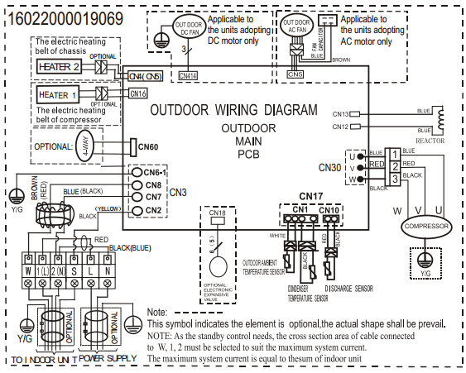
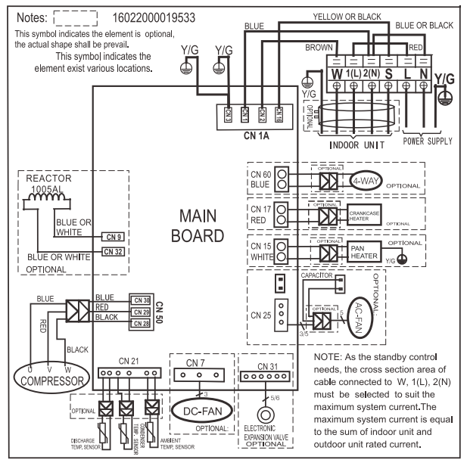
Difference3
Wiring diagram/ODU
New
Old
Notes: as the control program are difference, the new QHP and old QHP are not compatible.

Slide 23
Other Differences
Notes: Compressor and fan motor of ODU are different, so the performance will be difference, the details refer to spec .

Slide 24
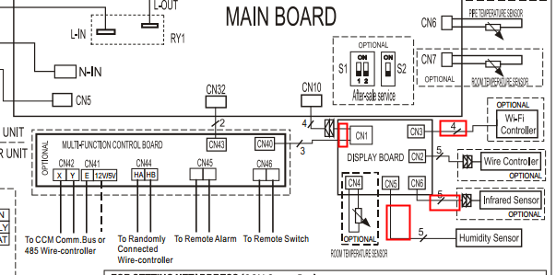
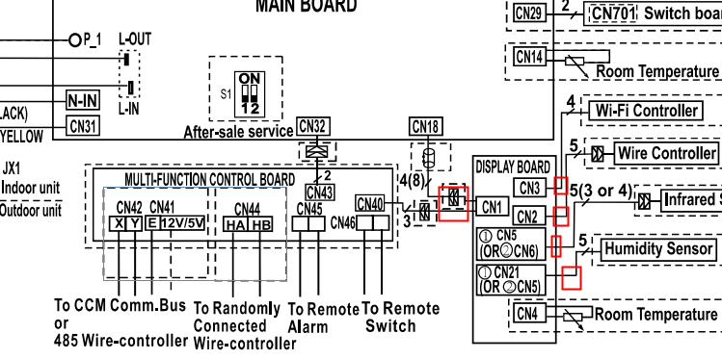
Multi function board clarification
Actually old and new multi function board combined display PCB could use old and new QHP models, mainly display PCB difference, pls refer to below:
Old
New
Notes: For old and new QHP models, multi function board only could connect 5V -4core-485 wired controller(120X1or 120G1), as main PCB don’t support any more 12V wired controller

Slide 25
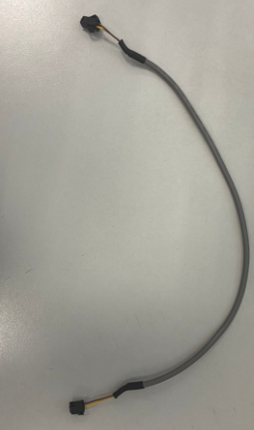
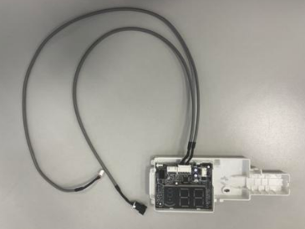
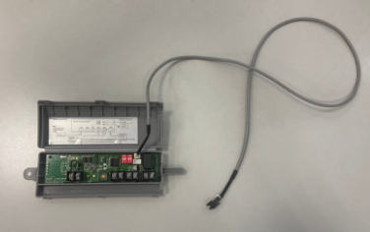
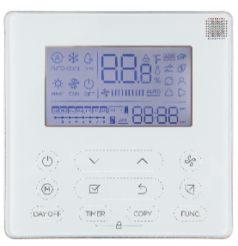
Multi function board clarification
Installation
Multi function board clarification
1.Part list
3-wired cable
2-wired cable
2-wired 12V cable
4-wired cable
CN1
CN43
X+Y+E+5V TB
for connecting to 120X1
17222000A63665
Display box subassembly
Already ignore other controller and sensor cable
17222000A63675
Transfer Adapter
(Multi function board )
17401204A01014
12V from Main PCB
120X1 wired controller: 17317100A27614
4-core -5V 485 communication
This instruction photo only use for multi function board installation,
The PCB photo is only for reference.
Notes:
接线需要再确认

Slide 26
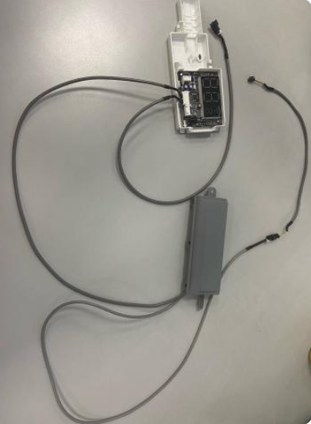
Multi function board clarification
Installation
2. Multi function board connection
2-wired 12V cable
Will connect with main PCB
4-wired cable
Will connect with main PCB
2-wired cable
Connect to 12V Cable
3-wired cable
Connect o adapter CN40
This instruction photo only use for multi function board installation,
the PCB photo is only for reference.
Notes:
接线需要再确认

Slide 27
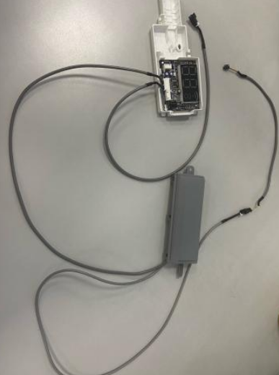
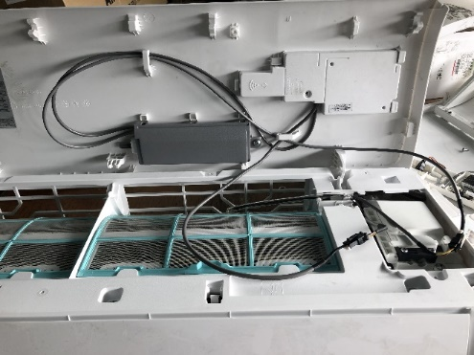
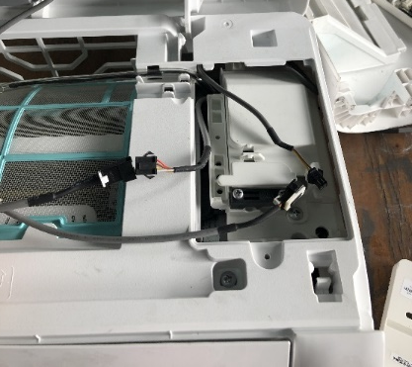
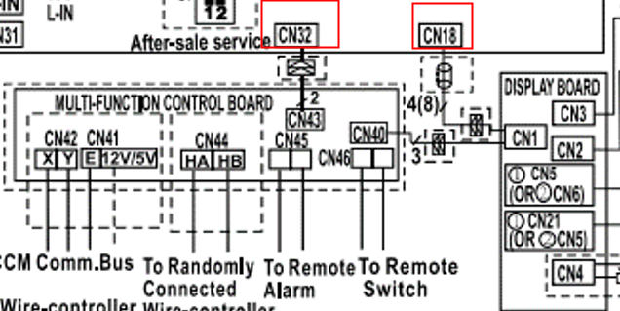
Multi function board clarification
Installation
3. Connect to main PCB
2-wired cable
4-wired cable
Install
2
1
3-wired cable
2-wired cable connect to main PCB board CN32.
4-wired cable connect to PCB board CN18.
communication
+12V power
communication
This instruction photo only use for multi function board installation,
the PCB photo is only for reference.
Notes:
接线需要再确认

Slide 28
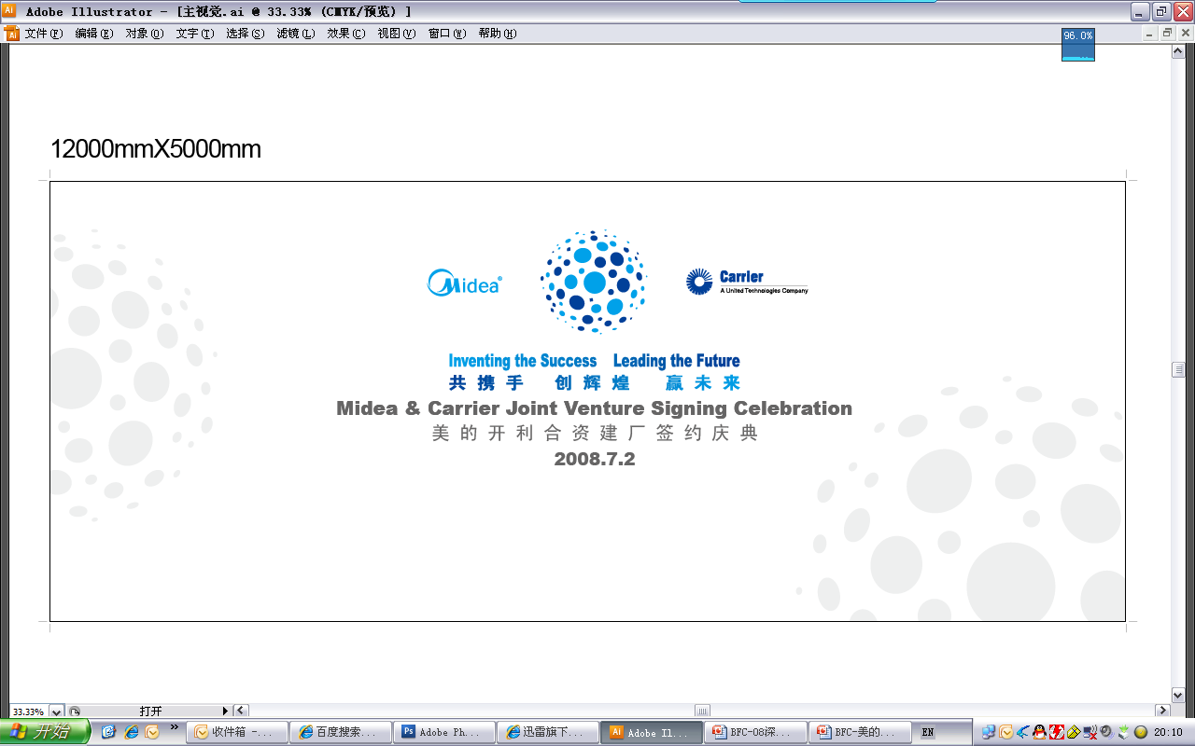
THANKS ！
Notes:
接线需要再确认

