Slide 1

GD Floor standing
R32 Cooling & Heating
3 DC inverter
FMCC 2022 April
Company Private

Slide 2
Contents
Part I Some Features
Part II Difference GD Floor standing
between old and new

Slide 3
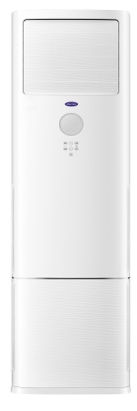
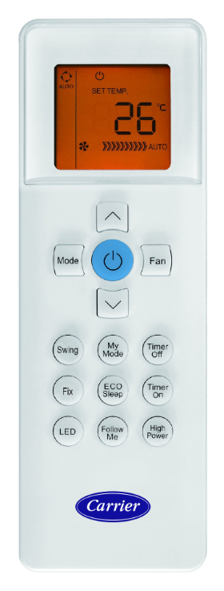
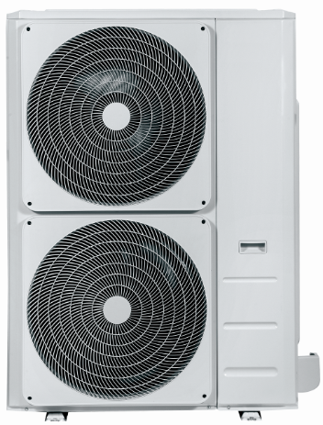

UNIVERTIAL CDU
RG67N
GD Floor-standing
Universal CDU
No | Inverter (R32) | SEER | SCOP | Operation temperature | Power supply | Remark
1 | ERP 48K | 6.2 A+++ | 4.0 A+ | 17~30 ℃ | 380~415V / 50Hz / 3Ph | European standard (EU)

Slide 4

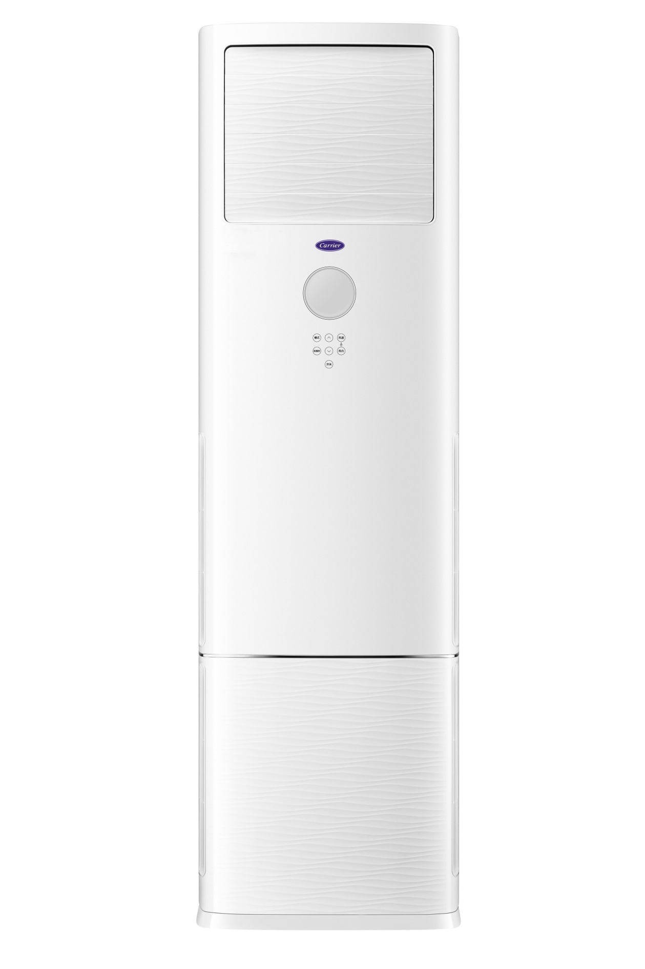
FLOOR STANDING
Features
Model Design
When the unit is shut down, the air outlet will automatically close to keep the dust out.
Dust-proof Air Outlet
VLED Hidden Display
Touch Buttons

Slide 5
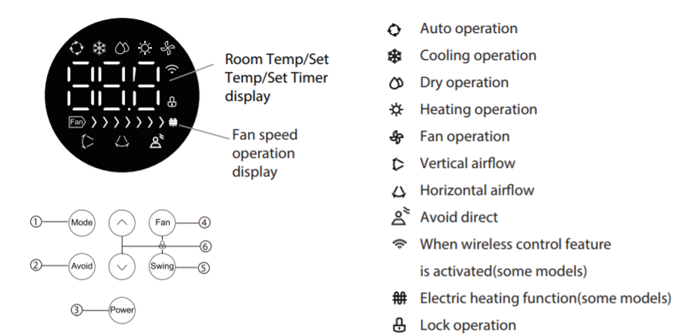
FLOOR STANDING
Features
VLED Display & Control Panel

Slide 6
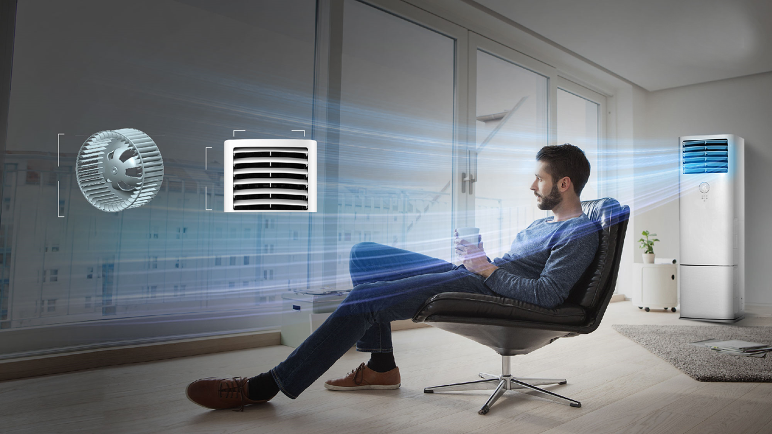
FLOOR STANDING
Features
Powerful Air Flow
Equipped with a powerful DC motor and a large-diameter centrifugal blower wheel to achieve an airflow of up to 2400 m³/h. The large air outlet and six large air directing blades enable an airflow distance of up to 12 m.
496mm
40cm
350mm
Large-diameter centrifugal blower wheel with a diameter of 40 cm
The air outlet area increases by 28%

Slide 7
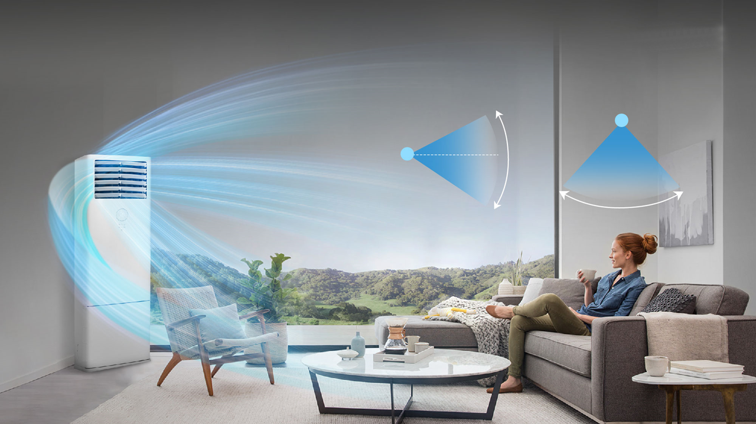
FLOOR STANDING
Features
3D Air Flow
Auto-swing horizontal and vertical air flap for optimal air distribution of supply air temperature and velocity inside air conditioned space.
50°
72°

Slide 8
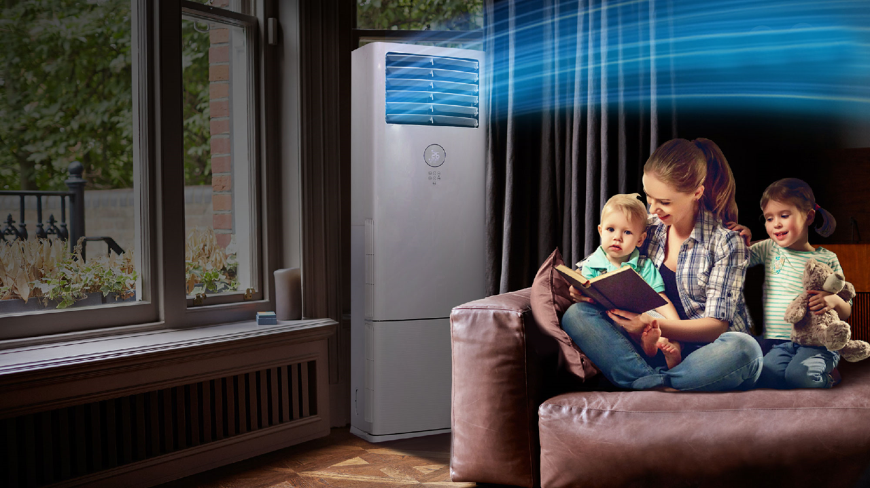
FLOOR STANDING
Features
Wind Avoid Me
With one tap of button, the airflow direction is automatically adjusted to the maximum angle to prevent direct cold/hot air flow person.
Notes:
只有机身的控制面板可以实现

Slide 9
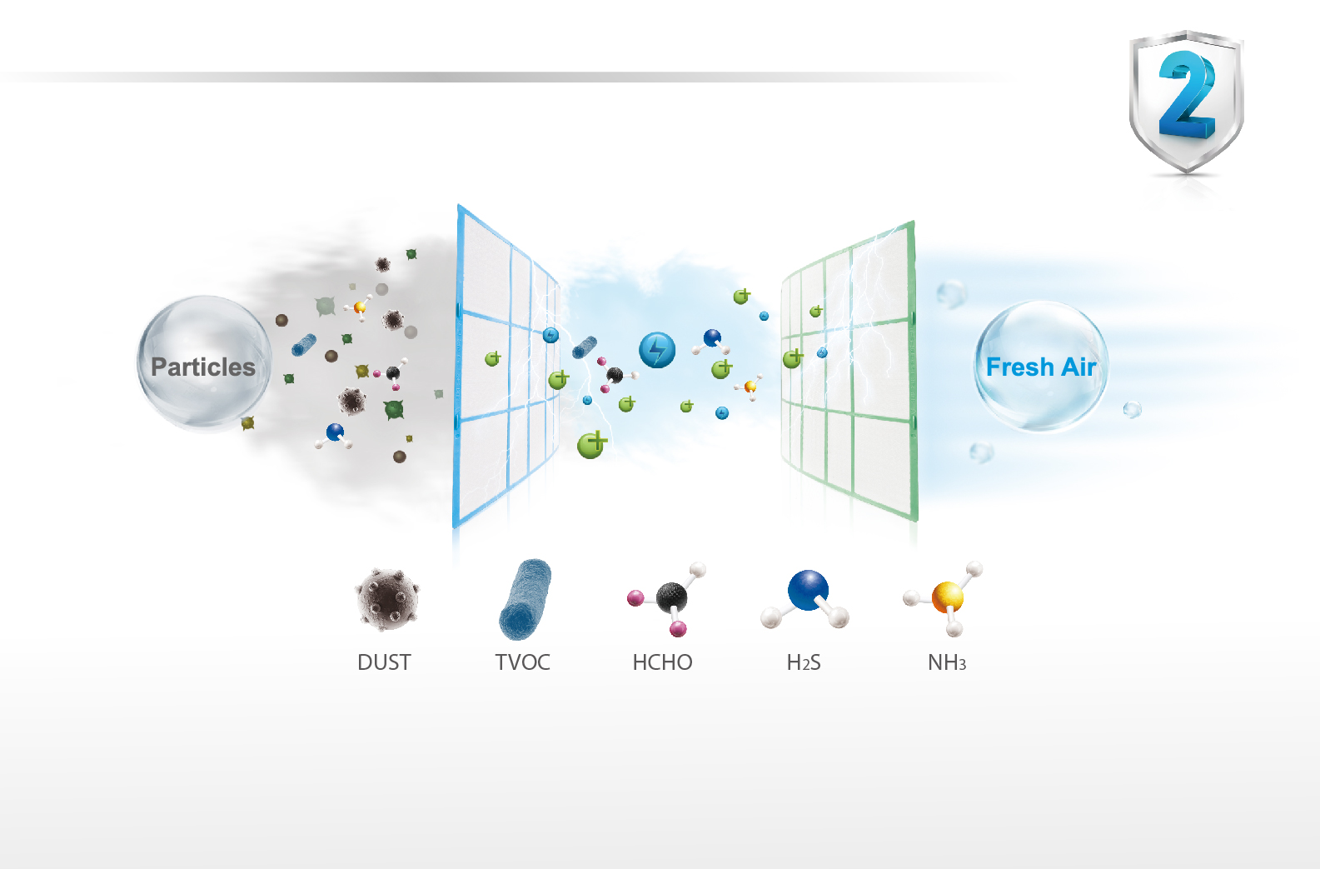
FLOOR STANDING
Features
Cleanable Dust Filter
High density filter removes the particles in the air, provides clean air always, and it is washable.

Slide 10
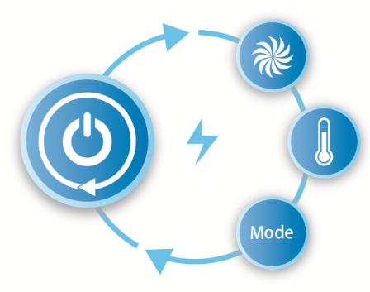
FLOOR STANDING
Features
Auto-Restart
If the air conditioner breaks off unexpectedly due to the power cut, it will restart with the previous function setting automatically when the power resumes.

Slide 11
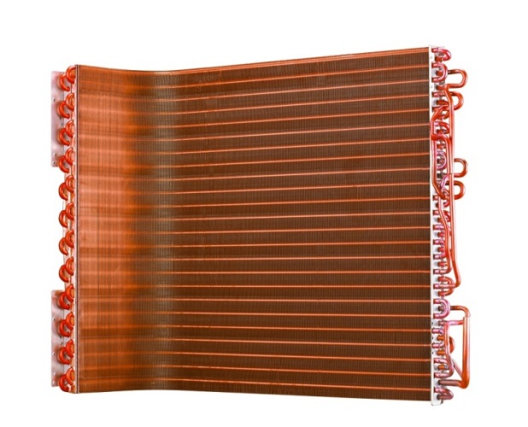
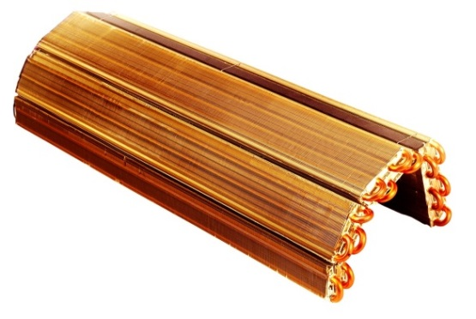
FLOOR STANDING
Features
Golden Fin Plus
The new generation anticorrosive golden coating on the heat exchangers can withstand the salty air, rain and other corrosive elements. It also effectively prevents bacteria from breeding and improves heat efficiency.
Indoor Coil (standard)
Outdoor Coil (standard for heat pump only)

Slide 12
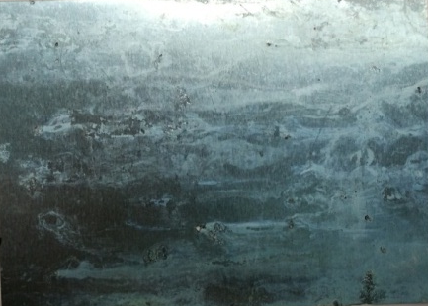
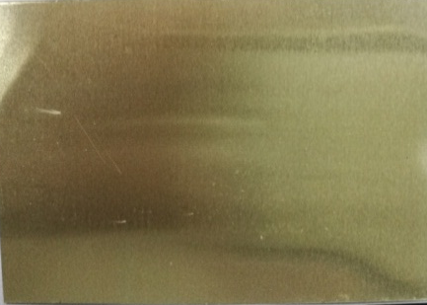
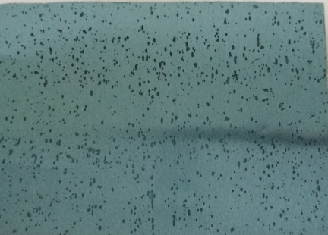
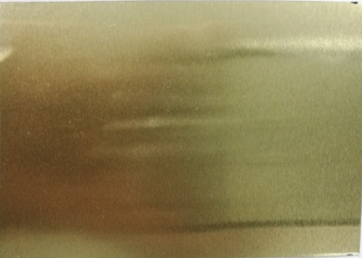
FLOOR STANDING
Features
Golden Fin Plus
Test 1
Test 2
Common Fin
Golden Fin
Common Fin
Golden Fin
Test1：1000h neutral salt spray (equivalent to 10+ years of service life under normal conditions): protection level ≥ 9.5, without perforation.
Test2：Acid resistance tests for 30 minutes (equivalent to 10,000 times accelerated acid rain test): corrosion area ≤ 0.5%.

Slide 13
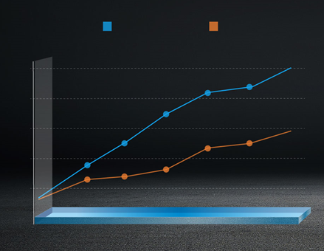
FLOOR STANDING
Features
Golden Fin Plus
Test 3: Dry-wet cycle tests 3000 times (equivalent to using an air conditioner for 10 years): the golden fin still has good hydrophilicity (hydrophilic angle θ≤30°).
Test 3
Common Fin
Gold Fin
Contact Angle (°)
50
40
30
20
10
0
500
1000
1500
2000
2500
3000
3500

Slide 14
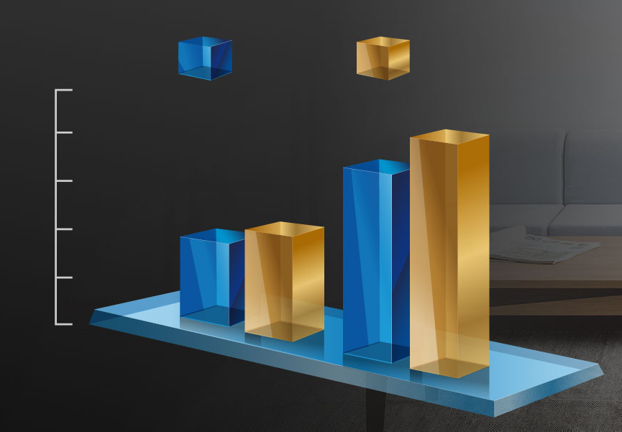
FLOOR STANDING
Features
Golden Fin Plus
After one year of operation, the prototype with golden coating shows better performance in all working conditions than the prototype with common coated foil.
Capacity
Common Fin
Golden Fin
Cooling
Heating

Slide 15








FLOOR STANDING
Other Features
Standard Features
Optional Features
Self-diagnosis and Auto-protection
Sleep Mode
☼ Crankcase Heater
☼ Base Pan Heater
Easy-cleaned Panel
LCD Display
Anti-Rust Cabinet
Independent Dehumidification
Auto Restart
Function
Timer
Golden Fin

Slide 16

Part II Difference to old unit
Difference GD Floorstanding
between old and new

Slide 17
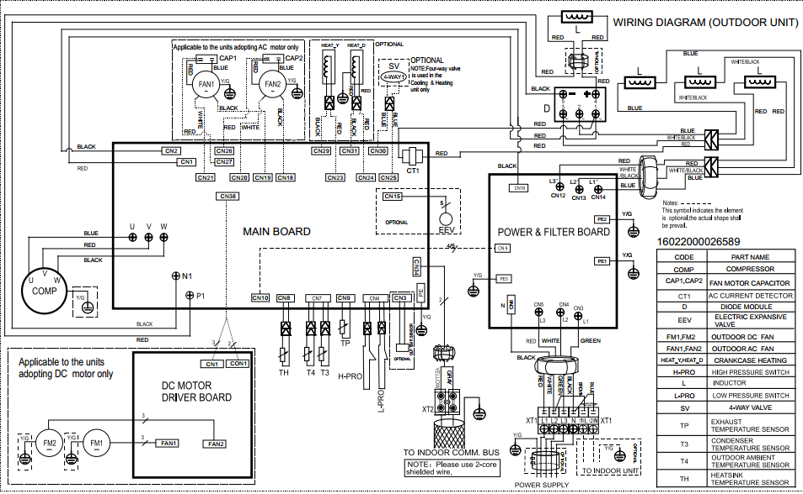
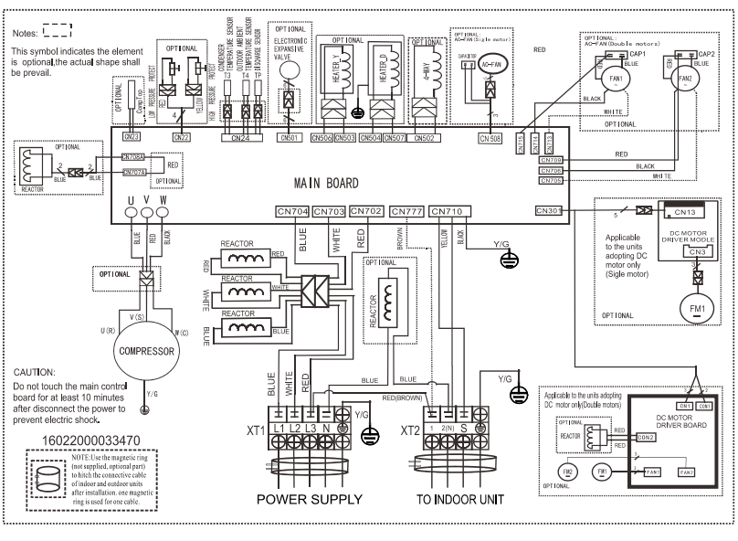
Difference1
IDU and CDU control update
Old
New ODU
Old: 485 communication: L/N/E+S1/S2
New current loop: L/N/S/E
Note，
Because of the communication way difference , new LCAC ERP and old LCAC ERP are not compatible .
New LCAC ERP IDU just match new LCAC ERP ODU.
Old LCAC ERP IDU just match Old LCAC ERP ODU.

Slide 18
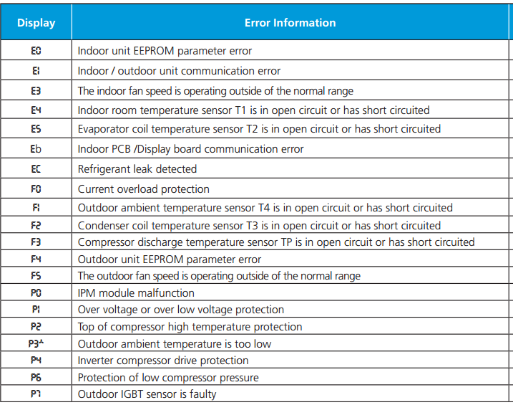
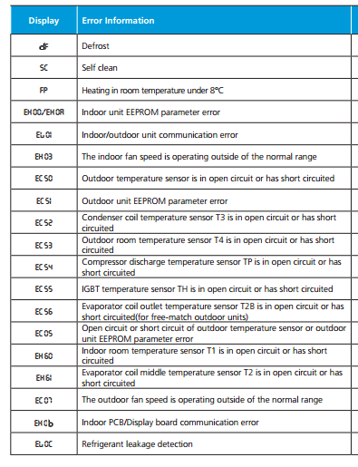
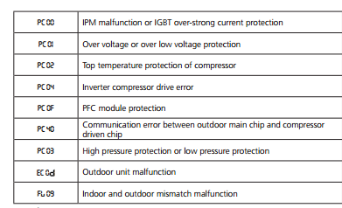
Difference2
Error code updated
Old
New
Notes: error code display updated into four digits from two digits,
so the display PCB and E-box code updated.

Slide 19
Other Differences
Notes: As control difference, performance data will difference , details refer to spec .

Slide 20
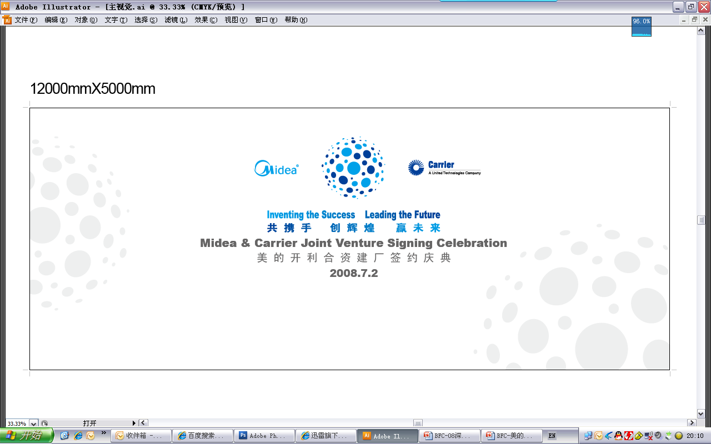
THANKS ！

