Slide 1
EUROP LCAC change
May , 2021

Slide 2
Light Commercial, complete overview
Series | Size | Model No. | KJR-120G2/X2 - four core wired（12V） | KJR-120G/X - two core wired (12V Non polarity) | Wifi port | main PCB1 board | main PCB2 board | main PCB3 board | KJR-120G1/X1 - four core wired (5V)
 |  |  |  |  |  |  |  |  | Connect to the Display
R32 IDU New Cassette | 7K-HP | 42QTD007D8S | Y | N | Y |  |  |  | /
 | 9K-HP | 42QTD009D8S | Y | N | Y |  |  |  | /
 | 12K-HP | 42QTD012D8S-1 | Y | N | Y |  |  |  | /
 | 18K-HP | 42QTD018D8S-2 | Y | N | Y |  |  |  | /
 | 24K-HP | 42QTD024D8S | N | Y | Y |  |  |  | /
 | 30K-HP | 42QTD030D8S | N | Y | Y |  |  |  | /
 | 36K-HP | 42QTD036D8S | N | Y | Y |  |  |  | /
 | 42K-HP | 42QTD042D8S | N | Y | Y |  |  |  | /
 | 48K-HP | 42QTD048D8S | N | Y | Y |  |  |  | /
 | 60K-HP | 42QTD060D8S | N | Y | Y |  |  |  | /
R32 IDUNew Under Ceiling | 12K-HP | 42QZA012D8S-1 | N | N | N |  |  |  | Y
 | 18K-HP | 42QZA018D8S-1 | N | N | N |  |  |  | Y
 | 18K-HP | 42QZL018D8S-2 | N | Y | N | 17122700001915 | 17122700A02648 | 17122700A02688 | /
 | 24K-HP | 42QZL024D8S | N | Y | N | 17122700001915 | 17122700A02648 | 17122700A02688 | /
 | 36K-HP | 42QZL036D8S | N | Y | N | 17122700001895 | 17122700A02647 | 17122700A02686 | /
 | 48K-HP | 42QZL048D8S | N | Y | N | 17122700001895 | 17122700A02647 | 17122700A02686 | /
 | 60K-HP | 42QZL060D8S | N | Y | N | 17122700001895 | 17122700A02647 | 17122700A02686 | /
R32 IDU New Ducted | 7K-HP | 42QSS007D8S | Y | N | Y |  |  |  | /
 | 9K-HP | 42QSS009D8S | Y | N | Y |  |  |  | /
 | 12K-HP | 42QSS012D8S-1 | N | Y | N | 17123000007398 | 17123000A03227 | 17123000A03307 | /
 | 18K-HP | 42QSS018D8S-1 | N | Y | N | 17123000007299 | 17123000A03225 | 17123000A03305 | /
 | 24K-HP | 42QSS024D8S | N | Y | N | 17123000007299 | 17123000A03225 | 17123000A03305 | /
 | 30K-HP | 42QSS030D8S | N | Y | N | 17123000007299 | 17123000A03225 | 17123000A03305 | /
 | 36K-HP | 42QSS036D8S | N | Y | N | 17123000007305 | 17123000A03245 | 17123000A03308 | /
 | 42K-HP | 42QSS042D8S | N | Y | N | 17123000007305 | 17123000A03245 | 17123000A03308 | /
 | 48K-HP | 42QSS048D8S | N | Y | N | 17123000007305 | 17123000A03245 | 17123000A03308 | /
 | 60K-HP | 42QSS060D8S | N | Y | N | 17123000007305 | 17123000A03245 | 17123000A03308 | /

Slide 3
PCB function
- New Cassette QTD
Series | Size | Model No. | KJR-120G2/X2 - four core wired（12V） | KJR-120G/X - two core wired (12V Non polarity) | Wifi port | main PCB1 board | main PCB2 board | main PCB3 board | KJR-120G1/X1 - four core wired (5V)
 |  |  |  |  |  |  |  |  | Connect to the Display
R32 IDU New Cassette | 7K-HP | 42QTD007D8S | Y | N | Y |  |  |  | /
 | 9K-HP | 42QTD009D8S | Y | N | Y |  |  |  | /
 | 12K-HP | 42QTD012D8S-1 | Y | N | Y |  |  |  | /
 | 18K-HP | 42QTD018D8S-2 | Y | N | Y |  |  |  | /
 | 24K-HP | 42QTD024D8S | N | Y | Y |  |  |  | /
 | 30K-HP | 42QTD030D8S | N | Y | Y |  |  |  | /
 | 36K-HP | 42QTD036D8S | N | Y | Y |  |  |  | /
 | 42K-HP | 42QTD042D8S | N | Y | Y |  |  |  | /
 | 48K-HP | 42QTD048D8S | N | Y | Y |  |  |  | /
 | 60K-HP | 42QTD060D8S | N | Y | Y |  |  |  | /
New Cassette Main control PCB | Wired controller port | Wifi port | Central control port
PCB1(standard) 24/30K 17122500004213 36~60K 17122500004211 | 120X(2core wired controller port | yes | yes
PCB2(optional) 24/30K 17122500A02909 36~60K 17122500A02907 | 120X2/120G2 (4core wired controller) port | yes | yes
Note，
TWINS and Central controller use same terminal X/Y/E, so these two functions you can just choose one

Slide 4
Electrical difference
PCB standard function
-New cassette
CN41
CN8
2 core non-polarity Wired controller
CN33
CN3
CN23
New Fan
Alarm
XYE/TWINS
ON-OFF
WIFI
CN38

Slide 5
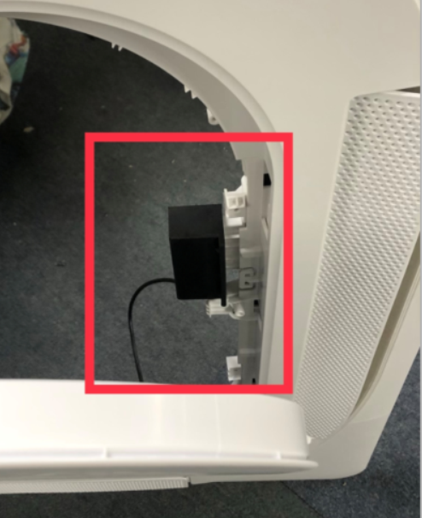
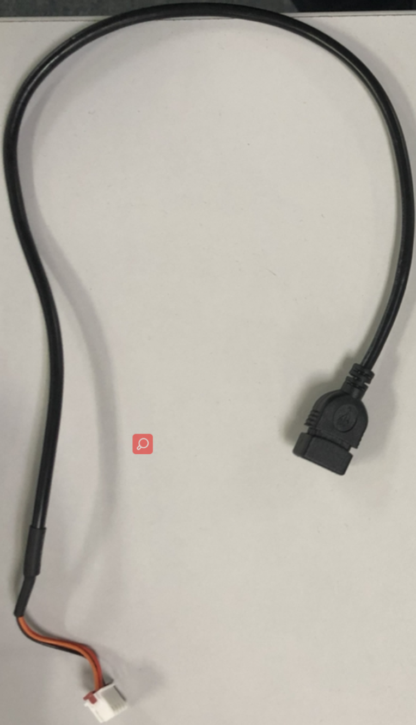
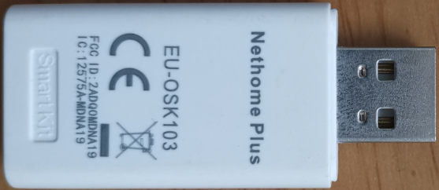
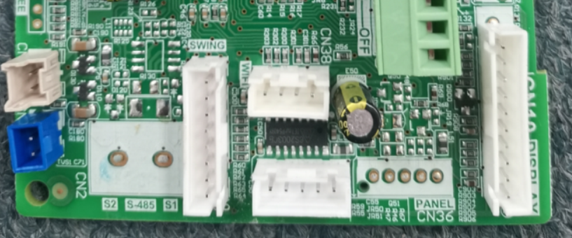
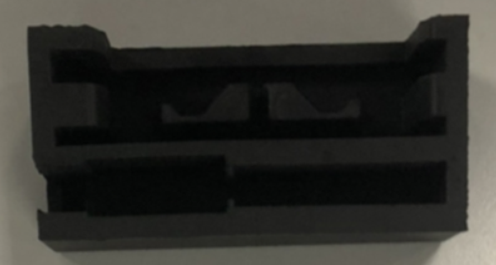
Electrical difference
WIFI connection
-New cassette wifi connection
①
③
②

Slide 6
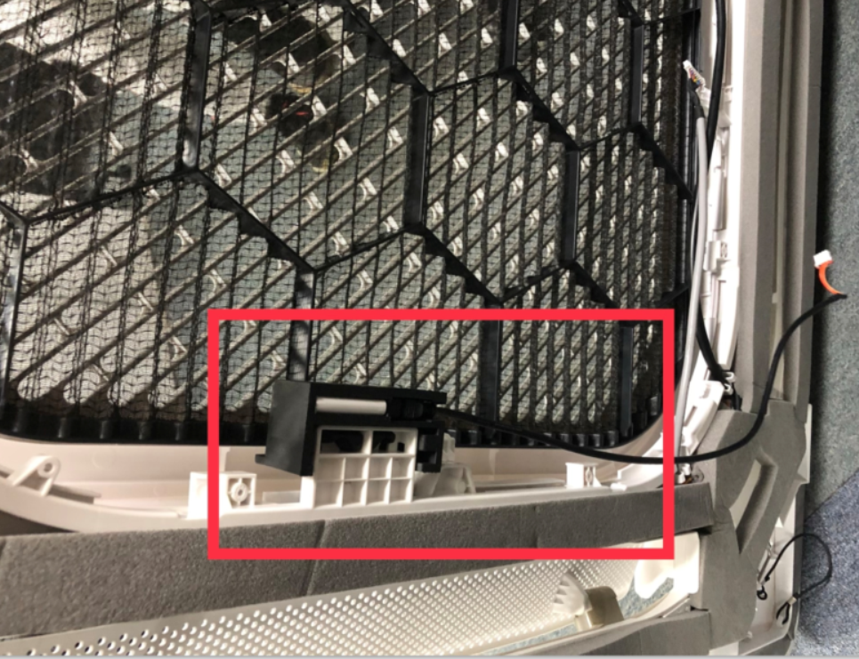
Electrical difference
WIFI connection
-New cassette wifi connection

Slide 7
PCB function
- Duct QSS
Series | Size | Model No. | KJR-120G2/X2 - four core wired（12V） | KJR-120G/X - two core wired (12V Non polarity) | Wifi port | main PCB1 board | main PCB2 board | main PCB3 board | KJR-120G1/X1 - four core wired (5V)
 |  |  |  |  |  |  |  |  | Connect to the Display
R32 IDU New Ducted | 7K-HP | 42QSS007D8S | Y | N | Y |  |  |  | /
 | 9K-HP | 42QSS009D8S | Y | N | Y |  |  |  | /
 | 12K-HP | 42QSS012D8S-1 | N | Y | N | 17123000007398 | 17123000A03227 | 17123000A03307 | /
 | 18K-HP | 42QSS018D8S-1 | N | Y | N | 17123000007299 | 17123000A03225 | 17123000A03305 | /
 | 24K-HP | 42QSS024D8S | N | Y | N | 17123000007299 | 17123000A03225 | 17123000A03305 | /
 | 30K-HP | 42QSS030D8S | N | Y | N | 17123000007299 | 17123000A03225 | 17123000A03305 | /
 | 36K-HP | 42QSS036D8S | N | Y | N | 17123000007305 | 17123000A03245 | 17123000A03308 | /
 | 42K-HP | 42QSS042D8S | N | Y | N | 17123000007305 | 17123000A03245 | 17123000A03308 | /
 | 48K-HP | 42QSS048D8S | N | Y | N | 17123000007305 | 17123000A03245 | 17123000A03308 | /
 | 60K-HP | 42QSS060D8S | N | Y | N | 17123000007305 | 17123000A03245 | 17123000A03308 | /
New Duct | Wired controller port | Wifi port | Central control port
PCB1(standard) | 120X(2core wired controller port | No | yes
PCB2(optional) | 120X(2core wired controller )port | yes | No
PCB3(optional) | 120X2/120G2 (4core wired controller) port | yes | yes
Note，
1. 2 WIRES WC(2 core non-polarity Wired controller) +wifi and TWINS and Central controller port all use the XYE terminal port so these three functions you can just choose one

Slide 8
PCB function
Under Ceiling QZL
Series | Size | Model No. | KJR-120G2/X2 - four core wired（12V） | KJR-120G/X - two core wired (12V Non polarity) | Wifi port | main PCB1 board | main PCB2 board | main PCB3 board | KJR-120G1/X1 - four core wired (5V)
 |  |  |  |  |  |  |  |  | Connect to the Display
R32 IDU New Ducted | 18K-HP | 42QZL018D8S-2 | N | Y | N | 17122700001915 | 17122700A02648 | 17122700A02688 | /
 | 24K-HP | 42QZL024D8S | N | Y | N | 17122700001915 | 17122700A02648 | 17122700A02688 | /
 | 36K-HP | 42QZL036D8S | N | Y | N | 17122700001895 | 17122700A02647 | 17122700A02686 | /
 | 48K-HP | 42QZL048D8S | N | Y | N | 17122700001895 | 17122700A02647 | 17122700A02686 | /
 | 60K-HP | 42QZL060D8S | N | Y | N | 17122700001895 | 17122700A02647 | 17122700A02686 | /
New Duct and under&ceiling | Wired controller port | Wifi port | Central control port
PCB1(standard) | 120X(2core wired controller port | No | yes
PCB2(optional) | 120X(2core wired controller )port | yes | No
PCB3(optional) | 120X2/120G2 (4core wired controller) port | yes | yes
Note，
1. 2 WIRES WC(2 core non-polarity Wired controller) +wifi and TWINS and Central controller port all use the XYE terminal port so these three functions you can just choose one

Slide 9
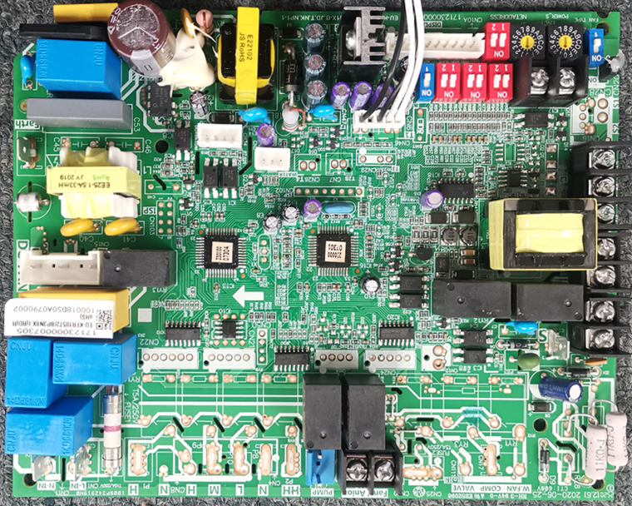
PCB1 standard function
- Duct and Under&Ceiling
PCB1 – standard 2 WIRES WC
CN23 ON-OFF
CN9 XYE(Central controller)/TWINS
CN45 2 core non-polarity Wired controller
CN33 Alarm
CN43 New Fan

Slide 10
PCB2 standard function
- Duct and Under&Ceiling
PCB2 - customize wifi port
CN23 ON-OFF
CN49 Wifi
CN45 2 core non-polarity Wired controller
CN33 Alarm
CN43 New Fan

Slide 11
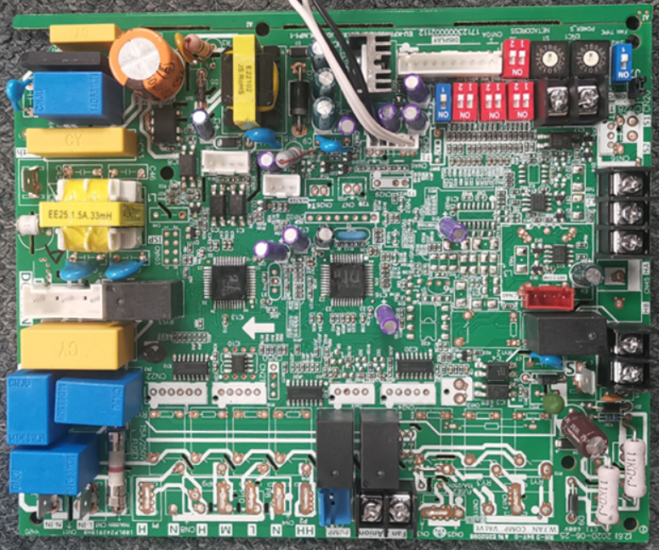
PCB3 standard function
- Duct and Under&Ceiling
PCB3 - customize 4 WIRES WC
CN23 ON-OFF
CN9 XYE(Central controller)/TWINS
CN40 4 WIRES(485) WC/WIFI
CN33 Alarm
CN43 New Fan

Slide 12
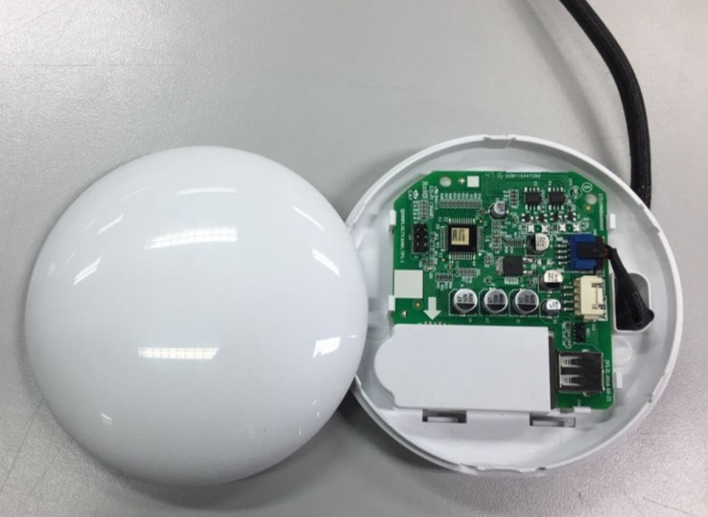
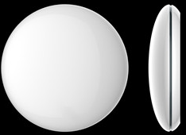
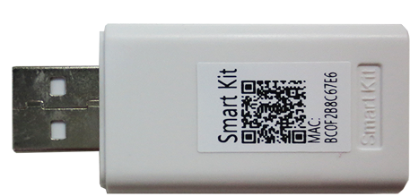
WIFI connection
- DUCT and under&ceiling wifi connection
Note , for DUCT and U&C type the original PCB don’t have wifi or CN40 terminal ， so it can not connect wifi module . If you want to connect wifi , you must customize .
Connection wire to LCAC product
USB Connection
WiFi Module

Slide 13
PCB function
- Console
Series | Size | Model No. | KJR-120G2/X2 - four core wired（12V） | KJR-120G/X - two core wired (12V Non polarity) | Wifi port | main PCB1 board | main PCB2 board | main PCB3 board | KJR-120G1/X1 - four core wired (5V)
 |  |  |  |  |  |  |  |  | Connect to the Display
R32 | 12K-HP | 42QZA012D8S-1 | N | N | N |  |  |  | Y
Console | 18K-HP | 42QZA018D8S-1 | N | N | N |  |  |  | Y

Slide 14
Electrical difference
PCB function
- Console
Functions | Standard | Optional
Infrared WRC | Y | N
2 WIRES WRC | N | N
4 WIRES WRC | Y | N
CCM WC | N | N
WIFI | N | N
ON-OFF | Y | N
ALARM | N | N
Connect 120G1/120X1 WRC
New Console
Connect to display board
Functions | Standard | Optional
Infrared WRC | Y | N
2 WIRES WRC | N | N
4 WIRES WRC | N | Y
CCM WC | N | N
WIFI | N | N
ON-OFF | Y | N
ALARM | N | N
Old Console
Connect 12B WRC

Slide 15
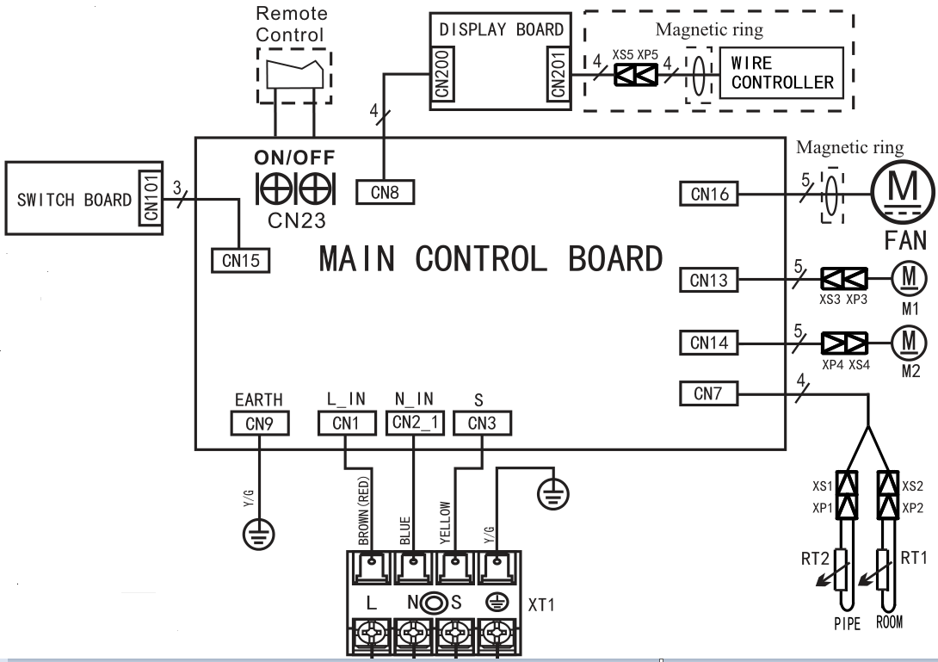
Electrical difference
PCB function
- Console
CN201 4 WIRES(485) WRC
Connect to 120G1/X1
CN23 ON-OFF

Slide 16
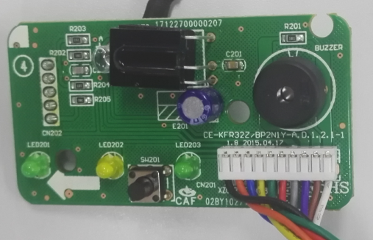
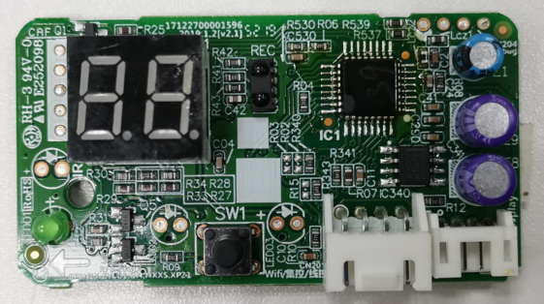
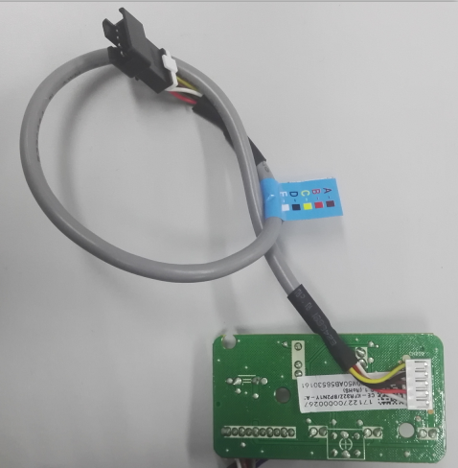
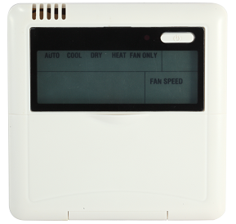
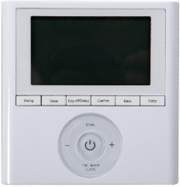
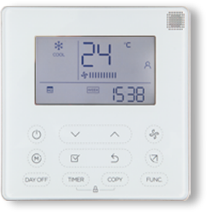
Electrical difference
PCB function
- Console
Old display
New display
Infrared WRC connection
Connect 485 WRC
12B(5 core)
120G1/120X1(4 core)

Slide 17
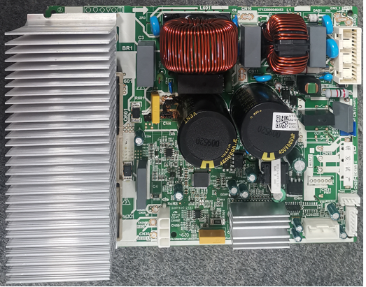
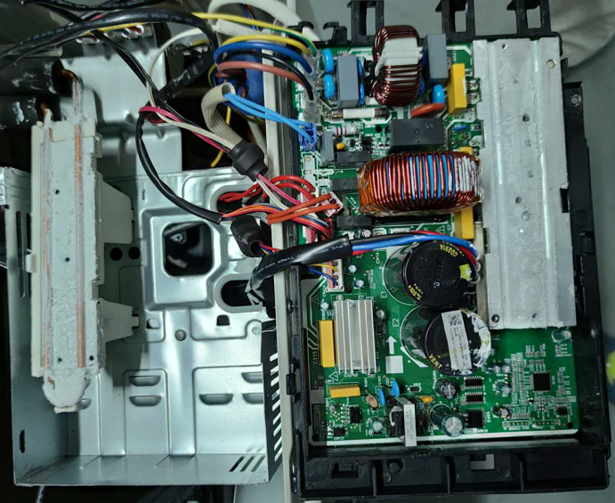
Electrical difference
New refrigerant cool stream inverter technology
old: Fan cool inverter technology
New: Refrigerant cool stream inverter technology

Slide 18
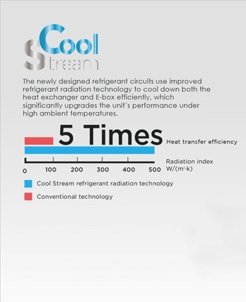
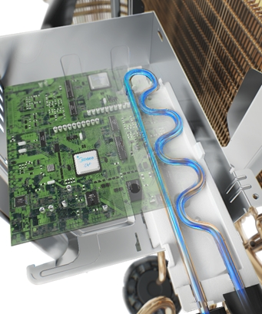
Electrical difference
New refrigerant cool stream inverter technology

Slide 19
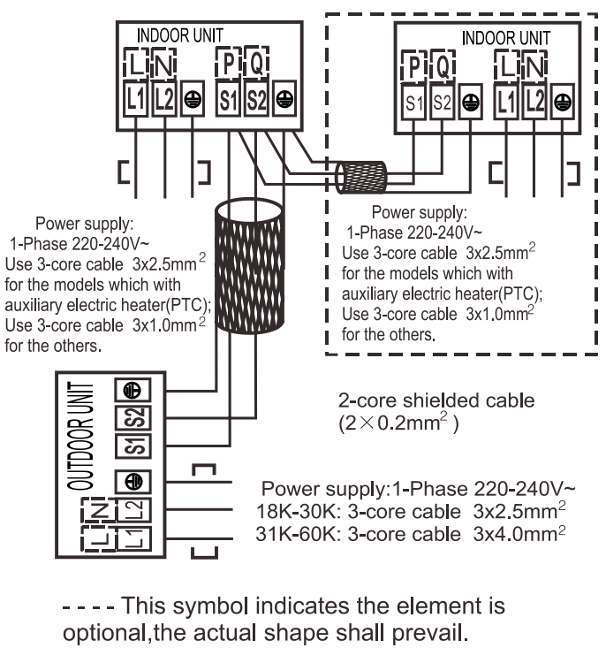
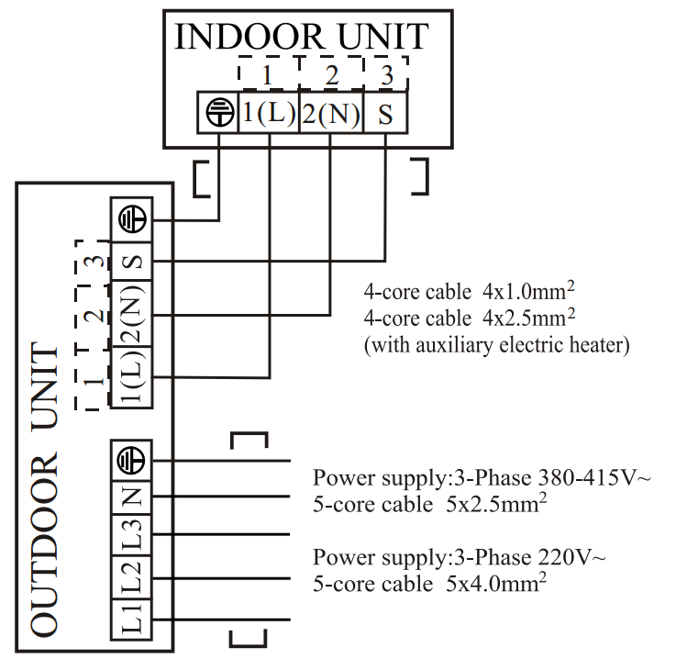
Electrical difference
Communication way
Old: 485 communication: L1/N/E+S1/S2
Same as CAC products
New current loop: L/N/S/E
Same as RAC split and multi

Slide 20
The end

