Slide 1
EUROP LCAC change
May , 2021

Slide 2
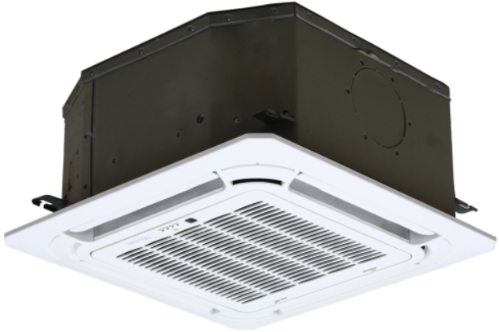
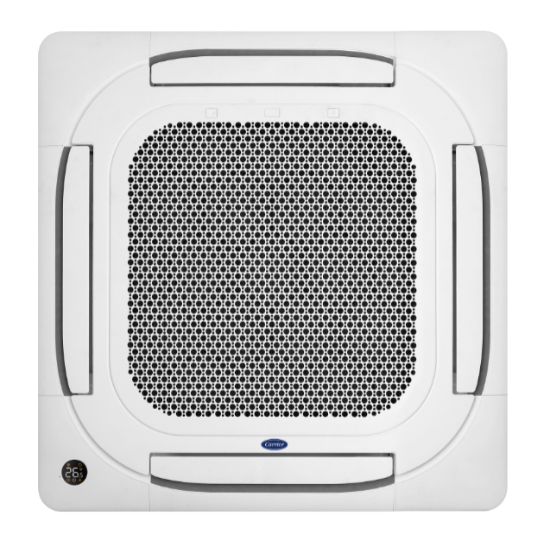
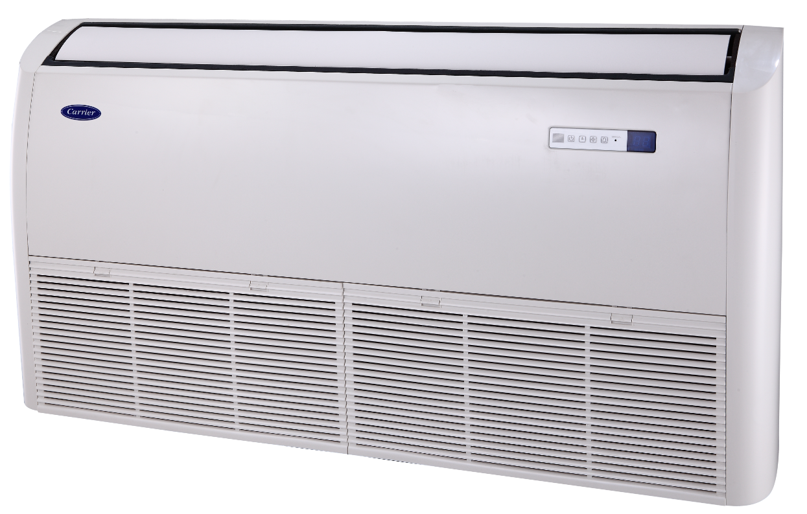
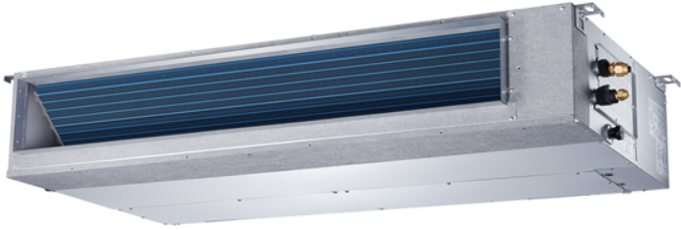
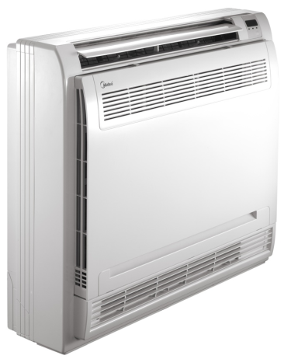
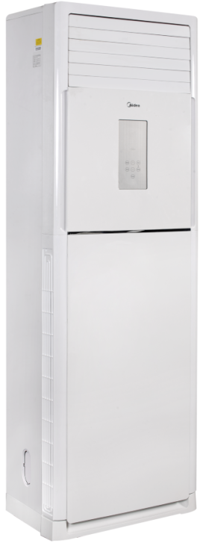
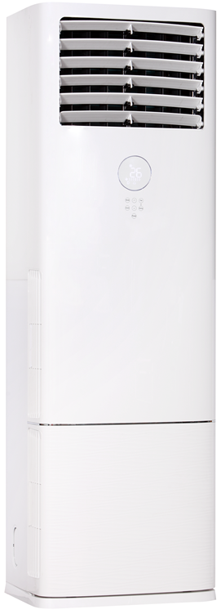
Product lines
Series | Picture | 12 | 18 | 24 | 30 | 36 (1phase) | 36 (3phase) | 42 | 48 (1phase) | 48 (3phase) | 60 (3 phase)
Compact Cassette |  | ● | ●
New Cassette |  |  |  | ● | ● | ● | ● | ● |  | ● | ●
Ceiling & Floor |  |  | ● | ● |  | ● | ● |  |  | ● | ●
A6 Duct |  | ● | ● | ● | ● | ● | ● | ● |  | ● | ●
Console |  | ● | ●
Floor&Standing |  |  |  |  |  |  |  |  | ● GD | ● GD

Slide 3
Contents
Electrical difference
Features difference
Structure difference

Slide 4
Electrical difference
●PCB function
● New refrigerant cool stream inverter technology
● Communication way

Slide 5
Electrical difference
PCB standard function
-New cassette
 | Functions | Standard | Optional
Standard | Infrared WRC | Y | /
Standard | 2 WIRES WC | Y | /
Customized | 4 WIRES WC | N | Y
Standard | CCM WC | Y | Y
Standard | WIFI | Y | Y
Standard | ON-OFF | Y | Y
Standard | ALARM | Y | Y
Standard is 2 core wired controller
120G/120X port and 12B wired controller port
New cassette
 | Functions | Standard | Optional
NA | Infrared WRC | N | N
Customized | 2 WIRES WC | N | Y
Standard | 4 WIRES WC | Y | /
Standard | CCM WC | Y | Y
Standard | WIFI | Y | Y
Standard | ON-OFF | Y | Y
Standard | ALARM | Y | Y
Standard is 4 core wired controller
Port 120G2/120X2
Super slim cassette
Note，
2 WIRES WC(2 core non-polarity Wired controller) and 4 WIRES WC(485 communication Wired controller) can not exist at same time.

Slide 6
Electrical difference
PCB function
- New Cassette
New Cassette Main control PCB | Wired controller port | Wifi port | Central control port
PCB1(standard) 24/30K 17122500004213 36~60K 17122500004211 | 120X(2core wired controller port | yes | yes
PCB2(optional) 24/30K 17122500A02909 36~60K 17122500A02907 | 120X2/120G2 (4core wired controller) port | yes | yes
Note，
TWINS and Central controller use same terminal X/Y/E, so these two functions you can just choose one

Slide 7
Electrical difference
PCB standard function
-New cassette
CN41
CN8
2 core non-polarity Wired controller
CN33
CN3
CN23
New Fan
Alarm
XYE/TWINS
ON-OFF
WIFI
CN38

Slide 8
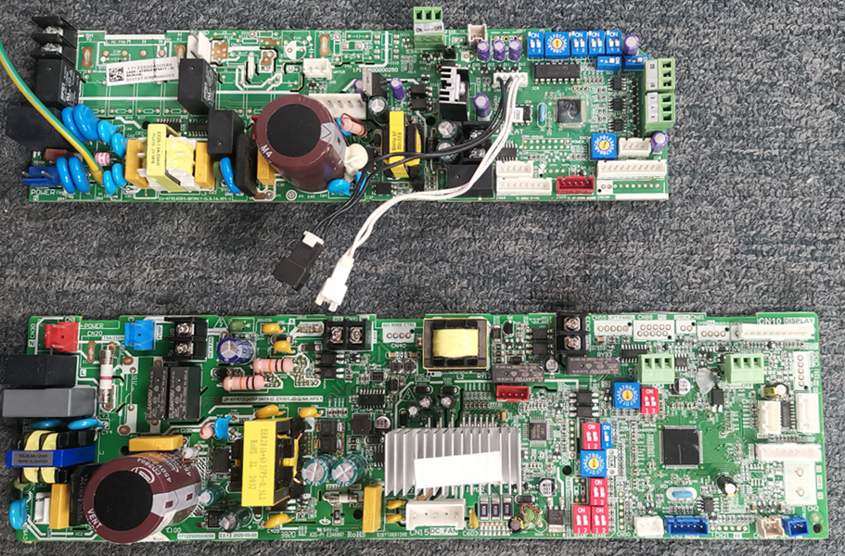
Electrical difference
PCB standard function
-New cassette
Super Slim cassette PCB
4 core CN40
Wired controller
New cassette PCB
CN41
2 core non-polarity Wired controller
WIFI
CN38

Slide 9
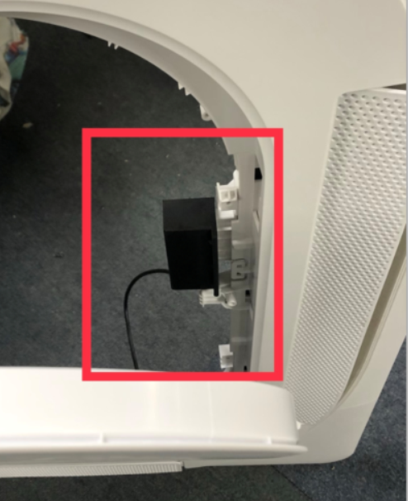
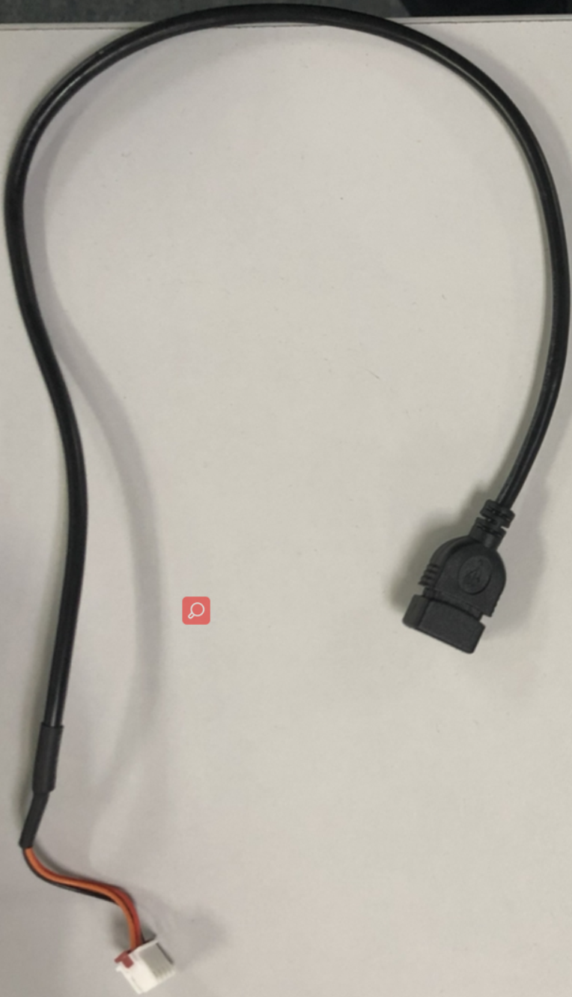
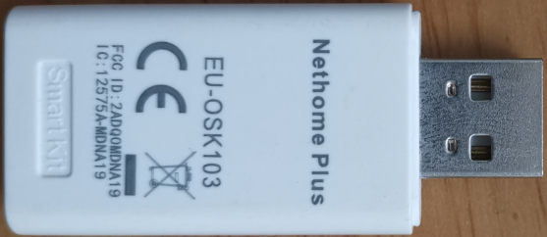
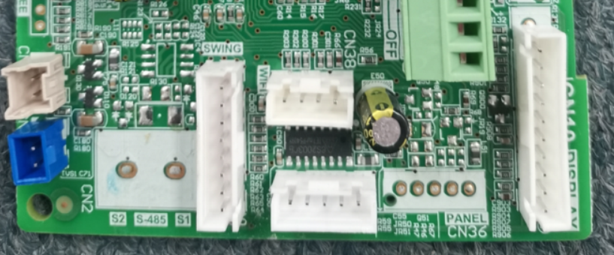
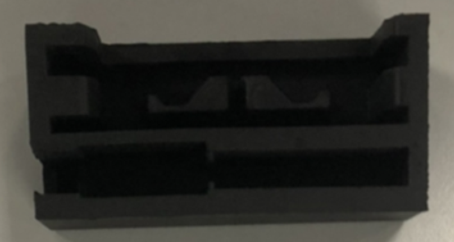
Electrical difference
WIFI connection
-New cassette wifi connection
①
③
②

Slide 10
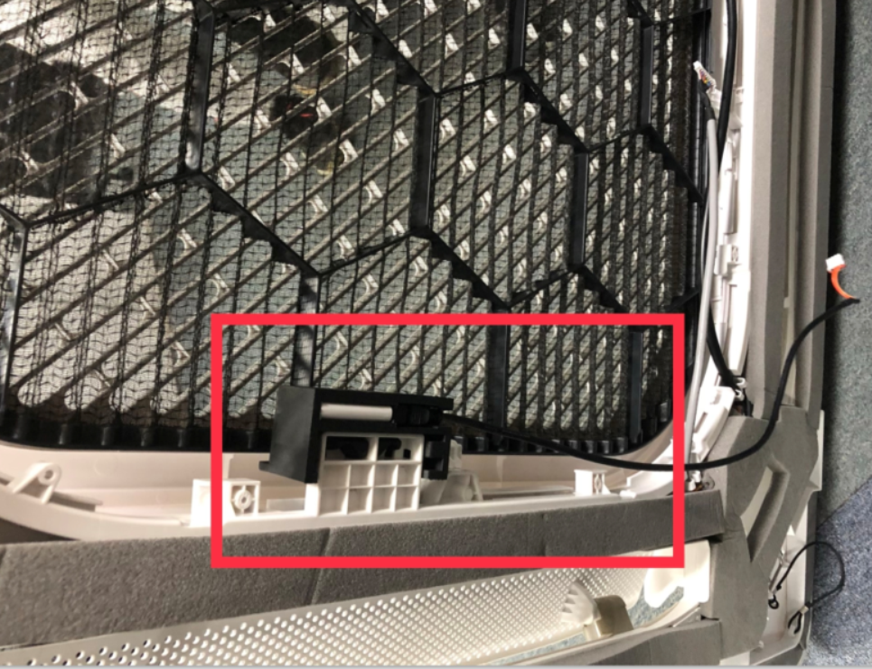
Electrical difference
WIFI connection
-New cassette wifi connection

Slide 11
Electrical difference
PCB standard function
- New Duct and Under&Ceiling
 | Functions | Standard | Optional
Standard | Infrared WRC | Y | /
Standard | 2 WIRES WC | Y | N
Customized | 4 WIRES WC | N | Y
Standard | CCM WC | Y | /
Customized | WIFI | N | Y
Standard | ON-OFF | Y | /
Standard | ALARM | Y | /
New Duct and
Under&Ceiling
Note，
1.2 WIRES WC(2 core non-polarity Wired controller) and 4 WIRES WC(485 communication Wired controller) can not exist at same time.
2. 2 WIRES WC(2 core non-polarity Wired controller) +wifi and Central control(X,Y,E) can not exist at same time.
Old Duct and
Under&Ceiling
 | Functions | Standard | Optional
Standard | Infrared WRC | Y | /
Customized | 2 WIRES WC | N | Y
Standard | 4 WIRES WC | Y | N
Standard | CCM WC | Y | /
Standard | WIFI | Y | N
Standard | ON-OFF | Y | /
Standard | ALARM | Y | /

Slide 12
Electrical difference
PCB function
- Duct and Under & Ceiling
New Duct and under&ceiling | Wired controller port | Wifi port | Central control port
PCB1(standard) | 120X(2core wired controller port | No | yes
PCB2(optional) | 120X(2core wired controller )port | yes | No
PCB3(optional) | 120X2/120G2 (4core wired controller) port | yes | yes
Note，
1. 2 WIRES WC(2 core non-polarity Wired controller) +wifi and TWINS and Central controller port all use the XYE terminal port so these three functions you can just choose one

Slide 13
Electrical difference
PCB function
- Duct and Under & Ceiling
Series | Size | Standard main PCB1 board 120X(2core wired controller port | Optional main PCB2 board 120X(2core wired controller )port+Wifi Port | Optional main PCB3 board 120X2/120G2 (4core wired controller) port
R32 IDU New Under-ceiling | 18K-HP | 17122700001915 | 17122700A02648 | 17122700A02688
 | 24K-HP | 17122700001915 | 17122700A02648 | 17122700A02688
 | 36K-HP | 17122700001895 | 17122700A02647 | 17122700A02686
 | 48K-HP | 17122700001895 | 17122700A02647 | 17122700A02686
 | 60K-HP | 17122700001895 | 17122700A02647 | 17122700A02686
R32 IDU New Ducted | 12K-HP | 17123000007398 | 17123000A03227 | 17123000A03307
 | 18K-HP | 17123000007299 | 17123000A03225 | 17123000A03305
 | 24K-HP | 17123000007299 | 17123000A03225 | 17123000A03305
 | 30K-HP | 17123000007299 | 17123000A03225 | 17123000A03305
 | 36K-HP | 17123000007305 | 17123000A03245 | 17123000A03308
 | 42K-HP | 17123000007305 | 17123000A03245 | 17123000A03308
 | 48K-HP | 17123000007305 | 17123000A03245 | 17123000A03308
 | 60K-HP | 17123000007305 | 17123000A03245 | 17123000A03308

Slide 14
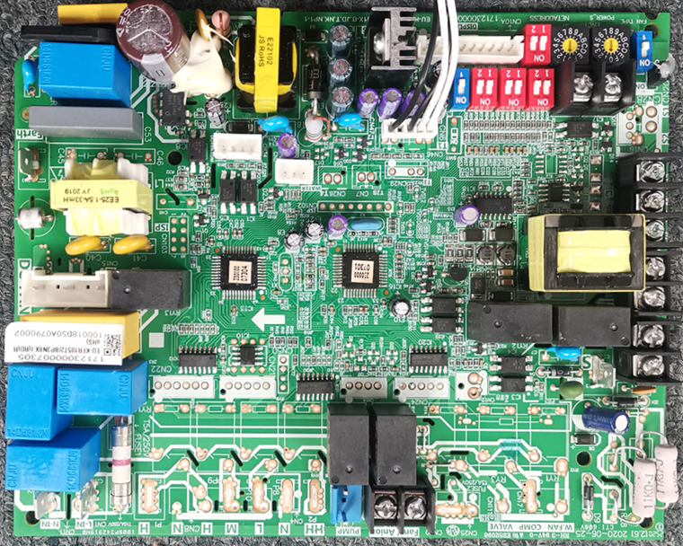
Electrical difference
PCB1 standard function
- Duct and Under&Ceiling
PCB1 – standard 2 WIRES WC
CN23 ON-OFF
CN9 XYE(Central controller)/TWINS
CN45 2 core non-polarity Wired controller
CN33 Alarm
CN43 New Fan

Slide 15
Electrical difference
PCB2 standard function
- Duct and Under&Ceiling
PCB2 - customize wifi port
CN23 ON-OFF
CN49 Wifi
CN45 2 core non-polarity Wired controller
CN33 Alarm
CN43 New Fan

Slide 16
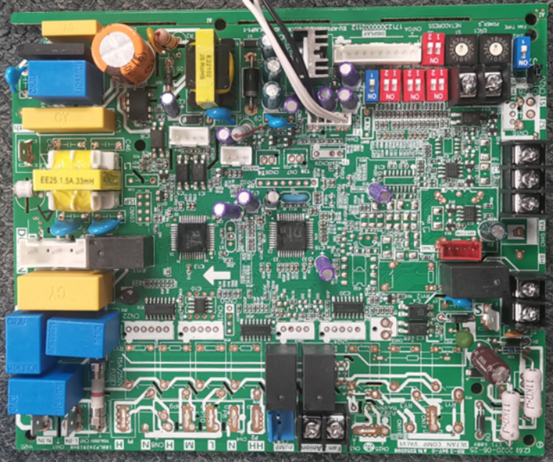
Electrical difference
PCB3 standard function
- Duct and Under&Ceiling
PCB3 - customize 4 WIRES WC
CN23 ON-OFF
CN9 XYE(Central controller)/TWINS
CN40 4 WIRES(485) WC/WIFI
CN33 Alarm
CN43 New Fan

Slide 17
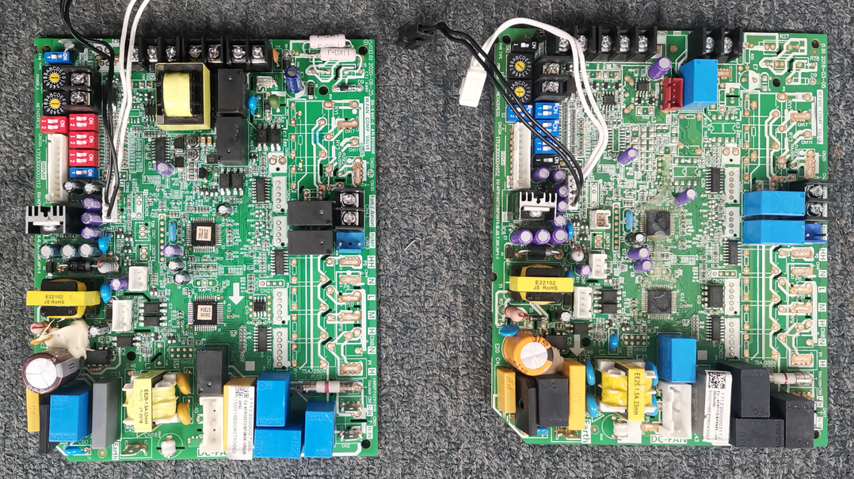
Electrical difference
PCB standard function
- Duct and Under&Ceiling
CN45 2 core non-polarity Wired controller
New DUCT PCB
Old DUCT PCB
CN40 4 core
Wired controller
Electrical Part for 2 core wired controller

Slide 18
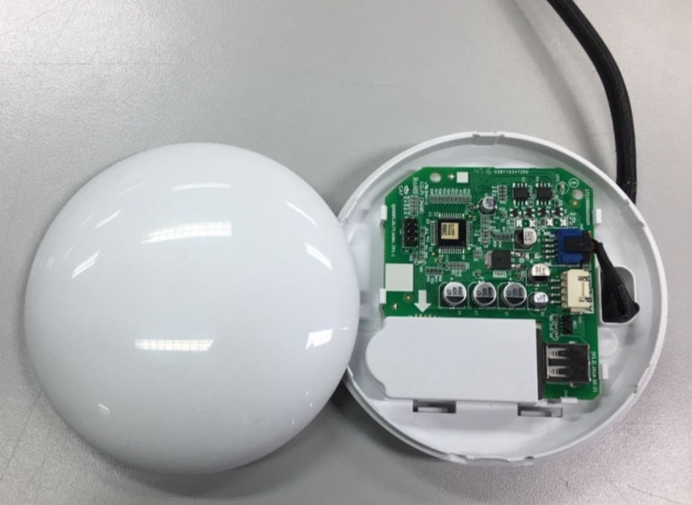
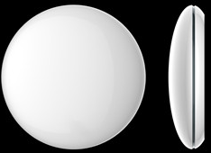
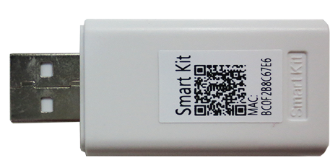
Electrical difference
WIFI connection
- DUCT and under&ceiling wifi connection
Note , for DUCT and U&C type the original PCB don’t have wifi or CN40 terminal ， so it can not connect wifi module . If you want to connect wifi , you must customize .
Connection wire to LCAC product
USB Connection
WiFi Module

Slide 19
Electrical difference
PCB function
- Console
Functions | Standard | Optional
Infrared WRC | N | N
2 WIRES WRC | N | N
4 WIRES WRC | Y | N
CCM WC | N | N
WIFI | N | N
ON-OFF | Y | N
ALARM | N | N
Connect 120G1/120X1 WRC
New Console
Connect to display board
Functions | Standard | Optional
Infrared WRC | Y | N
2 WIRES WRC | N | N
4 WIRES WRC | N | Y
CCM WC | N | N
WIFI | N | N
ON-OFF | Y | N
ALARM | N | N
Old Console
Connect 12B WRC

Slide 20
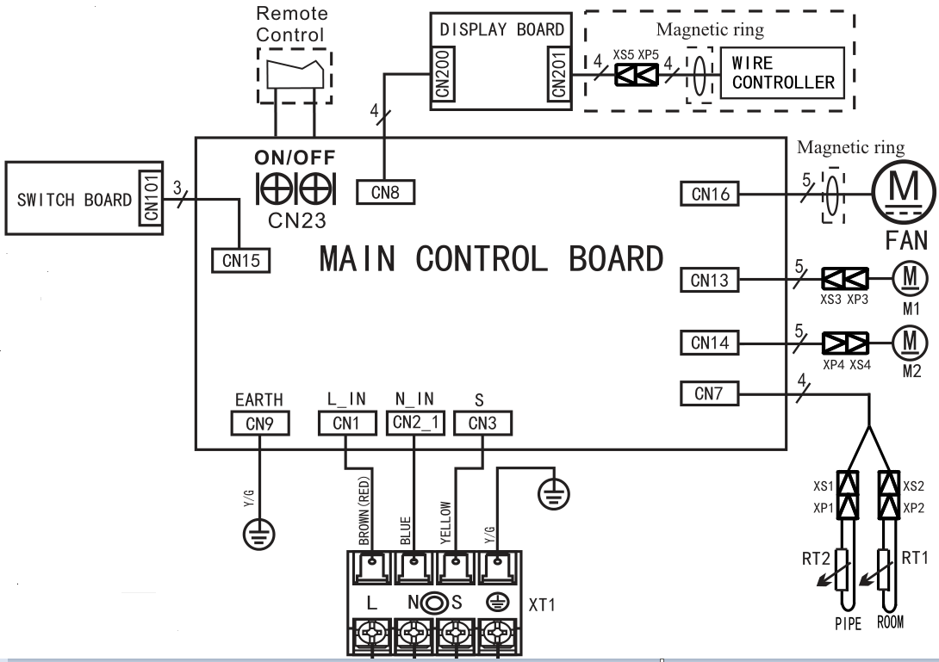
Electrical difference
PCB function
- Console
CN201 4 WIRES(485) WRC
Connect to 120G1/X1
CN23 ON-OFF

Slide 21
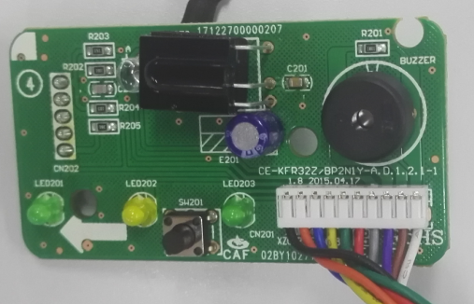
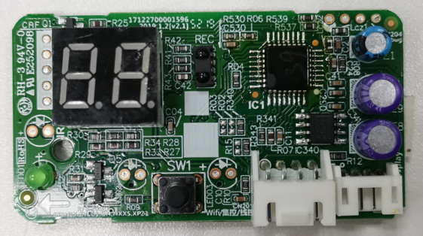
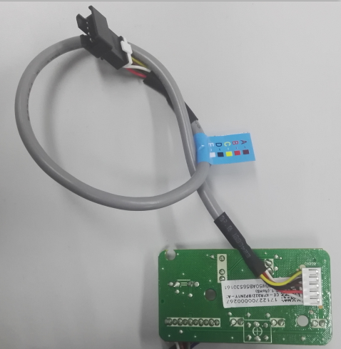
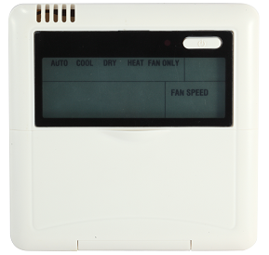
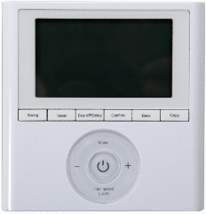
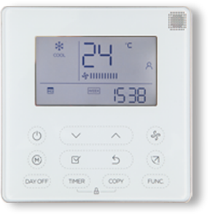
Electrical difference
PCB function
- Console
Old display
New display
Infrared WRC connection
Connect 485 WRC
12B(5 core)
120G1/120X1(4 core)

Slide 22
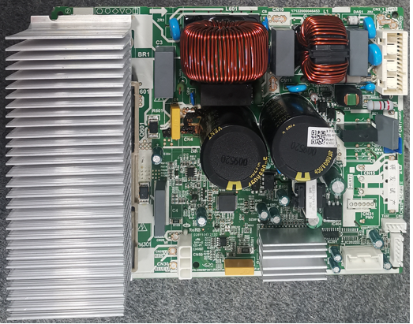
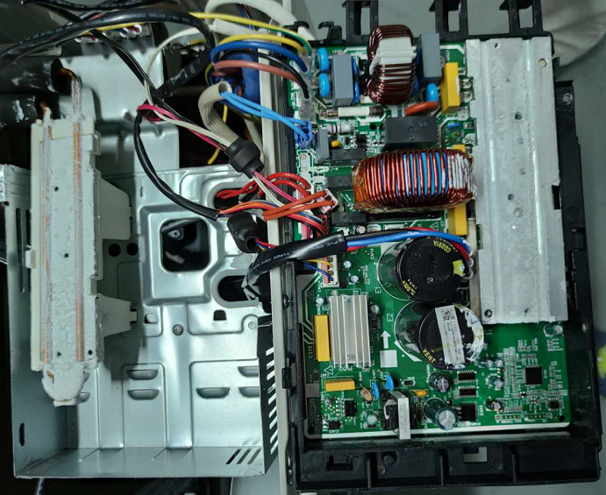
Electrical difference
New refrigerant cool stream inverter technology
old: Fan cool inverter technology
New: Refrigerant cool stream inverter technology

Slide 23
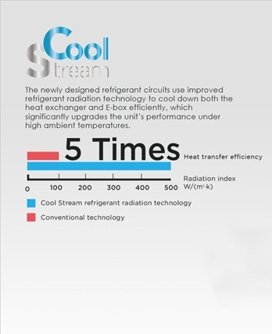
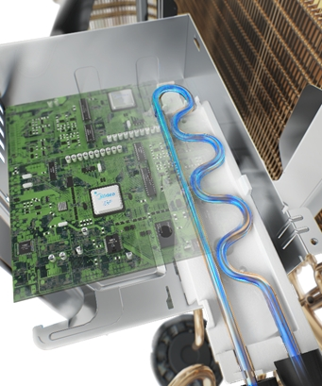
Electrical difference
New refrigerant cool stream inverter technology

Slide 24
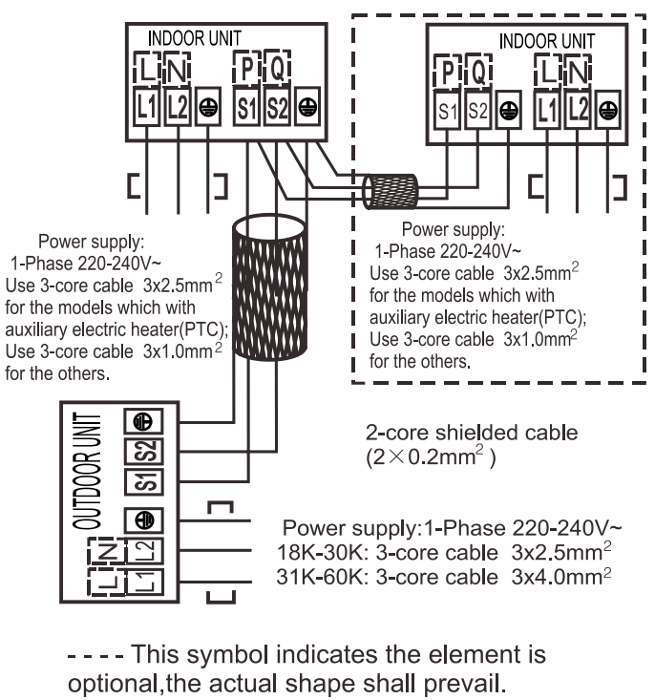
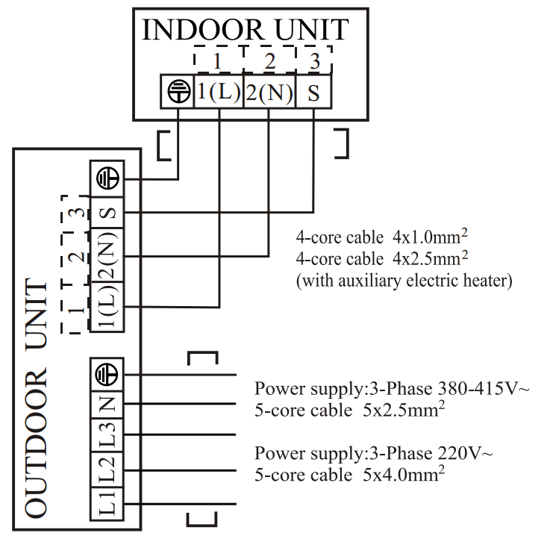
Electrical difference
Communication way
Old: 485 communication: L1/N/E+S1/S2
Same as CAC products
New current loop: L/N/S/E
Same as RAC split and multi

Slide 25
Electrical difference
Note，
Because of the communication way difference , new LCAC ERP and
Old LCAC ERP are not compatible .
New LCAC ERP IDU just match new LCAC ERP ODU.
Old LCAC ERP IDU just match Old LCAC ERP ODU.

Slide 26
Structure difference
●Drainage Pump built out
● High Lift Water Pump
● Materials
● Fireproof and Anti-Rat E-box
● Bigger Air Outlet Dimension
● Bigger Evaporator
● Drainage Pipe Diameter
● Package
● Installation paperboard
● Panel

Slide 27
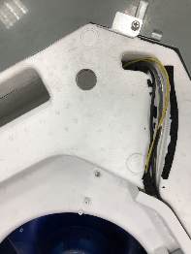
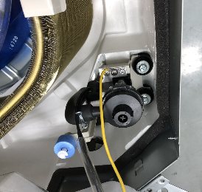
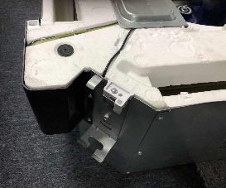
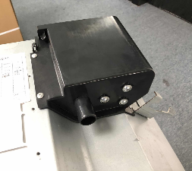
Structure difference
New cassette
-Drainage Pump
Old Cassette | New Cassette
Key optimization： Water drainage pump is built-out. It takes only 10min to replace the pump, saving up to half an hour for the aftersales man.

Slide 28
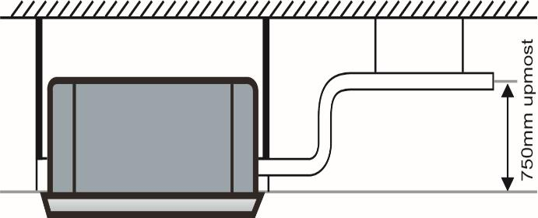
Structure difference
New cassette
-High Lift Water Pump
Key optimization： The lift of the water drainage pump increases from 750mm to 1000mm, water drainage capacity is higher. It’s convenient to install drainage piping under more space condition.
1000mm

Slide 29
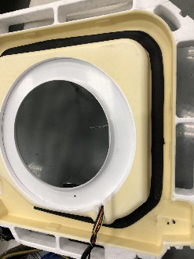
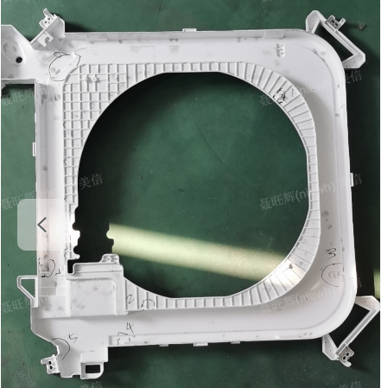
Structure difference
New cassette
-Materials
Old Cassette | New Cassette
Key optimization： The materials of the water collector is ABS, 2.4mm in thickness, more reliable comparing to previous 0.8mm absorbing-plastics molding type.
water collector :
0.8mm absorbing-plastics molding
water collector :
2.4mm ABS

Slide 30
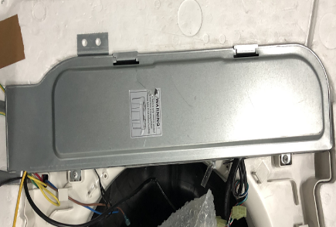
Structure difference
New cassette
-Fireproof and Anti-Rat E-box
Old Cassette | New Cassette
Key optimization： The electrical box are all-metal, and the dimension of the electrical outlet are designed Anti-Rat, preventing effectively the rats from entering in.

Slide 31
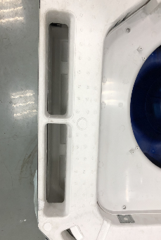
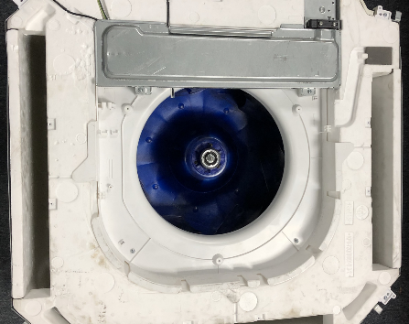
Structure difference
New cassette
-Bigger Air Outlet Dimension
Old Cassette | New Cassette
Key optimization： The area of air outlet is 23% bigger than previous, air velocity and noise is lower.

Slide 32
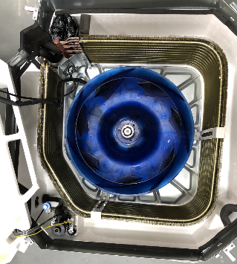
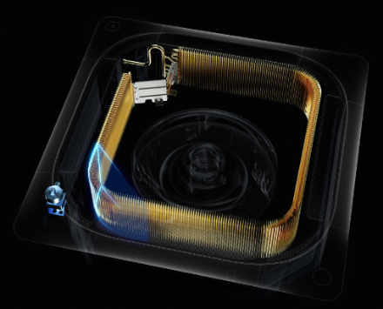
Structure difference
New cassette
-Bigger Evaporator
Old Cassette | New Cassette
Key optimization： With optimized evaporator, heat exchange area and capacity is increased, and the air flow is improved.

Slide 33
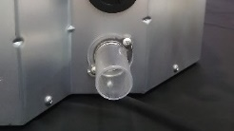
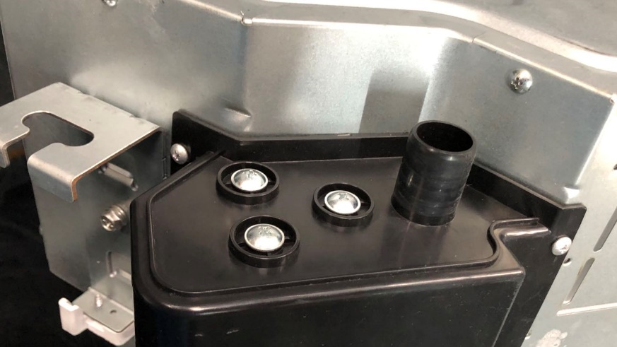
Structure difference
New cassette
-Drainage Pipe Diameter
Old Cassette | New Cassette
Key optimization： The diameter of drainage pipe is changed from 32mm to the mainstream 25mm.

Slide 34
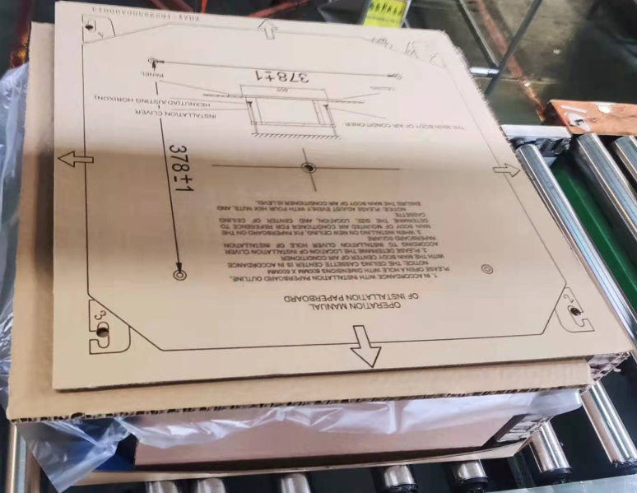
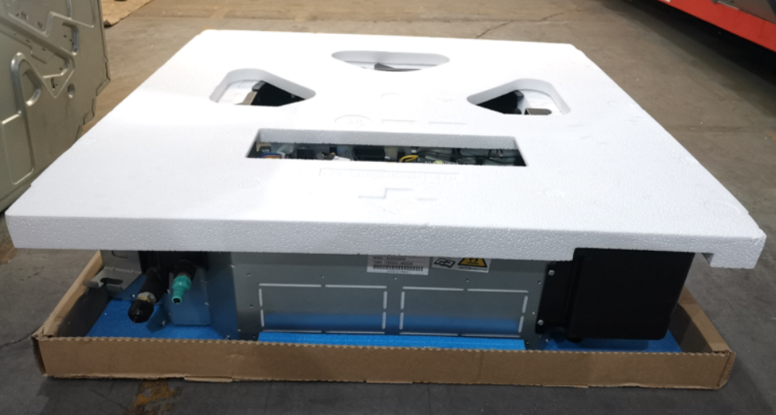
Structure difference
New cassette
-Package
Old Cassette | New Cassette
Key optimization： Brand-new package design for the new cassette, real drop test height is bigger than previous.

Slide 35
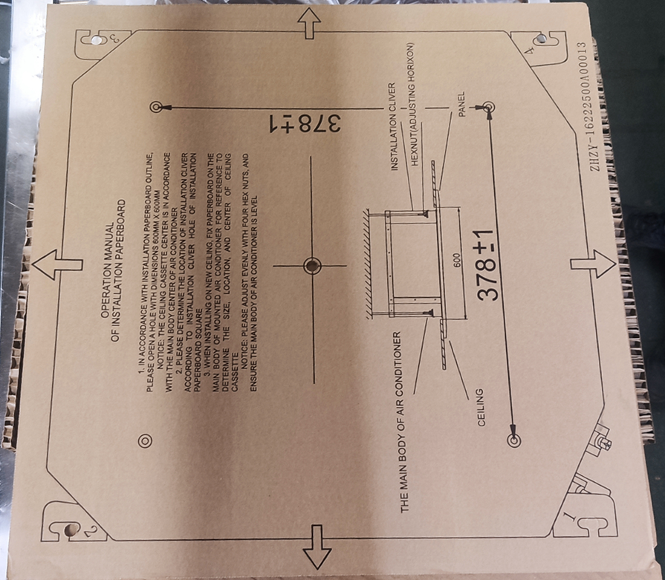
Structure difference
New cassette
-Installation paperboard
Old Cassette | New Cassette
Key optimization： The installation paperboard must be customized with installation hook.
Standard part
Customized part

Slide 36
Structure difference
New cassette panel
40CAS-L6
Independent Vane Control
Corner display
KJR-12B connection
Note, KJR-12B can not control independent vane and Breezeless.

Slide 37
Structure difference
New cassette panel
T-MBQ4-04BD
RG67G1
Independent Vane Control
Corner display
KJR-12B connection
Note，
KJR-12B can not control independent vane control ;
If you want to realize independent vane control , you must choose a special RC(RG67G1)) or 485WRC( KJR-120G/X, KJR-120G2/X2) .

Slide 38
Structure difference
New cassette panel
Note，
New cassette panel and old cassette panel are not compatible
New cassette panel just match new cassette type
Old cassette panel just match super slim cassette type

Slide 39
Features difference
New features
●1%~100%Grades Indoor Fan Speed
● Active clean
● Twins
● GA compressor frequency control
● X-ECO
● Gear
Below are old features, new LC also have below features
Notes:* means optional, #means new functions for 18C.

Slide 40
Feature difference
-New Features
1%~100%Grades Indoor Fan Speed
Au
20%
40%
60%
100%
80%
Due to the DC fan motor, indoor fan speeds are 100 grades, more comfortable and energy saving.
Via remote controller to select fan speed first, then the controller will display fan speed percentage, you can use the “UP and Down” button to increase or decrease fan speed in 1% increments, to change into any percentage.

Slide 41
Feature difference
-New Features
Active clean
The active Clean Technology washes away dust, mold, and grease that may cause odors when it adheres to the heat exchanger by automatically freezing and then rapidly thawing the frost.
The internal wind wheel then keeps operating to blow-dry the evaporator, thus preventing the growth of mold and keeping the inside clean.
Step1：
Cool evap
Step2：
Evap frost
Step3：
Evap defrost
and heat
Step4：
Fan

Slide 42
Feature difference
-New Features
Twins
Twins combination(Standard for some model)
The units can be installed as Twin systems: one outdoor unit can be connected with two indoor units. The indoor units can be combined in any of the different available ratings.
 | IDU | Indoor | Outdoor
 | Type | Units | Unit
 | Duct | 12K + 12K | 24k
 | Duct | 18K + 18K | 36k
Twins | U&C
System | Duct | 24K + 24K | 48K
 | Cassette
 | U&C
 | Duct | 30K + 30K | 60K
 | Cassette

Slide 43
Feature difference
-New Features
Twins
Twins combination(Standard for some model)
MAIN
SLAVE
with two indoor units. The indoor units can be combined in any of the different available ratings
Note, TWINS and Central controller use same terminal X/Y/E, so these two functions you can just choose one .

Slide 44
Feature difference
-New Features
Twins
Function combination table(include Twins)
New cassette | 2 WIRES WC | 4 WIRES WC | Central controller | WIFI | TWINS | ONOFF | ALARM
Standard 1 | Y | N | Y | Y | N | Y | Y
Standard 2 | Y | N | N | Y | Y | Y | Y
Customized | N | Y | Y | Y | N | Y | Y
Customized | N | Y | N | Y | Y | Y | Y
DUCT/C&F | 2 WIRES WC | 4 WIRES WC | Central controller | Wifi | TWINS | ONOFF | ALARM
Standard 1 | Y | N | Y | N | N | Y | Y
Standard 2 | Y | N | N | N | Y | Y | Y
Customized | Y | N | N | Y | N | Y | Y
Customized | N | Y | Y | N | N | Y | Y
Customized | N | N | Y | Y | N | Y | Y
Customized | N | Y | N | N | Y | Y | Y
Customized | N | N | N | Y | Y | Y | Y
Customized | N | Y | Y | Y | N | Y | Y
Customized | N | Y | N | Y | Y | Y | Y

Slide 45
Feature difference
-New Features
GA compressor frequency control
The frequency of traditional air conditioner has dramatic fluctuation during operation, leading to the instability of room temperature. However, air conditioners break away from this pattern with our unique GA Stepless Comfort Technology（0.6Hz for every step）. Its inverter frequency variation is so smooth that you wouldn’t notice the room temperature fluctuation (± 0.5℃) at all.
Fmax
Temperature Graph
Ordinary Inverter Mode
Fmin
±1℃
±0.5℃
Fmax
GA Stepless Inverter Mode
GA Stepless Inverter Mode
Fmin
Ordinary Inverter Mode

Slide 46
Feature difference
-New Features
X-ECO
X-ECO mode applies to inverter model, smart control on compressor frequency as low as 12HZ(depend on model). As a smart running mode, it limits the highest compressor frequency and fan speed of each stage by intelligent control system.
X-ECO mode could energy save.

Slide 47
Feature difference
-New Features
Gear
Carrier inverter air conditioners offer three operating power options: 50%, 75%, and 100%.
You can choose a lower power level to conserve energy.
1295W
1038W
728W
A++/A+ 9k model

Slide 48
The end

